Slide 1
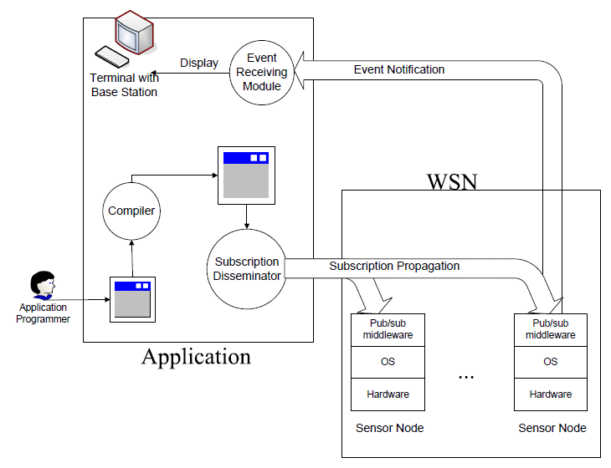
Student : Lai Yi (Steven)
Supervisor : Prof. Cao Jiannong
PSWare:
A Pub/Sub Middleware for WSN
Overview
Motivation:
  WSN applications are event-based
  Need composite events (events that depend on other events)
  Pub/sub is a suitable paradigm for events
Use PSWare for event-based WSN applications:
  Provide high level event abstraction
  Ease application development
  Improve reusability
System Architecture
Engineering Issues
High-level event abstraction: need an event language and a compiler / interpreter
Low-level customizable event processing mechanisms: need a VM-like runtime environment for event processing
Putting everything together: layered design, separation of concerns, etc.
Main Research Issue – Generic Composite Event Detection
The problem:
  Select a sensor node (detector) for each composite event for detecting it
  Minimize energy consumption (the number of hops for events to be forwarded to detectors)
The difficulty:
  Composite events may depend on other composite events
  Optimal detectors for one sub-event may not be optimal for the ‘overall’ event
Additional concerns:
  Event locality: detectors selected for one event may be ‘reused’ for detecting the same event later on
  Detector deployment: more detectors mean more available choices but also incurs additional maintenance cost. How to balance the trade-off?
Mathematical techniques used:
  Optimization
  Probability: for quantifying event locality
  Calculus: for calculating various distances / areas given a detector deployment

