Slide 1
Composite Event Detection
Users have no prior knowledge on the location and the time of the events
Centralized event detection mechanisms may not be suitable for WSNs due to energy constraints
Issues in distributed composite event detection:
Who will be the decision makers (event fusion nodes) for event detection
How to select these decision makers

Slide 2
The Event Detection Problem Formulation
Given:
A sensor network
Event types with relations (composite events can consist of multiple lower level events)
Assumptions:
Event definition (type and relations are known to all nodes)
Each primitive event is detected by a single node
Events can happen anywhere at any time
Composite events have to be detected by a group of nodes
Objective:
Once the events occur, find an efficient algorithm which will involve minimum number of nodes for detecting the events
The energy consumption is minimized

Slide 3
Approaches
When events occur, participating nodes flood the events in the network (fully distributed but inefficient)
When events occur, participating nodes report to the sink about the event types they detected. Then sink comes out with an optimal fusion structure.
Some nodes are pre-selected as fusion points in the network. When events occur, participating nodes randomly but smartly select a subset of those fusion points to detect events.

Slide 4
Randomized Event Detection Approach
Basic ideas:
When nodes first detect events, they will randomly forward the events to certain nearby fusion points.
Upon the detection of composite events, the fusion points will send feedback to the event sources so that nodes can compare which fusion point to select for each event type.
Trade-off in fusion point selection:
More fusion points will result in lower detection cost but higher maintenance cost
Optimization problem: how to balance this trade-off

Slide 5
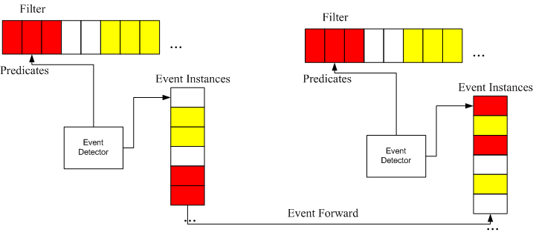
Event Detection Framework
A generic framework for implementing different event detection algorithms.
Components:
Event instance buffer for caching detected events
Event filters for evaluating composite events.
Event detector for implementing different event detection algorithms.

Slide 6
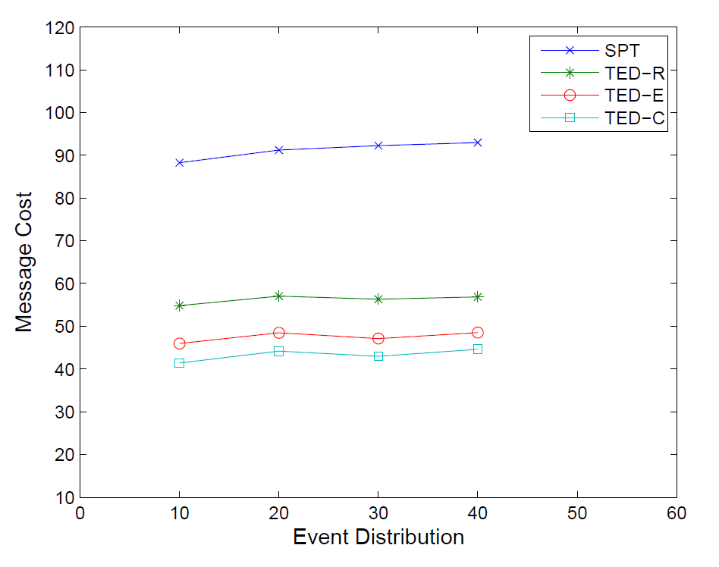
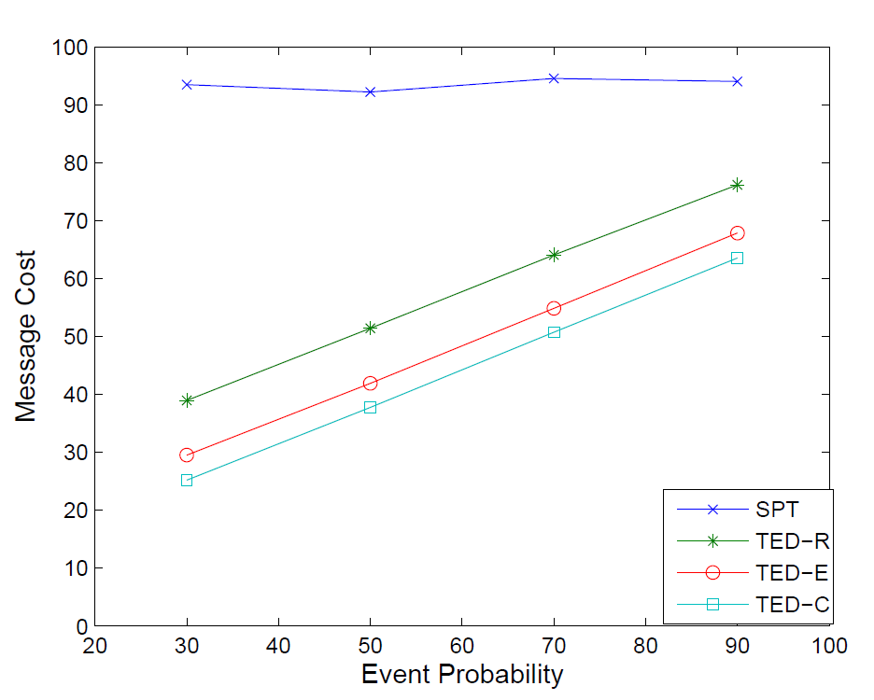
Performance Evaluation
Compared with shortest path approach where the event relations are not considered for detection

