Slide 1
Challenges of Using WSNs for ITS
Distributed detection & report of composite events (e.g. for detecting traffic jam)
Reliable delivery of real time data (e.g. collision avoidance)
WSN-based traffic light control
Middleware support
Energy efficient coverage for object tracking

Slide 2
Challenge 1: Composite Event Detection
Users have no prior knowledge on the location and the time of the events
Centralized event detection mechanisms may not be suitable for WSNs due to energy constraints
Issues in distributed composite event detection:
Who will be the decision makers (event fusion nodes) for event detection
How to select these decision makers

Slide 3
The Distributed Composite Event Detection Problem
Given:
A sensor network
Event types with relations (composite events can consist of multiple lower level events)
Assumptions:
Event definition (including types and relations) are known to all nodes
Each primitive event is detected by a single node
Events can happen anywhere at any time
Composite events have to be detected by a group of nodes
Objective:
Once the events occur, find an efficient algorithm which will involve minimum number of nodes for detecting the events
The energy consumption is minimized

Slide 4
Approaches
When events occur, participating nodes flood a message and identify partner participating nodes to come out with a coordinated fusion structure (fully distributed but inefficient)
When events occur, participating nodes report to the sink about the event types they detected. Then sink comes out with an optimal fusion structure.
Some nodes are pre-selected as fusion points in the network. When events occur, participating nodes randomly but smartly select a subset of those fusion points to detect events.

Slide 5
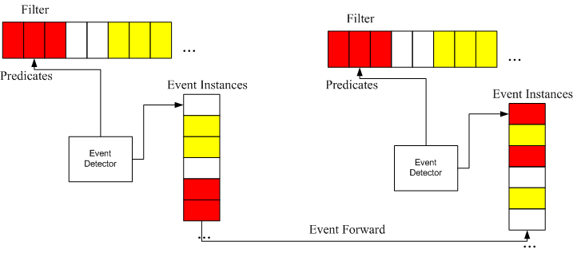
Event Detection Framework
Steps:
When nodes first detect events, they will randomly forward the events to certain nearby fusion points.
Upon the detection of composite events, the fusion points will send feedback to the event sources so that nodes can compare which fusion point to select for each event type.
Fusion point selection:
Optimization problem: more fusion points will result in less detection cost but more maintenance cost.

Slide 6
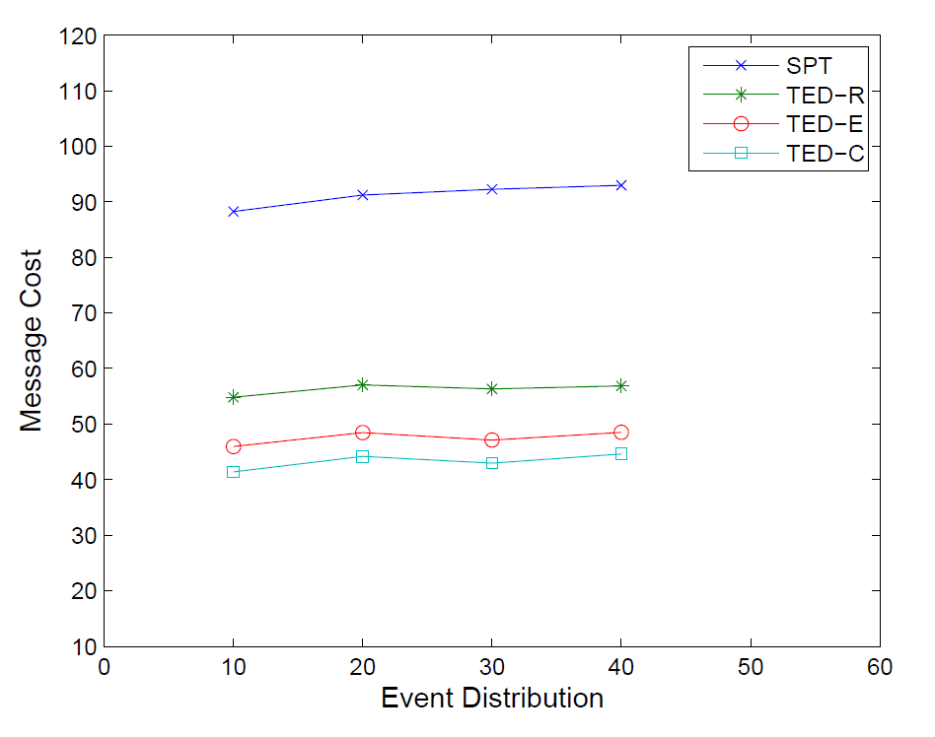
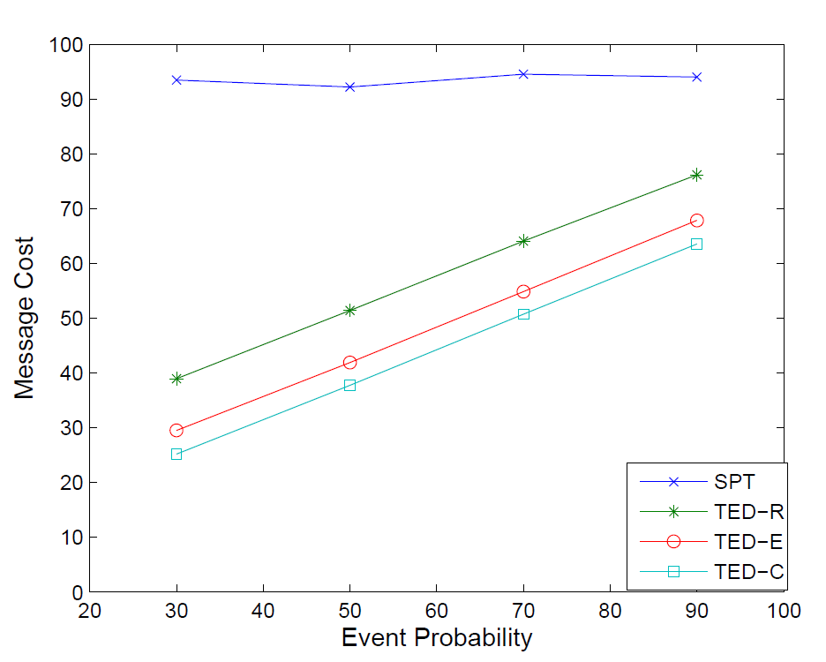
Performance Evaluation
Compared with shortest path approach where the event relations are not considered for detection

Slide 7
Challenge 2: Reliable Message Delivery
General Issues:
Wireless links may be unreliable
How to schedule the retransmission to minimize interference
How to construct multiple disjoint paths to deliver the messages
Issues related to ITS:
For certain ITS applications such as collision avoidance, messages not only need to be delivered reliably but also with short latency.
Due to high mobility in ITS, the messages may have unknown number of receivers
If a message is sent without reply, it is hard to distinguish if the message is lost or there is simply no receiver.

Slide 8
Approaches
Multi-path routing [1]
The path construction may be time-consuming and therefore may not meet the requirement on low latency
In case there is no receiver, no path can be found
Infrastructure-assisted message delivery
Use infrastructure (RSU) to help delivering messages
RSU are close to vehicles on the same road and can help to achieve low latency
Since message exchange usually happen in certain locations (such as intersections), RSU may have the knowledge of the vehicles in that location. This can help to identify the possible receivers
1 Network Coding Based Reliable Disjoint and Braided Multipath Routing for Sensor Networks. Yuwang Yang, Chunshan Zhong, Yamin Sun an Jingyu Yang, Journal of Network and Computer Applications, Vol 33, Issue 4, July 2010

Slide 9

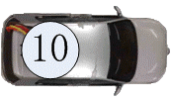

Solution
Use RSU as relay nodes to improve message reliability
Registration phase: vehicles will register when they pass intersections where accidents are more likely to occur
Message delivery phase: vehicles communicate with each other through RSU.

Slide 10
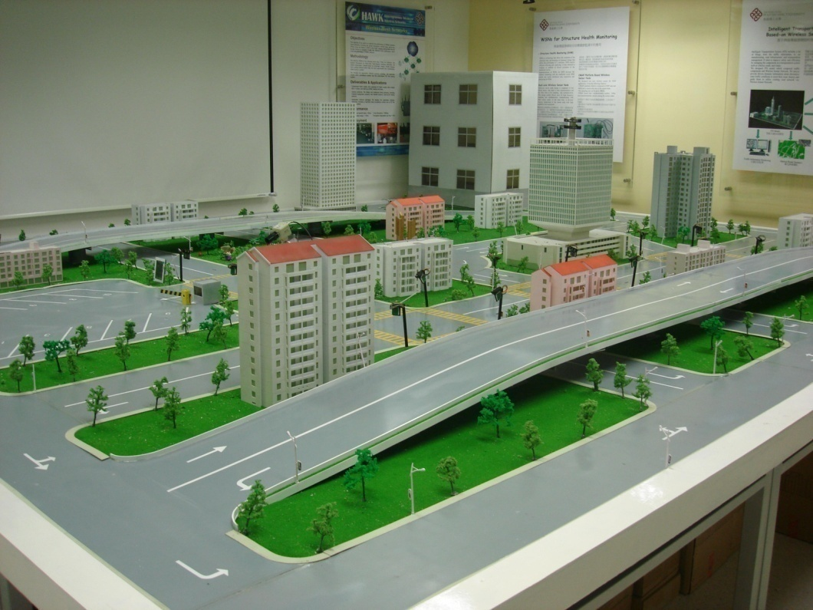
iTranSNet Testbed at PolyU

Slide 11

Collision Avoidance Based on Reliable Data Delivery Demo

Slide 12
Challenge 3: Collaborative Traffic Light Control using WSNs
Traffic light control problem
Various traffic elements, e.g. traffic volume, speed, pedestrian.
Dynamic and complex traffic environment.
Unpredictable incidents, e.g. traffic accident.
Existing work in this problem
Using traffic volume, waiting time.
Mainly focus on optimization of traffic light length in a fixed traffic light sequence.

Slide 13
Collaborative Traffic Light Control using WSNs
We use WSNs to monitor traffic condition and then control the traffic lights of multiple intersections in a distributed way.
Traffic volume, waiting time, number of stops, traffic flow characteristics are collected by WSNs.
Information of an intersection is exchanged with neighbor intersections.
Both the sequences and durations of traffic lights from multiple intersections are scheduled collaboratively.
Increase the overall throughput, decrease the average waiting time and number of stops.
Notes:
13

Slide 14
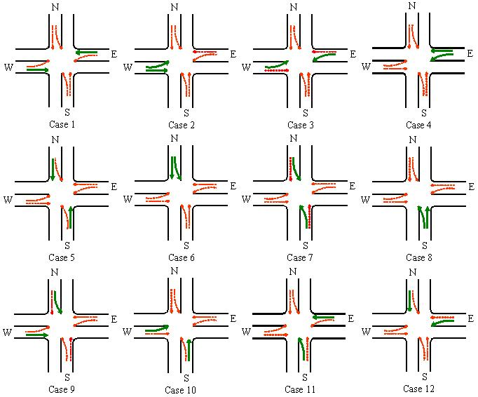
Collaborative Traffic Light Control of Multiple Intersections
Divide the traffic light sequences into twelve different cases, subject to the traffic safety rules.
Select one case to assign green lights using the real-time traffic data detected.

Slide 15
Collaborative Traffic Light Control of Multiple Intersections
A three-steps scheme is proposed to make the control decision: real-time traffic detection, green light sequence determination and light length determination.
Real-time Traffic Detection: detect and calculate traffic information in a real-time manner, e.g. traffic volume, waiting time, number of stops, vehicle density.
Green Light Sequence Determination: assign the next green light to the case with the largest green light demand using detected real-time traffic data.
Light Length Determination: determine the length of green lights based on local traffic volume and remaining durations of green lights from neighbor intersections.
Notes:
15

Slide 16
Performance Evaluation
Average waiting time comparisons between the four approaches.
Throughput-to-volume comparisons between the four approaches.
Average waiting time comparisons between the three approaches.
Average number of stops comparisons between the four approaches.
Notes:
16

Slide 17
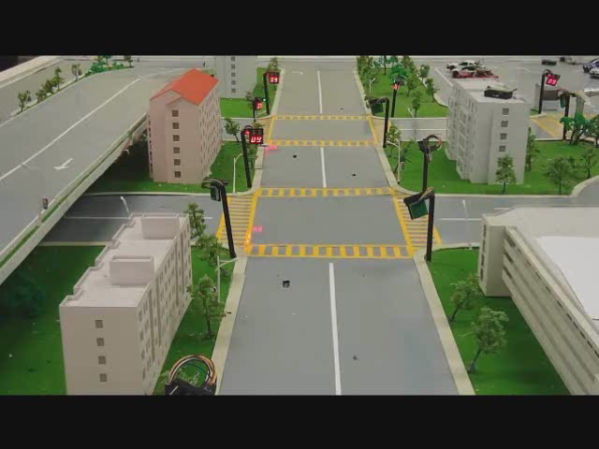
Adaptive Traffic Light Control Demo

Slide 18
Challenge 4: Middleware for ITS
Programming the sensor network is non-trivial
Certain functions such as event detection are shared by different ITS applications
Implementing these functions from scratch in different ITS applications may be difficult and not efficient.
To avoid reinventing the wheel, we need to have a middleware layer capable of supporting the common functions used by ITS

Slide 19
Middleware Approaches
Programming abstraction:
Pub/sub-based: define events and make subscriptions to get the events from WSN
Query-based: treat the WSN as a database and use SQL to query the data [1]
Agent-based: inject mobile codes into WSN [2]
Why pub/sub is more suitable:
Many ITS applications are event-based
Other programming abstraction have limitation to express the temporal and spatial relations between events
1 TinyDB: an Acquisitional Query Processing System for Sensor Networks. S. R. Madden, M. J. Franklin, J. M. Hellerstein, and W. Hong. ACM Transactions on Database Systems, Vol 30, Issue 1 March 2005
2. Mobile Agent Middleware for Sensor Networks: An Application Case Study. C.-L. Fok, G.-C. Roman, and C. Lu, In Fourth International Symposium on Information Processing in Sensor Networks, April 2005.

Slide 20
Pub/Sub Middleware for WSN (PSWare)
Design Issues:
Provide event definition language (EDL)
Implement event detection mechanisms
Implement event delivery mechanisms
System components:
EDL compiler/interpreter
Runtime environment on the sensor nodes for event processing

Slide 21
PSWare System Architecture

Slide 22
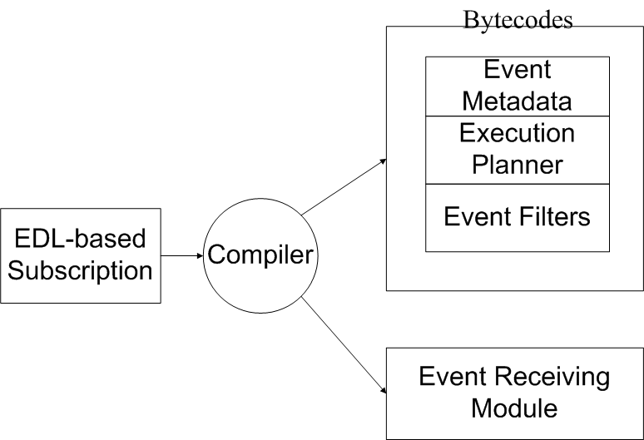
EDL and Its Compiler
Event CompTemp {
} on {
AvgTemp e1 and
AvgTemp e2
} where {
e2.time-e1.time=600
}

Slide 23
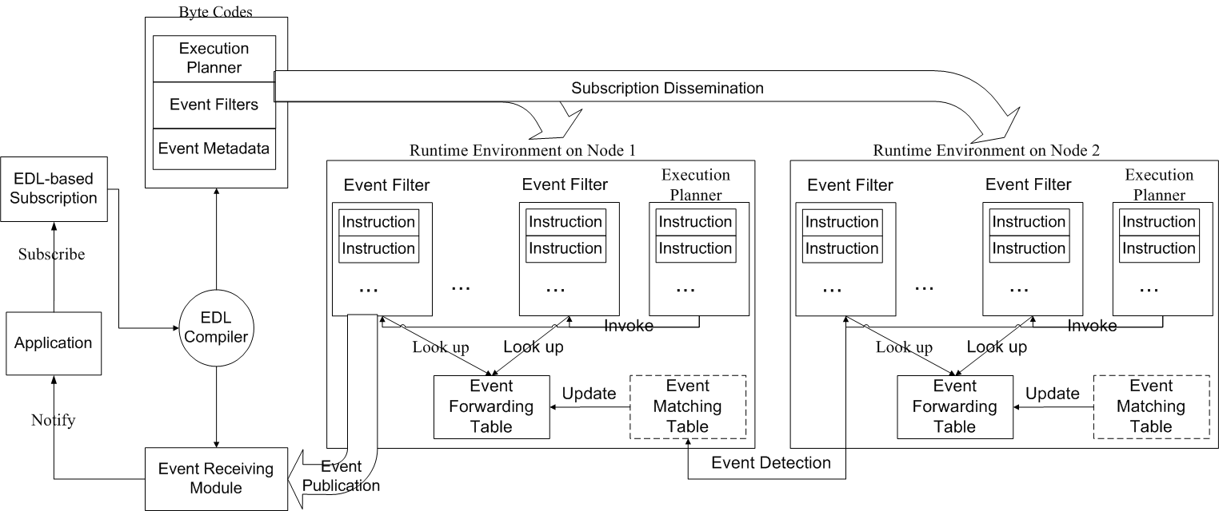
Runtime Environment on Sensor Nodes

Slide 24
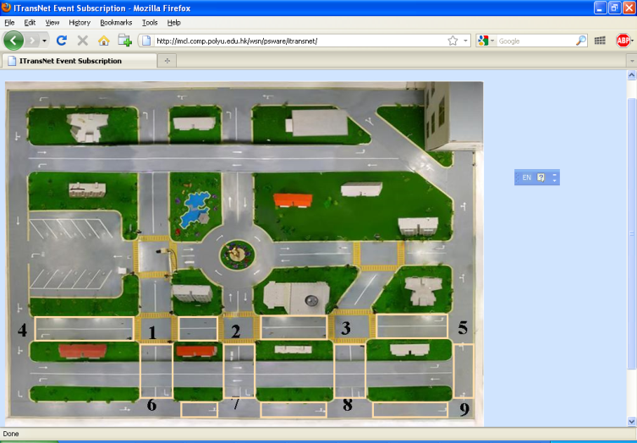
PSWare-based Traffic Jam Subscription
Pre-defined event templates for iTranSNet
Users can customize the events by changing parameters
Events may be subscribed / published through the web.

Slide 25

Pub/Sub Middleware Demo

Slide 26
Challenge 5: Vehicle Tracking
Vehicle tracking is tracking the position of the vehicle.
How to track the vehicle continuously?
How to track the position of the vehicle accurately?
Notes:
26

Slide 27
Issues
General issues in tracking:
Sleep scheduling
Energy efficient routing
Localization
Data fusion
Sensor selection
Issues related to ITS in tracking:
Save the energy when monitoring the given area and tracking the vehicle
Measure the position of the vehicle using simple algorithm
Predict the next position of the trajectory for vehicle accurately
Notes:
27

Slide 28
Sleep Scheduling for Energy Efficient Coverage in WSNs
Problem Definition
Given a network consists of sensor nodes. The sensor nodes can communicate with each other.
Assume each sensor has an identical sensing range and identical communication range. Each node knows its location.
The objective is to find the maximum number of the disjoint cover sets which can cover the area completely, and to identify the corresponding sets of sensors.
Notes:
28

Slide 29
Motivation
Finding the optimal complete coverage scheme in WSNs is not easy.
The existing works
MC-MIP[1]: as the numbers of sensors and targets become larger, the running time increases exponentially.
MCMCC[2]: cannot guarantee finding the optimum
GAMDSC[3]: only suitable when the numbers of targets and sensors are small.
[1] M. Cardei and D.-Z. Du, “Improving wireless sensor network lifetime through power aware organization,” Wireless Netw., vol. 11, no. 3, pp. 333–340, May 2005.
[2] S. Slijepcevic and M. Potkonjak, “Power efficient organization of wireless sensor networks,” in Proc. IEEE Int. Conf. Commun., vol. 2. Finland, 2001, pp. 472–476.
[3] C.-C. Lai, C.-K. Ting, and R.-S. Ko, “An effective genetic algorithm to improve wireless sensor network lifetime for large-scale surveillance applications,” in Proc. IEEE Congr. Evol. Comput., 2007, pp. 3531–3538.
Notes:
29

Slide 30
Solution
A localized evolutionary algorithm (LEA)
In PEA, the processor collects the information from network firstly and the global information is stored in each processor.
In LEA, each processor only holds a subset of global information based on its local knowledge.
Suppose the area is divided into several clusters. LEA is executed on each cluster head.
Notes:
30

Slide 31
Solution
The main difference between PEA and LEA
The subpopulation is stored in the processor.
Notes:
31

Slide 32
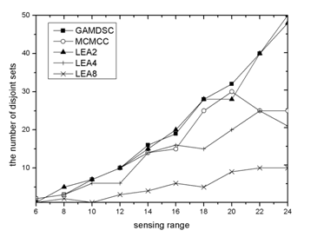
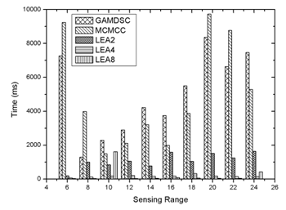
Performance Evaluation
Compared with two different centralized EA algorithms for the coverage problem, LEA can obtain the same or more number of disjoint sets in 80% cases, and the computing time is much less than the centralized algorithms.
Notes:
32

Slide 33
Challenge 5-2: Coverage-Preserving Routing Algorithm in WSNs
Problem Definition
Given sensors randomly deployed in a given area.
Assume each sensor has the identical sensing range and communication range. The sensor doesn't know it location, but it knows distance and the directional information.
The objective of the problem is to find the routing with maximum sensing coverage from source to sink and the constraint that the hop of the routing should be less than K.
Notes:
33

Slide 34
Motivation
Combining sensing coverage in together with routing has at least two benefits.
The energy of the network is saved.
The delivery time for the data is saved.
However, few algorithms integrated the sensing coverage with routing.
Notes:
34

Slide 35
Solution
Design a method based on Monte-Carlo integration to approximately calculate the sensing area and adopt the modified label setting (LS) algorithm to establish the routing in a distributed way.
Notes:
35

Slide 36
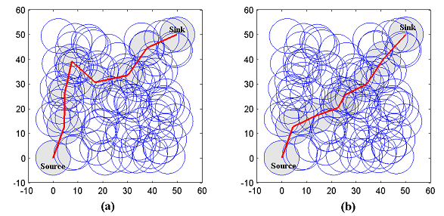
Performance Evaluation
A is obtained by proposed algorithm; B is obtained by k-hop path algorithm. The total sensing area is about 87% of the first one.
Notes:
36

Slide 37
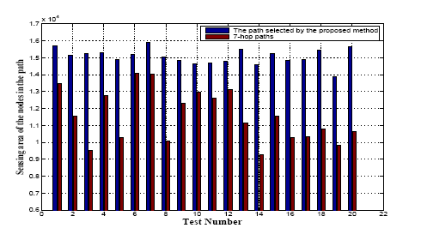
Performance Evaluation
Compared with the k-hops path, the proposed algorithm can find the routing with better sensing coverage, about 1.3 times of the sensing coverage obtained by the k-hops path.
Notes:
37

