Slide 1
Recent Work
2016.11 高亦乐

Slide 2
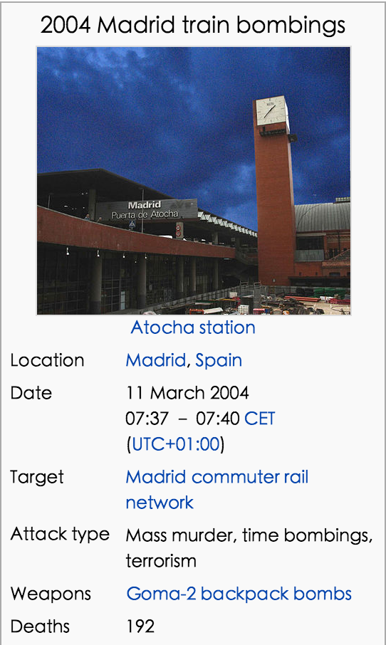
Network Information
Name：Train bombing
Size：64 vertices(terrorists)
243 edges (contacts)
Type: Undirected & Weighted Graph

Slide 3
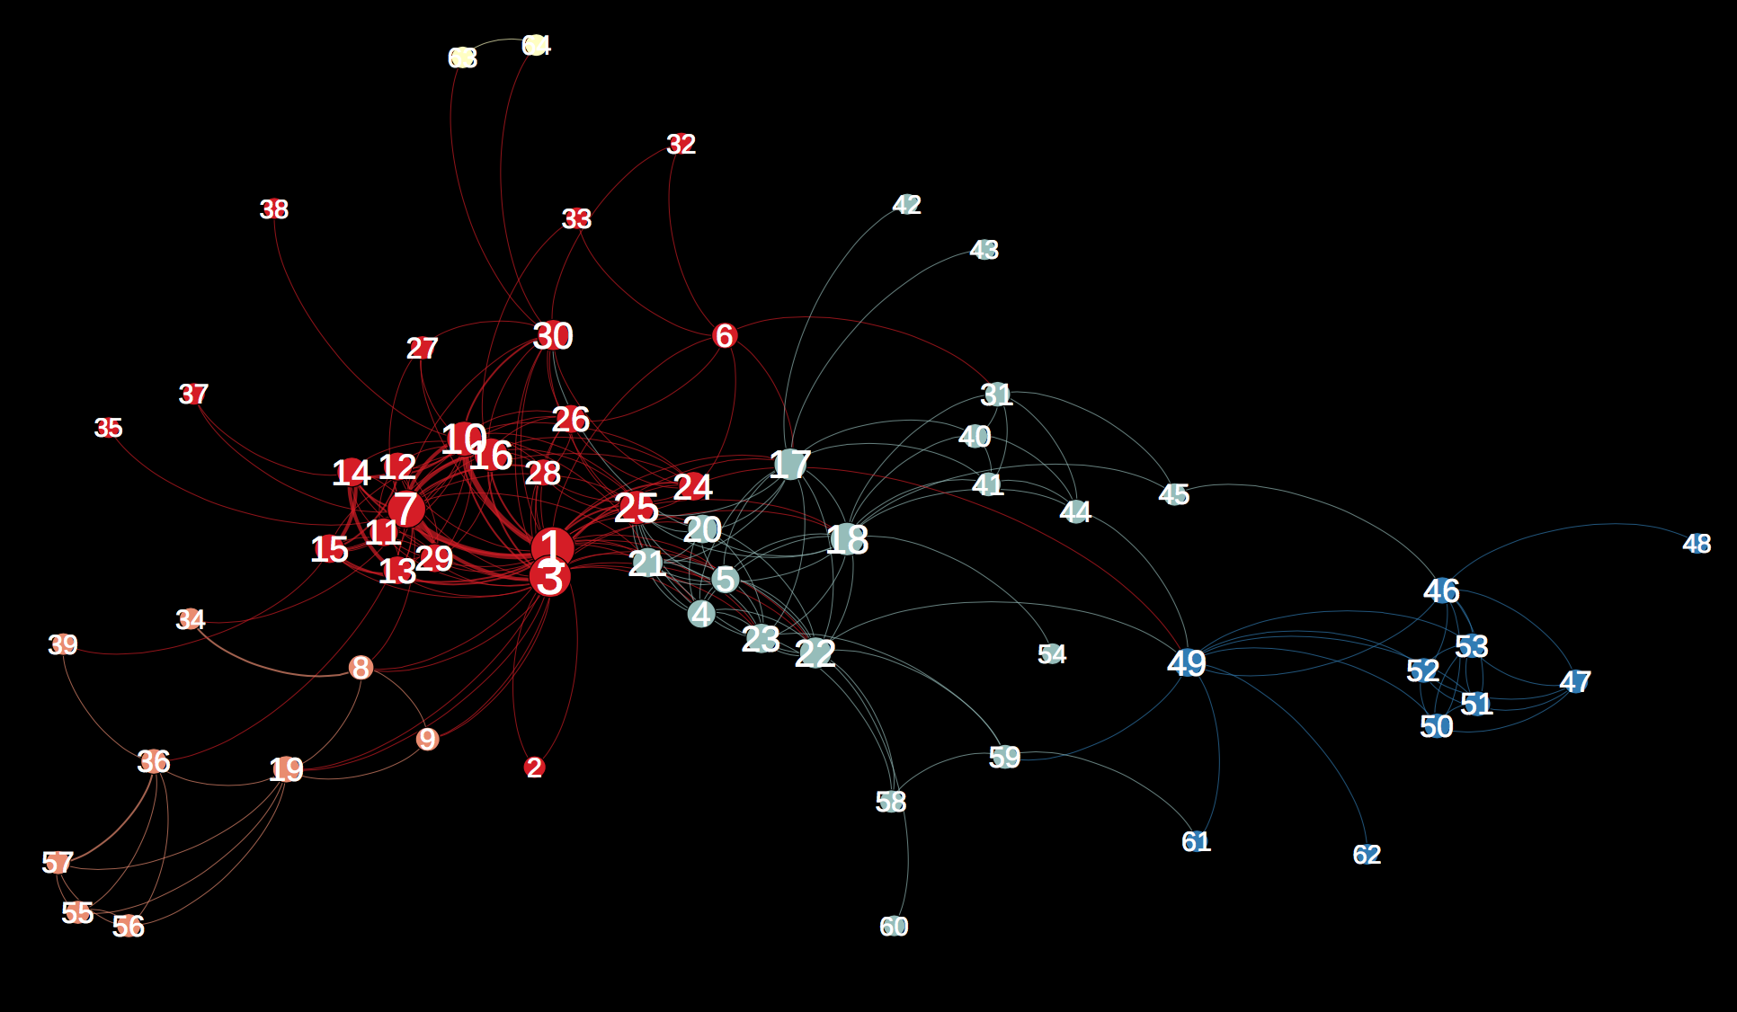

Slide 4
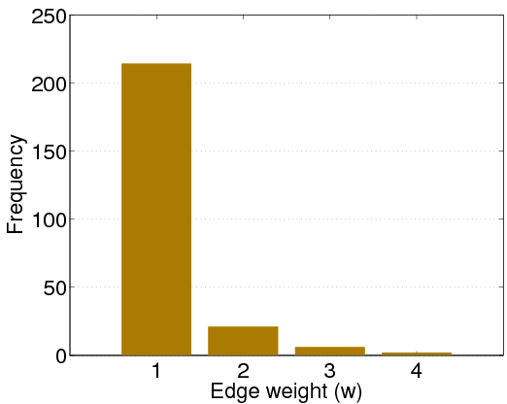
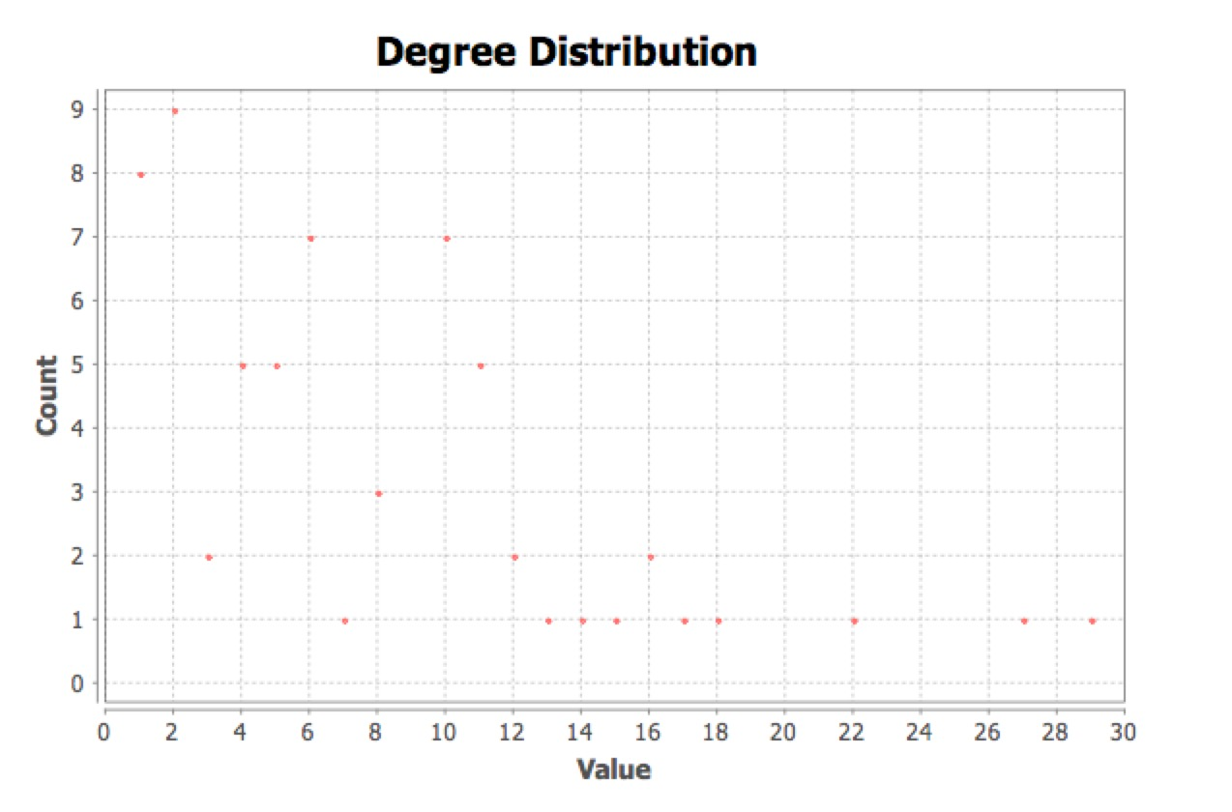
Weight & Degree

Slide 5
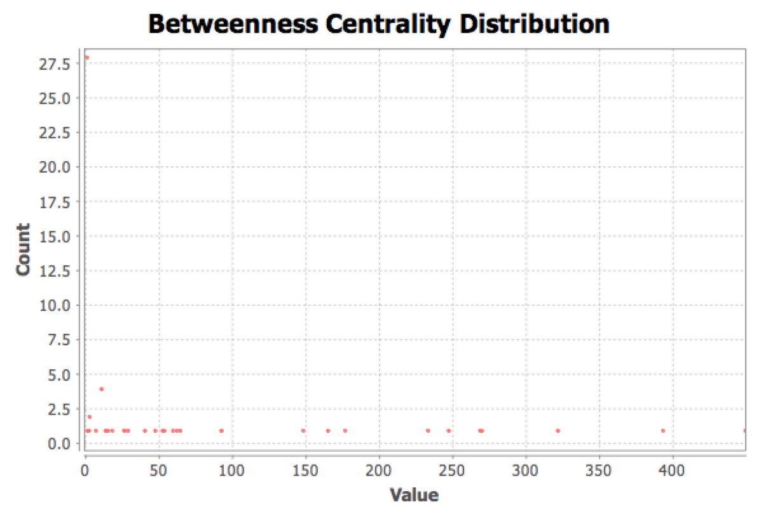
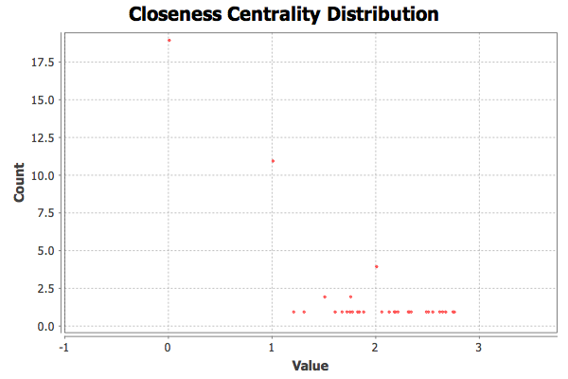
Traditional Centrality

Slide 6
Traditional Centrality
排名 | Degree Centrality |  | Closeness Centrality |  | Betweenness Centrality
1 | 1 | 29 | 1 | 0.583333333 | 50 | 448.5200998
2 | 3 | 27 | 3 | 0.572727273 | 1 | 392.3521719
3 | 7 | 22 | 25 | 0.508064516 | 3 | 320.8381859
4 | 10 | 18 | 7 | 0.5 | 24 | 268.98479
5 | 25 | 17 | 22 | 0.496062992 | 7 | 267.6658761
6 | 16 | 16 | 24 | 0.488372093 | 22 | 246.3920752
7 | 18 | 16 | 18 | 0.480916031 | 18 | 232.2502077
8 | 17 | 15 | 10 | 0.473684211 | 17 | 175.8186508
9 | 22 | 14 | 17 | 0.473684211 | 30 | 164.2050783
10 | 30 | 13 | 21 | 0.473684211 | 19 | 147.2830891

Slide 7
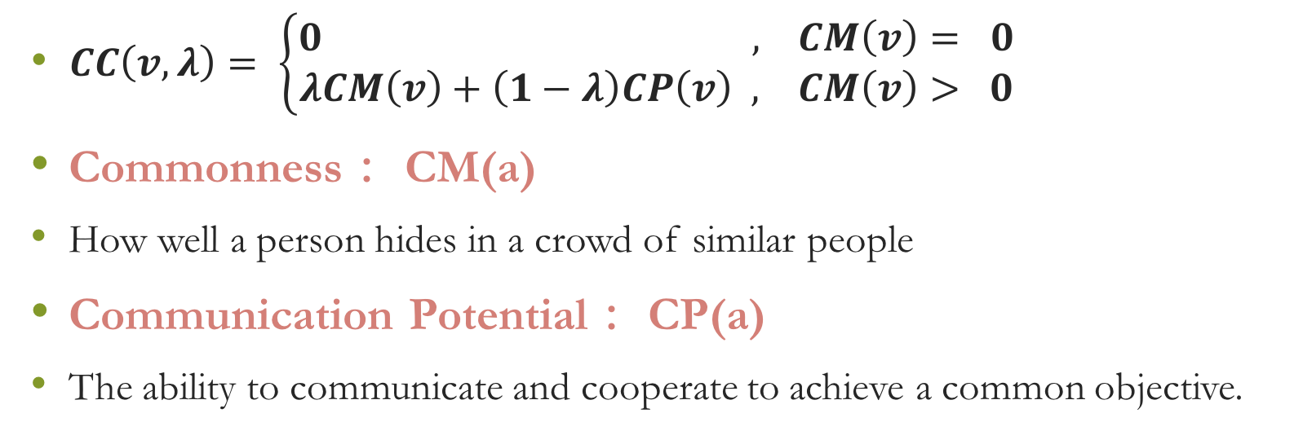
Covertness Centrality
$CC\left(v,λ\right)= \left\{\begin{aligned}0 , CM\left(v\right)= 0 \\ λCM\left(v\right)+\left(1−λ\right)CP\left(v\right) , CM\left(v\right)> 0\end{aligned}\right.$
Commonness： CM(a)
How well a person hides in a crowd of similar people
Communication Potential： CP(a)
The ability to communicate and cooperate to achieve a common objective.

Slide 8
Covertness Centrality
排名 | Covertness Centrality
1 | 1 | 0.28567
2 | 3 | 0.28077
3 | 4 | 0.26895
4 | 5 | 0.26895
5 | 26 | 0.26748
6 | 50 | 0.24892
7 | 25 | 0.24886
8 | 11 | 0.24886
9 | 12 | 0.24886
10 | 13 | 0.24886
Degree Centrality |  | Betweenness Centrality
1 | 29 | 49 | 448.5200998
3 | 27 | 1 | 392.3521719
7 | 22 | 3 | 320.8381859
10 | 18 | 24 | 268.98479
25 | 17 | 7 | 267.6658761
16 | 16 | 22 | 246.3920752
18 | 16 | 18 | 232.2502077
17 | 15 | 17 | 175.8186508
22 | 14 | 30 | 164.2050783
30 | 13 | 19 | 147.2830891

Slide 9
Conclusion
Not so
Notes:
一年时间内被抓捕

