Slide 1

Mini Quiz Application
2025 Aprill 23
Zhenghao Zhang

Slide 2
Key Features Implemented
Mini Quiz is a multiplayer Python quiz game built with Tkinter.
Each player answers the same 5 randomly chosen questions.
Each question has a 20-second countdown and time-based bonus scoring.
Questions and leaderboard are stored in external JSON files.
The project showcases how GUI, timing, scoring logic, and file I/O work together in Python.
2025 Aprill 23
4

Slide 3
Theoretical Concepts Applied
Control Flow
This project demonstrates logical flow control through if-else statements(Short-Circuit Evaluation) and loops, which are essential for managing the quiz’s question flow.
2025 Aprill 23
8

Slide 4
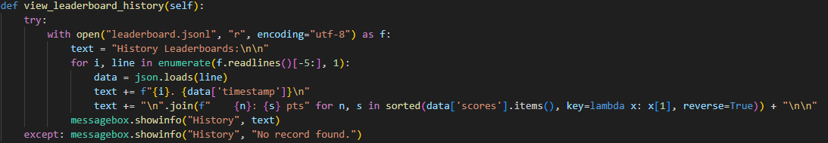
Theoretical Concepts Applied
Syntax and Semantics:
The program follows to Python’s indentation rules, function structure, and conditional expressions.
User input is correctly processed and case-insensitive.
Scores are calculated without producing negative values.
Errors (like valid input) are handled gracefully, preventing program crashes.
2025 Aprill 23
8

Slide 5
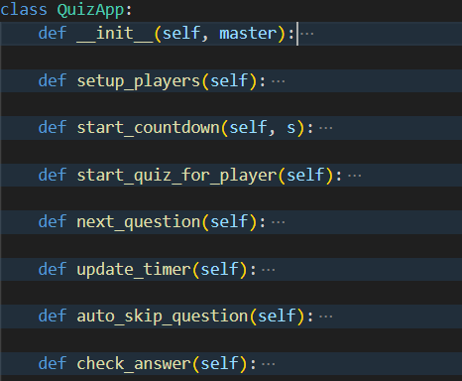
Theoretical Concepts Applied
Object-Oriented Programming (OOP)
2025 Aprill 23
8

Slide 6
DEMO
2025 Aprill 23
9

Slide 7
Future Improvements
Expand question pool to support dynamic difficulty balancing
Upgrade to an online quiz with database-backed leaderboard
2025 Aprill 23
9

Slide 8
Conclusion
Successfully implemented core features:
Timer-based gameplay and bonus scoring
Persistent leaderboard with file storage
Applied key programming concepts:
Control flow, file I/O, and OOP encapsulation
Dynamic difficulty not yet applied due to limited question pool
Project is modular and ready for future expansion
2025 Aprill 23
9

Slide 9
The End
2025 Aprill 23
Zhenghao Zhang

