Slide 1

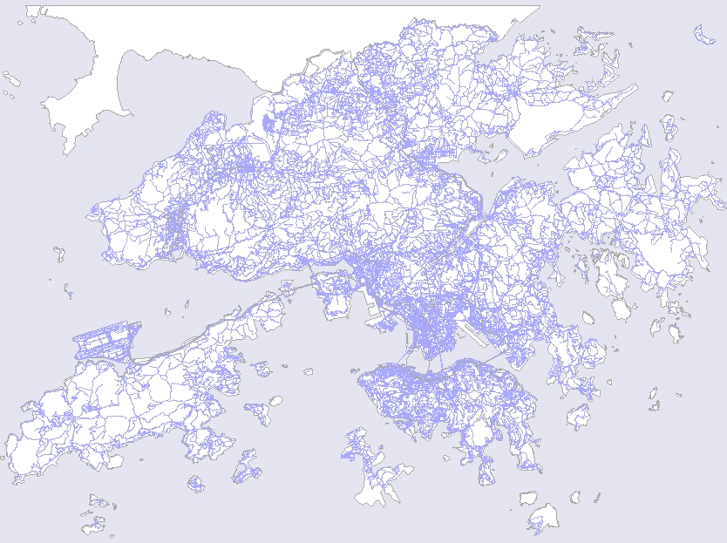
Locating Mobile Station with Ellipse Propagation Model Based on GSM Networks
Locating Mobile Station with
Ellipse Propagation Model
Based on GSM Networks
Presenter : Junyang Zhou
Supervisor : Dr. Joseph Kee-yin Ng
Co-Supervisor: Dr. Jianliang Xu

Slide 2
Content
Locating Mobile Station with Ellipse Propagation Model Based on GSM Networks
Background
My work
Current Findings
Future work
Q&A

Slide 3
Background
Locating Mobile Station with Ellipse Propagation Model Based on GSM Networks

Slide 4
Positioning Technology
Locating Mobile Station with Ellipse Propagation Model Based on GSM Networks
Global Positioning System (GPS)
  A GPS receiver measures the distances from 3 or more satellites and utilize a mathematical method, called “Triangulation” to calculate the actual position
  Blind Spot Problem: Signals from the satellites would be blocked, and reflected by tall buildings.
  Compensations
    Position Reckoning: Electronic Compass, and Speedometer
    Ground Stations

Slide 5
Positioning Technology
Locating Mobile Station with Ellipse Propagation Model Based on GSM Networks
Location Estimation based on Cellular Phone Network
  CDMA: ToA, TDoA, E-OTD, AoA
  GSM: Signal Strength Based Algorithms
  Accuracy depends on the cell type & layout
    Pico-cell: 10-1000m
    Micro-cell: 100-1000m
    Small Macro-cell: 1000-3000m
    Large Macro-cell: 3000-30Km
  Feasible for Metropolitan areas like Hong Kong
  Compliment to GPS

Slide 6

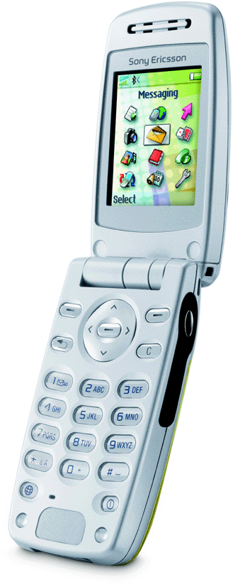

GSM Network
Locating Mobile Station with Ellipse Propagation Model Based on GSM Networks
SS = -62
TA = 2
Serving Cell
SS = -60
SS = -56
SS = -70
SS = -82

Slide 7
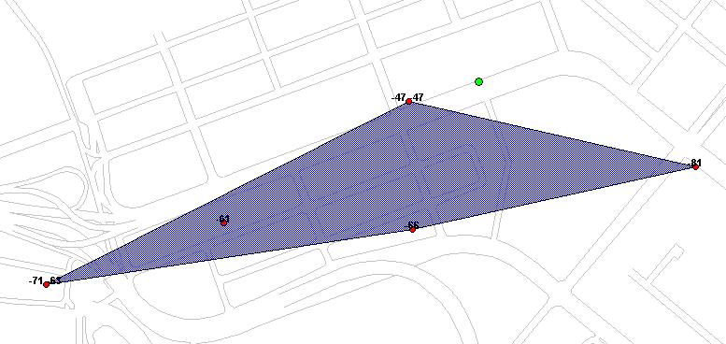
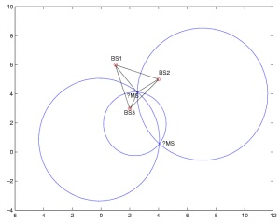
Signal Strength based Models: CG ,CT & Locus
Locating Mobile Station with Ellipse Propagation Model Based on GSM Networks
Transmitter
r3
r2
r1
Estimated
mobile location
Fine Tuning
Clustering
Eliminating Bad Data

Slide 8
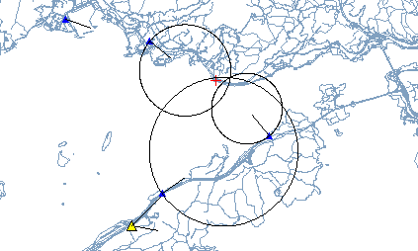
Center of Gravity(CG) vs. Circular Trilateration(CT)
Locating Mobile Station with Ellipse Propagation Model Based on GSM Networks
The mobile location can be outside the convex hull
  CT will be suitable for seashores or some remote areas

Slide 9
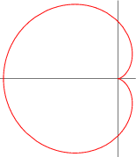
Circular Trilateration
Locating Mobile Station with Ellipse Propagation Model Based on GSM Networks
Circle
Circle with Bearing
Cardioid
Transmitter
r3
r2
r1
Estimated
mobile location
Estimated
mobile location
Transmitter

Slide 10
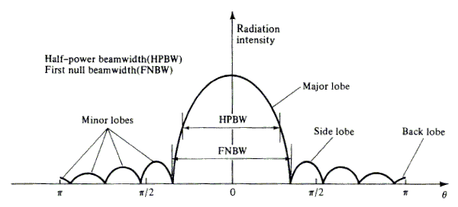
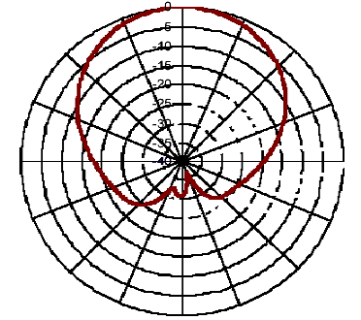
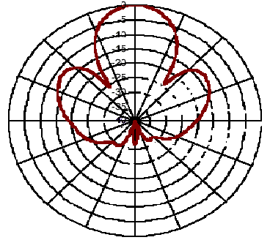
Locating Mobile Station with Ellipse Propagation Model Based on GSM Networks
Directional Signal Propagation Model
Involve Directional Property of All Antenna Types

Slide 11
My work
Locating Mobile Station with Ellipse Propagation Model Based on GSM Networks

Slide 12
Ellipse Propagation Model
Locating Mobile Station with Ellipse Propagation Model Based on GSM Networks
Main Idea:
Consider the effect of antenna signal directional transmission
Suppose the contour line of signal strength is an ellipse
Consider the base station is on one of the focus
Modify from the original propagation model
Present a new directional propagation model to describe the relationship between the distance and the signal strength

Slide 13

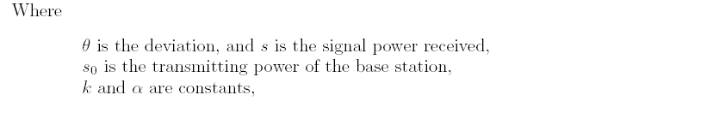
Ellipse Propagation Model
Locating Mobile Station with Ellipse Propagation Model Based on GSM Networks
Translate the signal strength into distance

Slide 14
Geometric Algorithm
Locating Mobile Station with Ellipse Propagation Model Based on GSM Networks
Main Idea
Use three base stations which are not in a line to locate the mobile station
Use Ellipse Propagation Model to translate the signal strengths received from the base stations into the distances between the base stations and the mobile station
Solve three equation groups derived from the three circles formula
Choose the center of these three solutions as the estimation of the mobile station

Slide 15

Geometric Algorithm
Locating Mobile Station with Ellipse Propagation Model Based on GSM Networks
Geometric Algorithm
Generate three equation groups from these three circles formula
Each equation group can only derive one solution
Choose the mean of these three solutions as the estimation

Slide 16
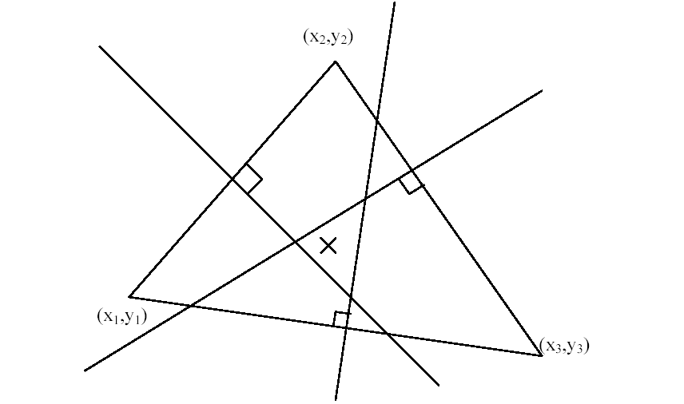
Geometric Algorithm
Locating Mobile Station with Ellipse Propagation Model Based on GSM Networks
The Geometric Interpretation of Geometric Algorithm
The three points on the triangle are the three base stations
The “cross” point is the estimation
Each intersection is the solution of the equation group derived from these three circles formula

Slide 17
Iterative Algorithm
Locating Mobile Station with Ellipse Propagation Model Based on GSM Networks
Main Idea
Use EPM to translate the signal strength into the distance
Consider the real location of the mobile station as the conditional expectation of the information of signal strengths and the base station locations
Consider the estimation of the mobile station as the certain part of the conditional expectation
Build up the iterative formula to find out the estimation
Choose the convergence point as the estimation of the mobile station

Slide 18


Iterative Algorithm
Locating Mobile Station with Ellipse Propagation Model Based on GSM Networks
Consider the “real” location is the conditional expectation
about the information we have, denoted it
Rewrite it as two parts: one is certain, one is uncertain.

Slide 19

Iterative Algorithm
Locating Mobile Station with Ellipse Propagation Model Based on GSM Networks
Estimation of the Mobile Station
x₀ and y₀ appear both side in the equations
Solve these equations by iterative method

Slide 20

Iterative Algorithm
Locating Mobile Station with Ellipse Propagation Model Based on GSM Networks
Iterative formulas
Choose the Geometric Algorithms function structures as f and g structures
Choose one point as initial value
Under some conditions, It can be proved the above iterative formulas have convergence point. This is the estimation of the mobile station

Slide 21
Statistical Estimation
Locating Mobile Station with Ellipse Propagation Model Based on GSM Networks
Main Idea
Use more than one snapshot information to find out the estimation
Use the Geometric Algorithm and the Iterative Algorithm based on the Ellipse Propagation Model

Slide 22
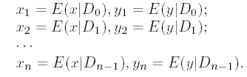
Statistical Estimation
Locating Mobile Station with Ellipse Propagation Model Based on GSM Networks
Define an information set
Derive a series of estimations from n snapshots
It can be proved the estimation of (x_{n} y_{n}) has the best performance within these series of estimations
Choose (x_{n} y_{n}) as the Statistical Estimation

Slide 23

Statistical Estimation
Locating Mobile Station with Ellipse Propagation Model Based on GSM Networks
Rewrite it as two parts: one is certain part, the other is uncertain part
By the iterative relationship, the Statistical Estimation can be rewrote as follow
Find out the estimation as the iterative algorithm does

Slide 24

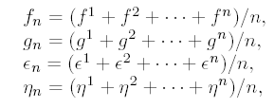
Two Special Structures
Locating Mobile Station with Ellipse Propagation Model Based on GSM Networks
The Average Structure
Consider each snapshot has the same contribution to the estimation

Slide 25
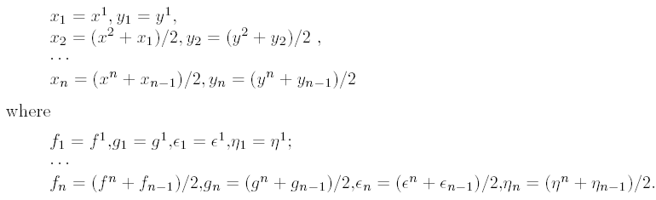
Two Special Structures
Locating Mobile Station with Ellipse Propagation Model Based on GSM Networks
The Special Weighted Structure
The contribution to the estimation will be discounted one half with the time passes

Slide 26
Current Findings
Locating Mobile Station with Ellipse Propagation Model Based on GSM Networks

Slide 27
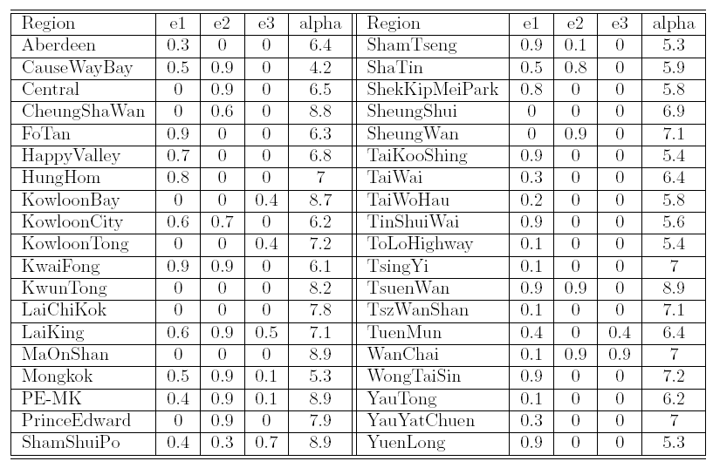
Lookup table
Locating Mobile Station with Ellipse Propagation Model Based on GSM Networks
Three types models
Divide the antennas into three types, each type builds up an ellipse model

Slide 28
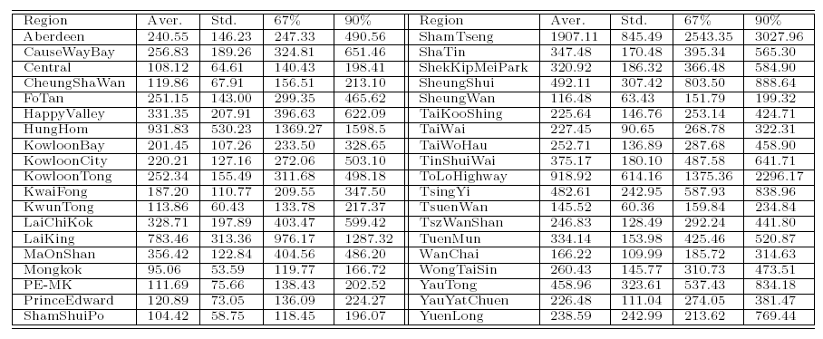
Result of the Geometric Algorithm
Locating Mobile Station with Ellipse Propagation Model Based on GSM Networks
Give the special points values: Mean, Standard deviation,
67% and 90% point value

Slide 29
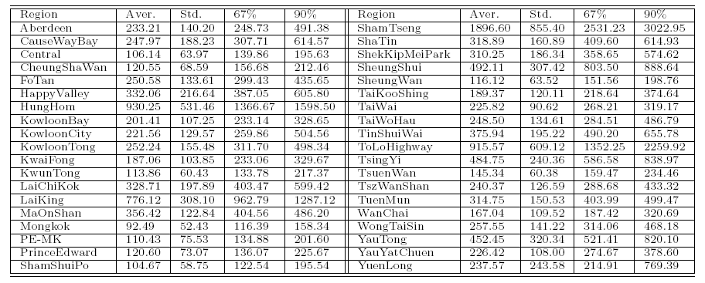
Result of the Iterative Algorithm
Locating Mobile Station with Ellipse Propagation Model Based on GSM Networks
Give the special points values: Mean, Standard deviation,
67% and 90% point value

Slide 30
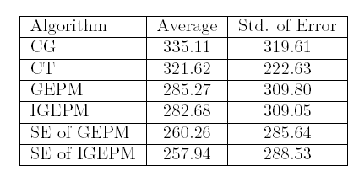
Compare with different algorithms
Locating Mobile Station with Ellipse Propagation Model Based on GSM Networks
GEPM and IGEPM have better accuracy than CG and CT do
SE of GEPM and IGEPM has the best effect

Slide 31
Future work
Locating Mobile Station with Ellipse Propagation Model Based on GSM Networks
Extend the propagation model in to 3-D model
Find out a filter to handle the problem of signal fluctuation

Slide 32
Q&A
Locating Mobile Station with Ellipse Propagation Model Based on GSM Networks

