Slide 1

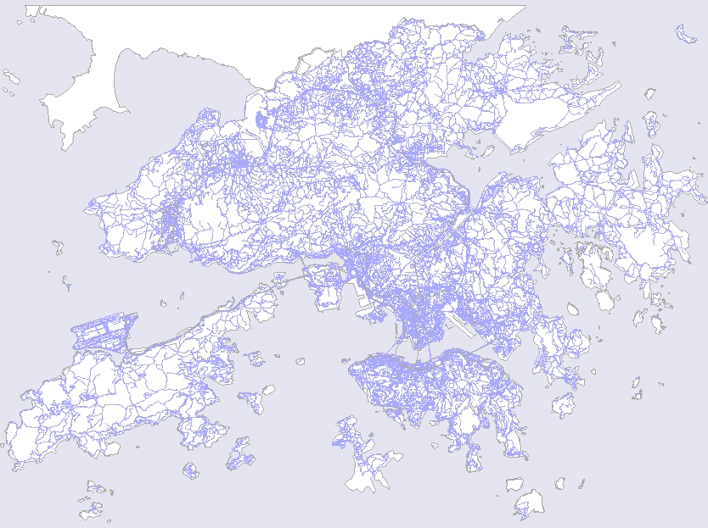
Providing Location Services within a Radio Cellular Network using Ellipse Propagation Model
Providing Location Services
within a Radio Cellular Network
using Ellipse Propagation Model
Junyang Zhou, Kenneth Man-Kin Chu, Joseph Kee-Yin Ng
Presenter : Junyang Zhou
Department of Computer Science,
Hong Kong Baptist University

Slide 2
Outline
Providing Location Services within a Radio Cellular Network using Ellipse Propagation Model
Introduction
Related works
The Ellipse Propagation Model (EPM)
The Geometric Algorithm based on the EPM
Simulation Results
Conclusion and Future work

Slide 3
Introduction
Providing Location Services within a Radio Cellular Network using Ellipse Propagation Model

Slide 4
Positioning Technology
Providing Location Services within a Radio Cellular Network using Ellipse Propagation Model
Global Positioning System (GPS)
  A GPS receiver measures the distances from 3 or more satellites and utilize a mathematical method, called “Triangulation” to calculate the actual position
  Blind Spot Problem: Signals from the satellites would be blocked, and reflected by tall buildings.
  Compensations
    Position Reckoning: Electronic Compass, and Speedometer
    Ground Stations

Slide 5
Positioning Technology
Providing Location Services within a Radio Cellular Network using Ellipse Propagation Model
Location Estimation based on Cellular Phone Network
  CDMA: ToA, TDoA, E-OTD, AoA
  GSM: Signal Strength Based Algorithms
  Accuracy depends on the cell type & layout
    Pico-cell: 10-1000m
    Micro-cell: 100-1000m
    Small Macro-cell: 1000-3000m
    Large Macro-cell: 3000-30Km
  Feasible for Metropolitan areas like Hong Kong

Slide 6
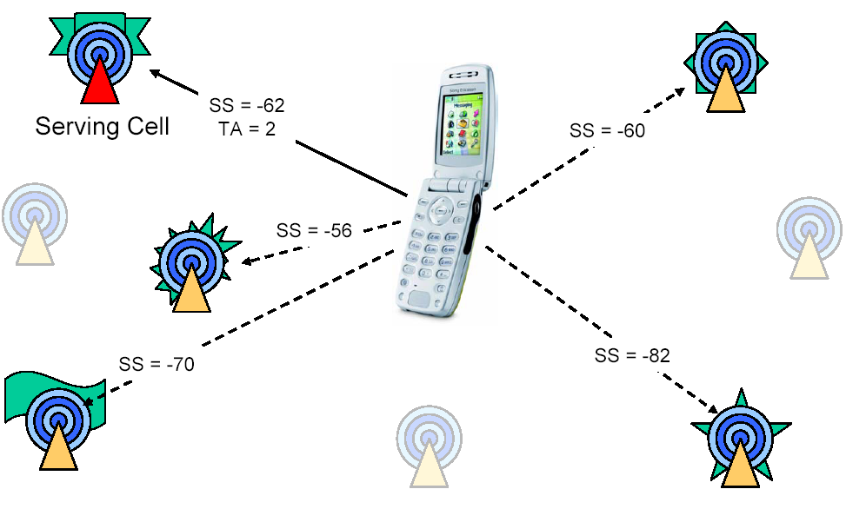
GSM Network
Providing Location Services within a Radio Cellular Network using Ellipse Propagation Model

Slide 7

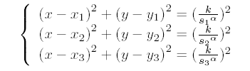
Related works
Providing Location Services within a Radio Cellular Network using Ellipse Propagation Model
Center of Gravity(CG)
Circular Trilateration(CT)

Slide 8
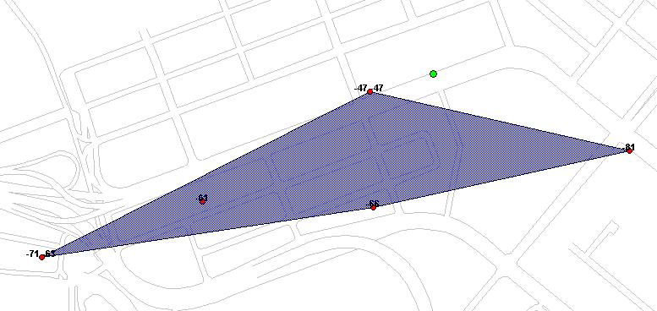
CG & CT
Providing Location Services within a Radio Cellular Network using Ellipse Propagation Model
Transmitter
r3
r2
r1
Estimated
mobile location

Slide 9
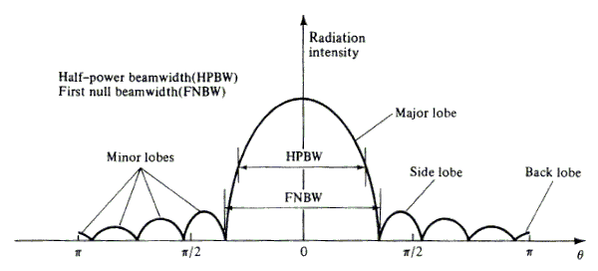
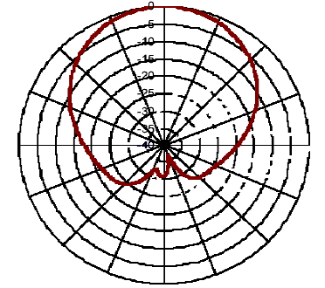
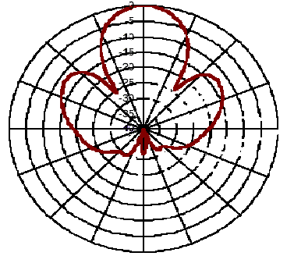
Providing Location Services within a Radio Cellular Network using Ellipse Propagation Model
Directional Transmission Property
Involve Directional Property of All Antenna Types

Slide 10
The Ellipse Propagation Model
Providing Location Services within a Radio Cellular Network using Ellipse Propagation Model
Consider the effect of antenna signal directional transmission
Suppose the contour line of signal strength is an ellipse
Consider the base station is on one of the focuses
Describe the relationship between the signal strength and the distance

Slide 11

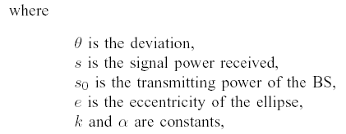
The Ellipse Propagation Model
Providing Location Services within a Radio Cellular Network using Ellipse Propagation Model
Translate the signal strength into the distance

Slide 12
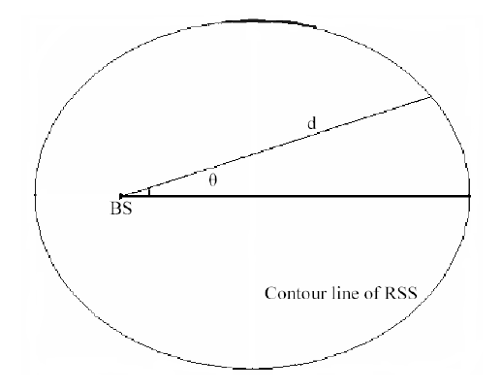
The Ellipse Propagation Model
Providing Location Services within a Radio Cellular Network using Ellipse Propagation Model
The Geometric Interpretation of the EPM

Slide 13
The Geometric Algorithm
Providing Location Services within a Radio Cellular Network using Ellipse Propagation Model
Use three base stations which are not in a line to locate the mobile station
Use the Ellipse Propagation Model (EPM) to translate the signal strength into the distance
Solve three equation groups derived from these three circles formulas
Choose the center of these three solutions as the estimation of the mobile station

Slide 14

The Geometric Algorithm
Providing Location Services within a Radio Cellular Network using Ellipse Propagation Model
Three circles formulas
These three circles can derive three straight lines
Generate three equation groups from these three straight lines
Each equation group can only derive one solution
Choose the mean of these three solutions as the estimation

Slide 15
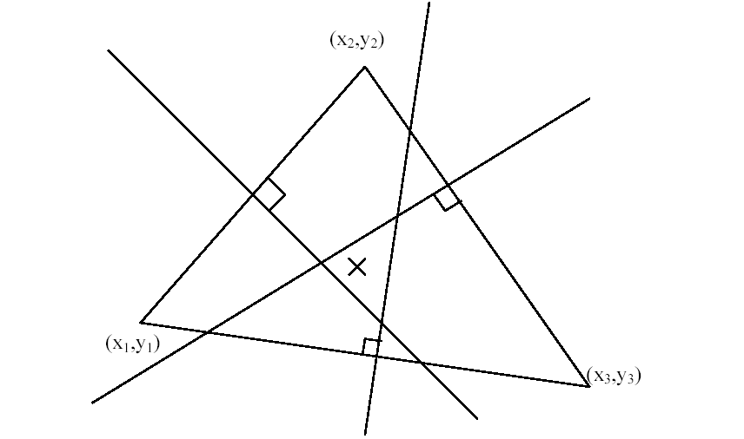
The Geometric Algorithm
Providing Location Services within a Radio Cellular Network using Ellipse Propagation Model
The Geometric Interpretation of the Geometric Algorithm
These three points on the triangle are the three base stations locations
Each intersection of two lines is the solution of the equation group
The “cross” point is the estimation of the Geometric Algorithm

Slide 16
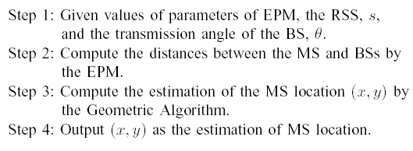
The Geometric Algorithm
Providing Location Services within a Radio Cellular Network using Ellipse Propagation Model
Steps of the Geometric Algorithm

Slide 17
Simulation Results
Providing Location Services within a Radio Cellular Network using Ellipse Propagation Model

Slide 18
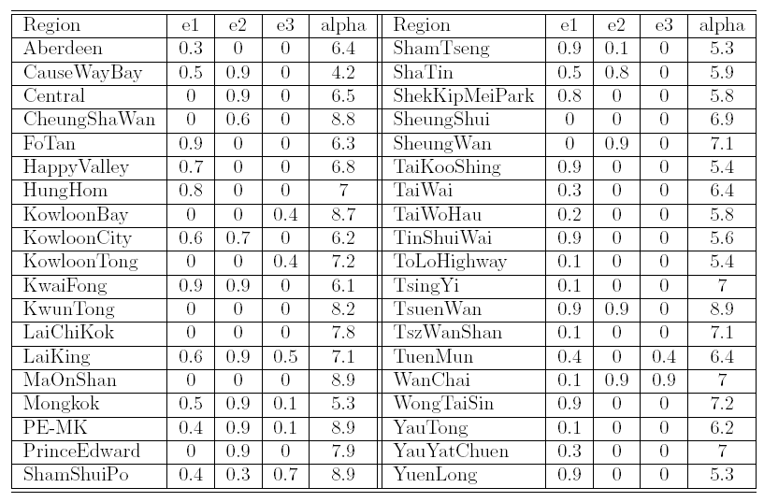
Lookup table
Providing Location Services within a Radio Cellular Network using Ellipse Propagation Model
Three types of models: Macro, Micro, and others
Divide the antennas into three types, each type builds up an ellipse model

Slide 19
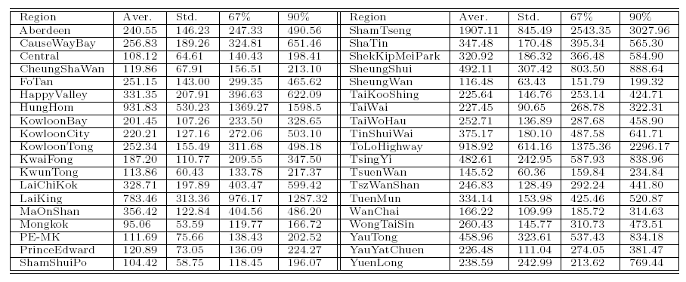
Result of the Geometric Algorithm
Providing Location Services within a Radio Cellular Network using Ellipse Propagation Model
Give the special points values: Mean, Standard deviation,
the 67% point value and the 90% point value

Slide 20
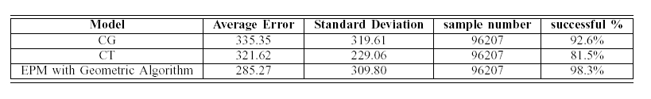
Compare with different algorithms
Providing Location Services within a Radio Cellular Network using Ellipse Propagation Model
Our method has better accuracy than the CG and CT do
The Geometric Algorithm has the best successful ratio

Slide 21
Conclusion and Future work
Providing Location Services within a Radio Cellular Network using Ellipse Propagation Model
Conclusion
  Yields a high accuracy in Hong Kong
  Simple and useful
Future work
  Extend the 2-D EPM into a 3-D model
  Develop and Implement some algorithms based on the 3-D model
  Find out a filter to reduce the effect of signal fluctuation

Slide 22
Thank you!
Providing Location Services within a Radio Cellular Network using Ellipse Propagation Model

