Slide 1

A Selector method for Providing Mobile Location Estimation Services within a Radio Cellular Network
A Selector Method for Providing
Mobile Location Estimation Services
within a Radio Cellular Network
Junyang Zhou, Joseph Kee-Yin Ng
Presenter: Junyang Zhou
Date: 20, April, 2006
Department of Computer Science
Hong Kong Baptist University

Slide 2
Outline
A Selector method for Providing Mobile Location Estimation Services within a Radio Cellular Network
1. Introduction
2. Related Work
3. Motivation
4. Algorithm selector with LDA
5. Experiment Result
6. Future work
7. Q & A

Slide 3
A Selector method for Providing Mobile Location Estimation Services within a Radio Cellular Network
1. Introduction

Slide 4
Positioning Technology
A Selector method for Providing Mobile Location Estimation Services within a Radio Cellular Network
Global Positioning System (GPS)
  A GPS receiver measures the distances from 3 or more satellites and utilizes a mathematical method, called “Triangulation” to calculate the actual position
  Blind Spot Problem: Signals from the satellites would be blocked, and reflected by tall buildings.

Slide 5
Positioning Technology
A Selector method for Providing Mobile Location Estimation Services within a Radio Cellular Network
Location Estimation Algorithms based on a Cellular Network
  CDMA: ToA, TDoA, E-OTD, AoA
  GSM: Signal strength based Algorithms
  Feasible for Metropolitan areas like Hong Kong
  Only the signal strength based algorithms can be applicable to all cellular networks

Slide 6
Positioning Technology
A Selector method for Providing Mobile Location Estimation Services within a Radio Cellular Network
Signal strength based positioning algorithms
  Geometric Model
  Statistical Model

Slide 7
2. Related work
A Selector method for Providing Mobile Location Estimation Services within a Radio Cellular Network

Slide 8
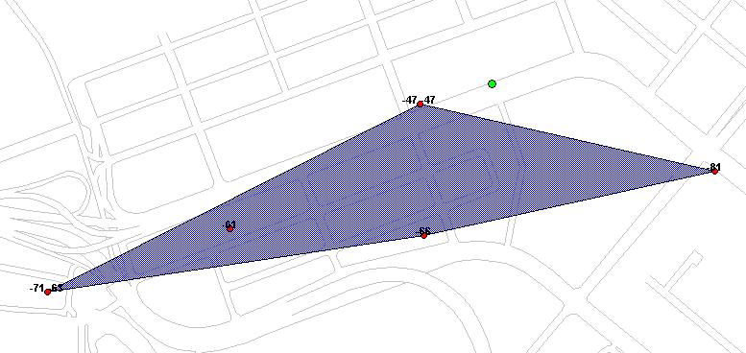

Center of Gravity Algorithm (CG)
A Selector method for Providing Mobile Location Estimation Services within a Radio Cellular Network
The “CG” estimation is always within the convex hull regardless the actual position of the MS is inside or outside this convex hull area

Slide 9

Circular Trilateration Algorithm (CT)
A Selector method for Providing Mobile Location Estimation Services within a Radio Cellular Network
Transmitter
r3
r2
r1
These three circles may not always
intersect in the one point
Estimated
mobile location

Slide 10
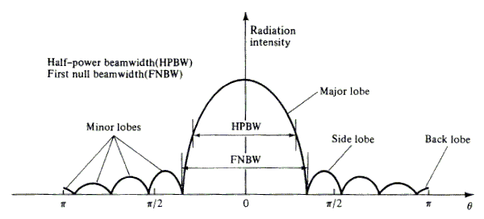
The Directional Antenna
A Selector method for Providing Mobile Location Estimation Services within a Radio Cellular Network

Slide 11
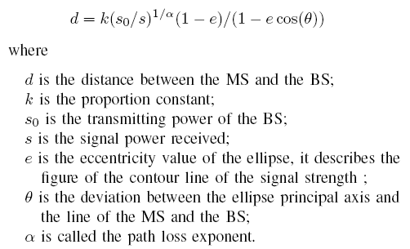
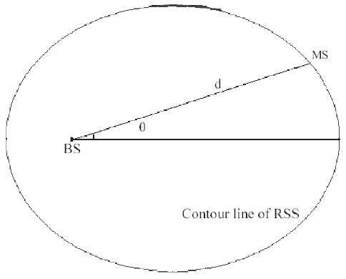
The Ellipse Propagation Model
A Selector method for Providing Mobile Location Estimation Services within a Radio Cellular Network
Consider the contour line of the signal strength as an ellipse

Slide 12
Two Algorithms based on EPM
A Selector method for Providing Mobile Location Estimation Services within a Radio Cellular Network
The Geometric Algorithm with EPM
The Iterative Algorithm with EPM

Slide 13
The Modified Directional Propagation Model
A Selector method for Providing Mobile Location Estimation Services within a Radio Cellular Network
µ = p +β₀ +β₁cos(θ) + β₂log(h) + β₆h
+ (β₃ + β₄log(h)+β₅e)*ln(d)
Use the Bayes Estimate as the estimation of the Model parameter
Provide a Bayes Estimate as the location of the MS based on MDPM

Slide 14
3. Motivation:
A Selector method for Providing Mobile Location Estimation Services within a Radio Cellular Network
Many signal strength based algorithms have been proposed (CG,CT,EPM, MDPM). And each algorithm has its champion region.
It needs to use an algorithm selector to combine the merits of these algorithms.
It is a classification problem.

Slide 15
4. Algorithm selector with LDA
A Selector method for Providing Mobile Location Estimation Services within a Radio Cellular Network
Linear Discriminant Analysis (LDA) is a statistical method to distinguish classes with their features
The original idea of the LDA is attribute to R. A. Fisher

Slide 16
Two cases of the LDA
A Selector method for Providing Mobile Location Estimation Services within a Radio Cellular Network
Two classes Linear Discriminant
C classes Linear Discriminant (C > 2)

Slide 17
5. Experiment Result
A Selector method for Providing Mobile Location Estimation Services within a Radio Cellular Network

Slide 18
Experiments
A Selector method for Providing Mobile Location Estimation Services within a Radio Cellular Network
Extract features from each snapshot information
Build up a three-level binary tree based on our research trend
First level : statistical model VS geometric model
MDPM VS CG + CT + EPM
Second Level: CG VS CT + EPM
Third Level : CT VS EPM
Total 116,284 snapshots

Slide 19

Simulation Results
A Selector method for Providing Mobile Location Estimation Services within a Radio Cellular Network
The result of discriminant

Slide 20
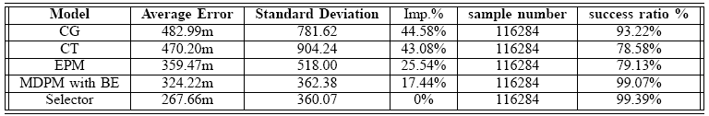
Simulation Results
A Selector method for Providing Mobile Location Estimation Services within a Radio Cellular Network
The result of algorithm selector and its comparison with CG, CT,EPM and MDPM

Slide 21
6. Future work
A Selector method for Providing Mobile Location Estimation Services within a Radio Cellular Network
1. Feature Extracted:
  Extract more features from the snapshot information
2. Selection Algorithm:
  Try to use other statistical approaches or AI algorithms as our algorithm selectors, such as the Bayes Classifier, KNN and SVM

Slide 22
7. Q & A
A Selector method for Providing Mobile Location Estimation Services within a Radio Cellular Network
Thank you!

