Slide 1

Algorithm Selectors for Providing Location Estimation Services within a Cellular Radio Network
Algorithm Selectors for Providing Location Estimation Services
within a Cellular Radio Network
Junyang Zhou, Joseph Kee-Yin Ng
Presenter: Junyang Zhou
Date: 16th, August, 2006
Department of Computer Science
Hong Kong Baptist University

Slide 2
Outline
Algorithm Selectors for Providing Location Estimation Services within a Cellular Radio Network
1. Introduction
2. Related Work
3. Motivation
4. Algorithm selector
5. Experiment
6. Future work
7. Q & A

Slide 3
Algorithm Selectors for Providing Location Estimation Services within a Cellular Radio Network
1. Introduction

Slide 4
Positioning Technology
Algorithm Selectors for Providing Location Estimation Services within a Cellular Radio Network
Global Positioning System (GPS)
  A GPS receiver measures the distances from 3 or more satellites and utilizes a mathematical method, called “Triangulation” to calculate the actual position
  Blind Spot Problem: Signals from the satellites would be blocked, and reflected by tall buildings.

Slide 5
Positioning Technology
Algorithm Selectors for Providing Location Estimation Services within a Cellular Radio Network
Location Estimation Algorithms based on a Cellular Network
  CDMA: ToA, TDoA, E-OTD, AoA
  GSM: Signal strength based Algorithms
  Feasible for Metropolitan areas like Hong Kong
  Only the signal strength based algorithms can be applicable to all cellular networks

Slide 6
Positioning Technology
Algorithm Selectors for Providing Location Estimation Services within a Cellular Radio Network
Signal strength based algorithms
  Geometric Model
  Statistical Model

Slide 7
2. Related work
Algorithm Selectors for Providing Location Estimation Services within a Cellular Radio Network

Slide 8
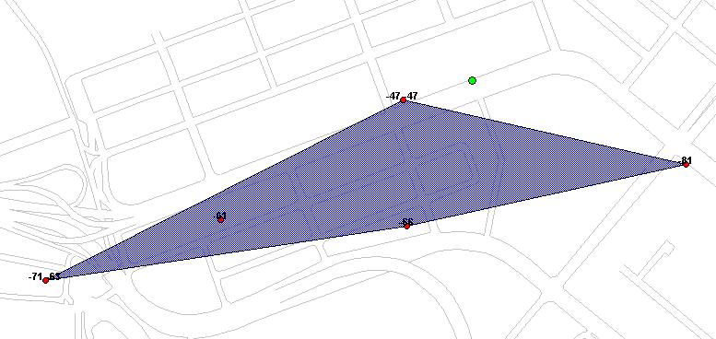

The Center of Gravity (CG) Algorithm
Algorithm Selectors for Providing Location Estimation Services within a Cellular Radio Network
The estimation of the CG algorithm is always within the convex hull regardless the actual position is inside or outside this convex hull

Slide 9

The Circular Trilateration (CT) Algorithm
Algorithm Selectors for Providing Location Estimation Services within a Cellular Radio Network
Transmitter
r3
r2
r1
These three circles may not
intersect in one point
Estimated
mobile location

Slide 10
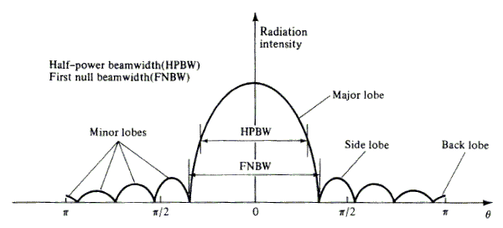
The Directional Antenna
Algorithm Selectors for Providing Location Estimation Services within a Cellular Radio Network

Slide 11
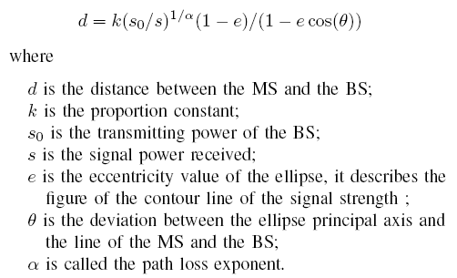
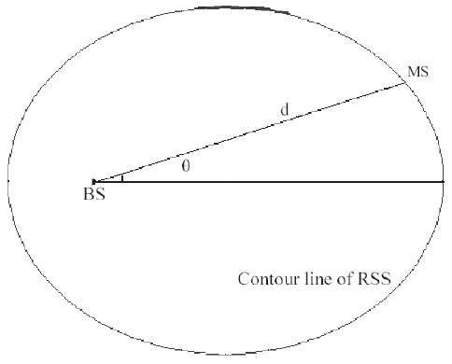
The Ellipse Propagation Model
Algorithm Selectors for Providing Location Estimation Services within a Cellular Radio Network
Consider the contour line of the received signal strength (RSS) as an ellipse

Slide 12
Two Algorithms based on EPM
Algorithm Selectors for Providing Location Estimation Services within a Cellular Radio Network
The Geometric Algorithm with EPM
The Iterative Algorithm with EPM

Slide 13
The Modified Directional Propagation Model
Algorithm Selectors for Providing Location Estimation Services within a Cellular Radio Network
µ = p +β₀ +β₁cos(θ) + β₂log(h) + β₆h
+ (β₃ + β₄log(h)+β₅e)*ln(d)
Use the Bayes Estimate as the estimation of the Model parameter
Provide the estimation of the location of the MS based on MDPM

Slide 14
3. Motivation:
Algorithm Selectors for Providing Location Estimation Services within a Cellular Radio Network
Many signal strength based algorithms have been proposed (CG, CT, EPM, MDPM). Each algorithm has its own champion region.
We need to build up a rule or a method to combine the merits of these algorithms based on the information of the snapshot.
It is a classification problem.

Slide 15
4. Algorithm selector
Algorithm Selectors for Providing Location Estimation Services within a Cellular Radio Network
Factors Extraction
Algorithm selector with the LDA Classifier
Algorithm selector with the Bayes Classifier

Slide 16
Algorithm selector (con’s)---Factors Extraction
Algorithm Selectors for Providing Location Estimation Services within a Cellular Radio Network
Region
Area of the Convex Hull
Numbers of the BSs involved
Timing Advance (TA)
Information of the Signal Strength ( mean & standard deviation )

Slide 17
Algorithm selector (con’s)---the LDA Classifier
Algorithm Selectors for Providing Location Estimation Services within a Cellular Radio Network
The Linear Discriminant Analysis (LDA) is a statistical method based on the variance analysis to classify classes with their features.
The original idea of the LDA is attribute to R. A. Fisher.
Calculate the Mahalanobis distance and choose the minimum to classify the snapshots

Slide 18
Algorithm selector (con’s)---the Bayes Classifier
Algorithm Selectors for Providing Location Estimation Services within a Cellular Radio Network
The Bayes Classifier is a statistical method based on the maximum likelihood rule to classify classes with their features
Calculate the posterior probability and choose the maximum to distinguish the data.
The Naïve Bayes Probabilistic Model
---Assume all features are independent
The Bayes Probabilistic Model
---Do not require the independent assumption

Slide 19
5. Experiment
Algorithm Selectors for Providing Location Estimation Services within a Cellular Radio Network
Setup of the experiment
Result of the experiment

Slide 20
Setup of the experiment
Algorithm Selectors for Providing Location Estimation Services within a Cellular Radio Network
Totally calculate 165,794 sets of snapshots
Divide the data into two parts:
---30% (49,510 sets) : Train the model parameter
---70% (116,284 sets): Test the model

Slide 21
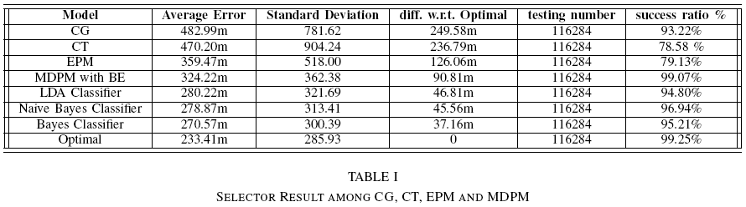
Result of the experiment
Algorithm Selectors for Providing Location Estimation Services within a Cellular Radio Network

Slide 22
6. Future work
Algorithm Selectors for Providing Location Estimation Services within a Cellular Radio Network
1. Features Extracted:
  Extract more features from the information of the snapshot
2. Selection Algorithm:
  Try to use other statistical approaches or AI algorithms as our algorithm selectors, such as KNN and SVM

Slide 23
7. Q & A
Algorithm Selectors for Providing Location Estimation Services within a Cellular Radio Network
Thank you!

