Slide 1

The Design of Providing Location Services in Metropolitan Area with 3D Ellipse Propagation Model
The Design of Providing Location Services in Metropolitan Area with 3D Ellipse Propagation Model within a Cellular Radio Network
Presenter: Junyang Zhou
Date: 4, July, 2006
Department of Computer Science
Hong Kong Baptist University

Slide 2
Outline
The Design of Providing Location Services in Metropolitan Area with 3D Ellipse Propagation Model
1. Introduction
2. Related Work
3. 3D Ellipse Propagation Model
4. Future work
5. Q & A

Slide 3
The Design of Providing Location Services in Metropolitan Area with 3D Ellipse Propagation Model
1. Introduction

Slide 4
Positioning Technology
The Design of Providing Location Services in Metropolitan Area with 3D Ellipse Propagation Model
Global Positioning System (GPS)
  A GPS receiver measures the distances from 3 or more satellites and utilizes a mathematical method to calculate the actual position
  Blind Spot Problem: Signals from the satellites would be blocked, and reflected by tall buildings.

Slide 5
Positioning Technology
The Design of Providing Location Services in Metropolitan Area with 3D Ellipse Propagation Model
Location Algorithms based on a Cellular Radio Network
  CDMA: ToA, TDoA, E-OTD, AoA
  GSM: Signal strength based Algorithms
  Feasible for Metropolitan areas like Hong Kong
  Only the signal strength based algorithms can be applicable to all cellular networks

Slide 6
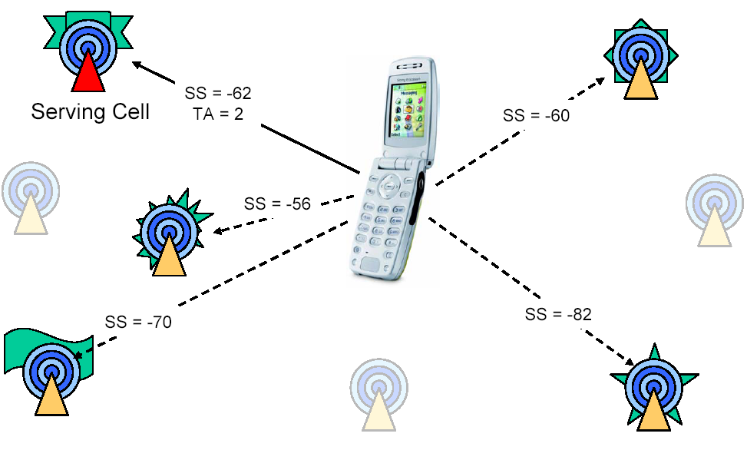
GSM Network
The Design of Providing Location Services in Metropolitan Area with 3D Ellipse Propagation Model

Slide 7
2. Related Work
The Design of Providing Location Services in Metropolitan Area with 3D Ellipse Propagation Model

Slide 8
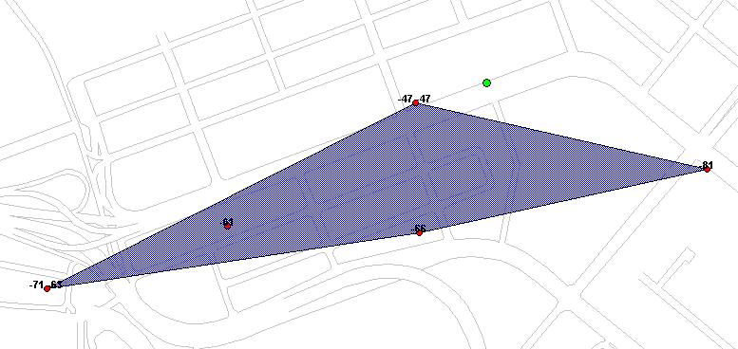

Center of Gravity Algorithm (CG)
The Design of Providing Location Services in Metropolitan Area with 3D Ellipse Propagation Model
Defect of CG:
The “CG” estimation is always within the convex hull regardless the actual position of the MS is inside or outside this convex hull area

Slide 9

Circular Trilateration Algorithm (CT)
The Design of Providing Location Services in Metropolitan Area with 3D Ellipse Propagation Model
Transmitter
r3
r2
r1
Defect of CG:
These three circles may not always
intersect in one point
Estimated
mobile location

Slide 10
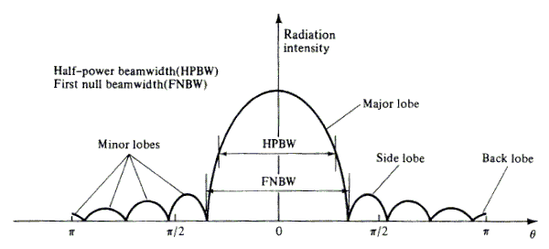
The Directional Antenna
The Design of Providing Location Services in Metropolitan Area with 3D Ellipse Propagation Model

Slide 11
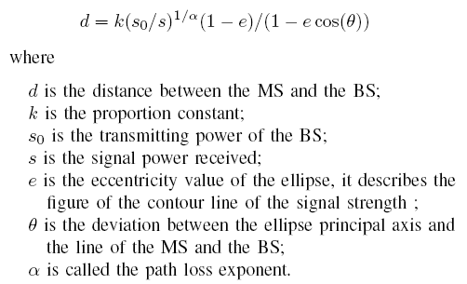
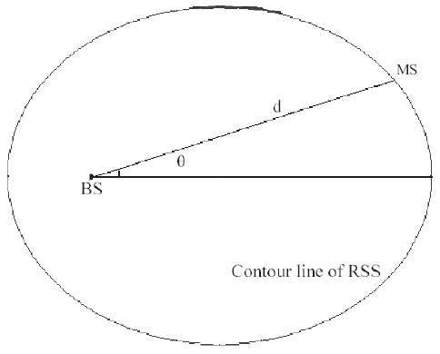
The Ellipse Propagation Model
The Design of Providing Location Services in Metropolitan Area with 3D Ellipse Propagation Model
Consider the contour line of the signal strength as an ellipse

Slide 12
Two Algorithms based on EPM
The Design of Providing Location Services in Metropolitan Area with 3D Ellipse Propagation Model
The Geometric Algorithm with EPM
  It derives from the CT algorithm and improve its defect
The Iterative Algorithm with EPM
  It improves the Geometric Algorithm with EPM
  It choose a convergence point as the location of the MS

Slide 13
3. 3D Ellipse Propagation Model
The Design of Providing Location Services in Metropolitan Area with 3D Ellipse Propagation Model
Extend Ellipse Propagation Model into 3D space.
  Build up a function to describe the relationship between the received signal strength and the BS-MS distance
Use the information of Four BSs to provide the 3D location of the MS.
  Extend the Geometric Algorithm and the Iterative Algorithm into 3D space

Slide 14
4. Future work
The Design of Providing Location Services in Metropolitan Area with 3D Ellipse Propagation Model
Sample Data
  Field test in Hong Kong Area
Train Model
  Build up a 3D Ellipse Propagation Model
Application
  Provide location services

Slide 15
5. Q & A
The Design of Providing Location Services in Metropolitan Area with 3D Ellipse Propagation Model
Thank you!

