Slide 1

How to build up a personal Website on Redhat Linux
How to build up a personal Website
on Redhat Linux
Presenter : Junyang Zhou

Slide 2
Outline
How to build up a personal Website on Redhat Linux
Introduction of Apache Server
Web Server Configuration Setting
Build up a personal Website on elpis Server

Slide 3
Introduction of Apache Server
How to build up a personal Website on Redhat Linux

Slide 4
Apache Server
How to build up a personal Website on Redhat Linux
The Apache Web server is a free HTTP (Web) server developed by the Apache Server Project.
It is a reliable, efficient , and easily extensible Web Server
Free open source code

Slide 5
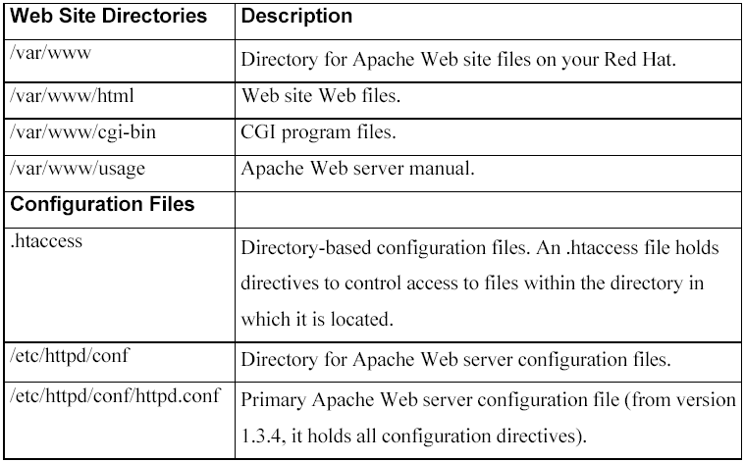
How to build up a personal Website on Redhat Linux
Important directories and configuration files

Slide 6
Web Server Configuration Setting
How to build up a personal Website on Redhat Linux

Slide 7
Configuration File
How to build up a personal Website on Redhat Linux
Apache Configuration File
/etc/httpd/conf/httpd.conf

Slide 8
Server Configuration (/etc/httpd/conf/httpd.conf)
How to build up a personal Website on Redhat Linux
Server Admin
The following ServerAdmin directive is used to specify the email address to which users can send mail for administrative issues. You can change to specify your email address
# ServerAdmin: Your address, where problems should be emailed.
ServerAdmin root@localhost

Slide 9
Server Configuration (/etc/httpd/conf/httpd.conf)
How to build up a personal Website on Redhat Linux
Document Root
On Redhat system, “/var/www” is your default Website directory. The DocumentRoot directive specifies the home directory for your Web pages. The ServerRoot directive specifies the path of your Web server configuration files, error files, and the log files.
DcoumentRoot “/var/www/html”
ServerRoot “/etc/httpd*”

Slide 10
Server Configuration (/etc/httpd/conf/httpd.conf)
How to build up a personal Website on Redhat Linux
Default web page
If Apache is given only a directory rather than a specific file (Web page), it looks for a default web page located in that directory and sends it. The file name of this default web page is “index.html”, but you can change to other file names.
DirectoryIndex index.html index.html.var

Slide 11
Server Configuration (/etc/httpd/conf/httpd.conf)
How to build up a personal Website on Redhat Linux
User Directory
Apache also enables a user to maintain Web pages located in a special subdirectory in the user’s home directory, rather than in the main Web site directory. To access this dirctory, use the symbol ~ followed by the user name. The name of this directory is specified with the UserDir directive, and the default name is public_html
UserDir public_html

Slide 12
Server Configuration (/etc/httpd/conf/httpd.conf)
How to build up a personal Website on Redhat Linux
Server Port
You can change the port number of the server
Listen 80 ( default http port number)

Slide 13
Server Configuration (/etc/httpd/conf/httpd.conf)
How to build up a personal Website on Redhat Linux
Virtual Hosting
--Virtual hosting allows the Apache web server to host multiple web sites.
--Apache supports both IP address and name-based virtual hosts.

Slide 14
Build up a personal Website on elpis Server
How to build up a personal Website on Redhat Linux
Create a folder “public_html” in your home directory
Create a html file “index.html” in public_html

Slide 15
Build up a personal Website on elpis Server
How to build up a personal Website on Redhat Linux
Change the permission of “/u/pg/username” is 701 (drwx-----x). Make sure other people can access your home directory.
where the username is the user on the elpis server,
for example: jyzhou

Slide 16
Build up a personal Website on elpis Server
How to build up a personal Website on Redhat Linux
Create the folder “public_html” in your home directory, and make sure other people can access your folder.
For example, the permission of the folder “public_html” can be 701 (drwx-----x)
or 755 (drwxr-xr-x)
Use command “chmod” to change the permission
  $ chmod 701 public_html

Slide 17
Build up a personal Website on elpis Server
How to build up a personal Website on Redhat Linux
Create web page file “index.html” or “index.php” in the “public_html” directory
Change the “index.html” permission in order other people can read and execute the file. For example:
$chmod 755 index.html
(or $chmod 705 index.html)
You can use the HTML language or PHP language to build up your homepage. And you can create more folders in the public_html directory.

Slide 18
Create a text counter in your homepage
How to build up a personal Website on Redhat Linux
A simple example:
<?php
$fpr = fopen( “counter.txt” , ”r” );
$num = fgets($fpr,10);
print “$num \n”;
fclose($fpr);
$fpw = fopen(“counter.txt”, “w”);
$newnum = fputs($fpw, $num+1);
fclose($fpw);
?>

Slide 19
Thank you!
How to build up a personal Website on Redhat Linux

