Slide 1

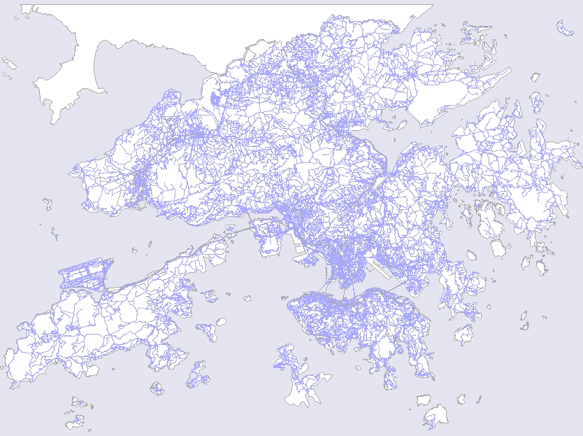
Locating Mobile Station with Ellipse Propagation Model Based on GSM Networks
Locating Mobile Station with
Ellipse Propagation Model
Based on GSM Networks
Presenter : Junyang Zhou
Supervisor : Dr. Joseph Kee-yin Ng
Co-Supervisor: Dr. Jianliang Xu

Slide 2
Outline
Locating Mobile Station with Ellipse Propagation Model Based on GSM Networks
Introduction
My work
Current Findings
Q&A

Slide 3
Introduction
Locating Mobile Station with Ellipse Propagation Model Based on GSM Networks

Slide 4
Positioning Technology
Locating Mobile Station with Ellipse Propagation Model Based on GSM Networks
Global Positioning System (GPS)
  A GPS receiver measures the distances from 3 or more satellites and utilize a mathematical method, called “Triangulation” to calculate the actual position
  Blind Spot Problem: Signals from the satellites would be blocked, and reflected by tall buildings.
  Compensations
    Position Reckoning: Electronic Compass, and Speedometer
    Ground Stations

Slide 5
Positioning Technology
Locating Mobile Station with Ellipse Propagation Model Based on GSM Networks
Location Estimation based on Cellular Phone Network
  CDMA: ToA, TDoA, E-OTD, AoA
  GSM: Signal Strength Based Algorithms
  Accuracy depends on the cell type & layout
    Pico-cell: 10-1000m
    Micro-cell: 100-1000m
    Small Macro-cell: 1000-3000m
    Large Macro-cell: 3000-30Km
  Feasible for Metropolitan areas like Hong Kong
  Compliment to GPS

Slide 6

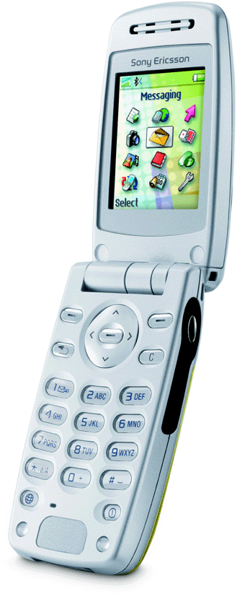

GSM Network
Locating Mobile Station with Ellipse Propagation Model Based on GSM Networks
SS = -62
TA = 2
Serving Cell
SS = -60
SS = -56
SS = -70
SS = -82

Slide 7
My work
Locating Mobile Station with Ellipse Propagation Model Based on GSM Networks
2-D Ellipse Propagation Model (EPM)
Geometric Algorithm based on EPM
Iterative Algorithm based on EPM
Statistical Estimation based on EPM
3-D Ellipse Propagation Model (3DEPM)

Slide 8
Ellipse Propagation Model
Locating Mobile Station with Ellipse Propagation Model Based on GSM Networks
Consider the effect of antenna signal directional transmission
Suppose the contour line of signal strength is an ellipse
Consider the base station is on one of the focus
Modify from the original propagation model
Provide a new directional propagation model to describe the relationship between the distance and the signal strength

Slide 9

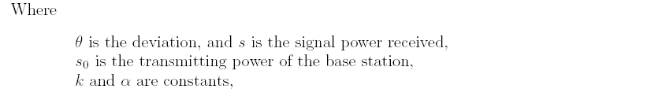
Ellipse Propagation Model
Locating Mobile Station with Ellipse Propagation Model Based on GSM Networks
Translate the signal strength into distance

Slide 10
Geometric Algorithm
Locating Mobile Station with Ellipse Propagation Model Based on GSM Networks
Use three base stations which are not in a line to locate the mobile station
Use Ellipse Propagation Model (EPM) to translate the signal strengths received from the base stations into the distances between the base stations and the mobile station
Solve three equation groups derived from the three circles formula
Choose the center of these three solutions as the estimation of the mobile station

Slide 11

Geometric Algorithm
Locating Mobile Station with Ellipse Propagation Model Based on GSM Networks
Geometric Algorithm
Generate three equation groups from these three circles formula
Each equation group can only derive one solution
Choose the mean of these three solutions as the estimation

Slide 12
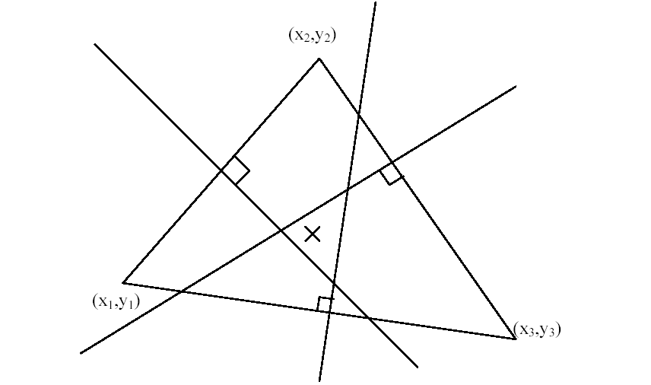
Geometric Algorithm
Locating Mobile Station with Ellipse Propagation Model Based on GSM Networks
The Geometric Interpretation of Geometric Algorithm
The three points on the triangle are the three base stations
The “cross” point is the estimation
Each intersection is the solution of the equation group derived from these three circles formula

Slide 13
Iterative Algorithm
Locating Mobile Station with Ellipse Propagation Model Based on GSM Networks
Use EPM to translate the signal strength into the distance
Consider the real location of the mobile station as the conditional expectation of the information of signal strengths and the base station locations
Consider the estimation of the mobile station as the certain part of the conditional expectation
Build up the iterative formula to find out the estimation
Choose the convergence point as the estimation of the mobile station

Slide 14


Iterative Algorithm
Locating Mobile Station with Ellipse Propagation Model Based on GSM Networks
Consider the “real” location is the conditional expectation
about the information we have, denoted it
Rewrite it as two parts: one is certain, one is uncertain.

Slide 15

Iterative Algorithm
Locating Mobile Station with Ellipse Propagation Model Based on GSM Networks
Estimation of the Mobile Station
x₀ and y₀ appear both side in the equations
Solve these equations by iterative method

Slide 16

Iterative Algorithm
Locating Mobile Station with Ellipse Propagation Model Based on GSM Networks
Iterative formulas
Choose the Geometric Algorithms function structures as f and g structures
Choose one point as initial value
Under some conditions, It can be proved the above iterative formulas have convergence point. This is the estimation of the mobile station

Slide 17
Statistical Estimation
Locating Mobile Station with Ellipse Propagation Model Based on GSM Networks
Use more than one snapshot information to find out the estimation
Use the Geometric Algorithm and the Iterative Algorithm based on the Ellipse Propagation Model

Slide 18
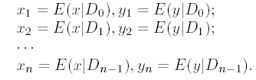
Statistical Estimation
Locating Mobile Station with Ellipse Propagation Model Based on GSM Networks
Define an information set
Derive a series of estimations from n snapshots
It can be proved the estimation of (x_{n} y_{n}) has the best performance within these series of estimations
Choose (x_{n} y_{n}) as the Statistical Estimation

Slide 19

Statistical Estimation
Locating Mobile Station with Ellipse Propagation Model Based on GSM Networks
Rewrite it as two parts: one is certain part, the other is uncertain part
By the iterative relationship, the Statistical Estimation can be rewrote as follow
Find out the estimation as the iterative algorithm does

Slide 20

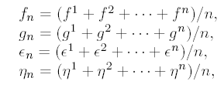
Two Special Structures
Locating Mobile Station with Ellipse Propagation Model Based on GSM Networks
The Average Structure
Consider each snapshot has the same contribution to the estimation

Slide 21
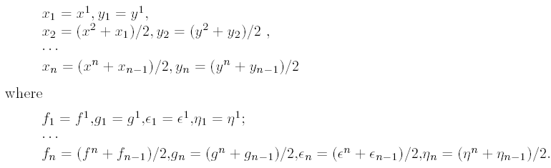
Two Special Structures
Locating Mobile Station with Ellipse Propagation Model Based on GSM Networks
The Special Weighted Structure
The contribution to the estimation will be discounted one half with the time passes

Slide 22
3-D Ellipse propagation Model
Locating Mobile Station with Ellipse Propagation Model Based on GSM Networks
Consider the effect of antenna signal directional transmission
The contour surface of signal strength is an Ellipse-Sphere
Consider the base station is on one of the focus
Extend from the 2-D Ellipse Propagation Model

Slide 23
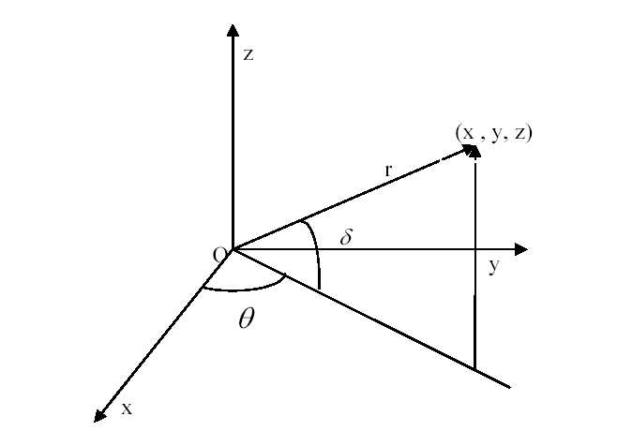
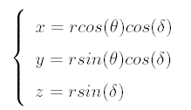
3-D Ellipse propagation Model
Locating Mobile Station with Ellipse Propagation Model Based on GSM Networks
Transform formula between polar coordinates and the rectangle coordinates

Slide 24
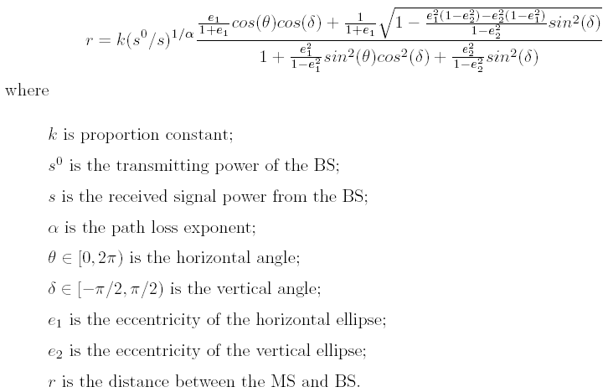
3-D Ellipse propagation Model
Locating Mobile Station with Ellipse Propagation Model Based on GSM Networks

Slide 25

3-D Ellipse propagation Model
Locating Mobile Station with Ellipse Propagation Model Based on GSM Networks
It is the 2-D Ellipse Propagation Model

Slide 26
Current Findings
Locating Mobile Station with Ellipse Propagation Model Based on GSM Networks

Slide 27
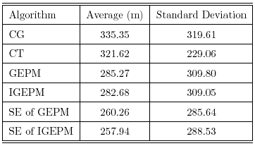
Compare with different algorithms
Locating Mobile Station with Ellipse Propagation Model Based on GSM Networks
GEPM and IGEPM have better accuracy than CG and CT do
SE of GEPM and IGEPM has the best effect

Slide 28
Summary
Locating Mobile Station with Ellipse Propagation Model Based on GSM Networks
2-D Ellipse Propagation Model (EPM)
Geometric Algorithm based on EPM
Iterative Algorithm based on EPM
Statistical Estimation based on EPM
3-D Ellipse Propagation Model (3DEPM)

Slide 29
Futrue Work
Locating Mobile Station with Ellipse Propagation Model Based on GSM Networks
Develop and Implement some algorithms based on 3DEPM
Find out a filter to handle the signal fluctuation problem

Slide 30
References
Locating Mobile Station with Ellipse Propagation Model Based on GSM Networks
[1] Junyang Zhou, Kenneth M. Chu, Joseph K. Ng, "Providing Location Services within a Radio Cellular Network using the Ellipse Propagation Model", to appear in Proceedings of the 19th International Conference on Advanced Information Networking and Applications (AINA 2005), March 28-30, Taipei, Taiwan, 2005.
[2] Junyang Zhou, Kenneth M. Chu, and Joseph K. Ng, "The Design and Implementation of a Signal Strength Based Mobile Location Estimation Algorithm for Mobile Computing", submitted to ICDCS 2005, Columbus, Ohio, USA, 2005.
[3] Junyang Zhou, and Joseph K. Ng, "Analysis of Statistical Estimation for Mobile Location Estimation", Technical Report COMP-04-009, Department of Computer Science, Hong Kong Baptist University, November 1 2004.
[4] Junyang Zhou, and Joseph K. Ng, "Mobile Location Estimation using a 3-Dimension Ellipse Propagation Model", Technical Report COMP-04-006, Department of Computer Science, Hong Kong Baptist University, November 1 2004.

Slide 31
Q&A
Locating Mobile Station with Ellipse Propagation Model Based on GSM Networks

