Slide 1

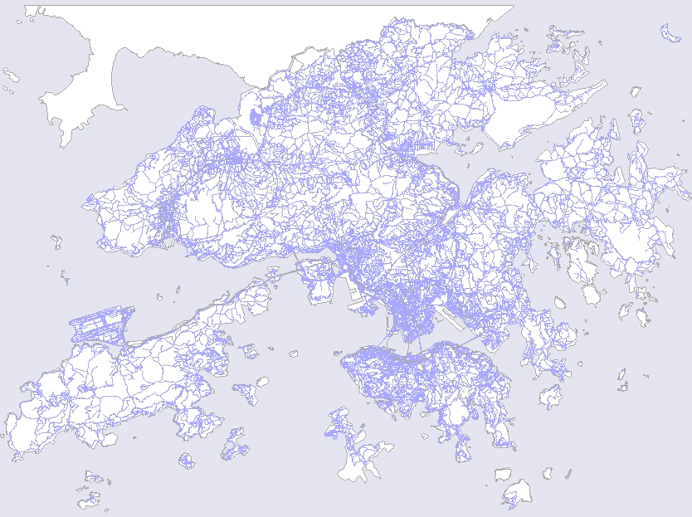
An Improved Ellipse Propagation Model for Location Estimation in facilitating Ubiquitous Computing
An Improved Ellipse Propagation Model
for Location Estimation
in facilitating Ubiquitous Computing
Presenter : Junyang Zhou
Supervisor : Dr. Joseph Kee-yin Ng
Co-Supervisor: Dr. Jianliang Xu

Slide 2
Outline
An Improved Ellipse Propagation Model for Location Estimation in facilitating Ubiquitous Computing
1. Introduction
2. Related Works
3. The Iterative Algorithm under EPM
4. Simulation Results
5. Future work
6. Q & A

Slide 3
1. Introduction
An Improved Ellipse Propagation Model for Location Estimation in facilitating Ubiquitous Computing

Slide 4
Positioning Technology
An Improved Ellipse Propagation Model for Location Estimation in facilitating Ubiquitous Computing
Global Positioning System (GPS)
  A GPS receiver measures the distances from 3 or more satellites and utilize a mathematical method, called “Triangulation” to calculate the actual position
  Blind Spot Problem: Signals from the satellites would be blocked, and reflected by tall buildings.
  Compensations
    Position Reckoning: Electronic Compass, and Speedometer
    Ground Stations

Slide 5
Positioning Technology
An Improved Ellipse Propagation Model for Location Estimation in facilitating Ubiquitous Computing
Location Estimation based on Radio Cellular Phone Network
  CDMA: ToA, TDoA, E-OTD, AoA
  GSM: Signal Strength Based Algorithms
  Feasible for Metropolitan areas like Hong Kong

Slide 6

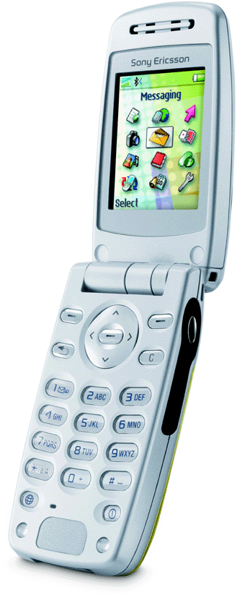

GSM Network
An Improved Ellipse Propagation Model for Location Estimation in facilitating Ubiquitous Computing
SS = -62
TA = 2
Serving Cell
SS = -60
SS = -56
SS = -70
SS = -82

Slide 7
2. Related works
An Improved Ellipse Propagation Model for Location Estimation in facilitating Ubiquitous Computing

Slide 8
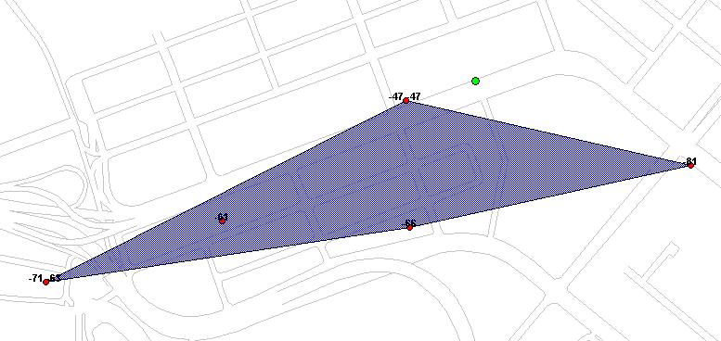

Center of Gravity Algorithm (CG)
An Improved Ellipse Propagation Model for Location Estimation in facilitating Ubiquitous Computing
The “CG” estimation is always within the convex hull regardless the actual position of the MS is inside or outside this convex hull area

Slide 9

Circular Trilateration Algorithm (CT)
An Improved Ellipse Propagation Model for Location Estimation in facilitating Ubiquitous Computing
Transmitter
r3
r2
r1
These three circles may not always
intersect in the same point
Estimated
mobile location

Slide 10
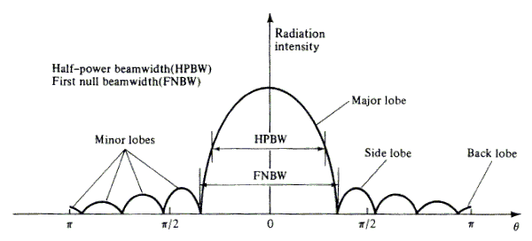
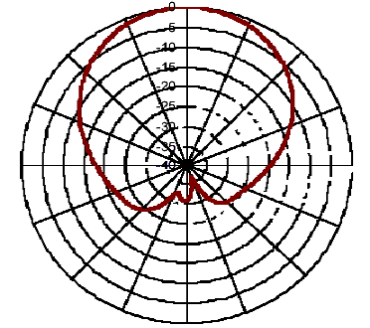
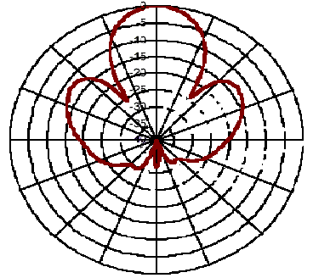
The Directional Antenna
An Improved Ellipse Propagation Model for Location Estimation in facilitating Ubiquitous Computing

Slide 11
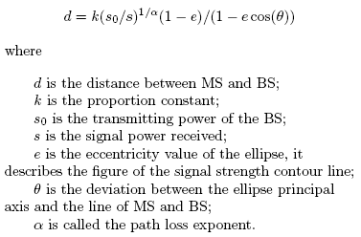
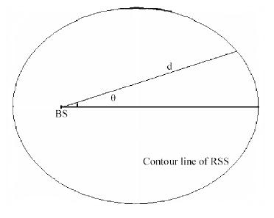
The Ellipse Propagation Model
An Improved Ellipse Propagation Model for Location Estimation in facilitating Ubiquitous Computing
Consider the contour line of the signal strength as an ellipse

Slide 12

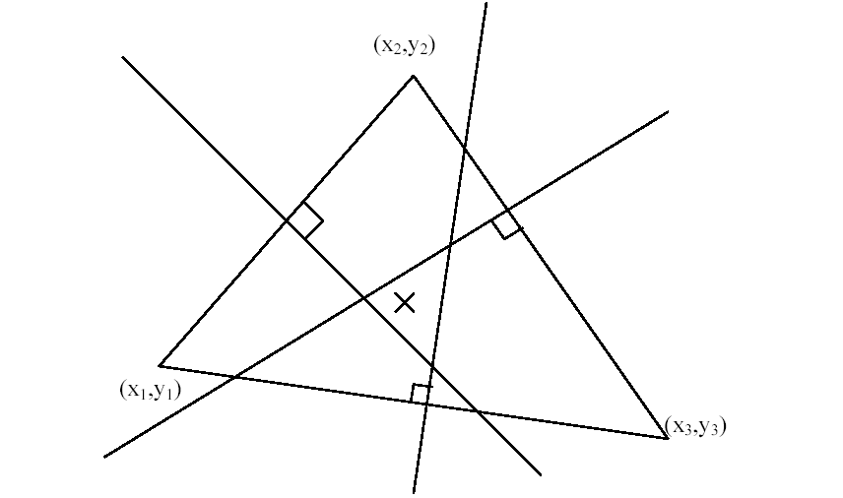
The Geometric Algorithm under EPM
An Improved Ellipse Propagation Model for Location Estimation in facilitating Ubiquitous Computing
Use three base stations not in a line to provide the MS location
Choose the “cross point” as the estimation of the Geometric Algorithm

Slide 13
3. The Iterative Algorithm under EPM
An Improved Ellipse Propagation Model for Location Estimation in facilitating Ubiquitous Computing

Slide 14
Motivation:
An Improved Ellipse Propagation Model for Location Estimation in facilitating Ubiquitous Computing
One parameter of EPM is fixed in the Geometric Algorithm, errors may be induced as the surrounding environment changes
The Iterative Algorithm is used to improve the Geometric Algorithm and to provide a more accurate and stable estimation

Slide 15
Idea:
An Improved Ellipse Propagation Model for Location Estimation in facilitating Ubiquitous Computing
Use EPM to translate the signal strength into the distance
Consider the real location of the mobile station as the conditional expectation of the information of signal strengths and the base station locations
Consider the estimation of the mobile station as the certain part of the conditional expectation
Build up the iterative formula to provide the estimation
Choose the convergence point as the estimation of the MS location

Slide 16


Structure of the Iterative Algorithm
An Improved Ellipse Propagation Model for Location Estimation in facilitating Ubiquitous Computing
Consider the “real” location is the conditional expectation
Rewrite it as two parts: one is certain, one is uncertain.
Choose the certain terms as the estimation of the location of the MS

Slide 17

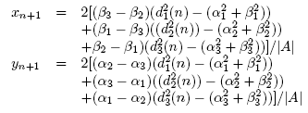

Using Geometric Algorithm with Iterative Algorithm
An Improved Ellipse Propagation Model for Location Estimation in facilitating Ubiquitous Computing
Define the deviation as:
The iterative formulas under the Geometric Algorithm
The Iterative formulas can be rewritten as

Slide 18

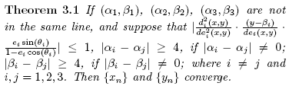
Convergence of the Iterative Algorithm
An Improved Ellipse Propagation Model for Location Estimation in facilitating Ubiquitous Computing
Define two distance functions
The Convergence Theory
The key points of the proof

Slide 19
4. Simulation Results
An Improved Ellipse Propagation Model for Location Estimation in facilitating Ubiquitous Computing

Slide 20
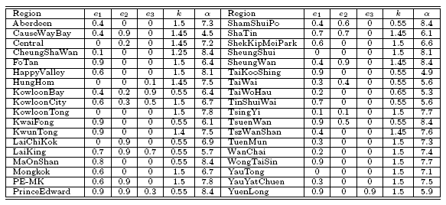
Estimating the EPM patameters
An Improved Ellipse Propagation Model for Location Estimation in facilitating Ubiquitous Computing
The Lookup Table

Slide 21
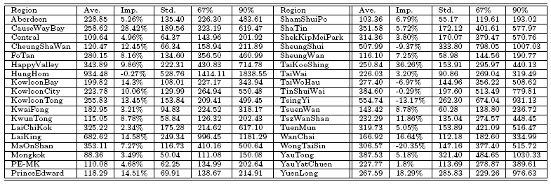
Results of the Iterative Algorithm
An Improved Ellipse Propagation Model for Location Estimation in facilitating Ubiquitous Computing
The Iterative Algorithm result and improvement over
the Geometric Algorithm

Slide 22

Compare among CG, CT and Geometric Algorithm
An Improved Ellipse Propagation Model for Location Estimation in facilitating Ubiquitous Computing
Compare among the CG, CT, Geometric and Iterative Algorithm
and improvement

Slide 23
5. Futrue work
An Improved Ellipse Propagation Model for Location Estimation in facilitating Ubiquitous Computing
1. Use the TA information to provide the MS location
2. Extend the EPM into a 3-D model
3. Find out a filter to handle the signal fluctuation problem

Slide 24
6. Q&A
An Improved Ellipse Propagation Model for Location Estimation in facilitating Ubiquitous Computing

