Slide 1

A New Approach to Mobile Location Estimation within a Radio Cellular Network
A New Approach to
Mobile Location Estimation within a Radio Cellular Network
Presenter: Junyang Zhou
Department of Computer Science
Hong Kong Baptist University

Slide 2
Outlines
A New Approach to Mobile Location Estimation within a Radio Cellular Network
1. Introduction
2. Signal Propagation Model
3. Estimation Method of Model Parameter
4. Bayes Estimate with a Normal prior distribution
5. Location Estimation Method
6. Simulation Results
7. Conclusions and Future works
8. Q & A

Slide 3
1. Introduction
A New Approach to Mobile Location Estimation within a Radio Cellular Network

Slide 4
A New Approach to Mobile Location Estimation within a Radio Cellular Network
Mobile Location Estimation is receiving considerable attention in the field of wireless communications for its great potential in different kinds of applications such as logistics, tourism and entertainment
Although GPS is widely used for location estimation, it may not provide accurate result in metropolitan area, like Hong Kong
Blind Spot Problem: Signals from the satellites would be blocked, and reflected by tall buildings.

Slide 5
A New Approach to Mobile Location Estimation within a Radio Cellular Network
Many algorithms have been proposed:
AOA, TOA, TDOA, EOTD
These methods are only applicable to CDMA network
The signal strength is the common attribute of all radio cellular networks
Signal strength-based positioning algorithms
1. Geometric Model: CG, CT, EPM
2. Statistical Model: SPM, DPM

Slide 6
2. Signal Propagation Model
A New Approach to Mobile Location Estimation within a Radio Cellular Network

Slide 7
Uniform Signal Propagation Model (USPM)
A New Approach to Mobile Location Estimation within a Radio Cellular Network
The formula of USPM
µ = f + g*ln(d)
Where µ is the received signal strength in decibels
d is the distance between the BS and the MS
f and g are two functions about the surrounding factors
It can be used to describe all the propagation models mentioned in this paper

Slide 8
A New Approach to Mobile Location Estimation within a Radio Cellular Network
a) Free Space Propagation Model: Given by Kaveh Pahlavan
P_{r}= (P_{t}G_{t}G_{r}λ²)/((4π)²Ld²)
It can be rewritten as:
-ln(P_{r}) = -ln(P_{t}) - ln(G_{t}G_{r}λ²/[(4π)²L]) + 2 ln(d)
where f = -ln(P_{t}) - ln(G_{t}G_{r}λ²/[(4π)²L]) , g = 2
b) The Statistical Propagation Model (SPM)
µ = p +β₀+(β₁+β₂ *δ )*ln(d)
where f = p + β₀ , g = (β₁+β₂ *δ)

Slide 9
A New Approach to Mobile Location Estimation within a Radio Cellular Network
c) The Ellipse Propagation Model (EPM )
d = k(s₀/s)^{1/α}*(1-e)/(1-e*cos(δ))
It can be rewritten as:
-ln(s) = -ln(s₀)–α*ln(k*(1-e))+α*ln(1-e*cos(δ))+α*ln(d)
It is similar with the following model:
µ = p + β₀ + β₁cos(δ) +β₂ln(d)
where f = p + β₀ + β₁cos(δ) , g = β₂
d) The Directional Propagation Model (DPM)
µ = p+β₀+β₁g+β₂ log(h)+(β₃ + β₄log(h)+ β₅e)*ln(d)
where f = p + β₀ + β₁g + β₂ log(h) ,
g = β₃ + β₄log(h)+ β₅e

Slide 10
A New Approach to Mobile Location Estimation within a Radio Cellular Network
To combine the merits of SPM, EPM and DPM, we present a
new directional signal propagation model, and name it as the
Modified Directional Propagation Model (MDPM)
The Modified Directional Propagation Model (MDPM)
µ = p +β₀ +β₁cos(δ) + β₂log(h) + β₆h
+ ( β₃ + β₄log(h) +β₅e)*ln(d)
where f = p + β₀ + β₁cos(δ) + β₂log(h) + β₆h ,
g = β₃ + β₄log(h) +β₅e

Slide 11
3. Estimation Method of Model Parameter
A New Approach to Mobile Location Estimation within a Radio Cellular Network

Slide 12
a) Structure
A New Approach to Mobile Location Estimation within a Radio Cellular Network
RSS, s, follows a Guassian distribution and its p.d.f.
  p( s |β,σ²) = exp{-0.5*(s-µ(β))²/σ²}/sqrt(2π)
Given the parameter β has its prior distribution π(β),
then we can derive the posterior p.d.f. of β
p(β| s, σ²) = π(β)*p( s |β,σ²)/p(s|σ²)
Maximize this above posterior p.d.f. to provide the estimation of β.

Slide 13
b) Data Collection
A New Approach to Mobile Location Estimation within a Radio Cellular Network
According to the GSM specification, the range of the received signal strength, RSS, is between -29dBm and
-114dBm.
Divide the data into two types:
a) Sufficient Data
b) Insufficient Data
The likelihood function p( s |β,σ²) for an antenna
p( s | β,σ² ) = likelihood function of sufficient data *
likelihood function of insufficient data

Slide 14
c) Parameter Estimation
A New Approach to Mobile Location Estimation within a Radio Cellular Network
Given that the likelihood function p( s |β,σ²) based on β and σ² and the prior distribution of β, π(β), then we can derive the posterior p.d.f. of β
p(β| s, σ²) = π(β) p( s |β,σ²)/p( s |σ²)
Maximize the above p.d.f. to provide the estimation of β
Define SSE = ∑(s_{i} - µ_{i}(β_{BE}))², then σ² = SSE/(n - r)
Use an iterative method to give the value of β and σ²

Slide 15
4. Bayes Estimate with a Normal prior distributioin
A New Approach to Mobile Location Estimation within a Radio Cellular Network

Slide 16

Consider a linear regression model
A New Approach to Mobile Location Estimation within a Radio Cellular Network
where Y is a 1 x n vector , βis a 1 x r vector, X is n x r matrix, and εis a 1 x r random vector and obeys a multi-dimensional normal distribution
Assume the prior distribution of βas follows:

Slide 17

Derive an iterative formula to provide an estimation of β
A New Approach to Mobile Location Estimation within a Radio Cellular Network
where
g_{1i}(x) = (p(x+ε_{i})-p(x))/(Φ(x+ε_{i})-Φ(x)),
g_{2i}(x)=p(x)/Φ(x).
Theorem:
The above iterative formula converges. Furthermore,
It converges in only one solution.
That is to say, the likelihood function of β reaches a global
maximum in the convergence point.

Slide 18
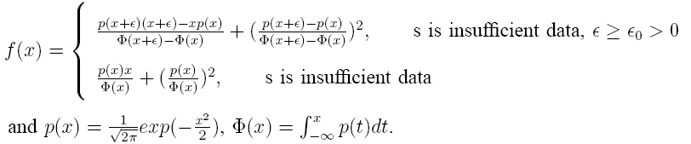

A New Approach to Mobile Location Estimation within a Radio Cellular Network
This theorem has been verified from the following lemmas
Lemma1:
where X_{i}, β_{n} and β_{n-1} are all r x 1 vectors.
Lemma2:
where
Lemma3: A_{n} is a matrix with all eigenvalues are greater
than 0 and its largest eigenvalue is less than 1.
where

Slide 19
5. Location Estimation Method
A New Approach to Mobile Location Estimation within a Radio Cellular Network
Denote the true location of MS as l = (x, y)^{T}
Given that the likelihood function of s is p(s | l, (β,σ²) ) , a function based on l and (β,σ²). And the parameters values are derived by our model.
The prior distributionπ(l) of l obeys a uniform distribution
Then derive the posterior p.d.f. of l
p( l | s, (β,σ²) ) = π(l) p(s | l, (β,σ²) )/p( s | (β,σ²) )
Based on different kinds of loss functions, we can derive different Bayes Estimate of l from the above formula.

Slide 20
6. Simulation Results
A New Approach to Mobile Location Estimation within a Radio Cellular Network
With the technical support of two mobile operators in Hong Kong, we have conducted an intensive field test in many regions in Hong Kong to validate our model
We divided the data into two parts:
  30% of the data for training
  70% of the data for testing

Slide 21
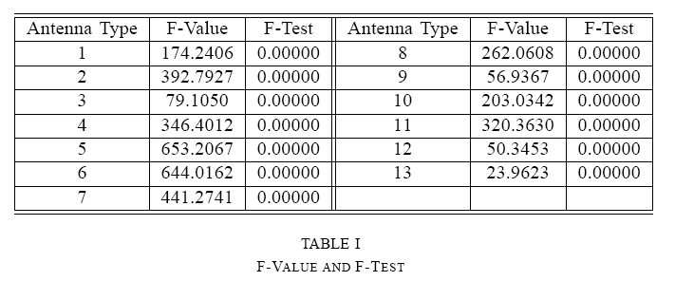
a) Importance Test on the Added Parameter
A New Approach to Mobile Location Estimation within a Radio Cellular Network

Slide 22
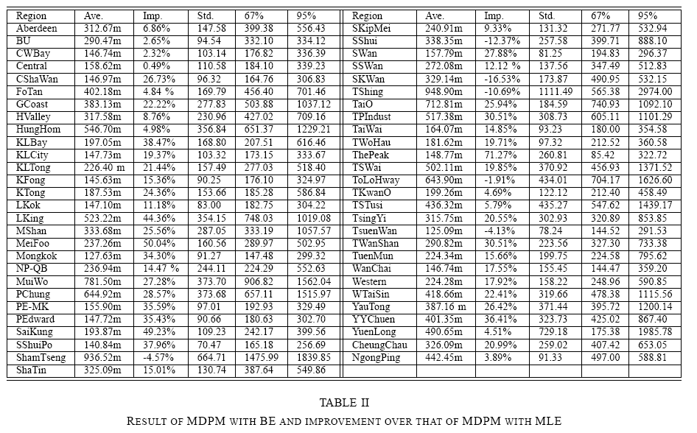
b) Results of the MDPM
A New Approach to Mobile Location Estimation within a Radio Cellular Network

Slide 23
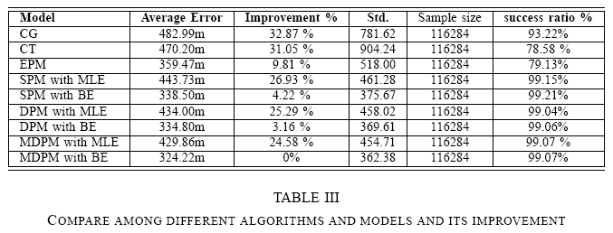
c) Compare among different algorithms
A New Approach to Mobile Location Estimation within a Radio Cellular Network

Slide 24
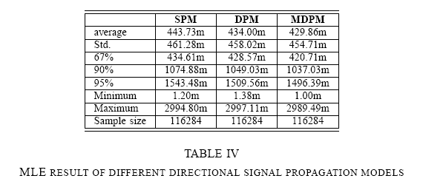
d) MLE results of different models
A New Approach to Mobile Location Estimation within a Radio Cellular Network

Slide 25
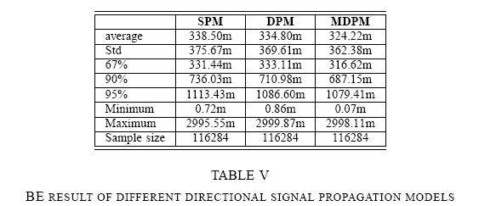
e) BE results of different models
A New Approach to Mobile Location Estimation within a Radio Cellular Network

Slide 26
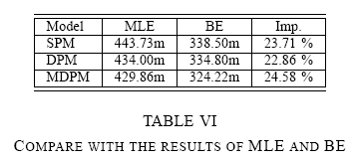
f) Compare with the results of MLE and BE
A New Approach to Mobile Location Estimation within a Radio Cellular Network

Slide 27
7. Conclusions and Future works
A New Approach to Mobile Location Estimation within a Radio Cellular Network
Conclusions:
1. The Uniform Signal Propagation Model includes all the signal propagation models we have mentioned above.
2. The Bayes Estimate reaches the global maximum of the likelihood function about the model parameter
3. Our Model (MDPM) has done the best performance among the signal propagation models (SPM, EPM, DPM)
4. The result of BE is better than that of MLE.
Future works:
Filter method to handle signal fluctuation
Selector method to combine the merits of different models

Slide 28
8. Q&A
A New Approach to Mobile Location Estimation within a Radio Cellular Network
Thanks!

