Slide 1

Not Another Twitter Project:
Automated Live Streaming
And User Outreach
Steven Zych - October 2020

Slide 2
Introduction
This project looks at using sentiment analysis, Twitter streaming, and a chatbot to enable hands-free user outreach and engagement.
The data used in this project contains over 10,000 tweets about Amazon, which I sourced myself.
Disclaimer: I have no relationship with Amazon (or any brand), data on them is just plentiful.

Slide 3
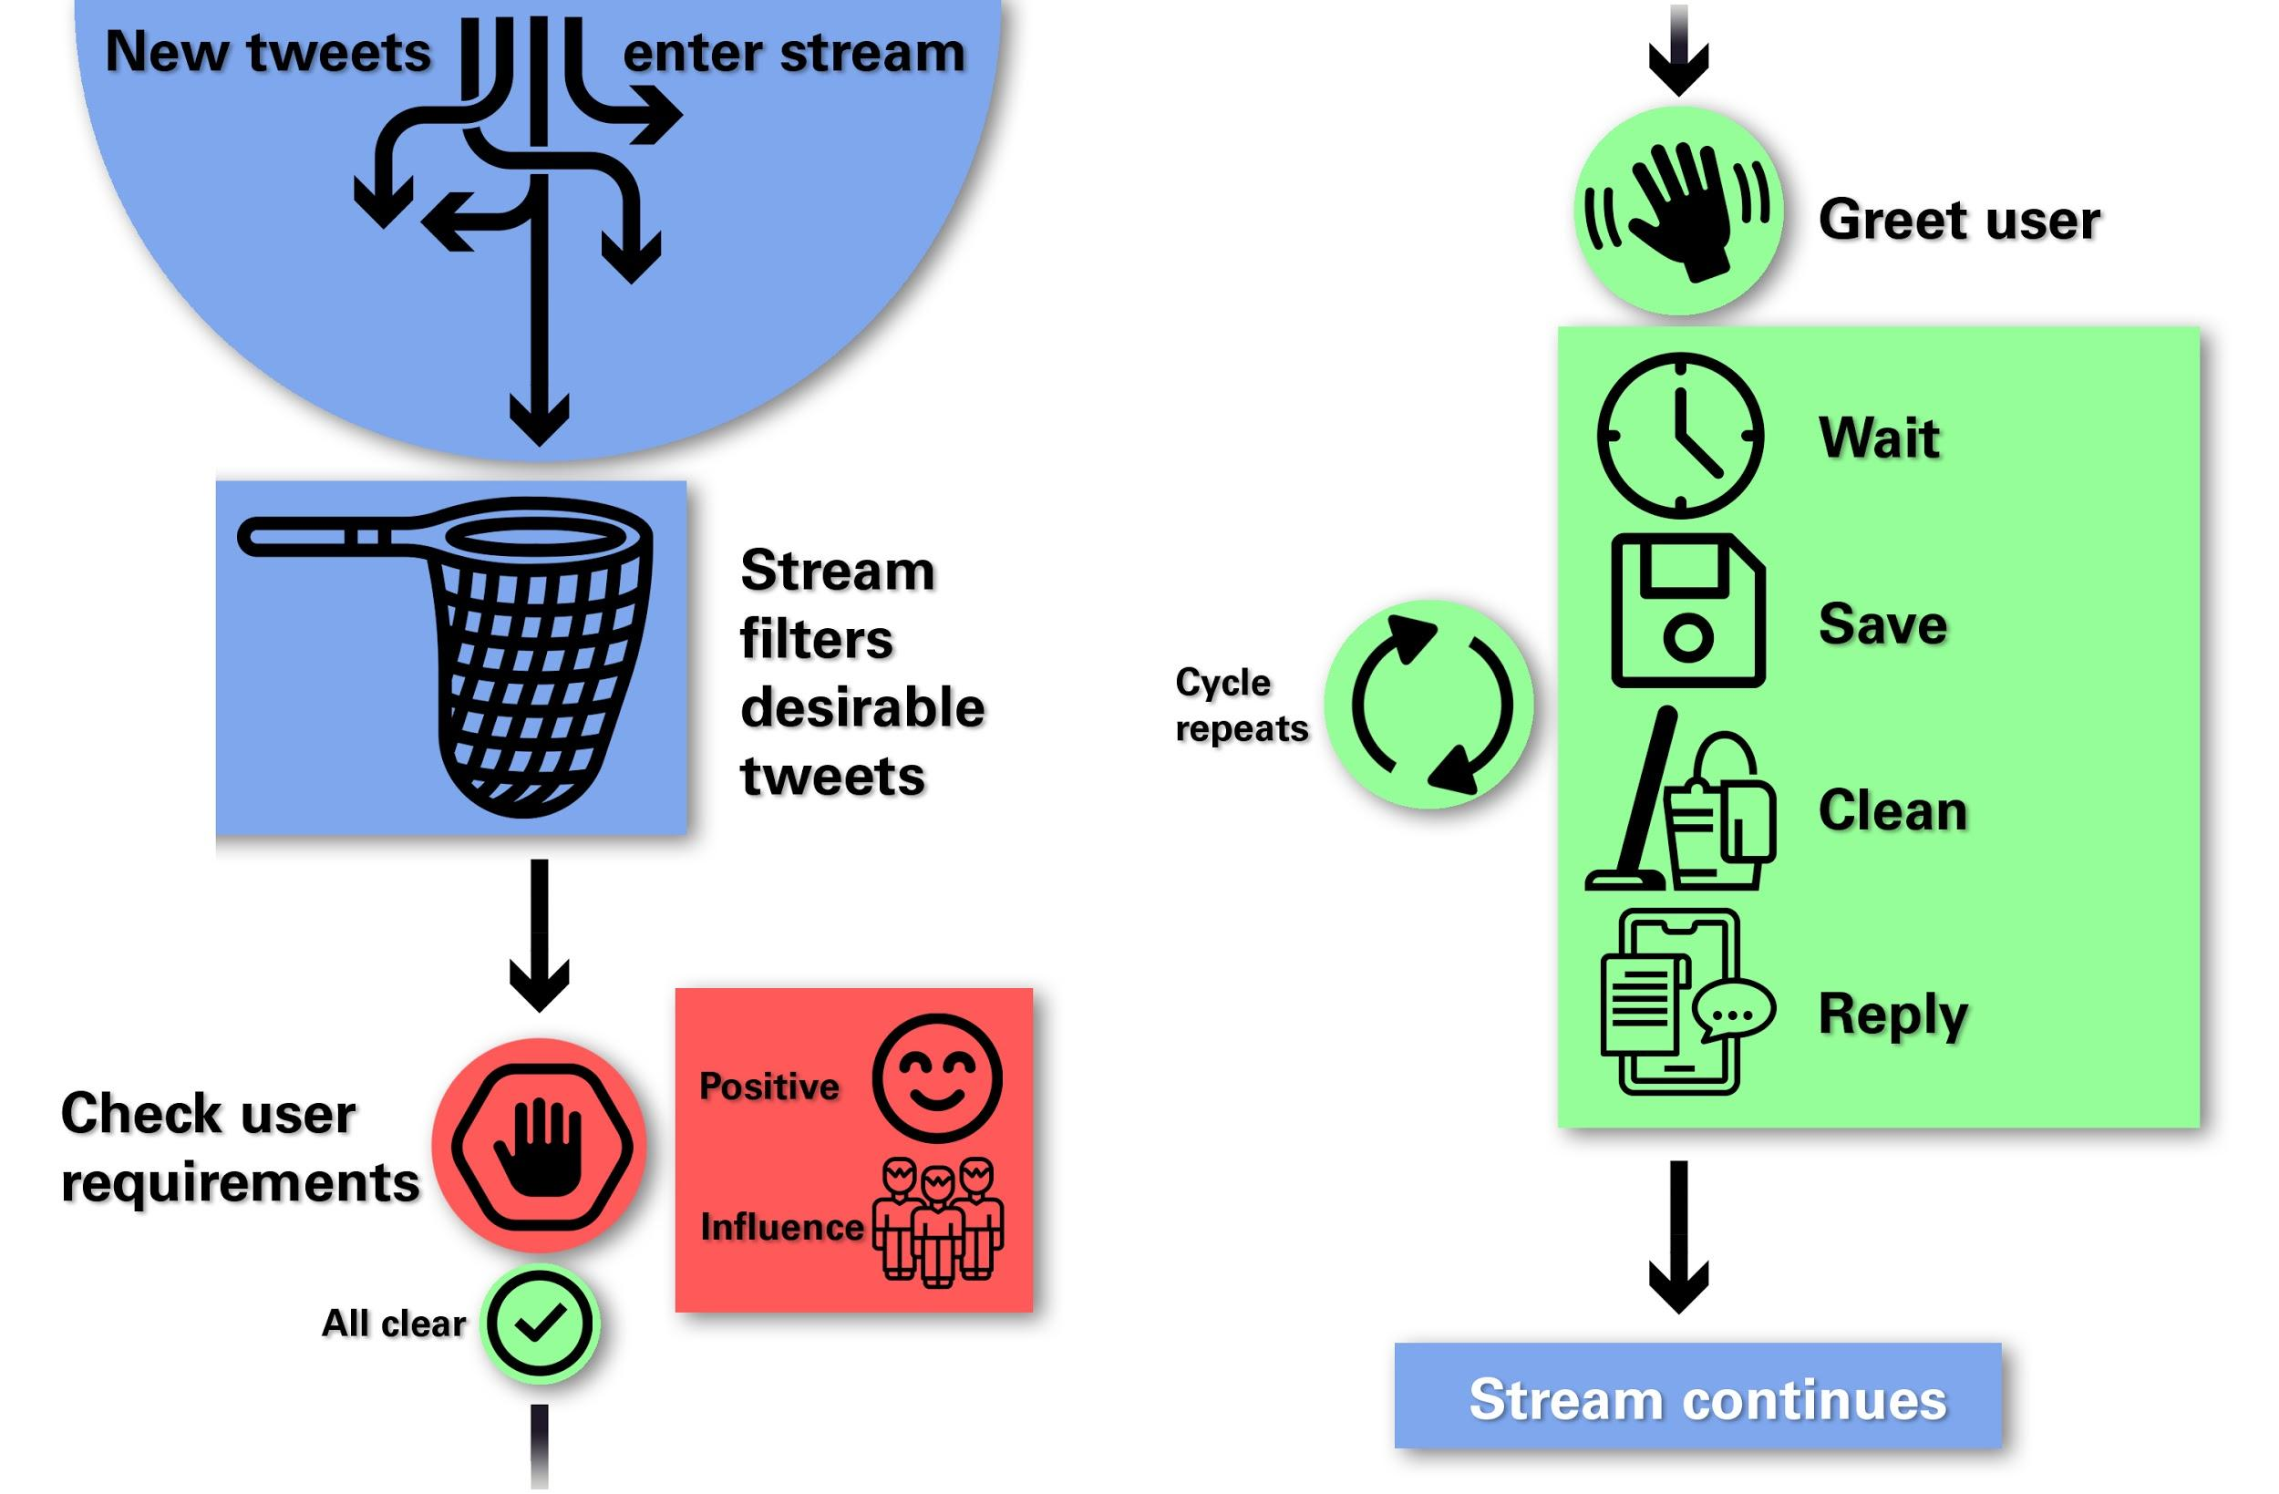

Slide 4
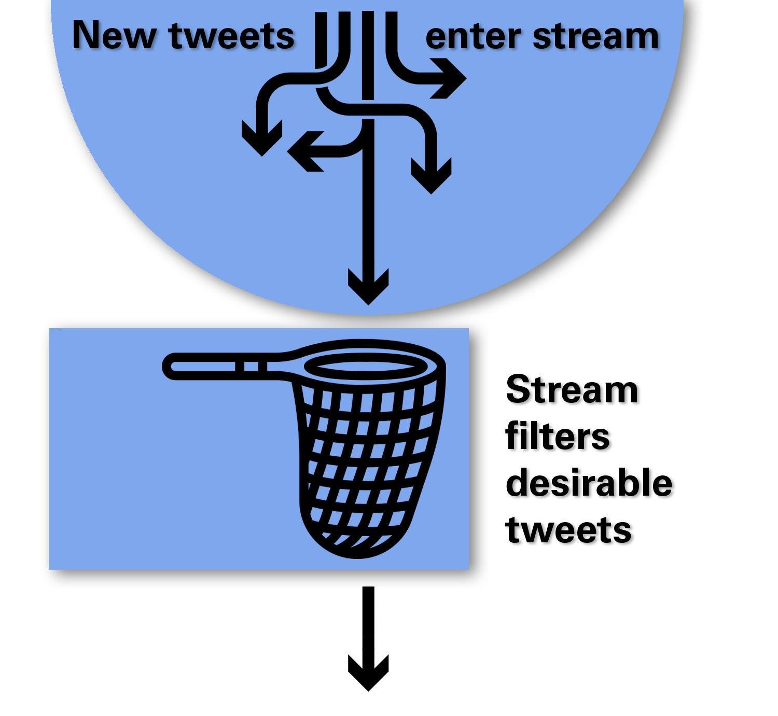
The Stream
The Twitter streamer sees everything being tweeted right now.
It sorts based on my criteria:
Tweets in English
Tweets about Amazon
Only extended messages
No retweets

Slide 5
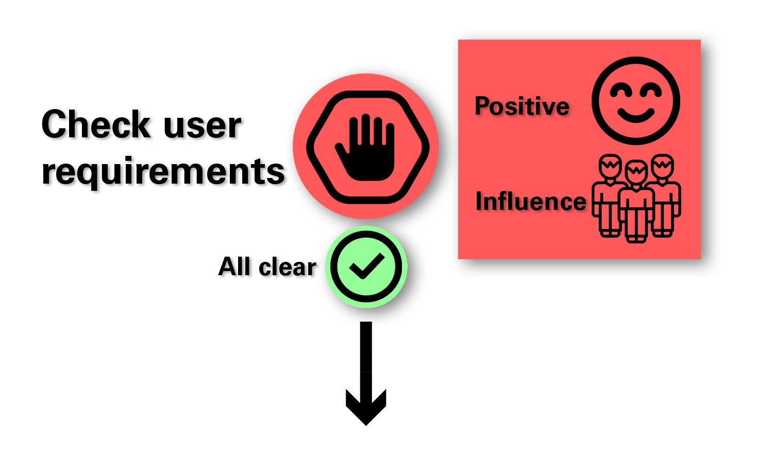
The Neural Network
The neural network is passed a tweet it can read and predicts its sentiment.
If the brand sentiment is positive and the user has enough followers:
They get the OK
A conversation begins

Slide 6
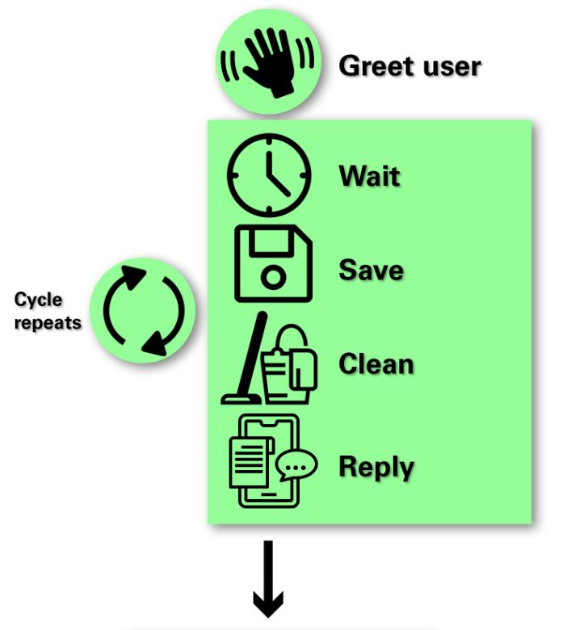
The Conversation
Each conversation is unique to the user. Allows for a more stable relationship.
The conversation follows the protocol:
Send user a greeting and invitation to work together
Wait for user to reply
Save any new direct messages to local copy
Make the messages computer-readable
Reply to the new message(s)
Repeat

Slide 7
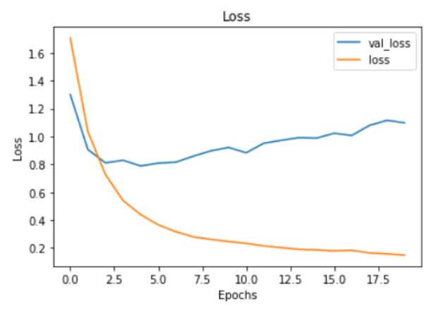
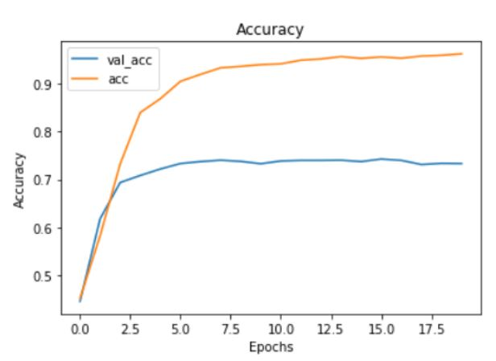
Neural Network Performance
The network used for this project suffered from overfitting. A final accuracy of 73% was achieved. (More labeled data will greatly improve performance.)

Slide 8
Business Uses
Contact positive users to initiate brand outreach for potential ad sponsorship or collaboration.
Gather data on user responses to chatbot to further improve its performance.
Re-train neural net and deploy for targeted social resources based on location.
Reach out to negative users to initiate customer service.

Slide 9
Further Research And Coming Updates
Neural network support on chatbot replies, as well as maintaining hard-coded ones.
Increase amount of manually- labeled data, as well as dataset as a whole.
Make chatbot send emails to human employees when passing on a task.
Research asynchronous execution to have multiple streams and convos at once.

Slide 10
Thank you!
An extra thank you to Abhineet Kulkarni and my
Flatiron School cohort for enduring support.

