Slide 1

King County Housing
Steven Zych - July 2020

Slide 2
Introduction
This project provides a machine learning model aimed at helping first-time buyers purchase a home in or around Seattle, WA.
All data comes from Kaggle, from May 2014 to May 2015.
Notes:
"What factors bring down the price of a house the most, with least impact to overall quality?"

Slide 3
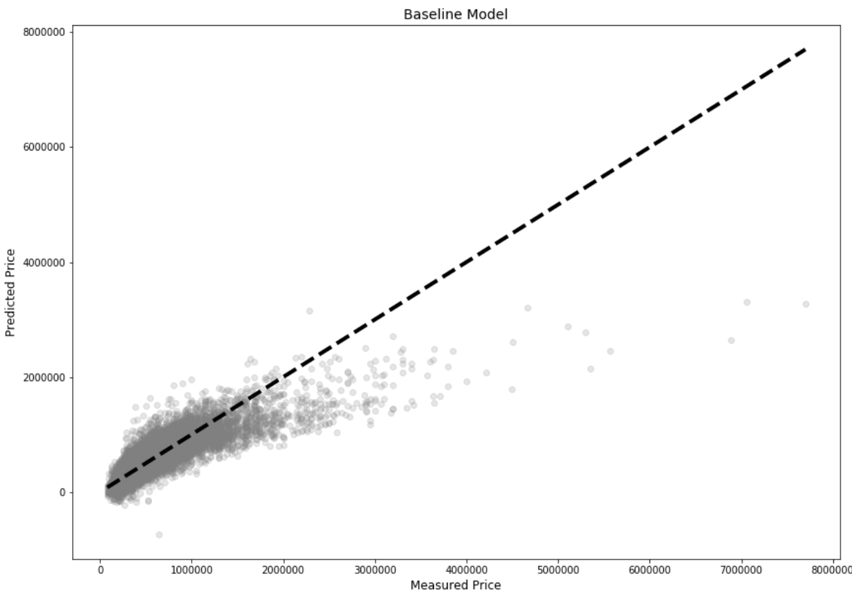
Baseline Model
All following models are based on this one and aim to improve these numbers.
R² of 0.692
RMSE of $213,446.

Slide 4
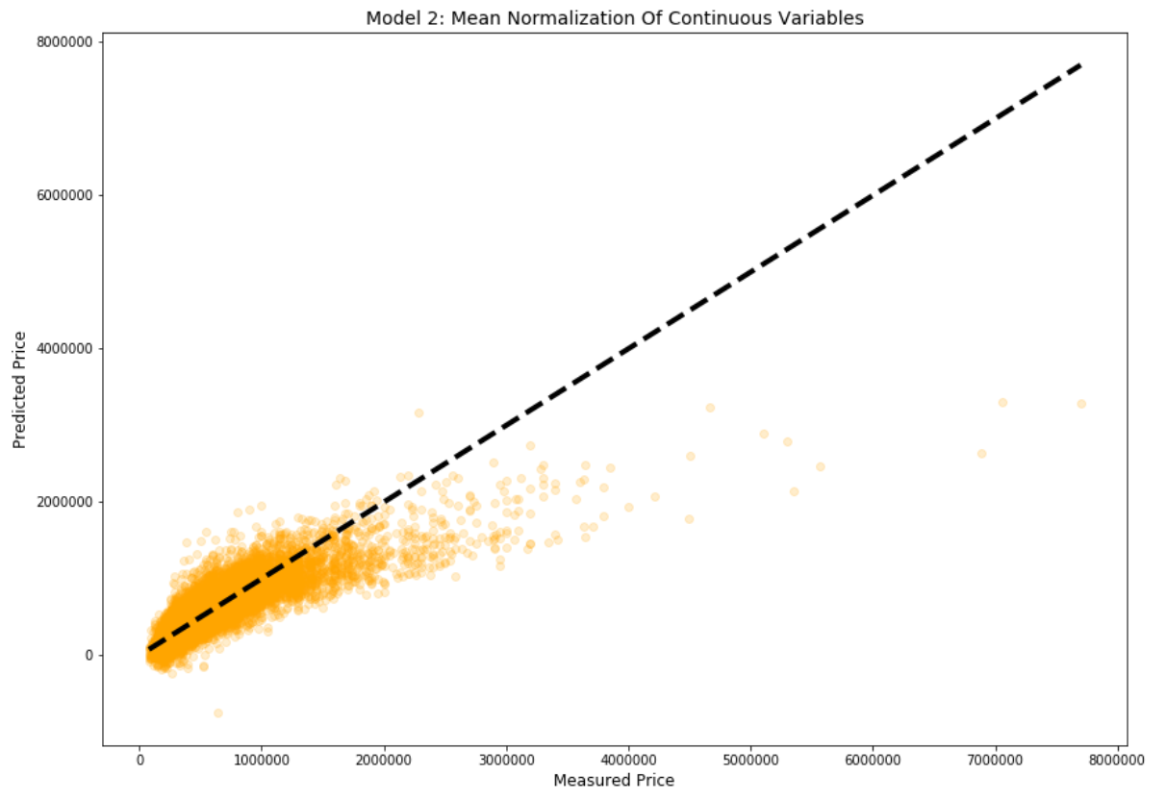
Model 2: Mean Normalization of Continuous Variables
Almost no visible change from previous model.
Most of the work here happening “under the hood.”
R² of 0.689
RMSE of $213,306

Slide 5
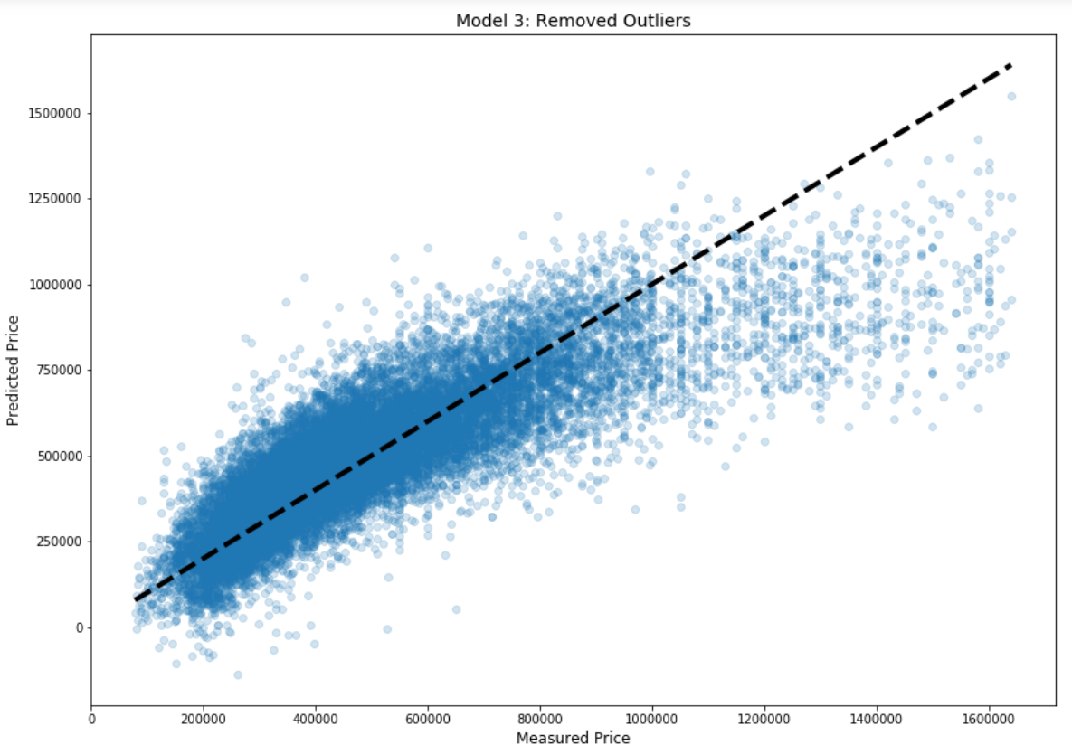
Model 3: Removing Outliers
Significant improvements, plot becomes more readable.
Extremely pricey and large homes removed from data.
R² of 0.693
RMSE of $137,906

Slide 6
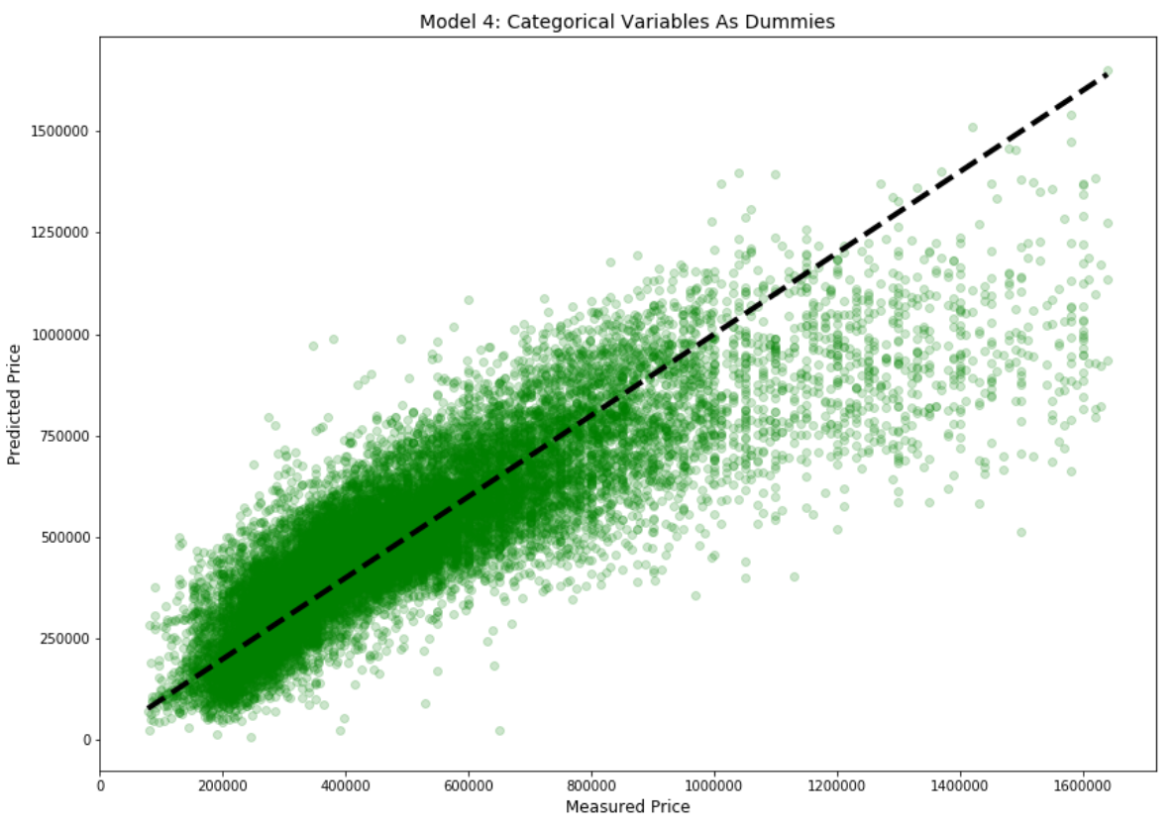
Model 4: Categorical Variables As Dummies
Marginal improvements on RMSE, but R² much better.
First model where location plays a major role.
R² of 0.721
RMSE of $133,961

Slide 7
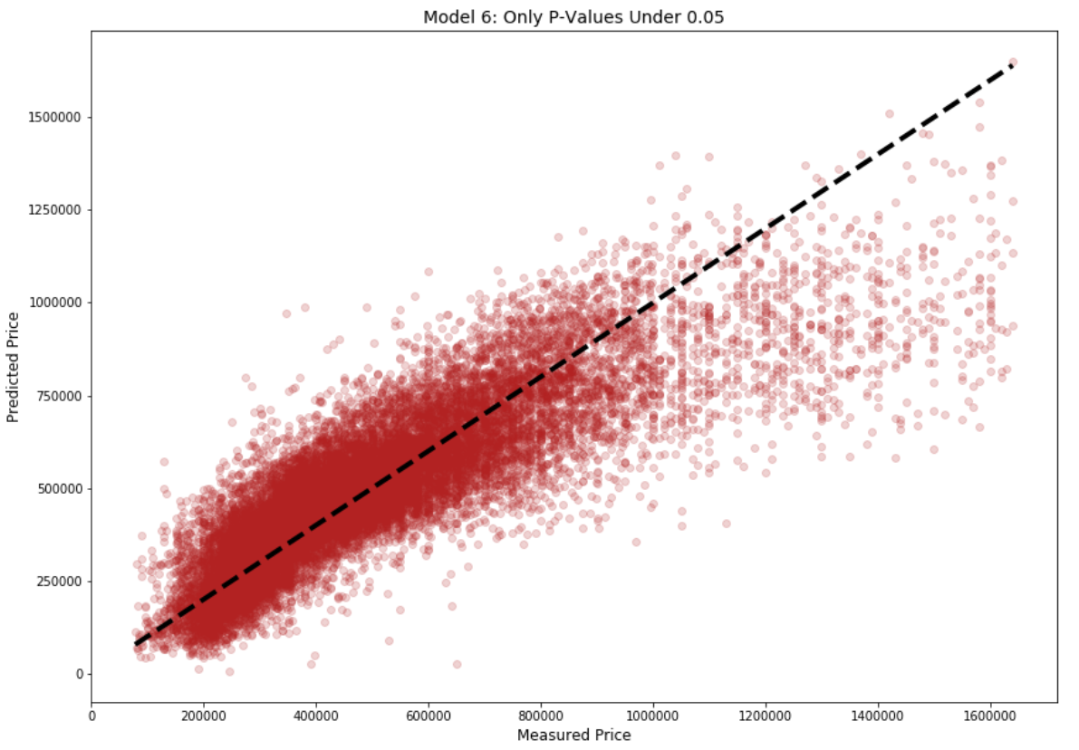
Model 6: Only P-Values Under 0.05
(Model 5 omitted from presentation for time.)
This model uses only the most reliable predictors in the dataset.
It is the final model.
R² of 0.721
RMSE of $135,925

Slide 8
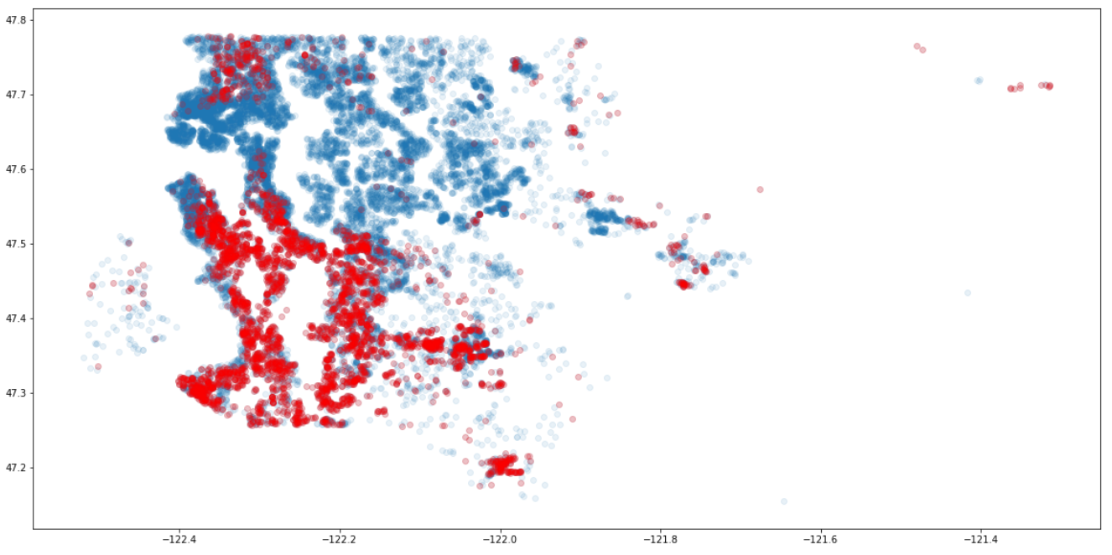
Key Findings
1. Buy south of Mercer Island.
2. Buy where neighbors have big yards.
3. Don’t get a basement.
4. Don’t live on the waterfront.
Red dots are homes ≤ $300K.

Slide 9
Further Research Goals
1. RMSE value is tolerable as-is, but seriously needs to be reduced.
2. More locational data. Sorting zipcodes into cities instead of just using lat and long.
3. Look at relationship between proximity to cultural institution and price.
4. Look at demographic info to avoid gentrification.

Slide 10
Thank you, and happy house hunting!

