Slide 1

Tanzanian Wells:
Assessing Water Source Failure With Machine Learning
Steven Zych - August 2020
Notes:
Fun fact: The blue symbolizes the Indian Ocean as well as the countries many lakes and rivers (Wikipedia).

Slide 2
Introduction
Machine learning for the Gov’t of Tanzania to predict water well failure, and combat the effects of drought-prone dry season.
Data is available at DrivenData and contains information on ~59K wells, and classifies wells as functional, functional-needs-repairs, and nonfunctional.
Notes:
Combat the effects of drough-prone dry season.

Slide 3
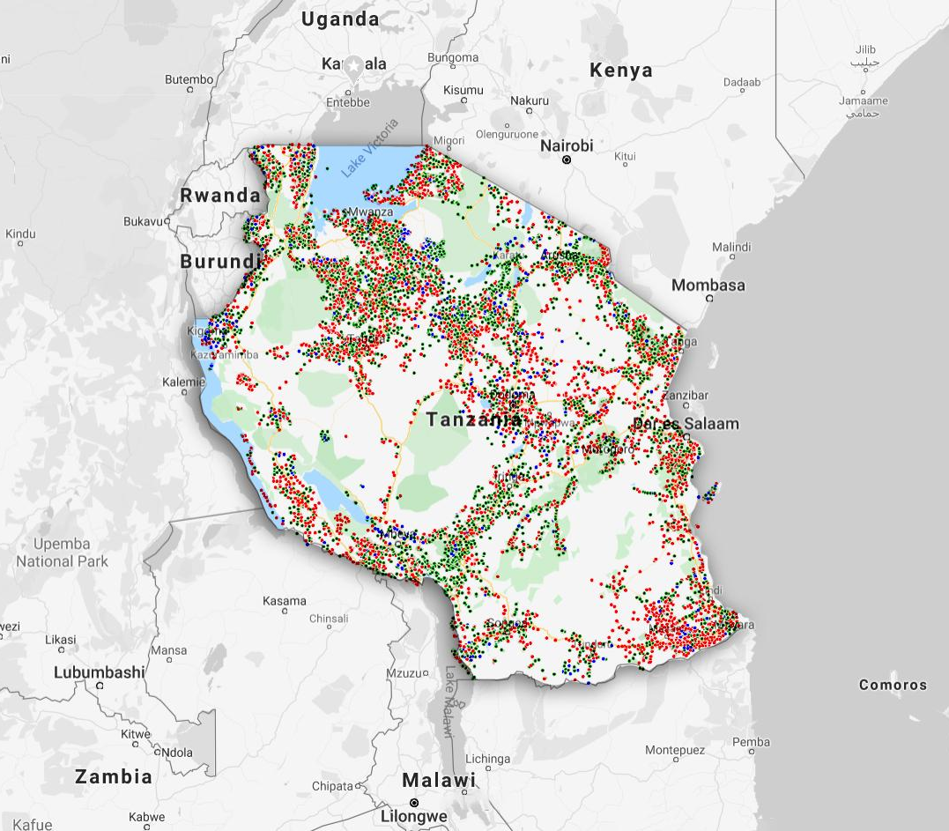
A Quick Preview Of The Data
This map shows each dot as a well, overlaid on Tanzania, the colors mean:
Functional
Functional-needs-repairs
Nonfunctional

Slide 4
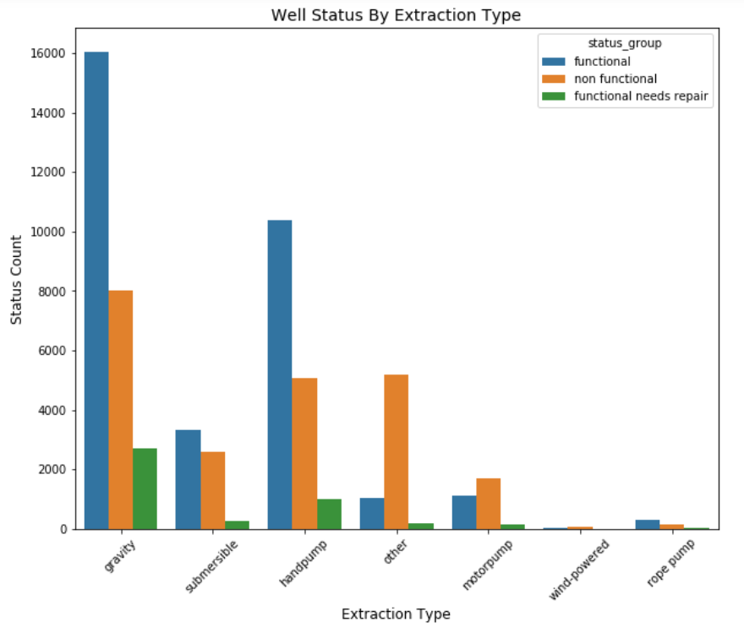
Extraction Methods
Extraction method “other” proved most problematic.
Highest percentage of nonfunctional wells.

Slide 5
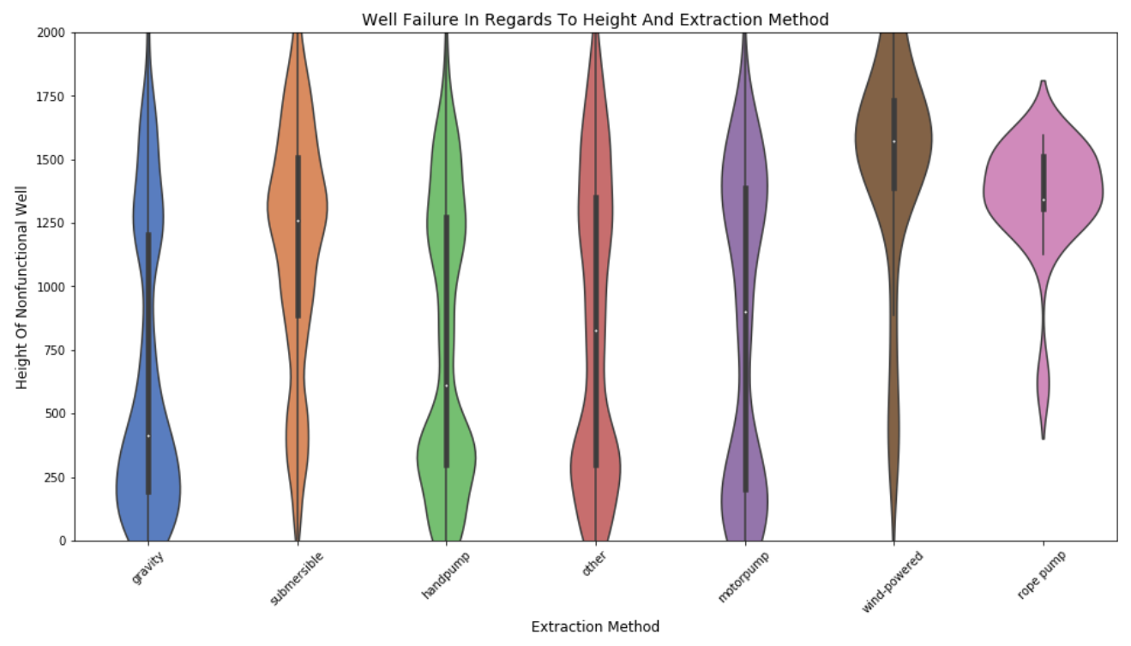
Height And Extraction Methods
Extraction method failure depends on height.
Notice rope and gravity pumps.

Slide 6
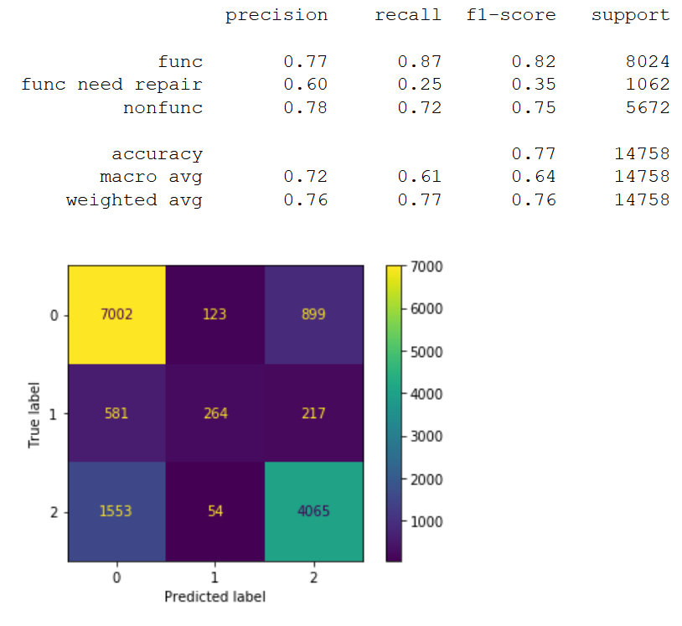
Classification Model Performance
77% accuracy overall.
Best at predicting functional and nonfunctional well status.
Partially affected by a class imbalance.

Slide 7
Recommendations & Further Research
Investigate relationship between height and extraction method and well functionality.
Address potential reporting bias from data collection based on time of year/weather
Dig deeper into ML classifier to improve predictions on nonfunctional wells (most vital).
See if machine learning model works in other East African nations.

Slide 8
Thank you!
Asante sana!

Slide 9
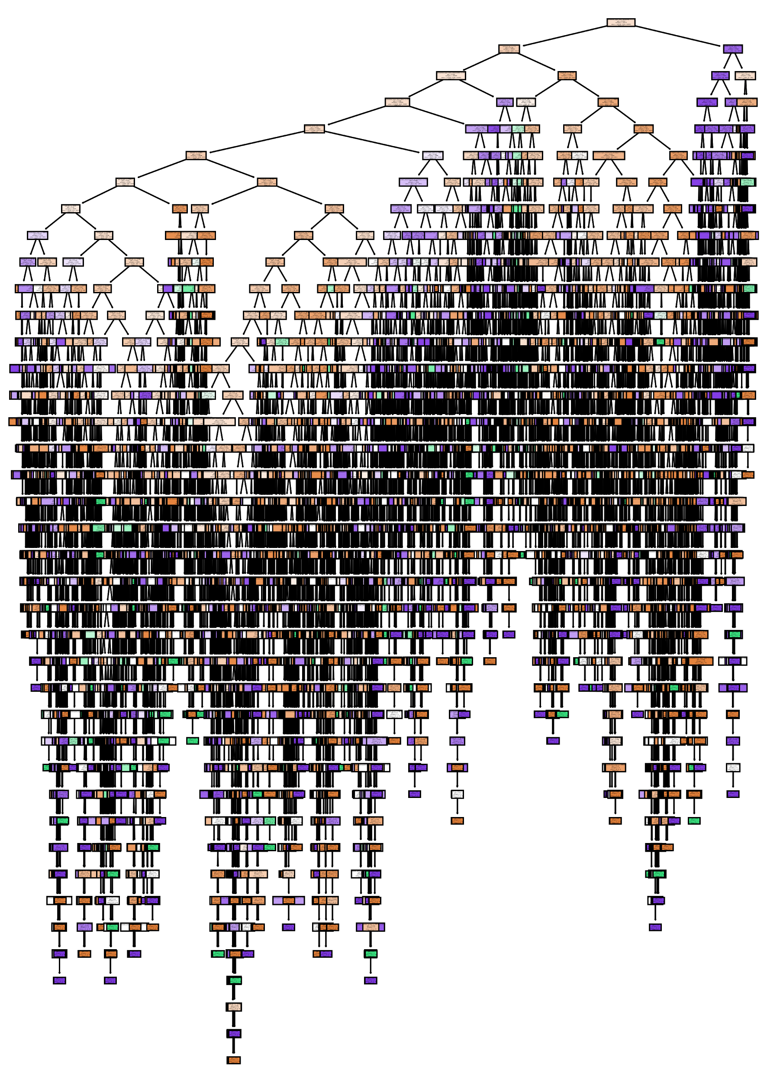
Appendix
Example of decision tree, unpruned:
Full summary of the chosen RF model:

Slide 10
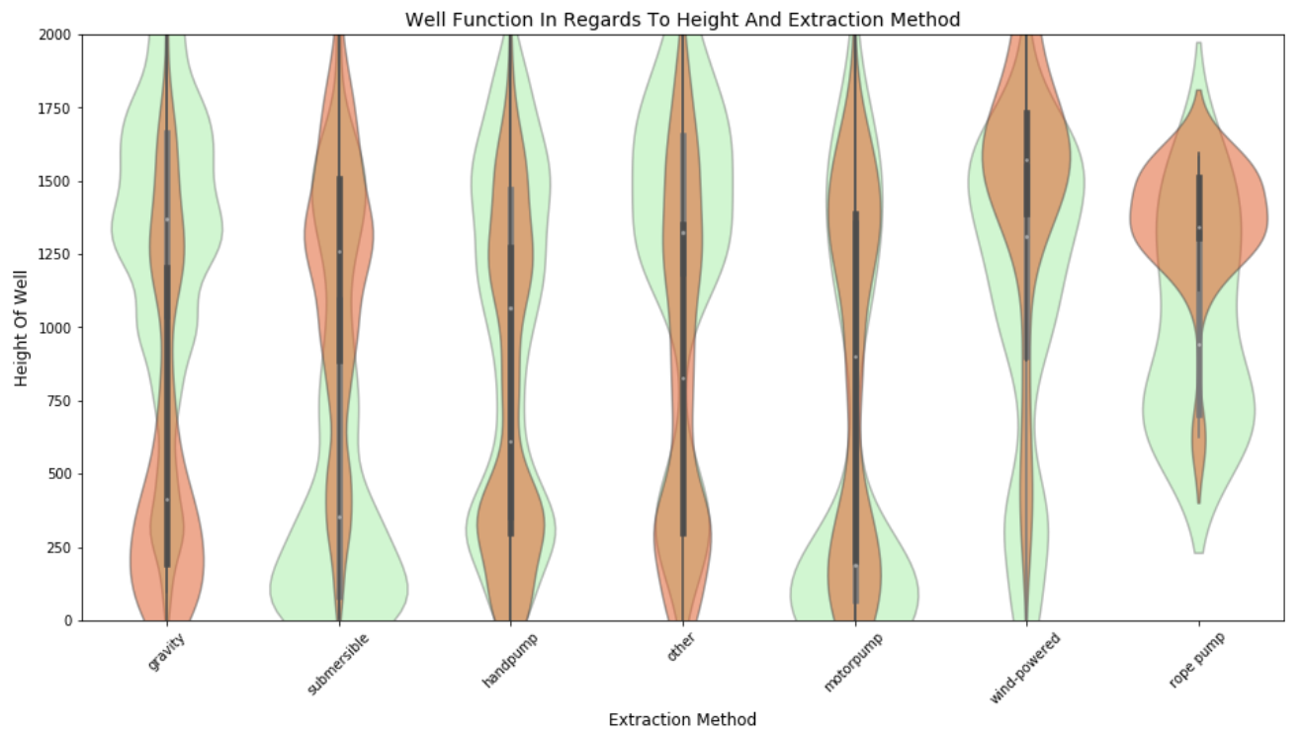
Appendix
Overlay violin plot of amount of functional (green) and nonfunctional (red) wells based on extraction method and GPS height (height zero values removed):

