Slide 1

Tweet Sentiment:
Analyzing Public Opinion Through Natural Language Processing
Steven Zych - September 2020

Slide 2
Introduction
This project uses NLP (natural language processing) to see how Twitter users feel about Google, Apple, and their products.
Data is available at data.world. It contains 8,721 tweets, as well as their sentiment, and target brand.
Notes:
Combat the effects of drough-prone dry season.

Slide 3
Examples
Negative
.@wesley83 I have a 3G iPhone. After 3 hrs tweeting at #RISE_Austin, it was dead! I need to upgrade. Plugin stations at #SXSW.
['3g', 'iphone', '3', 'hrs', 'tweeting', 'dead', 'need', 'upgrade', 'plugin', 'stations']
Positive
@jessedee Know about @fludapp ? Awesome iPad/iPhone app that you'll likely appreciate for its design. Also, they're giving free Ts at #SXSW
['know', 'awesome', 'ipadiphone', 'app', 'youll', 'likely', 'appreciate', 'design', 'also', 'theyre', 'giving', 'free', 'ts']
Neutral
Holler Gram for iPad on the iTunes App Store - http://t.co/kfN3f5Q (via @marc_is_ken) #sxsw
['holler', 'gram', 'ipad', 'itunes', 'app', 'store', 'via']

Slide 4
Why NLP with Twitter?
Benefits:
Unfiltered, honest feedback
Nearly unlimited, constant data
Freely accessible online
Drawbacks:
Unstandardized spelling
Decentralized, no fact checking
Can be bloated by “squeaky wheels”
Notes:
Squeaky wheel = Loudest complainer

Slide 5
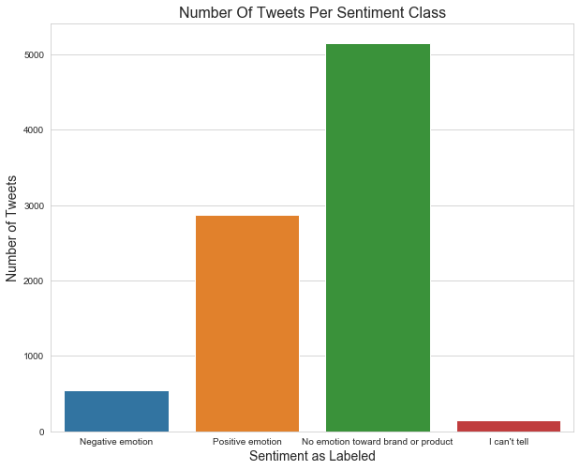
Tweets Per Sentiment
The majority of tweets in the data showed “No emotion” toward a brand.
Of the emotional tweets, positive ones dominated.

Slide 6
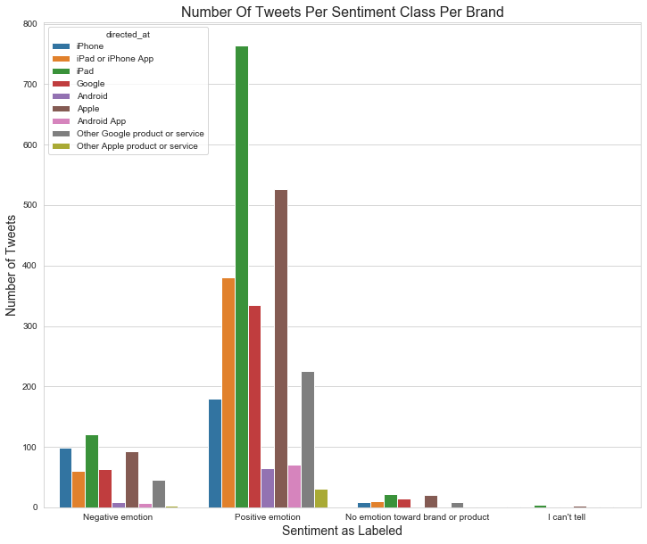
Tweets Per Sentiment Per Brand/Product
Sentiment had little impact on which brands were tweeted at most.
Positive sentiment tweets were most often directed at a brand.
Neutral tweets are almost never directed.

Slide 7
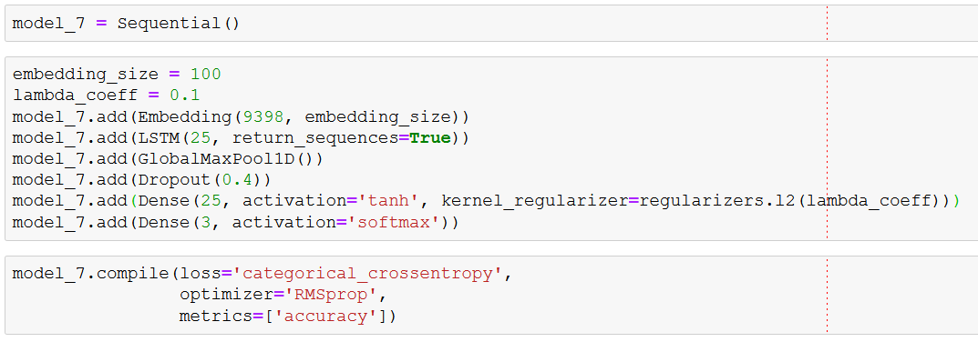
Neural Network Architecture
Seven models were compiled and trained. This was the best (and final) attempt:

Slide 8
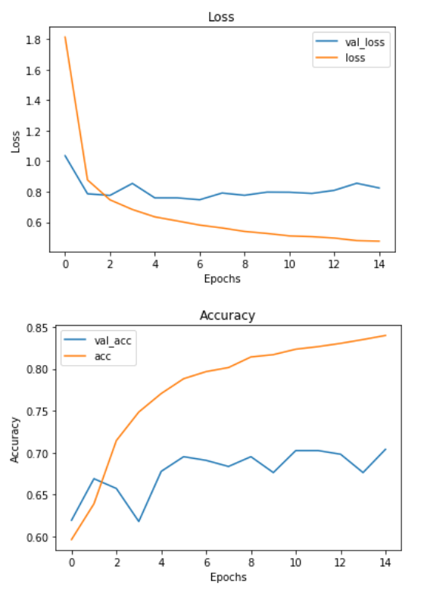
Neural Network Performance
The final model was still somewhat overfit, but performed best in terms of validation accuracy and validation loss. (Overfitting on other models was significantly more drastic, around 90% training accuracy, 60% validation accuracy.)

Slide 9
Business Applications
Filter messages by sentiment, paying most attention to the negative ones.
Use same filtering as market research on what product features cause most negativity.
Model as a barometer for general public settlement of company.
Positive-sentiment messages from popular accounts could be filtered out to make brand ambassador deals, etc.

Slide 10
Recommendations For Further Research
New model to use Emojis, emoticons, and punctuation as affect markers.
Investigate relationship between sentiment and replies / retweets.
Create a more homogenous body of data, with less linguistic variance.
Implement transfer learning trained on similar tech data.

Slide 11
Thank you!

