Slide 1

Introduction to the
Object-Relational Mapping Toolkit

Slide 2
Agenda
Overview
Generator
JavaServer Pages: Essential Components
Querying the Database
Data Manipulation
Helpful Features
Built-in Tags

Slide 3
Overview
SQLTags is a free, open source, object-relational mapping toolkit and “development framework” that provides Java developers with a new and innovative way to access and manipulate data stored within a relational database.
SQLTags is targeted, primarily, at the Java Server Pages (JSP) environment and can be easily adapted to either the, so called, “Model 1” or “Model 2” JSP Architectures.
At the SQLTags core is a generator that builds a Java class and a JSP tag for each table within a specified database schema, and a set of run-time support classes and JSP tags that facilitate database development within Java.
The generator packages everything up into a single "Java Archive" or "jar" file for easy deployment into your web server environment(s).
This “jar” file can be used within any JSP page to provide easy access to the underlying tables.

Slide 4
Install
The SQLTags home is: (you guessed it)
  http://SQLTags.org/
For the very latest and greatest visit:
  http://SQLTags.org/docs/
    sqltags-x-x-x.jar - “.jar” file has only Java code
    sqltags-x-x-x.tar.gz - “.tar” file has code, samples, and JDBC.
To Install:
  Download the “Tar” not the “Jar”
  Unzip into ./sqltags-x-x-x/aitworks-sqltags/
  Obtain JDBC driver for your database
  You’re ready!
Obtain files from the SQLTags CD-ROM!

Slide 5
Generator
Run the Generator:
  Windows:
  java -classpath sqltags-x-x-x.jar;anyJdbc.jar SQLTags
  Unix:
  java -classpath sqltags-x-x-x.jar:anyJdbc.jar SQLTags
Notes:
    Replace “sqltags-x-x-x.jar” w/ specific file & path
    Replace “anyJdbc.jar” with w/ specific JDBC driver
    Notice classpath separator is either “:” or “;”

Slide 6
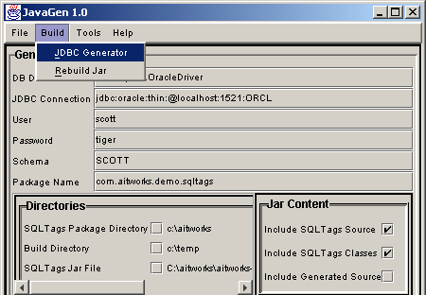
Generator
Database Driver-- requires JDBC MetaData
JDBC URL
User, Password
Schema
Package
Directories
  SQLTags
  Build
Jar File & Contents

Slide 7
Generator Notes
JDBC Drivers
  for Oracle, MySQL included in the “Tar” file
  More on the SQLTags CD-ROM
  Links on SQLTags web site
Package Name
  location for generated table and tag classes
  com.aitworks.sqltags.demo.sqltags (examples)
SQLTags Output “.jar” File
  generate directly to /WEB-INF/lib
Contents
  SQLTags Classes for single Jar
  Source code, too

Slide 8
JSP Components
Properties File-- JDBC Connection Pool
Imports-- Built-in & Generated Tags
  <%@ page import="com.aitworks.sqltags.jsptags.*
  ,com.aitworks.demo.sqltags.*” %>
Taglib-- Generated Jar
  <%@ taglib uri="/WEB-INF/lib/demoTags.jar”
  prefix="sqltags” %>
Connection-- wraps all Tags, ref Properties
  <sqltags:connection id="connect"
  initSrc="/WEB-INF/sqltags.properties">
  . . .
  </sqltags:connection>

Slide 9
Properties File
# SQLTags Properties File
#
connectionTimeToLiveSeconds=240
# JDBC URL
connectionUrl=jdbc:oracle:thin:@localhost:1521:ORCL
# Connection Limit (max)
maxPoolSize=1
# Optimum Pool Size
poolSize=1
# Initial/Minimum Pool Size (min)
minPoolSize=1
password=tiger
userName=scott
# Database Driver (Driver specific)
databaseDriver=oracle.jdbc.OracleDriver
# types that require “streams”
asciiStreamTypes=LONG
binaryStreamTypes=BLOB
characterStreamTypes=CLOB

Slide 10
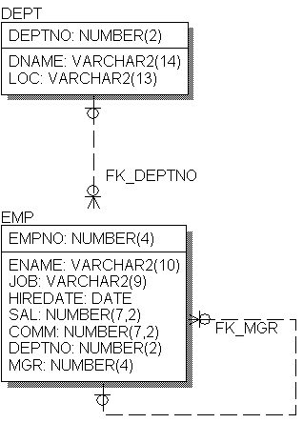
Example Data Model
The “Classic”
  EMP - DEPT Example
Critical Components
  Table Names
  Column Names
Equally as important
  Foreign Key Names
  FK_DEPTNO
  FK_MGR

Slide 11
Querying the Database
SQLTags can query the database in several ways:
  Single Table Query
  Master-Detail Nesting
  Parent Lookup
  Free-form, generic Cursor tag
Complex queries are supported with nested <where> and <fetch> tags

Slide 12
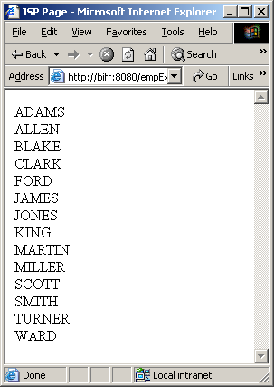
Single Table Queries
Simple Example
<%@ page import="com.aitworks.sqltags.jsptags.*,
com.aitworks.demo.sqltags.*" %>
<%@ taglib uri="/WEB-INF/lib/demoTags.jar"
prefix="sqltags" %>
<html>
<head><title>JSP Page</title></head>
<body>
<sqltags:connection id="connect"
initSrc="/WEB-INF/oracle.properties">
<sqltags:emp id="e" where="order by ENAME">
<%= e.getENAME() %><BR>
</sqltags:emp>
</sqltags:connection>
</body>
</html>

Slide 13
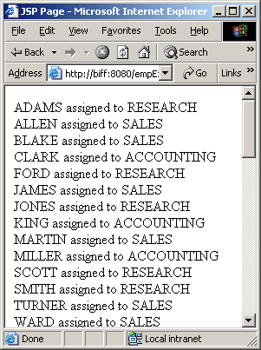
Parent FK Queries
Parent Lookup Example
<%@ page import="com.aitworks.sqltags.jsptags.*,
com.aitworks.demo.sqltags.*" %>
<%@ taglib uri="/WEB-INF/lib/demoTags.jar"
prefix="sqltags" %>
<html>
<head><title>JSP Page</title></head>
<body>
<sqltags:connection id="connect"
initSrc="/WEB-INF/oracle.properties">
<sqltags:emp id="e" where="order by ename">
<%= e.getENAME() %> assigned to
<%= e.getFK_DEPTNO_PARENT().getDNAME() %>
<BR>
</sqltags:emp>
</sqltags:connection>
</body>
</html>

Slide 14
Paging Support
Paging Support is Built-in Feature
  Set paging Attribute to “true”
  Set displaySize Attribute to desired page size
  Add a <Last> tag to identify last row or query
  Use <previous> and <next> tags to build links to next and previous pages
Example …

Slide 15
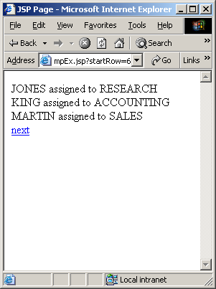
Paging Support
Paging Example
<%-- edited for space --%>
<html>
<head><title>JSP Page</title></head>
<body>
<sqltags:connection id="connect"
initSrc="/WEB-INF/oracle.properties">
<sqltags:emp paging=“true” displaySize=“3”
id="e" where="order by ename">
<%= e.getENAME() %> assigned to
<%= e.getFK_DEPTNO_PARENT().getDNAME() %>
<BR>
<sqltags:last name="e">
<sqltags:next href="empEx.jsp"
parentName="e">next
</sqltags:next>
</sqltags:last>
</sqltags:emp>
</sqltags:connection>
<%-- edited for space --%>

Slide 16
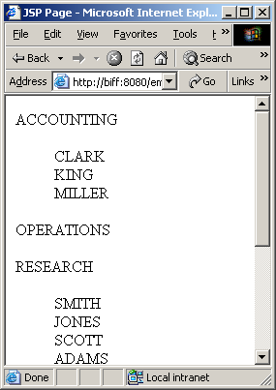
Master-Detail Queries
Master-Detail Example
<%-- edited for space --%>
<sqltags:dept id="d" where="order by DNAME">
<%= d.getDNAME() %>
<BLOCKQUOTE>
<sqltags:emp id="e" foreignKey="FK_DEPTNO"
parentName="d">
<%= e.getENAME() %><BR>
</sqltags:emp>
</BLOCKQUOTE>
</sqltags:dept>
<%-- edited for space --%>

Slide 17
Data Manipulation
DML can be Specified as Follows:
  Operation Attribute
    <sqltags:emp id=“e” operation=“insert” />
    Executes specified operation
  ButtonName Attribute
    <sqltags:emp id=“e” buttonName=“button” />
    Executes operation contained in button Parameter
  Direct Call via Snippet Variable
    <% e.insert(); e.update(); e.delete(); %>

Slide 18
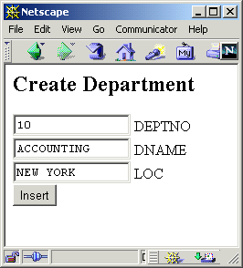
Request Properties
<h2>Create Department</h2>
<FORM>
<INPUT NAME="DEPTNO" SIZE="15" VALUE="10"> DEPTNO
<BR><INPUT NAME="DNAME" SIZE="15" VALUE="ACCOUNTING"> DNAME
<BR><INPUT NAME="LOC" SIZE="15" VALUE="NEW YORK"> LOC
<BR><INPUT NAME="fop" TYPE="submit" VALUE="Insert">
</FORM>
Since the “properties” attribute is “true” and the field names in the Form match the column names from the DEPT table the values will automatically be assigned.
<sqltags:dept
id=”d”
buttonName=”fop”
properties=”true”
/>
Processed By

Slide 19
Array Processing
SQLTags supports multi-row Update, Inserts, and Delete
Rows of Inputs are named as follows:
  columnName[arrayIndex]
    ENAME[1]=“Steve”; ENAME[2]=“Joe”; …
    <input name=“ename[1]” value=“Steve”>
Operation Names Match arrayIndex
  operation[arrayIndex]
    operation[1]=“insert”; operation[2]=“delete”;
Each Operation Controls one Row

Slide 20
Handler Classes
SQLTags Provides “Database Events” for User-Defined Validation and Business Logic Support
    preInsert, postInsert
    preUpdate, postUpdate
    preDelete, postDelete
    preQuery, postFetch, postQuery
If a “pre” event Fails, operation is halted
SQLTags Provides “Tag Events”
    start, afterBody, end

Slide 21
Support Tags
Paging Support
  <first>, <last>, <next>, <previous>
Complex Queries
  <where>, <orderBy>, <fetch>, <cursor>, <statement>
Connection, Initialization
  <connection>, <initialize>
Authorization
  <authorize>

Slide 22
Cursor Tag
Cursor Example
<%@ page import="com.aitworks.sqltags.jsptags.*,
com.aitworks.demo.sqltags.*" %>
<%@ taglib uri="/WEB-INF/lib/demoTags.jar"
prefix="sqltags" %>
<html>
<head><title>JSP Page</title></head>
<body>
<sqltags:connection id="connect"
initSrc="/WEB-INF/oracle.properties">
<sqltags:cursor id="cur"
sql="select * from EMP order by ENAME">
<sqltags:fetch name="cur">
<%= cur.getString("ENAME") %><BR>
</sqltags:fetch>
</sqltags:cursor>
</sqltags:connection>
</body>
</html>

Slide 23
Statement,Where,Fetch
Statement, Where, Fetch
<%-- edited for space --%>
<sqltags:connection id="connect"
initSrc="/WEB-INF/oracle.properties">
<sqltags:cursor id="cur">
<sqltags:statement name="cur">
select * from EMP
order by ENAME
</sqltags:statement>
<sqltags:fetch name="cur">
<%= cur.getString("ENAME") %><BR>
</sqltags:fetch>
</sqltags:cursor>
</sqltags:connection>
<%-- edited for space --%>

Slide 24
Review
SQLTags is a free, open source, object-relational mapping toolkit and “development framework” that provides Java developers with a new and innovative way to access and manipulate data stored within a relational database.
SQLTags is targeted, primarily, at the Java Server Pages (JSP) environment and can be easily adapted to either the, so called, “Model 1” or “Model 2” JSP Architectures.
At the SQLTags core is a generator that builds a Java class and a JSP tag for each table within a specified database schema, and a set of run-time support classes and JSP tags that facilitate database development within Java.
The generator packages everything up into a single "Java Archive" or "jar" file for easy deployment into your web server environment(s).
This “jar” file can be used within any JSP page to provide easy access to the underlying tables.

Slide 25

Questions?
Database/JDBC …
Java/JSP …
User Interface …
AIT

Slide 26

AIT
Applied Information Technologies, Inc.
      Oracle on the Web since 1995
      http://www.ait-inc.com
Web/Database Integration
Java and JSP Development
Oracle DBA Services

