Slide 1
Introduction to JSP Development
using NetBeans, CVS, and SQLTags

Slide 2
Objectives
Students should have a good understanding of the development tools and how they fit into the overall development process.
Upon completion, students should be familiar with JSP development concepts and be prepared to begin developing JSP web pages.

Slide 3

Experience
Your experience?
Java, JSP?
ASP, CF, PHP, Other?
Object Oriented?
HTML, JavaScript?

Slide 4
Outline
Lesson 1- Overview
Lesson 2- Introduction to JSP (optional)
Lesson 3- NetBeans IDE
Lesson 4- Concurrent Versioning System
Lesson 5- SQLTags

Slide 5
Lesson 1- Overview
The Big Picture

Slide 6

Lesson 1- Overview
Objective: to gain an understanding of the overall development process and become familiar with specific development tools.
Understand how the individual components fit into the overall process

Slide 7
Lesson 1- Overview
Process
  Development
    CVS Checkout/Update
    Modify/Test Pages
    CVS Commit
  Test
    CVS Tag
    CVS Export
  Production
    CVS Export
    Possible Branching
Tools
  Development
    NetBeans IDE on each workstation
    1 CVS & DB Server
  Test
    1 Web & DB Server
  Production
    Web Server(s)
    DB Server(s)

Slide 8

Development Tools
NetBeans IDE on each desktop
  Integrated web server, editor, and debugger included in NetBeans
CVS* Repository on one server
  * or External Version Control System like VSS
Development database server
DEV
CVS Server
Update/Commit
1
JDBC
Developers: NetBeans IDE
Integrated Web Server

Slide 9
Development Process
NetBeans- Project setup
CVS Checkout/Update
  Copy of entire application
  Checks for conflicts
  Updates local copies
  Gets “clean” copies (oops)
Modify & Test Pages
  (Do what developers do)
CVS Commit
  posts changes to CVS
DEV
CVS Server
Update/Commit
1
JDBC
Developers: NetBeans IDE
Integrated Web Server

Slide 10

Overall Configuration- Test
DEV
2
TEST
CVS Server
Web Server
TEST
JDBC
HTTP
Update/Commit
1
JDBC
End Users
Application is “deployed”
to TEST Server using a
“CVS export”; periodically, the application is “Tagged” in CVS as a “release candidate”
Developers: NetBeans IDE
Integrated Web Server

Slide 11
Overall Configuration- Production
DEV
A “tagged” release is deployed
to Production server(s) from
CVS (after rigorous testing)
CVS Server
Update/Commit
End Users
1
JDBC
HTTP
3
Web Server
PROD
Web Server
PROD
JDBC
PROD
Web Server
PROD
Developers: NetBeans IDE
Integrated Web Server

Slide 12
Lesson 1- Review
Process
  Development
    CVS Checkout/Update
    Modify/Test Pages
    CVS Commit
  Test
    CVS Tag
    Integration testing
  Production
    Support live application
Tools
  Development
    NetBeans IDE on each workstation
    1 CVS & DB Server
  Test
    1 Web & DB Server
  Production
    Web Server(s)
    DB Server(s)
Questions?

Slide 13

Lesson 2- JSP Introduction

Slide 14
Lesson 2- JSP Introduction
Objective: Upon completion, student should have basic understanding of JSP and be prepared to develop simple JSP pages
Reality Check: Show of Hands
  What is your JSP Experience Level?
    Expert
    Experienced
    Beginner
    What is JSP, anyway?

Slide 15
JSP Overview
JSP looks similar to ColdFusion or Active Server Pages (ASP)
Basically, JSP pages are HTML pages with:
  limited “Snippets” of Java code,
  calls to JavaBeans, and
  Custom Tags.
JSPs are maintained within a “Web Module” in NetBeans

Slide 16

JSP is Servlet
JSP is Servlet
  When a JSP page is hit for the first time, it is automatically compiled into a servlet.
  The Servlet is then available to web server
  Servlets have built-in application, session, request, and page variables

Slide 17
JSP Built-in “Scopes”
Page
  Available within one page, not available to forwarded or included pages
Request
  Available to single user for duration of one “page hit”
  Contains “CGI” Vars
  getParameter()
  getRemoteUser()
  Is Available to forwarded and included pages
Session
  Available to single user from page-to-page until session time-out
Application
  Available to and shared by all users
  initialized once, each time web server is started.
User Defined Attributes
  available to all scopes
  setAttribute()
  getAttribute()

Slide 18
Components of a JSP Page
Declarations
  <%@ ... %>
  Standard headers
Snippets
  <% ... %>
  <%= ... %>
Comments
  <%-- … --%>
JavaBeans
  useBean
  scope
Tags, Tags, Tags
  Built-in
  Custom
And, of course, HTML

Slide 19
JSP & Tag Example
Example:
Defines a Taglib, Declairation
<%@taglib uri="/WEB-INF/lib/sqltags.jar" prefix="sqltags" %>
<%-- open a database query --%>
<table>
<sqltags:emp id="emp" where="order by ename">
<%-- loop through the rows of your query --%>
<tr>
<td><%= emp.getEMPNO() %></td>
<td><%= emp.getENAME() %></td>
<td><%= emp.getFK_DEPTNO_PARENT().getDNAME() %></td>
</tr>
</sqltags:emp>
</table>
Comment
Snippet
Custom Tag, from taglib

Slide 20
JSP Declarations
Declarations
  <%@ … %>
  Like #includes within a “C” program
    imports
    content-type of the output page
  Typically, declarations are the same for most every page. A Template can be used.
  Example:
  <%@import “org.sqltags.*” %>
  <%@ taglib uri="tags.jar" prefix=”my" %>

Slide 21
JSP Snippets
Snippets
  Most coding is done within snippets; however, avoid excessive use.
  A block of Java code is introduced using the “<%” syntax. Must be complete Java statement.
  <% … %>
  In-line expressions are introduced with the “<%=“ syntax. Is simply a valid “string” expression.
  <%= … %>
Examples:
<% String s = new String( “Steve” );
out.println(“name is “+s);
%>
id is <%= request.getRemoteUser() %>
In-line expressions are simply stuffed into a “print” statement.

Slide 22
JSP Comments
JSP Comments that are hidden from the browser
<%-- this is a comment, the comment continues until the ending syntax, this text will not get to the browser
--%>
HTML Comments
  passed on to browser
  <!-- html comment -->

Slide 23
Web Module
A Web Module contains “jsp” files plus the WEB-INF directory structure.
  WEB-INF/
    classes/
    lib/
CLASSPATH typically contains:
  WEB-INF/classes/
  WEB-INF/lib/*.jar
JavaBeans, Tags installed under WEB-INF

Slide 24
JSP JavaBeans
JavaBeans
  Basically, a JavaBean is a Java Class that follows some simple conventions.
  Provides a default (zero argument) “constructor”
  Provides access to Class Variables with “setter” and “getter” that follow a well-defined pattern:
    Class Property: “myName” would be accessible as:
      void setMyName(String myName)
      String getMyName()

Slide 25
JSP JavaBeans
Hide Java code from JSP page, and that’s good!
Are reusable
Bean Scope
  Request
  Session
  Application
Really Cool!
Nice way to build “utilities” for many tedious tasks
AVOID embedding HTML within your JavaBeans
AVOID embedding excessing Java within JSP pages

Slide 26
JSP JavaBeans
Define a project under your official domain:
  com.yourdom.projx.beans
  WEB-INF/classes/com/yourdom/projx/beans
Invoked by <jsp:useBean/>
Scope controls how long the Bean “lives”
  Page, request (default), session, or application
Calls the default “constructor” and uses “reflection” to access class variables
  getName() - returns variable “name”
  setName() - sets the “name” variable
Also, all “methods” are available to JSP page

Slide 27
JSP Tags
JSP natively supports custom tags
  Another way to “hide” Java code from JSP.
    <jsp:useBean\>
    <jsp:forward\>
Many free taglibs are available
    SQLTags
    Mailer Tags
    Java Standard Tag Library (JSTL)
Similar to JavaBeans
Custom Taglibs
  A “TLD” maps custom tags to their supporting Java classes
  Supporting Classes define behavior of:
    doStart
    doAfterBody
    doEnd
  The “tag body” is evaluated repeatedly until SKIP is returned

Slide 28
JSP & Tag Example (Review)
Examples:
Defines a Taglib, Declairation
<%@taglib uri="/WEB-INF/lib/sqltags.jar" prefix="sqltags" %>
<%-- open a database query --%>
<table>
<sqltags:emp id="emp" where="order by ename">
<%-- loop through the rows of your query --%>
<tr>
<td><%= emp.getEMPNO() %></td>
<td><%= emp.getENAME() %></td>
<td><%= emp.getFK_DEPTNO_PARENT().getDNAME() %></td>
</tr>
</sqltags:emp>
</table>
Comment
Snippet
Custom Tag

Slide 29
JSP Hints
Helpful hints
  You’ll be mostly using a bit of snippets, perhaps a few JavaBeans, and Tags (for JDBC access).
  The “request object” and “request parameters” also critical for obtaining “form inputs.”
  Again, AVOID HTML in JavaBeans
  AVOID “excessive” Java within the JSP
  SQLTags will provide easy database access

Slide 30
JSP Review
JSP looks similar to ColdFusion or Active Server Pages (ASP).
Basically, JSP pages are HTML pages with limited “Snippets” of Java code, calls to JavaBeans, and Custom Tags.
JSPs are maintained within a “Web Module” in NetBeans
Questions?

Slide 31

Lesson 3- NetBeans IDE

Slide 32
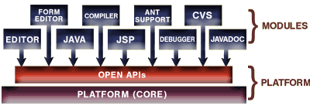
Lesson 3- NetBeans IDE
Objective: to be introduced to the NetBeans Integrated Development Environment.

Slide 33
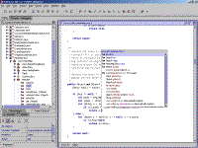
NetBeans IDE- Overview
Project Manager
Mounts
Web Modules
CVS Integration
Work Spaces
Debugger

Slide 34
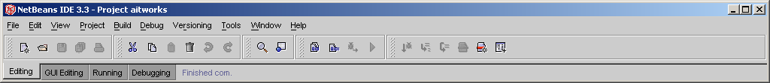
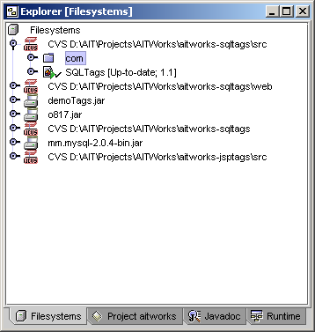
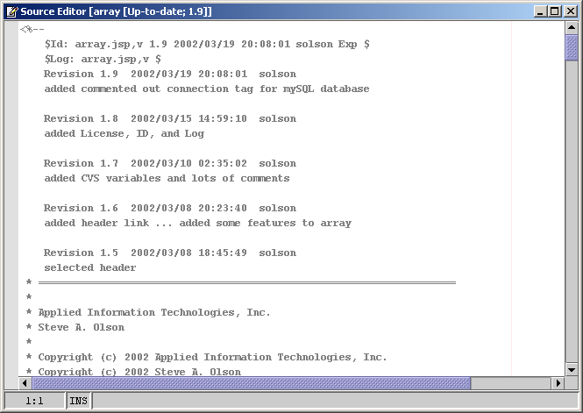
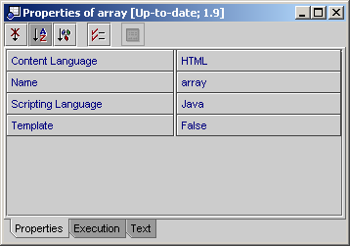
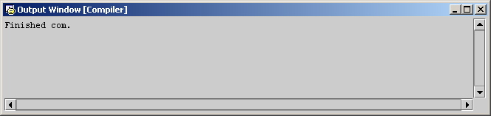
NetBeans- Screen shot Editing

Slide 35
NetBeans- Projects
Project Manager
  Allows developers to switch between different projects
  Allows developers to switch between different versions of the same project
  Defines location for local files
  “Remembers” mounts
  Controls Java CLASSPATH

Slide 36
NetBeans- Mounts
Manages files within projects
Mount Types
  Local Directory
  CVS Repository **
  JAR file
  FTP Server
CVS Mount supports built-in version control
Each Mount is added to CLASSPATH
for Web Modules
  WEB-INF/
  WEB-INF/classes
  WEB-INF/lib/*.jar
    Also added to CLASSPATH
Add required JAR files to WEB-INF/lib

Slide 37
NetBeans- Web Modules
JSP development is accomplished within a Web Module
Basically, Web Modules are defined by the WEB-INF directory structure
Implications to CLASSPATH
WAR tool for deployment
Supported by Built-in Web Server

Slide 38
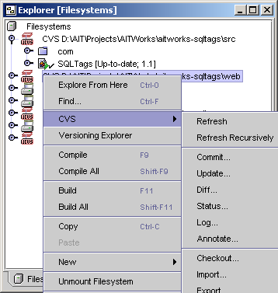
NetBeans- CVS Integration
Within any CVS Mount
Right-click an item
Options:
  Refresh
  Commit
  Update
  Diff
  …

Slide 39
NetBeans- Work Spaces
Three main work spaces; however, they are configurable
  Editing - Explorer, Editor, Output, Properties
  GUI Editing - not needed for Web Mods
  Debugging - Watches, Editor/Debugger, Output
Each work space controls a set of windows specific for the task
Hint: Switching brings back windows

Slide 40
NetBeans- Screen shot Editing

Slide 41
NetBeans- Editing/Running
Double-click to Edit
Right-click -> Execute to run a JSP page
Right-click-> Execute-(force reload) to run JSP page and restart Tomcat Server (changes to server configuration)
Right-click-> Compile to compile a JSP page
Execute:
  NetBeans will save and compile the JSP page
  Then Launch the Tomcat Servlet engine
  Then Launch the Browser with appropriate URL to access the page
  Server messages displayed in “output” window.
Compile
  Errors are displayed in “output” window
  Double-click on errors to edit code

Slide 42
NetBeans- Debugger
Select a JSP page from the Explorer window
Then select
  Debug->Start
  from the main menu
  The page will execute within the debugger
Break points and Watches can be set within work space
Options Include:
  Single Step
  Step Into
  Run to Cursor
  Run to Break Point
  Finish
Mouse Over shows variable’s values
Stack viewer
More …

Slide 43
NetBeans IDE- Review
Project Manager
Mounts
Web Modules
CVS Integration
Work Spaces
Debugger
Questions?

Slide 44

Lesson 4- CVS

Slide 45
Lesson 4- CVS
Objective: to be introduced to the Concurrent Versioning System.
Highlighting main features, only.

Slide 46
CVS Overview
Repository Setup
Checkout
Update
Add
Remove
Commit
Tag

Slide 47
CVS Background
CVS does not provide for the traditional “checkout” where a file is locked by one developer, instead all files are writable
Developers periodically refresh their local copy with “update” command
Modified Files are sent to CVS using the “commit” command
Conflicts are possible and must be managed and merged

Slide 48
CVS Repository Setup
Repository Setup
  Unix Server is Recommended (not required)
  Create “owner” account
  run “cvs init”
  Modify
    CVSROOT/passwd - defines users and passwords
    CVSROOT/cvswrappers - defines binary files
  Import initial files, if necessary
  Configure /etc/inetd.conf

Slide 49
CVS- Checkout
CVS checkout
  Only used to initialize local copy
  Gets latest version of every file
  Can be used to checkout a “branch” or “tag” for maintenance of previous versions
  All update, diff, commit commands are “relative” to the checkout

Slide 50
CVS Update
CVS Update
  Update often
  Update “Get Clean Copy”
    Throw away local changes and overwrite with latest copy from repository
  Always update just prior to “commit”
  If in doubt, update!

Slide 51
CVS Add
CVS Add
  Adds a new file or directory to the Repository
  Be careful with “Binary” files, use -kb (binary) option
  Be sure to “commit” after Add or file will not be available

Slide 52
CVS Remove
CVS Remove
  Removes a file from Repository
  Must delete file prior to remove, or select option to delete file from NetBeans
  Be sure to “commit” the remove or file will stay in the Repository

Slide 53
CVS Commit
CVS Commit
  Commits a change to the Repository based on the local copy
  Changes, Adds, and Removes must all be “committed” before they will take effect
  Be sure to “update” prior to “commit” to deal with “conflicts” if they occur

Slide 54
CVS Tag
CVS Tag
  Marks all files within the Repository with the given name
  Really, it just adds an entry within each file mapping the current version to the tag name
  Used to “define” a version of the application as a whole so that it can be reconstructed later
  Allows for easy maintenance of legacy versions without stalling progress on main development trunk-- very powerful!

Slide 55
CVS Review
Repository Setup
Checkout
Update
Add
Remove
Commit
Tag
Questions?

Slide 56

Lesson 5- SQLTags

Slide 57
Lesson 6- SQLTags
Objective: to be introduced to the SQLTags taglib.
Highlighting main features, only.

Slide 58
What is SQLTags?
SQLTags is a free, open source, object-relational mapping toolkit and “development framework” that provides a new and innovative approach to data-driven web applications development.
At the SQLTags core is a generator that builds a JavaBean and a JSP tag for each table within a specified database schema. Additionally, a set of built-in JSP tags and run-time support classes facilitate database development within JSP.
The generator packages everything into a single "Java Archive" or "jar" file for easy deployment into your Web Application.
SQLTags is Independent of any specific J2EE Application Server or Database avoiding vendor “lock-in” at either level.
SQLTags is quick and easy to learn.

Slide 59
How Does SQLTags Work?
The Generator gets input from the user and generates a “Java Archive” or JAR file based on JDBC database metadata.
  JDBC Driver, username, password, schema info
  Jar output filename, options …
The “jar” file, taglib, and “dataSource” mappings are added to the deployment descriptor.
  Web.xml: taglib directive, dataSource, options ...
Finally, JSP pages are authored using the taglib.

Slide 60
Why Use SQLTags?
Eases building, maintaining data-driven JSP pages.
Eases impact of database change
  Select, Insert, Update, and Delete statements are generated (based on database metadata).
  Simply re-run generator whenever database is changed.
Supports Java and JSP industry standards like:
  JavaBeans, JSP Standard Tag Lib (JSTL), Struts, JSP 2.0.
Works well with EA Server (Jaguar)
  Easily deploys to EA Server within Web Application (WAR).
  Can use Container’s Pooled Data Sources and Roles.
Not specific to EA Server, any JSP 1.2 container

Slide 61
Why Use SQLTags? (con’t)
Faster JSP Development
  Automatically associates “request parameters” to columns
  Built-in Data Manipulation Language (DML) methods:
    Insert, update, delete
    Built-in array processing for multi-row updates
  Automatic iteration based on “where clause” or “array params”
  Built-in paging with next, previous tags
  Built-in access to container’s security using allow, deny tags
  Supports parent-child nesting of tags based on foreign keys
Quick and easy to learn.
One line of JSP eliminates lots of tedious work
Shorter development cycle, more productive.

Slide 62
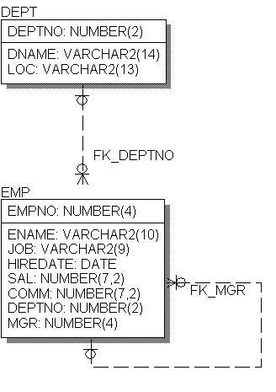
SQLTags Mapping Example
DEPT table maps to <x:dept/>
EMP table maps to <x:emp/>
Columns are “JavaBean” accessible
Parent foreign keys are also “JavaBean” accessible
  [Example follows]
Tags can be nested based on foreign keys
  [Example follows]

Slide 63
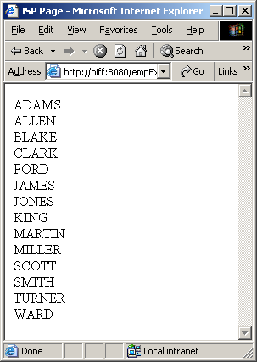
SQLTags Complete Example
Simple Page
<%@ taglib uri="/WEB-INF/lib/demoTags.jar"
prefix="sqltags" %>
<%@ taglib uri="/tags/jstl-core" prefix="c" %>
<html>
<head><title>JSP Page</title></head>
<body>
<sqltags:connection id="connect">
<sqltags:emp id="e" where="order by ENAME">
<c:out value=“${e.ENAME}”/><br>
</sqltags:emp>
</sqltags:connection>
</body>
</html>

Slide 64
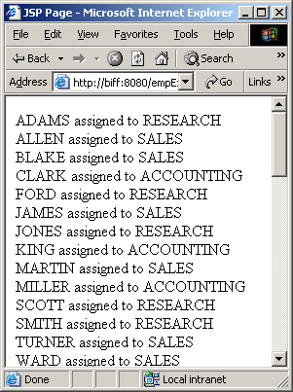
Parent FK Lookups
Parent Lookup Example
<%@ taglib uri="/WEB-INF/lib/demoTags.jar"
prefix="sqltags" %>
<%@ taglib uri="/tags/jstl-core" prefix="c" %>
<html>
<head><title>JSP Page</title></head>
<body>
<sqltags:connection id="connect" >
<sqltags:emp id="e" where="order by ename">
<c:out value="${e.ENAME}"/> assigned to
<c:out value="${e.FK_DEPTNO_PARENT.DNAME}"/>
<br>
</sqltags:emp>
</sqltags:connection>
</body>
</html>

Slide 65
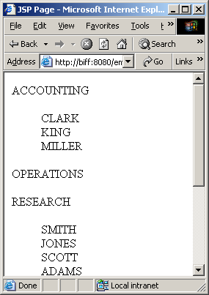
Parent-Child Nesting
Parent-Child Example
<%-- edited for space --%>
<sqltags:connection id="connect" >
<sqltags:dept id="d" where="order by DNAME">
<c:out value="${d.DNAME}" />
<BLOCKQUOTE>
<sqltags:emp id="e" foreignKey="FK_DEPTNO"
parentName="d">
<c:out value="${e.ENAME}"/>
<br>
</sqltags:emp>
</BLOCKQUOTE>
</sqltags:dept>
<%-- edited for space –-%>

Slide 66
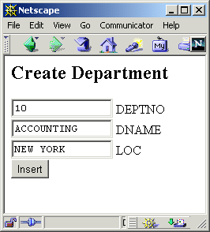
Request Properties
<h2>Create Department</h2>
<FORM>
<INPUT NAME="DEPTNO" SIZE="15" VALUE="10"> DEPTNO
<BR><INPUT NAME="DNAME" SIZE="15" VALUE="ACCOUNTING"> DNAME
<BR><INPUT NAME="LOC" SIZE="15" VALUE="NEW YORK"> LOC
<BR><INPUT NAME="fop" TYPE="submit" VALUE="Insert">
</FORM>
Since the “properties” attribute is “true” and the field names in the Form match the column names from the DEPT table the values will automatically be assigned.
<sqltags:dept
id=”d”
buttonName=”fop”
properties=”true”
/>
Processed By

Slide 67
SQLTags Notes
SQLTags is good for data-centric web applications with simple to moderate levels of complexity.
Web applications that closely follow a solid data model are ideal for SQLTags.
Complex, process intensive applications are, generally, not good candidates for SQLTags.

Slide 68

Questions? Comments?
Database/JDBC …
Java/JSP …
User Interface …
Generator
JSP Development

Slide 69
Outline
Lesson 1- Overview
Lesson 2- Introduction to JSP (optional)
Lesson 3- NetBeans IDE
Lesson 4- Concurrent Versioning System
Lesson 5- SQLTags

