Slide 1

Part 1:
SQLTags Concepts

Slide 2

Introduction- Presenter
Presentation Goals
To Share:
  Experience,
  Insights, and
  Practices
Get Feedback
Answer Questions

Slide 3

Introduction- Audience
Who are You?
Experience Level?
  Oracle/JDBC (DBA)
  Java/JSP (Developers)
  HTML/Graphics? (UI)

Slide 4
Overview
SQLTags is a free, open source, object-relational mapping toolkit and “development framework” that provides Java developers with a new and innovative way to access and manipulate data stored within a relational database.
SQLTags is targeted, primarily, at the Java Server Pages (JSP) environment and can be easily adapted to either the, so called, “Model 1” or “Model 2” JSP Architectures.
At the SQLTags core is a generator that builds a Java class and a JSP tag for each table within a specified database schema, and a set of run-time support classes and JSP tags that facilitate database development within Java.
The generator packages everything up into a single "Java Archive" or "jar" file for easy deployment into your web server environment(s).
This “jar” file can be used within any JSP page to provide easy access to the underlying tables.

Slide 5
Introduction- Skill Sets
Web Applications Development Requires the Following Skill Sets:
  HTML/Graphic Designers/User Interface
  Database Administrators/Database Designers
  Developers/Programmers
Each “Skill Set” Requires Dedication; thus
Each “Skill Set” Requires Different People

Slide 6




Introduction- Skill Sets
HTML/Graphic Designers
Database Administrators/ Database Designers
Programmers

Slide 7
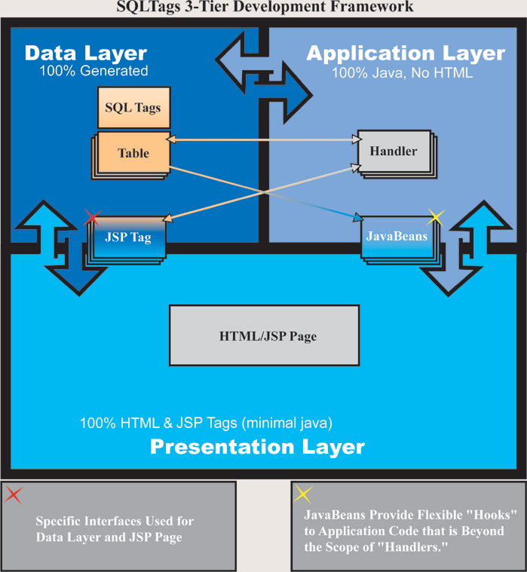
Introduction- Teamwork

Slide 8
SQLTags Framework
Data Layer
  SQLTags Classes
  100% Generated
Application Layer
  SQLTagsHandler
  JavaBeans
Presentation Layer
  HTML
  SQLTags JSP TAGS

Slide 9
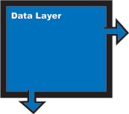
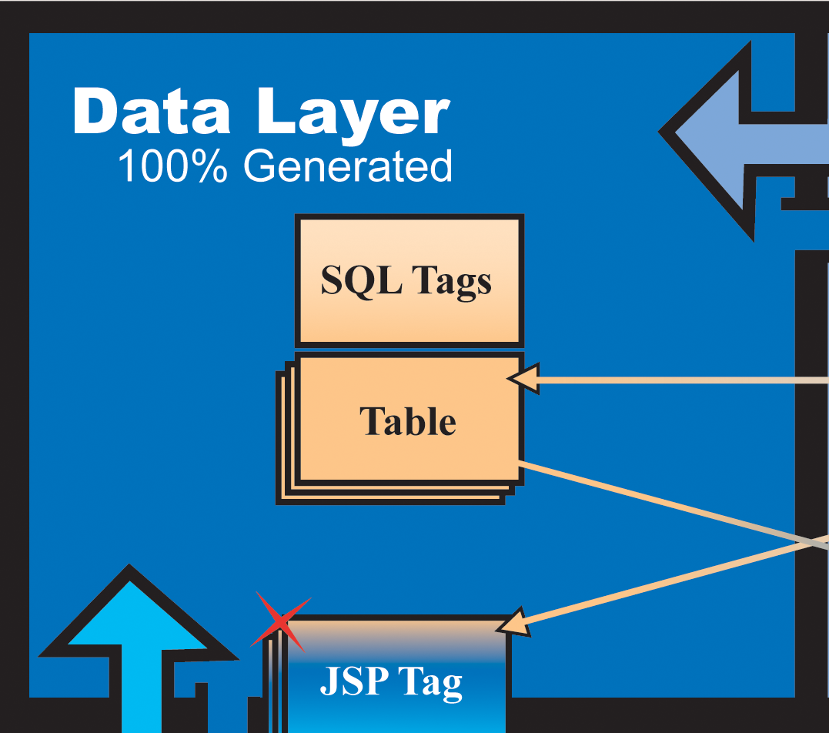
Data Layer
DBAs maintain Database Schema and Generated Classes
Based on Entity-Relationship Diagram (“ERD”)
Database Tables, Indexes, and Other Objects
Generated Java Classes

Slide 10
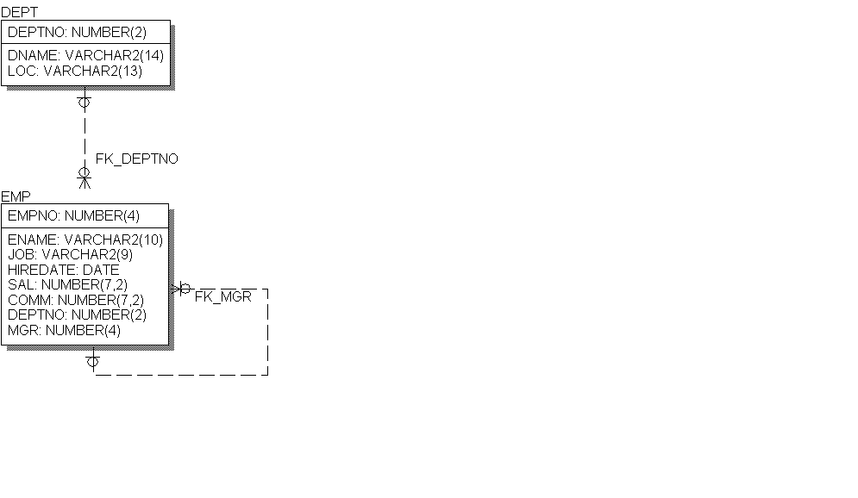
Data Layer
ERD Describes
  Database
    Tables
      DEPT, EMP
    Foreign Keys
      FK_DEPTNO
      FK_MGR
    Indexes and Other …
  Java Classes
    DEPT.class, DEPT_TAG.class
    EMP.class, EMP_TAG.class

Slide 11
Data Layer
Java Classes
  Follows “JavaBean” conventions
  Available to JSP Page
    as JavaBeans
    and as TAGS
  Provides Accessors and Mutators for:
    Columns
    Foreign Keys

Slide 12
Data Layer
DEPT.java
DEPT Class Example
  Accessors & Mutators
    Columns
    Foreign Keys, too!
  DML Operations
    Insert
    Update
    Delete
  More …
// Accessors
String getDEPTNO()
String getDNAME()
String getLOC()
// Mutators
void setDEPTNO(String s)
void setDNAME(String s)
void setLOC(String s)
// FK PARENT Accessors
// FK CHILDREN Accessors
EMP getFK_DEPTNO_CHILDREN()
…
boolean insert()
boolean update()
boolean delete()
boolean select()
boolean fetch()

Slide 13
Data Layer
EMP.java
EMP Class Example
  Accessors & Mutators
    Columns
    Foreign Keys, too!
  DML Operations
    Insert
    Update
    Delete
  More …
// Accessors
String getEMPNO()
String getENAME()
String getJOB()
String getHIREDATE()
…
// Mutators
void setEMPNO(String s)
void setENAME(String s)
void setJOB(String s)
Void setHIREDATE(String s)
…
// FK PARENT Accessors
DEPT getFK_DEPTNO_PARENT()
EMP getFK_MGR_PARENT()
// FK CHILDREN Accessors
EMP getFK_MGR_CHILDREN()
…

Slide 14
Data Layer
Example.jsp
SQLTags TAGS
Each Table Becomes a JSP TAG
Attributes for Each Column
Integration with JSP “Request” object
Class is Exposed via Scrptlet Variable
Much, Much, More …
<html>
…
<sqltags:dept
id=”d”
operation=”Insert”
DEPTNO=”10”
DNAME=”ACCOUNTING”
LOC=”NEW YORK”
/>
…
</html>
Example2.jsp
<html>
…
<sqltags:dept
id=”d2”
properties=“true”
operation=“Insert”
/>
…
</html>

Slide 15
SQLTags Framework
Data Layer
  SQLTags Classes
  100% Generated
Application Layer
  SQLTagsHandler
  JavaBeans
  JSP Pages
Presentation Layer
  HTML Pages
  SQLTags JSP TAGS

Slide 16
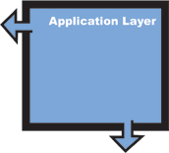
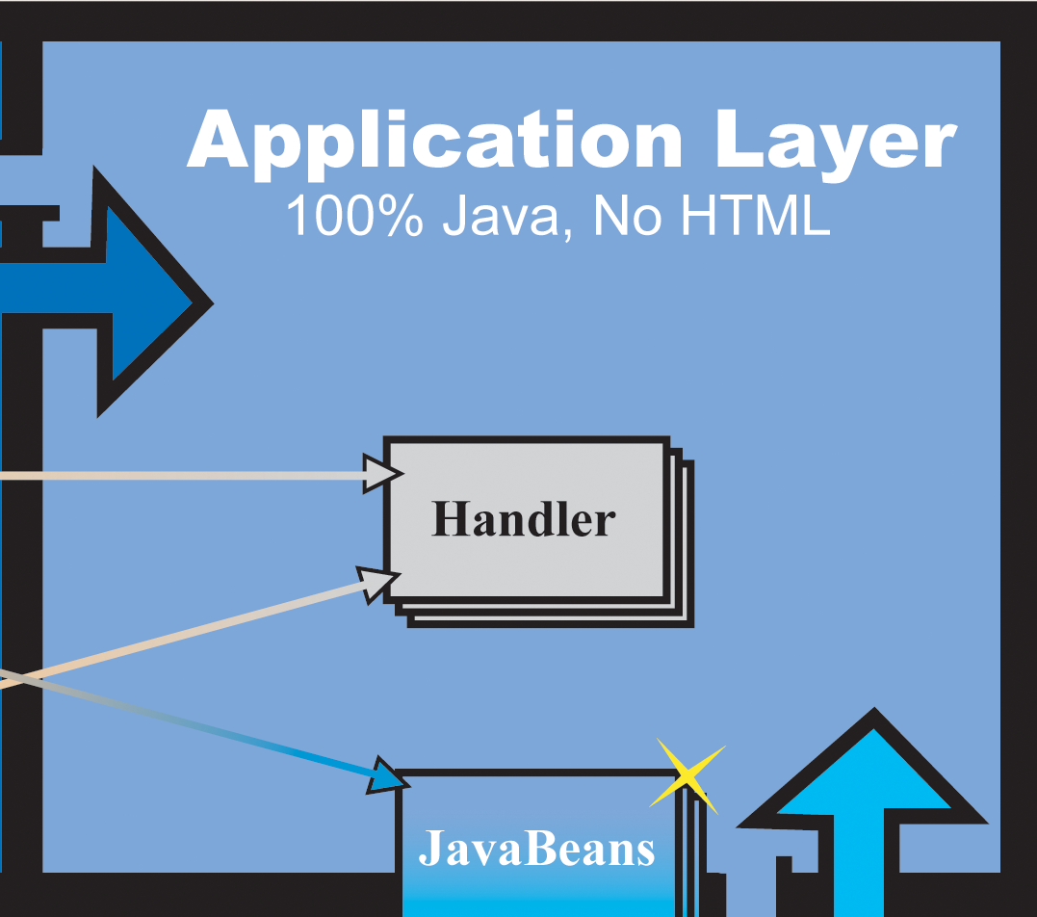
Application Layer
Java Developers maintain
SQLTagsHandlers “handle”
  Database Events
JavaBeans
  Generalized Functions
Other JSP Tags
  More Generalized Functions abstracted into JSP tags
Servlets/Struts Components

Slide 17
Application Layer
SQLTagsHandler
  Programmers Build Java Classes that “Extend” SQLTagsHandler
  Defines specific “Events” where Application Specific code is called
  Provides a Structure for Integration with Generated Code and JSP
  Provides a Structure for Separation from Generated Code and JSP
SQLTagsHandler
Database Events
preInsert
postInsert
preUpdate
postUpdate
preDelete
postDelete
preQuery
postFetch
postQuery
Tag Events
Start
AfterBody
End

Slide 18

Application Layer
JavaBeans
  Nothing within the SQLTags Framework Prohibits Development or use of Additional JavaBeans.
  In fact, the generated “Table” classes are JavaBeans.
JSP Tags
  Nothing within the SQLTags Framework Prohibits Development or use of Additional JSP Tags.

Slide 19
SQLTags Framework
Data Layer
  SQLTags Classes
  100% Generated
Application Layer
  SQLTagsHandler
  JavaBeans
Presentation Layer
  HTML
  SQLTags JSP TAGS

Slide 20
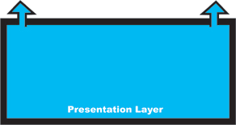
Presentation Layer
JSP Pages are Maintained by HTML Authors using:
  HTML, DHTML, XML
  JavaScript
  SQLTags TAGS
  Other JSP TAGS
  JavaBeans
  Very, Very Limited Embedded Java (Scriptlets)

Slide 21
Presentation Layer
SQLTags Built-in Features
  properties=“true”
  paging=“true”
  caching=“true”
  “handler reference”
  scriptlet variables
  SELECT formatting
  BIND formatting
Looping
  based on “where”
Data Manipulation:
  Insert, Update, Delete
Automatic Join on Foreign Keys to:
  Parent
  Children

Slide 22
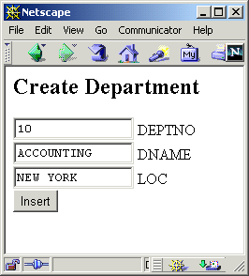
Presentation Layer
<h2>Create Department</h2>
<FORM>
<INPUT NAME="DEPTNO" SIZE="15" VALUE="10"> DEPTNO
<BR><INPUT NAME="DNAME" SIZE="15" VALUE="ACCOUNTING"> DNAME
<BR><INPUT NAME="LOC" SIZE="15" VALUE="NEW YORK"> LOC
<BR><INPUT NAME="fop" TYPE="submit" VALUE="Insert">
</FORM>
Since the “properties” attribute is “true” and the field names in the Form match the column names from the DEPT table the values will automatically be assigned.
<sqltags:dept
id=”d”
buttonName=”fop”
properties=”true”
/>
Processed By

Slide 23
Presentation Layer
Support Tags
  Where - defines complex where clause
  OrderBy - defines order by clause on “join”
  Fetch - Fetch Rows
  First - First on page
  Last - Last on page
Additional Tags
  Connect - Connect to database using pool
  Cursor - generic cursor tag for complex queries
  Previous - previous page Anchor
  Next - next page Anchor

Slide 24
SQLTags Framework
Data Layer
  SQLTags Classes
  100% Generated
Application Layer
  SQLTagsHandler
  JavaBeans
Presentation Layer
  HTML
  SQLTags JSP TAGS

Slide 25

Questions?
SQLTags …
  Data, Application, Presentation
Java/JSP …
User Interface …

Slide 26
Part 2:
Using SQLTags

Slide 27
Part 2: Agenda
Overview
Generator
JavaServer Pages: Essential Components
Querying the Database
Data Manipulation
Helpful Features
Built-in Tags

Slide 28
Part 2:Overview
Run Generator
  Define package, identify Schema
  Create Jar file
Setup Deployment Descriptor (web.xml)
  Define connection pool properties
  DataSource
Create JSP Pages
  Reference packages,
  Jar file
Query Database
  Simple Table
  Master-Detail
  Foreign Key Lookup
  Cursor
Modify Data
  Operation
  Arrays
  Using Properties=true

Slide 29
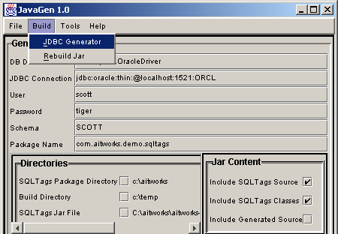
SWING Generator
Database Driver-- requires JDBC MetaData
JDBC URL
User, Password
Schema
Package
Directories
  SQLTags
  Build
Jar File & Contents

Slide 30
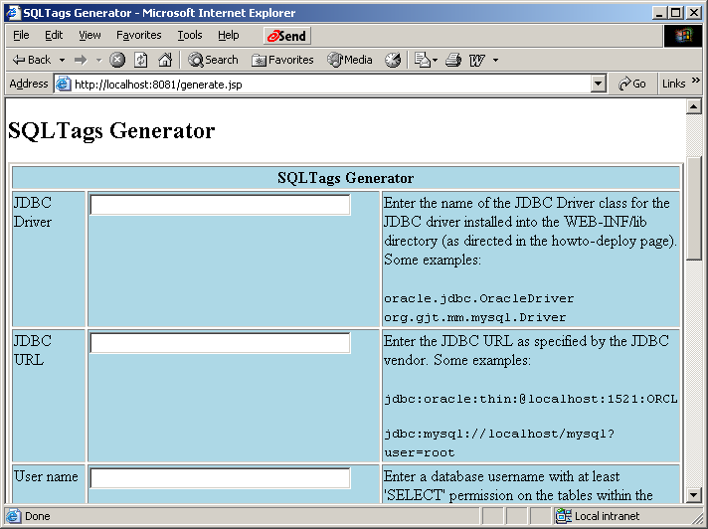
HTTP Generator
Database Driver-- requires JDBC MetaData
JDBC URL
User, Password
Schema
Package
Jar File
Options

Slide 31
Generator Notes
JDBC Drivers
  for Oracle, MySQL included in the “Tar” file
  More on the SQLTags CD-ROM
  Links on SQLTags web site
Package Name
  location for generated table and tag classes
  com.aitworks.sqltags.demo.sqltags (examples)
SQLTags Output “.jar” File
  generates to /WEB-INF/tmp
Contents
  SQLTags Classes for single Jar
  Source code, too

Slide 32
JSP Components
Deployment -- JDBC Connection Pool
Taglib-- Generated Jar
  <%@ taglib uri="demoTags.jar” prefix=”demo” %>
Connection-- wraps all Tags, ref Properties
  <sqltags:connection id="connect">
  . . .
  </sqltags:connection>

Slide 33
Deployment Descriptor
The J2EE Deployment Descriptor for a standard Web Application is the file:
WEB-INF/web.xml
The Deployment Descriptor contains installation specific parameters for each web application.
SQLTags “Context Parameters” example:
<context-param>
<param-name>SQLTags.userName</param-name>
<param-value>scott</param-value>
</context-param>

Slide 34
Deployment Descriptor
SQLTags.bindStrings
Should almost always be set to false. Default is true. Controls the way in which variables are bound to SQL statements for inserts and updates and in the where clauses for selects, updates, and deletes. if bindStrings = true all bindings are done using the setString (PreparedStatement). If bindStrings = false Numerical and Data types are bound using native Java Number and Date types. bindStrings = false is recommended. Default is true for backward compatibility.
SQLTags.useCM
Valid values: true or false; default is true. Controls use of either the internal <SQLTags:> JDBC Connection Pool or an external DataSource maintained by the Application Server. True indicates the internal Connection Pool is used referencing the JDBC context params (below), false indicates an external DataSource will be used instead and the related context params (below) will be ignored.
SQLTags.dataSource
Defines the default DataSource to be used when useCM (above) is false and no dataSource attribute is included on the connections when useCM is false. Default value is jdbc/SQLTagsDS.
The following Context Params are only needed if SQLTags.useCM is set to true.
SQLTags.databaseDriver Database driver class as provided by JDBC vendor.
SQLTags.connectionUrl The JDBC connection URL as defined by the JDBC Vendor.
SQLTags.maxPoolSize Maximum number of JDBC connections allowed in the pool.
SQLTags.poolSize Normal/starting size of JDBC connection pool.
SQLTags.userName Database username used to connect to the database.
SQLTags.password Password for SQLTags.userName.

Slide 35
Example Data Model
The “Classic”
  EMP - DEPT Example
Critical Components
  Table Names
  Column Names
Equally as important
  Foreign Key Names
  FK_DEPTNO
  FK_MGR

Slide 36
Querying the Database
SQLTags can query the database in several ways:
  Single Table Query
  Master-Detail Nesting
  Parent Lookup
  Free-form, generic Cursor tag
Complex queries are supported with nested <where> and <fetch> tags

Slide 37
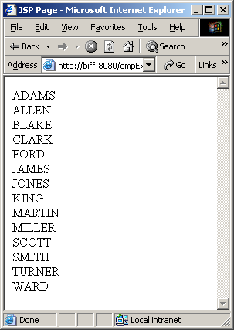
Single Table Queries
Simple Example
<%@ taglib uri="demoTags.jar" prefix="sqltags" %>
<html>
<head><title>JSP Page</title></head>
<body>
<sqltags:connection id="connect">
<sqltags:emp id="e" where="order by ENAME">
<%= e.getENAME() %><BR>
</sqltags:emp>
</sqltags:connection>
</body>
</html>

Slide 38
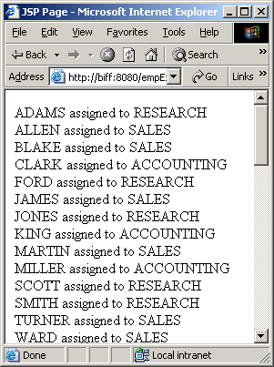
Parent FK Queries
Parent Lookup Example
<%@ taglib uri="demoTags.jar" prefix="sqltags" %>
<html>
<head><title>JSP Page</title></head>
<body>
<sqltags:connection id="connect">
<sqltags:emp id="e" where="order by ename">
<%= e.getENAME() %> assigned to
<%= e.getFK_DEPTNO_PARENT().getDNAME() %>
<BR>
</sqltags:emp>
</sqltags:connection>
</body>
</html>

Slide 39
Paging Support
Paging Support is Built-in Feature
  Set paging Attribute to “true”
  Set displaySize Attribute to desired page size
  Add a <Last> tag to identify last row or query
  Use <previous> and <next> tags to build links to next and previous pages
Example …

Slide 40
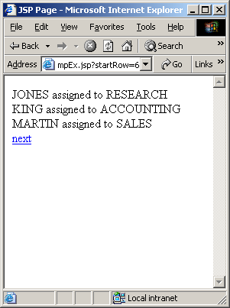
Paging Support
Paging Example
<%-- edited for space --%>
<html>
<head><title>JSP Page</title></head>
<body>
<sqltags:connection id="connect">
<sqltags:emp paging=“true” displaySize=“3”
id="e" where="order by ename">
<%= e.getENAME() %> assigned to
<%= e.getFK_DEPTNO_PARENT().getDNAME() %>
<BR>
<sqltags:last name="e">
<sqltags:next href="empEx.jsp"
parentName="e">next
</sqltags:next>
</sqltags:last>
</sqltags:emp>
</sqltags:connection>
<%-- edited for space --%>

Slide 41
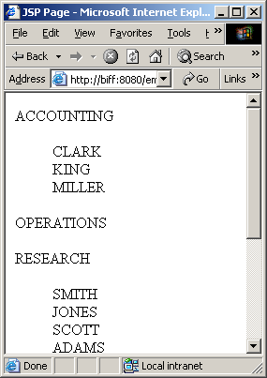
Master-Detail Queries
Master-Detail Example
<%-- edited for space --%>
<sqltags:dept id="d" where="order by DNAME">
<%= d.getDNAME() %>
<BLOCKQUOTE>
<sqltags:emp id="e" foreignKey="FK_DEPTNO"
parentName="d">
<%= e.getENAME() %><BR>
</sqltags:emp>
</BLOCKQUOTE>
</sqltags:dept>
<%-- edited for space --%>

Slide 42
Data Manipulation
DML can be Specified as Follows:
  Operation Attribute
    <sqltags:emp id=“e” operation=“insert” />
    Executes specified operation
  ButtonName Attribute
    <sqltags:emp id=“e” buttonName=“button” />
    Executes operation contained in button Parameter
  Direct Call via Snippet Variable
    <% e.insert(); e.update(); e.delete(); %>

Slide 43
Request Properties
<h2>Create Department</h2>
<FORM>
<INPUT NAME="DEPTNO" SIZE="15" VALUE="10"> DEPTNO
<BR><INPUT NAME="DNAME" SIZE="15" VALUE="ACCOUNTING"> DNAME
<BR><INPUT NAME="LOC" SIZE="15" VALUE="NEW YORK"> LOC
<BR><INPUT NAME="fop" TYPE="submit" VALUE="Insert">
</FORM>
Since the “properties” attribute is “true” and the field names in the Form match the column names from the DEPT table the values will automatically be assigned.
<sqltags:dept
id=”d”
buttonName=”fop”
properties=”true”
/>
Processed By

Slide 44
Array Processing
SQLTags supports multi-row Update, Inserts, and Delete
Rows of Inputs are named as follows:
  columnName[arrayIndex]
    ENAME[1]=“Steve”; ENAME[2]=“Joe”; …
    <input name=“ename[1]” value=“Steve”>
Operation Names Match arrayIndex
  operation[arrayIndex]
    operation[1]=“insert”; operation[2]=“delete”;
Each Operation Controls one Row

Slide 45
Handler Classes
SQLTags Provides “Database Events” for User-Defined Validation and Business Logic Support
    preInsert, postInsert
    preUpdate, postUpdate
    preDelete, postDelete
    preQuery, postFetch, postQuery
If a “pre” event Fails, operation is halted
SQLTags Provides “Tag Events”
    start, afterBody, end

Slide 46
Support Tags
Paging Support
  <first>, <last>, <next>, <previous>
Complex Queries
  <where>, <orderBy>, <fetch>, <cursor>, <statement>
Connection, Initialization
  <connection>, <initialize>
Authorization
  <authorize>

Slide 47
Cursor Tag
Cursor Example
<%@ taglib uri="demoTags.jar" prefix="sqltags" %>
<html>
<head><title>JSP Page</title></head>
<body>
<sqltags:connection id="connect">
<sqltags:cursor id="cur"
sql="select * from EMP order by ENAME">
<sqltags:fetch name="cur">
<%= cur.getString("ENAME") %><BR>
</sqltags:fetch>
</sqltags:cursor>
</sqltags:connection>
</body>
</html>

Slide 48
Statement,Where,Fetch
Statement, Where, Fetch
<%-- edited for space --%>
<sqltags:connection id="connect">
<sqltags:cursor id="cur">
<sqltags:statement name="cur">
select * from EMP
order by ENAME
</sqltags:statement>
<sqltags:fetch name="cur">
<%= cur.getString("ENAME") %><BR>
</sqltags:fetch>
</sqltags:cursor>
</sqltags:connection>
<%-- edited for space --%>

Slide 49
Questions?
Database/JDBC …
Java/JSP …
User Interface …
Generator
JSP Development

