Slide 1
SQLTags Framework
JSP Development
using the SQLTags Framework

Slide 2

Introduction- AIT
Applied Information Technologies, Inc.
      Oracle on the Web since 1995
Web/Database Integration
  Presented SQLweb at 1995 MAOP Meeting
Focused on Java and JSP Development
and Oracle DBA Services

Slide 3

Introduction- Audience
Who are You?
Experience Level?
  Oracle/JDBC (DBA)
  Java/JSP (Developers)
  HTML/Graphics? (UI)

Slide 4

Introduction- Presenter
Why are we here?
Presentation Goals
To Share:
  Experience,
  Insights, and
  Practices
Get Feedback from Peers

Slide 5
Introduction- Skill Sets
Web/Database Integration Requires the Following Skill Sets:
  HTML/Graphic Designers/User Interface
  Database Administrators/Database Designers
  Developers/Programmers
Each “Skill Set” Requires Dedication; thus
Each “Skill Set” Requires Different People

Slide 6




Introduction- Skill Sets
HTML/Graphic Designers
Database Administrators/ Database Designers
Programmers

Slide 7
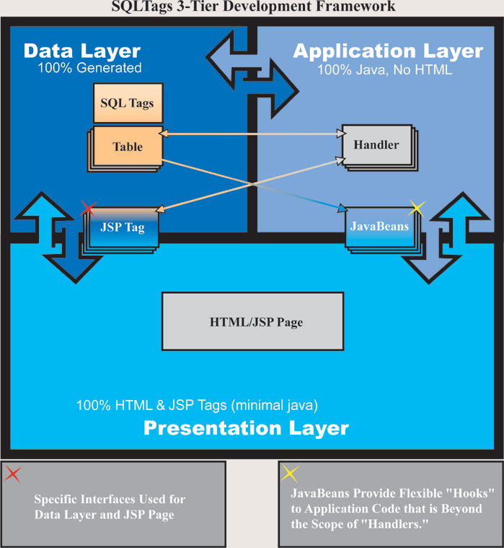
Introduction- Teamwork

Slide 8
SQLTags Framework
Data Layer
  SQLTags Classes
  100% Generated
Application Layer
  SQLTagsHandler
  JavaBeans
Presentation Layer
  HTML
  SQLTags JSP TAGS

Slide 9
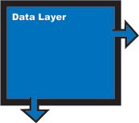
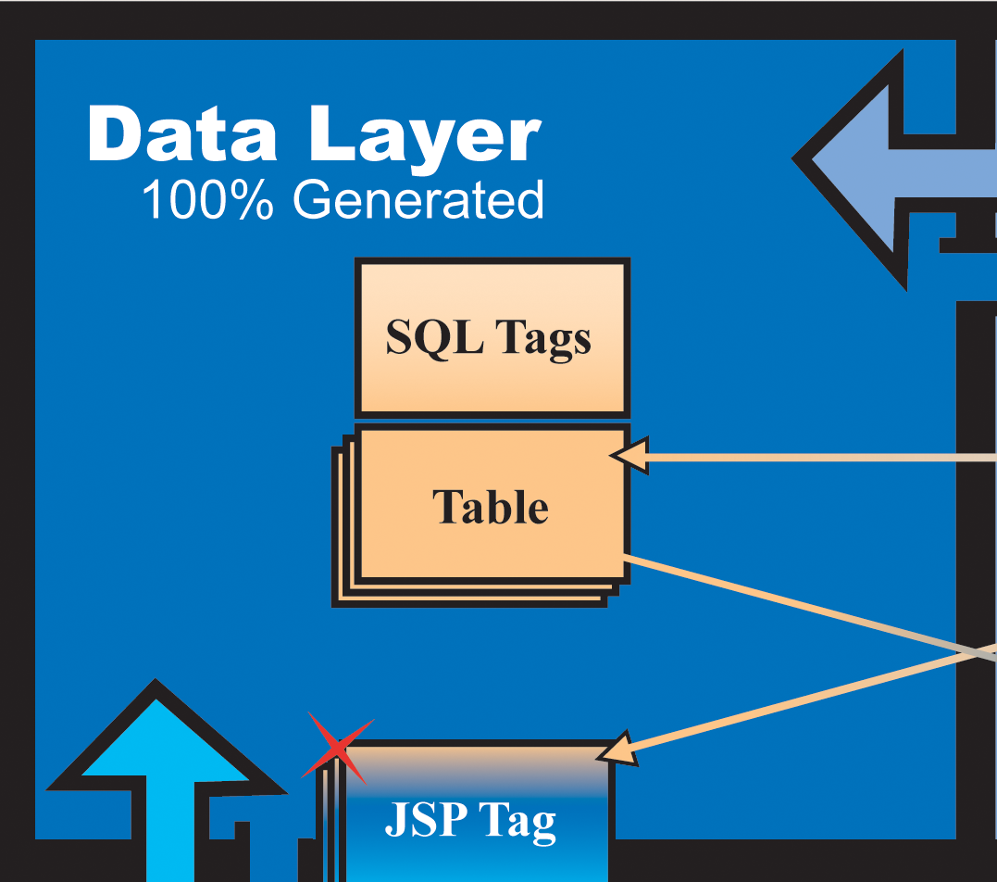
Data Layer
DBAs maintain Database Schema and Generated Classes
Based on Entity-Relationship Diagram (“ERD”)
Database Tables, Indexes, and Other Objects
Generated Java Classes

Slide 10
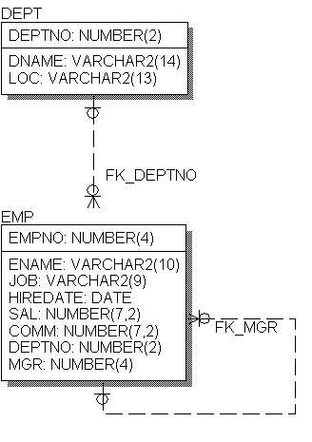
Data Layer
ERD Describes
  Database
    Tables
      DEPT, EMP
    Foreign Keys
      FK_DEPTNO
      FK_MGR
    Indexes and Other …
  Java Classes
    DEPT.class, DEPT_TAG.class
    EMP.class, EMP_TAG.class

Slide 11
Data Layer
Java Classes
  Follows “JavaBean” conventions
  Available to JSP Page
    as JavaBeans
    and as TAGS
  Provides Accessors and Mutators for:
    Columns
    Foreign Keys

Slide 12
Data Layer
DEPT.java
DEPT Class Example
  Accessors & Mutators
    Columns
    Foreign Keys, too!
  DML Operations
    Insert
    Update
    Delete
  More …
// Accessors
String getDEPTNO()
String getDNAME()
String getLOC()
// Mutators
void setDEPTNO(String s)
void setDNAME(String s)
void setLOC(String s)
// FK PARENT Accessors
// FK CHILDREN Accessors
EMP getFK_DEPTNO_CHILDREN()
…
boolean insert()
boolean update()
boolean delete()
boolean select()
boolean fetch()

Slide 13
Data Layer
EMP.java
EMP Class Example
  Accessors & Mutators
    Columns
    Foreign Keys, too!
  DML Operations
    Insert
    Update
    Delete
  More …
// Accessors
String getEMPNO()
String getENAME()
String getJOB()
String getHIREDATE()
…
// Mutators
void setEMPNO(String s)
void setENAME(String s)
void setJOB(String s)
Void setHIREDATE(String s)
…
// FK PARENT Accessors
DEPT getFK_DEPTNO_PARENT()
EMP getFK_MGR_PARENT()
// FK CHILDREN Accessors
EMP getFK_MGR_CHILDREN()
…

Slide 14
Data Layer
Example.jsp
SQLTags TAGS
Each Table Becomes a JSP TAG
Attributes for Each Column
Integration with JSP “Request” object
Class is Exposed via Scrptlet Variable
Much, Much, More …
<html>
…
<sqltags:dept
id=”d”
operation=”Insert”
DEPTNO=”10”
DNAME=”ACCOUNTING”
LOC=”NEW YORK”
/>
…
</html>
Example2.jsp
<html>
…
<sqltags:dept
id=”d2”
properties=“true”
operation=“Insert”
/>
…
</html>

Slide 15
SQLTags Framework
Data Layer
  SQLTags Classes
  100% Generated
Application Layer
  SQLTagsHandler
  JavaBeans
Presentation Layer
  HTML
  SQLTags JSP TAGS

Slide 16
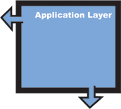
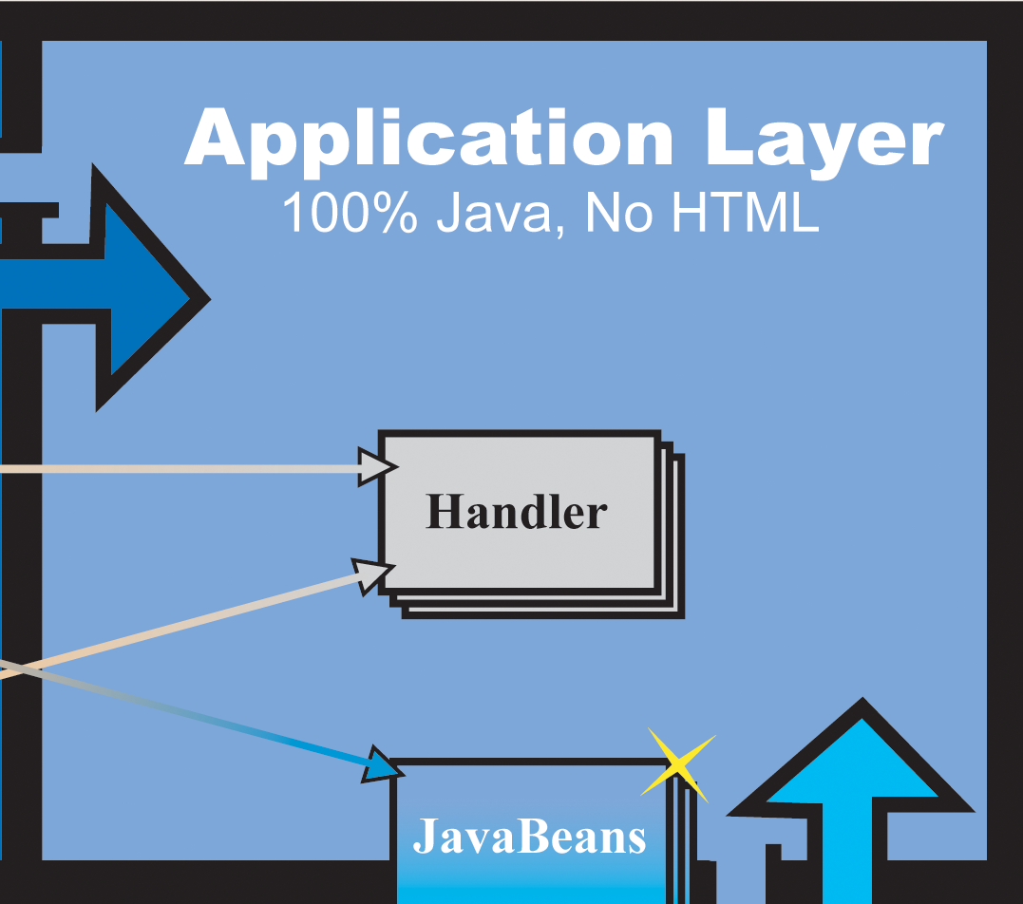
Application Layer
Java Developers maintain
SQLTagsHandlers “handle”
  Database Events
  JSP Page Events
JavaBeans
  Generalized Functions
Other JSP Tags
  More Generalized Functions abstracted into JSP tags

Slide 17
Application Layer
SQLTagsHandlerContract
  Programmers Build Java Classes that “Implement” SQLTagsHandlerContract
  Defines specific “Triggers” where Application Specific code is called
  Provides a Structure for Integration with Generated Code and JSP
  Provides a Structure for Separation from Generated Code and JSP
SQLTagsHandlerContract
Database Events
preInsert
postInsert
preUpdate
postUpdate
preDelete
postDelete
preQuery
postFetch
postQuery
Tag Events
preStart
postStart
perAfterBody
postAfterBody
perEnd
postEnd

Slide 18
Application Layer
Database Events
  DML Events
    Pre and Post Events for Operation;
      preInsert, postInsert
  Ditto Update, Delete
  onError
    Informs “Handler” of Database Errors
  Provides: Validation, Logging, Error Checking, Auditing, …
Database Events - Insert
preInsert
Rejected
INSERT
OnError
postInsert

Slide 19
Application Layer
Database Events- Query
Query Events
  preQuery,
  postFetch,
  postQuery
  onError
    Informs “Handler” of Database Errors
Follows “Cursor” Life-Cycle
preQuery
OnError
postFetch
postQuery

Slide 20
Application Layer
TAG Events
    preStart, postStart
    preAfterBody, postAfterBody
    preEnd. postEnd
Follows TAG Life-Cycle
Provides Mechanism for Limited Customization of TAG Behavior
TAG Life-Cycle
doStart
doAfterBody
doEnd

Slide 21

Application Layer
JavaBeans
  Nothing within the SQLTags Framework Prohibits Development or use of Additional JavaBeans.
  In fact, the generated “Table” classes are JavaBeans.
JSP Tags
  Nothing within the SQLTags Framework Prohibits Development or use of Additional JSP Tags.

Slide 22
SQLTags Framework
Data Layer
  SQLTags Classes
  100% Generated
Application Layer
  SQLTagsHandler
  JavaBeans
Presentation Layer
  HTML
  SQLTags JSP TAGS

Slide 23
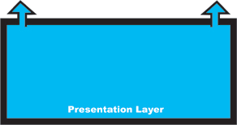
Presentation Layer
JSP Pages are Maintained by HTML Authors using:
  HTML, DHTML, XML
  JavaScript
  SQLTags TAGS
  Other JSP TAGS
  JavaBeans
  Very, Very Limited Embedded Java (Scriptlets)

Slide 24
Presentation Layer
SQLTags Built-in Features
  properties=“true”
  paging=“true”
  caching=“true”
  “handler reference”
  scriptlet variables
  SELECT formatting
  BIND formatting
Looping
  based on “where”
Data Manipulation:
  Insert, Update, Delete
Automatic Join on Foreign Keys to:
  Parent
  Children

Slide 25
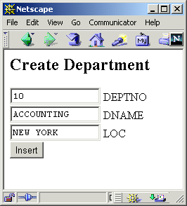
Presentation Layer
<h2>Create Department</h2>
<FORM>
<INPUT NAME="DEPTNO" SIZE="15" VALUE="10"> DEPTNO
<BR><INPUT NAME="DNAME" SIZE="15" VALUE="ACCOUNTING"> DNAME
<BR><INPUT NAME="LOC" SIZE="15" VALUE="NEW YORK"> LOC
<BR><INPUT NAME="fop" TYPE="submit" VALUE="Insert">
</FORM>
Since the “properties” attribute is “true” and the field names in the Form match the column names from the DEPT table the values will automatically be assigned.
<sqltags:dept
id=”d”
buttonName=”fop”
properties=”true”
/>
Processed By

Slide 26
Presentation Layer
Support Tags
  Where - defines complex where clause
  OrderBy - defines order by clause on “join”
  Fetch - Fetch Rows
  First - First on page
  Last - Last on page
Additional Tags
  Connect - Connect to database using pool
  Cursor - generic cursor tag for complex queries
  Previous - previous page Anchor
  Next - next page Anchor

Slide 27
SQLTags Framework
Data Layer
  SQLTags Classes
  100% Generated
Application Layer
  SQLTagsHandler
  JavaBeans
Presentation Layer
  HTML
  SQLTags JSP TAGS

Slide 28
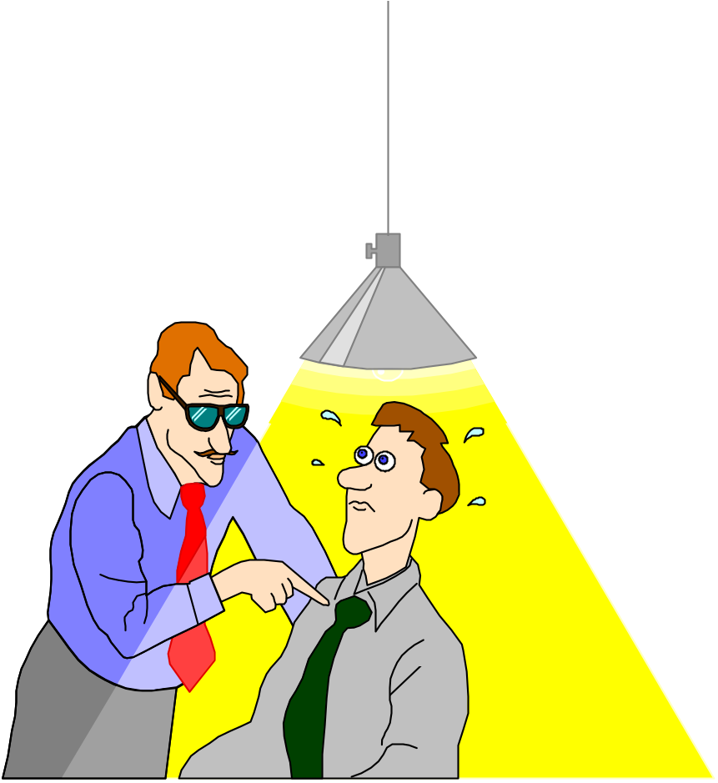
Questions?
Oracle Database …
Java/JSP …
User Interface …
AIT

Slide 29
AIT
Applied Information Technologies, Inc.
      Oracle on the Web since 1995
      http://www.ait-inc.com
Web/Database Integration
Java and JSP Development
Oracle DBA Services

