Slide 1
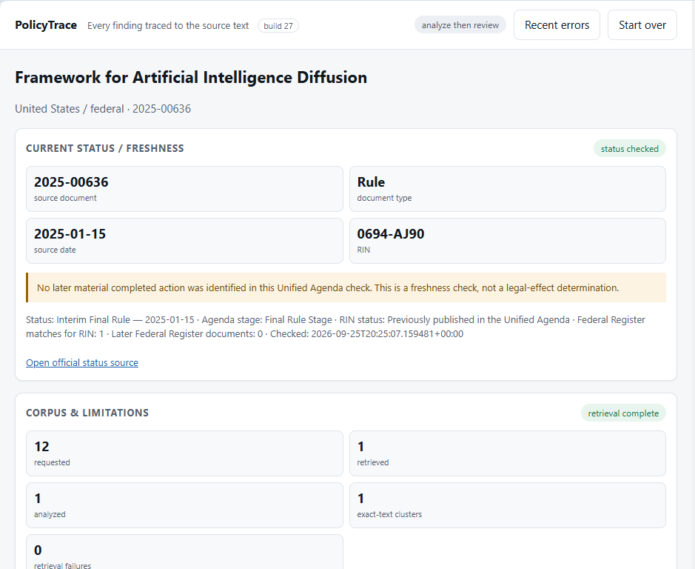
PolicyTrace
Evidence-grounded policy intelligence
Turn regulations, comments, news, and public feedback into traceable, reviewable leadership briefs.
Microsoft Foundry + GPT-5 mini
Build 27 validated live
PowerPoint for video entry
Notes:
[Sources]
- Project title and product screenshots from the user-provided PolicyTrace build 27 artifacts and live demo screenshots.
- Microsoft Foundry deployment/model and build validation from the live rehearsal captured in the AI handoff and Foundry monitor screenshots.

Slide 2
The challenge: trusted policy insight is slow
The contest challenge asks for transparent, evidence-grounded policy insights across policy text, comments, news, and public feedback.
CHALLENGE FIT
Analysts need more than a summary.
• Policy evidence is scattered across official text, public comments, news, correspondence, surveys, and social platforms.
• Manual review can take weeks.
• Simple sentiment scores hide why people support, oppose, question, or misunderstand a policy.
PolicyTrace turns that mess into a traceable evidence package - before any finding reaches leadership.
PolicyTrace
Notes:
[Sources]
- Innovation Studio challenge PDF: “Policy and Public Sentiment Analyst” challenge description says analysts must assess proposed laws and regulations while understanding responses across documents, comments, news, correspondence, call-center transcripts, surveys, and social platforms; it notes manual review can take weeks and sentiment scores may obscure reasons.

Slide 3
Solution: make every AI claim inspectable
PolicyTrace shifts the user experience from “trust the AI” to “inspect the evidence trail.”
Official source
package
Foundry
analysis
Evidence
verification
Human-reviewed
report
1
2
3
collect before AI
verify against text
review before approval
Audit log preserves every reviewed claim
Product invariant
No important claim without evidence. No evidence without a support check. No final report without human approval.
PolicyTrace
Notes:
[Sources]
- Product workflow and invariant from user-provided PolicyTrace handoff and final approved demo artifacts.
- Microsoft Foundry use is supported by the live Foundry monitor screenshot and successful PolicyTrace run artifacts.

Slide 4
Architecture: source-first, model-second
The system gathers deterministic source receipts before asking the model to produce or verify claims.
Leadership
Report
Federal Register
+ GovInfo
Regulations.gov
comments
Normalized
source package
Microsoft Foundry
GPT-5 mini
GDELT / media
pointers
Evidence
Audit Log
Implementation notes
• Search and intake are non-AI source-building steps.
• Docket detection is conservative; comments are loaded only from a confirmed docket.
• Verification labels stay separate from model confidence.
PolicyTrace
Notes:
[Sources]
- Architecture based on PolicyTrace source package, intake, verification, human review, Leadership Report, and Evidence Audit Log behavior demonstrated in the live run.
- Data sources align with Innovation Studio challenge resources: Regulations.gov API, Federal Register, GovInfo, GDELT Project, Microsoft Foundry, Azure AI Search, and related resources.

Slide 5
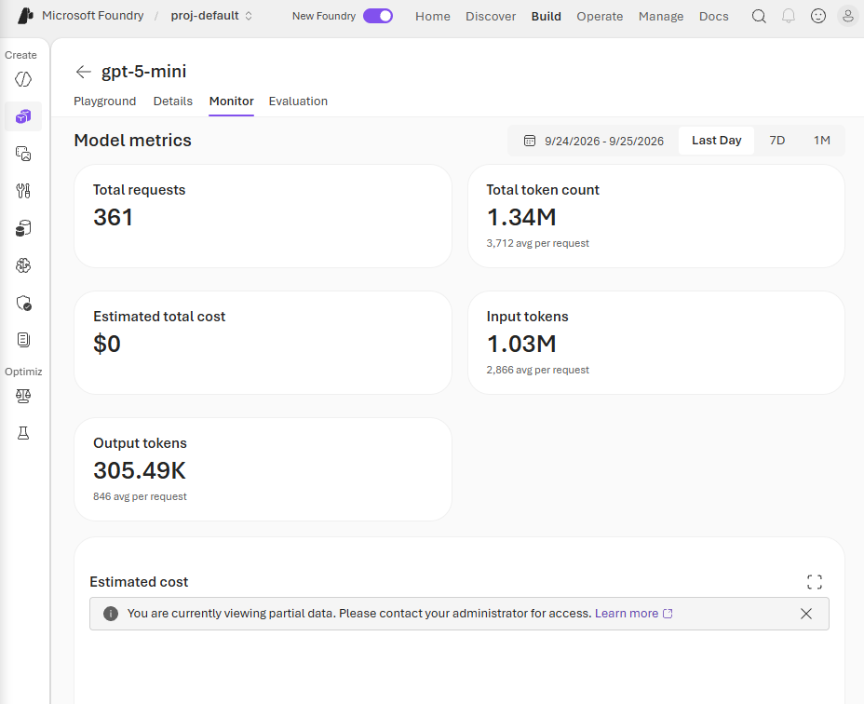
Live Microsoft Foundry integration was proven
The rehearsal used a real Foundry deployment, not a mocked model response.
361
1.34M
requests
total tokens
1.03M
305.49K
input tokens
output tokens
Why it matters: the same model that generated findings also produced enough traceable receipts for human review.
Foundry monitor after rehearsal
PolicyTrace
Notes:
[Sources]
- Microsoft Foundry monitor screenshot from user-provided “Microsoft Foundrytokens.pdf” showing 109 requests, 424.56K total tokens, 320.46K input tokens, and 104.11K output tokens.
- PolicyTrace live demo run used provider Microsoft Foundry with deployment/model gpt-5-mini, according to user-provided live rehearsal artifacts and handoff.

Slide 6
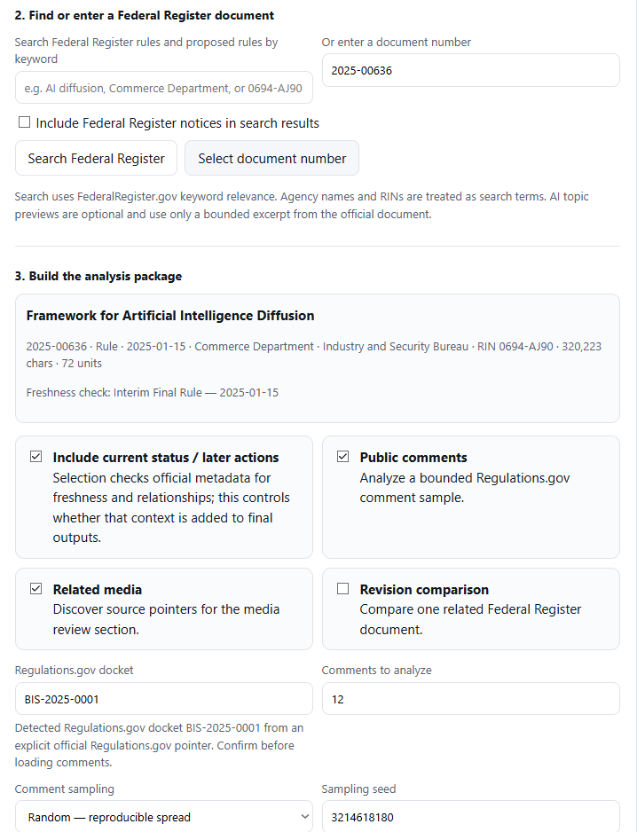
The live demo path is deterministic and judge-friendly
One policy, one source package, one traceable review path.
DEMO INPUT
Federal Register document
2025-00636
Framework for Artificial Intelligence Diffusion
Docket BIS-2025-0001
Random sample seed 1953583223
• Current status, comments, and related media enabled.
• Balanced report standard selected.
• The UI states no AI analysis starts until the user confirms the source package.
PolicyTrace
Notes:
[Sources]
- PolicyTrace intake screenshots and saved project JSON from the approved rehearsal: primary_document_number 2025-00636, docket_id BIS-2025-0001, comment_sampling_method random, comment_sampling_seed 1953583223, report_standard balanced, and related source options enabled.

Slide 7
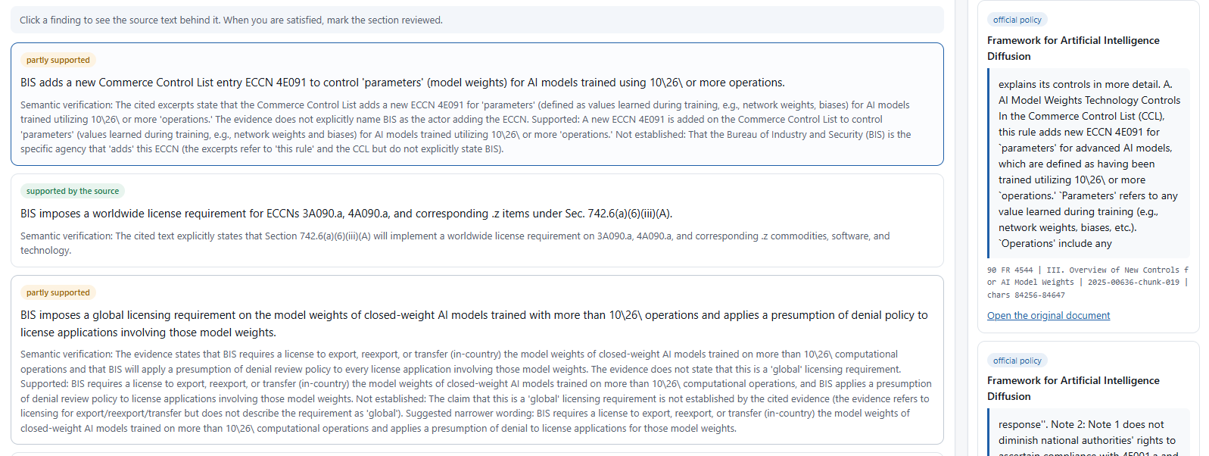
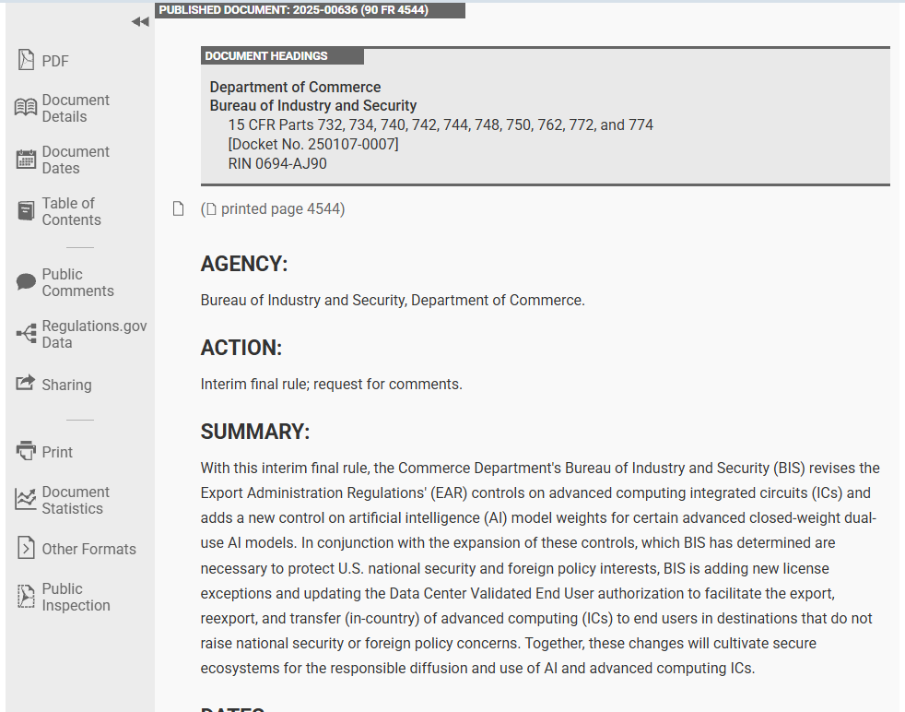
Evidence-first review: every finding is inspectable
A reviewer can click a claim, inspect the exact source passage, and open the original official document.
Supported finding
Exact passage
Original Federal Register page
PolicyTrace
Notes:
[Sources]
- Live demo screenshot showing a supported finding and the “WHERE THIS COMES FROM” evidence panel for Federal Register document 2025-00636.
- Live demo screenshot showing the original Federal Register page for “Framework for Artificial Intelligence Diffusion.”

Slide 8
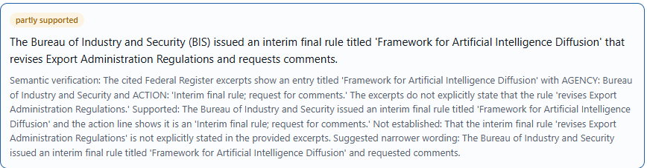
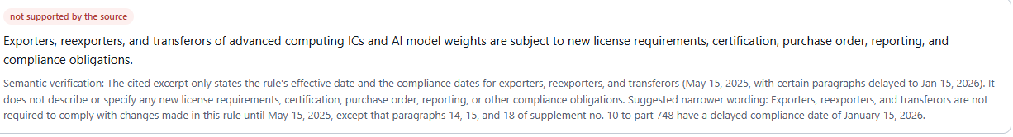
The verifier is allowed to disagree with the model
PolicyTrace preserves nuance instead of forcing every claim into “true” or “false.”
No source found: citation-integrity gate stops the claim before report promotion.
Reviewer flag required
Partially supported: what was established, what was not established, and suggested narrower wording.
PolicyTrace
Notes:
[Sources]
- Live demo screenshots showing a partially supported claim in PolicyTrace and a no-source finding where semantic verification was not attempted because the citation-integrity gate failed.
- Evidence Audit Log from the approved run records claim-understanding-014 as needs_human_review, report promotion BLOCKED, and evidence receipts none.

Slide 9
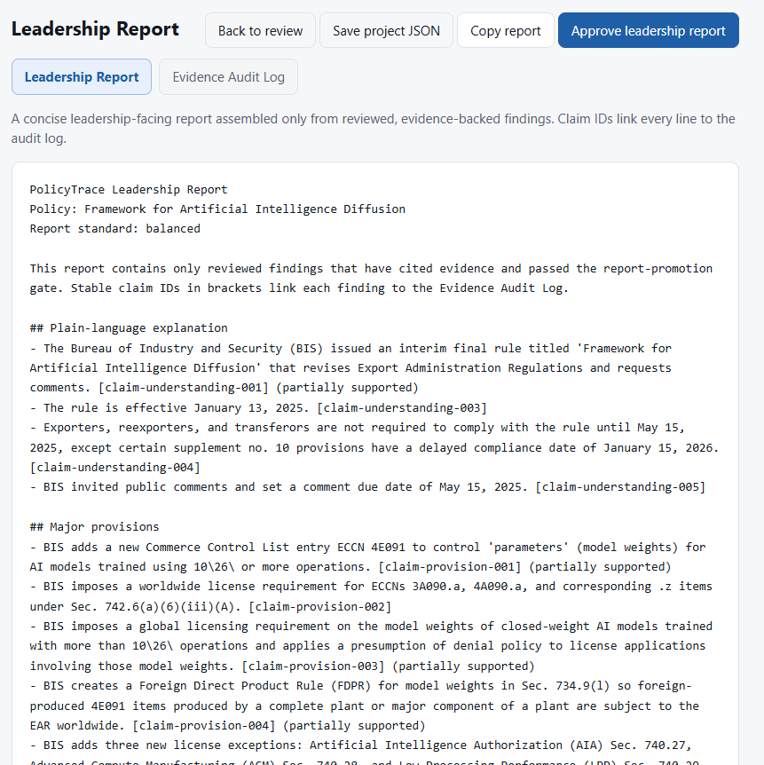
Two outputs: a leadership brief and a receipt layer
The Leadership Report is concise; the Evidence Audit Log preserves the full review record.
Leadership Report
reviewed findings only
Evidence Audit Log
all reviewed claims
Final approved rehearsal
• Final human review status: approved.
• 2 findings withheld from normal leadership promotion.
• Flagged claim remains visible in the audit log with no evidence receipt.
• Stable claim IDs link report bullets to evidence receipts.
Nothing disappears because the AI was wrong.
PolicyTrace
Notes:
[Sources]
- Final Leadership Report PDF shows the report is approved, includes reviewed evidence-backed findings, and records withheld findings in the Review limitations section.
- Final Evidence Audit Log PDF shows final human review status approved and preserves the blocked flagged finding plus the final approval acknowledgement.

Slide 10
Impact and next steps
PolicyTrace is built to be useful, auditable, and realistic to scale.
JUDGING FIT
Performance
works end-to-end
Innovation
evidence-first AI
Impact
safer policy briefs
Feasibility
web app + APIs
What we learned
Near-term roadmap
• The audit log is the core product strength: reviewers can inspect every claim.
• Leadership summaries should inherit caution from the verifier, not smooth it away.
• Source-specific connectors matter: FCC ECFS is a future priority beyond Regulations.gov.
• Auto-promote verifier narrower wording for partially supported claims.
• Add ECFS retrieval for FCC comments.
• Improve status/freshness checks by agency-specific identifiers.
• Package clean demo repo, video, and PowerPoint for submission.
You do not have to trust the AI - here is the evidence trail.
PolicyTrace
Notes:
[Sources]
- Official Rules PDF: judging criteria are 25% Solution Performance, 25% Innovation, 25% Economic Value & Societal Impact, and 25% Feasibility.
- Blind AI review notes from the user-provided pasted text identified the Evidence Audit Log as strong and flagged future improvements around partially supported wording, status/freshness nuance, source-specific comment retrieval, and leadership-report concision.

