Slide 1
LIMELIGHT
HELPING ACTOR FANS AND MOVIE BUFFS ONE SEARCH AT A TIME !

Slide 2
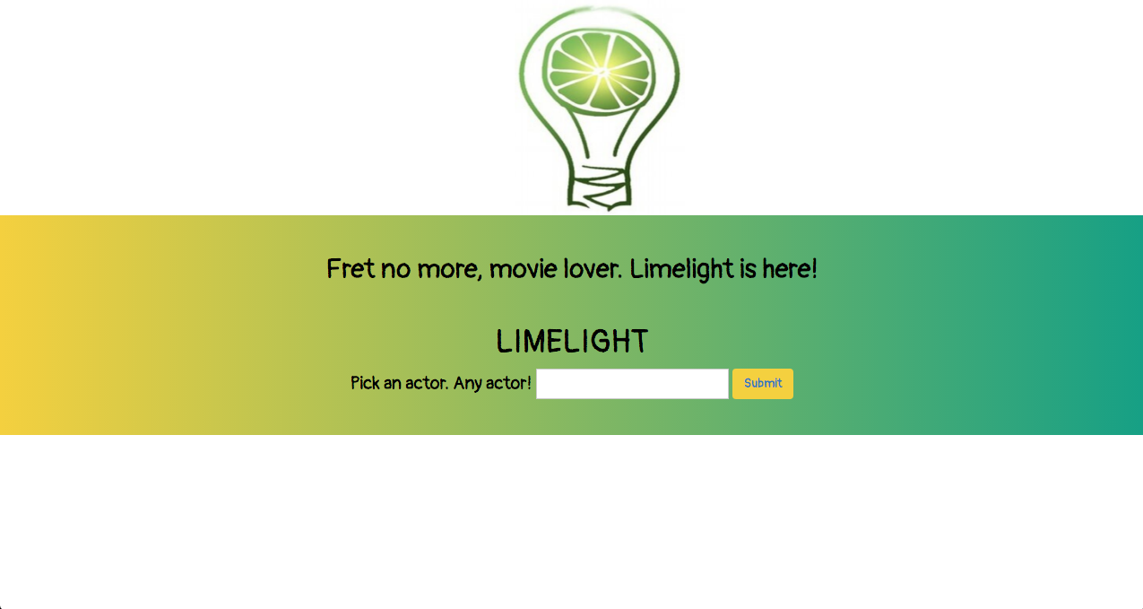
INTRODUCTION

Slide 3
OVERVIEW
APPLICATION FOR SEARCH FUNCTIONALITY
USER LOOKUP OF FAVORITE ACTOR
API
COMBINATION OF IMDB AND YOUTUBE
RESULT
ACTOR BIROGRAPHY AND TRAILER LIBRARY

Slide 4
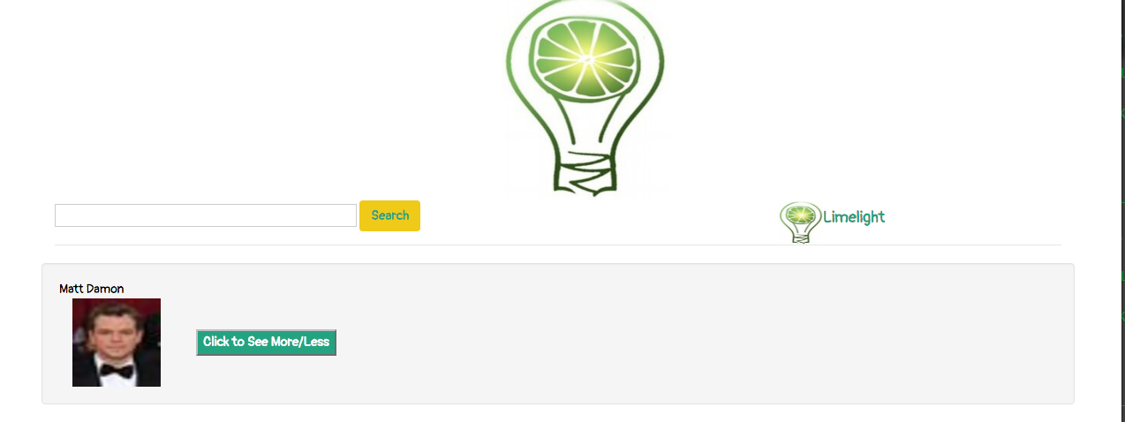
FUNCTIONALITY

Slide 5
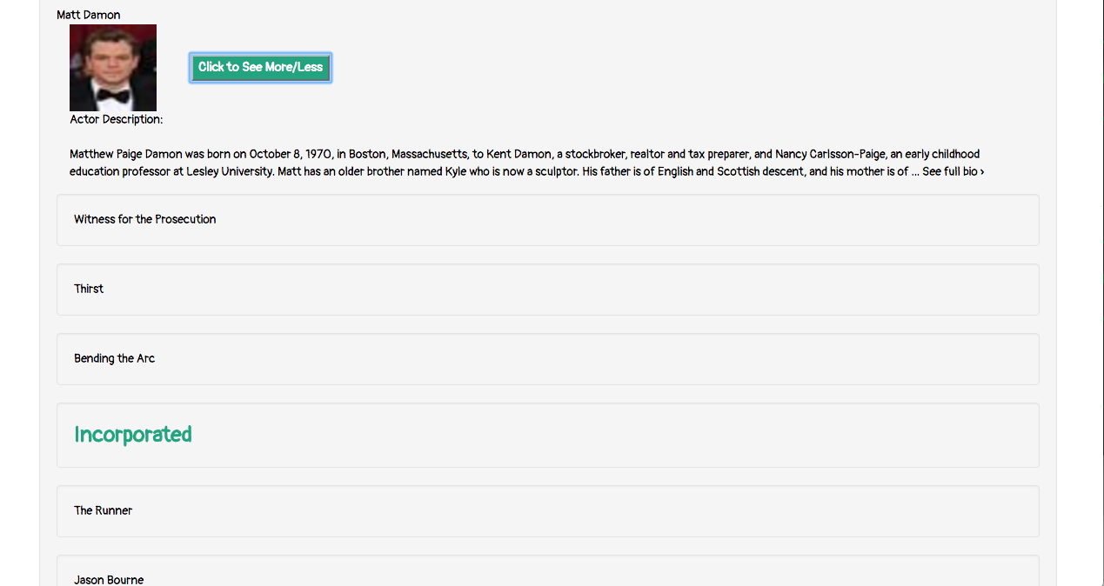
FUNCTIONALITY

Slide 6
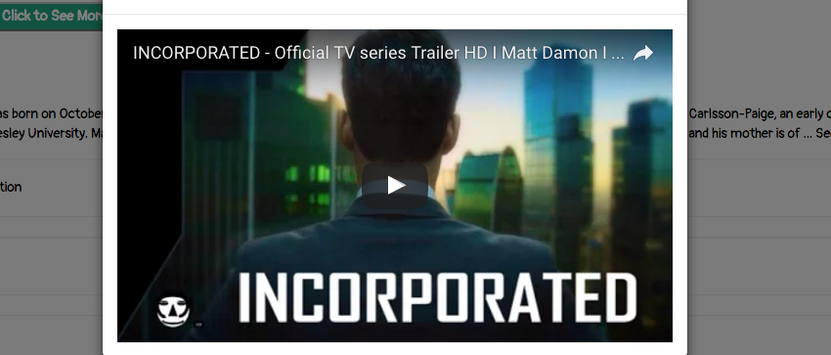
FUNCTIONALITY

Slide 7
LIVE DEMO
Start

Slide 8
DEVELOPMENT
USER INTERFACE
DISPLAY AND EASE OF USE
BUILD ON IMDB DATA PULL
ADD ON OF ANOTHER API FOR USER CONVENIENCE
FANDANGO
ONLINE MOVIE STREAM

