Slide 1
Zero Friction Development
When we’re ready to code, nothing gets in our way.

Slide 2
Practices
One-second Feedback: Make a change, see the feedback, keep working.
Know Your Editor: automated refactorings, keyboard shortcuts, code completion, navigation.
Reproducible builds: check out any commit and it works for any developer on any machine
Dependency management: dependencies are in the repository
Local builds: tests run entirely locally
Five-minute Integration: Fast, reliable tests
Control Complexity: beware of heavy frameworks, libraries. Optimize for maintenance over initial development.
Automate Everything: build, integrate, deploy, run scripts

Slide 3
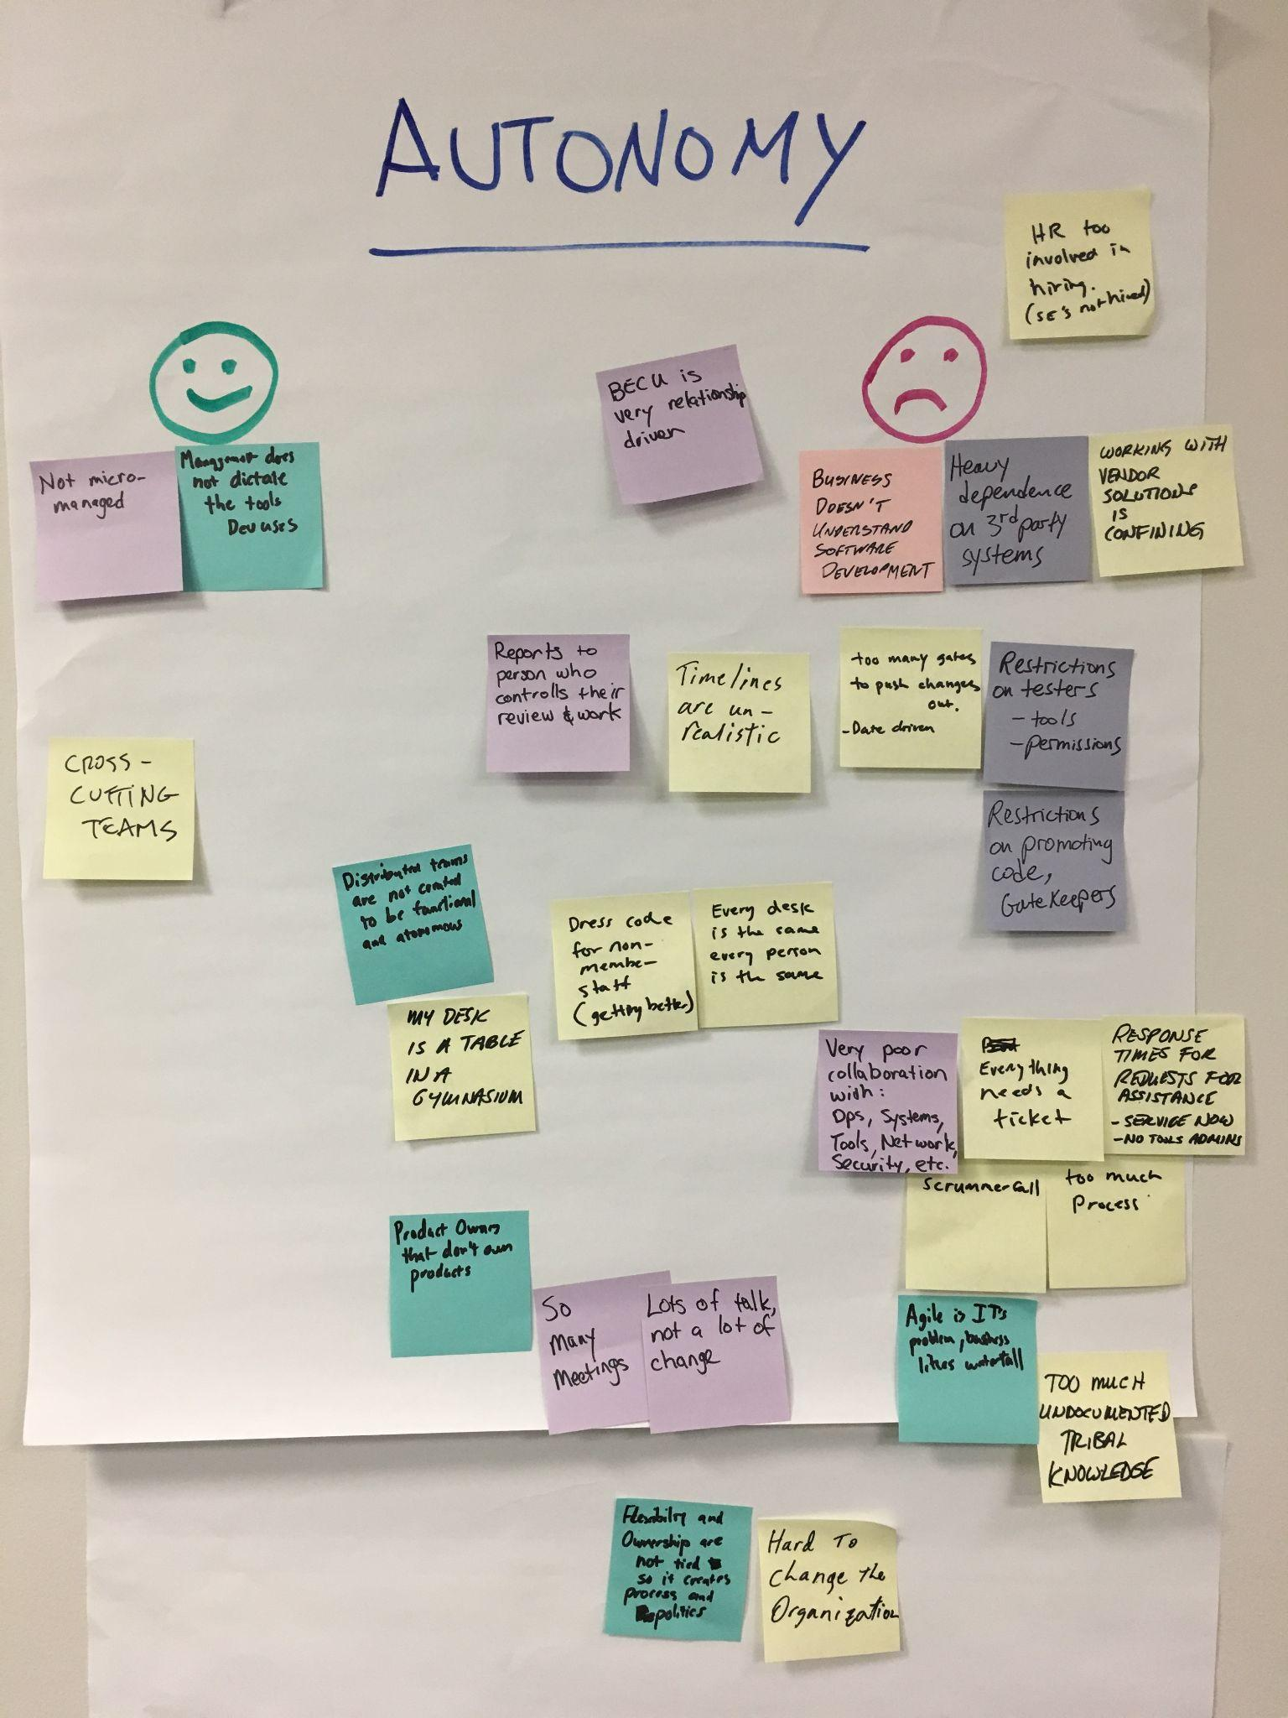
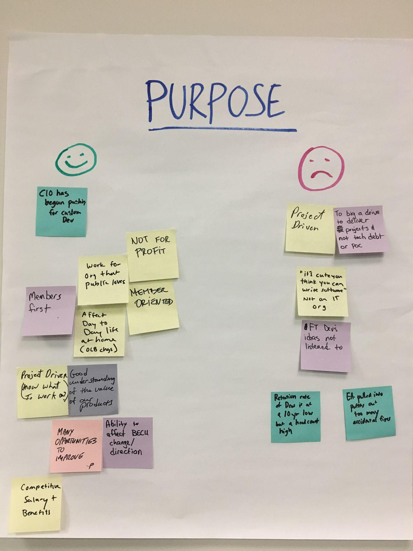
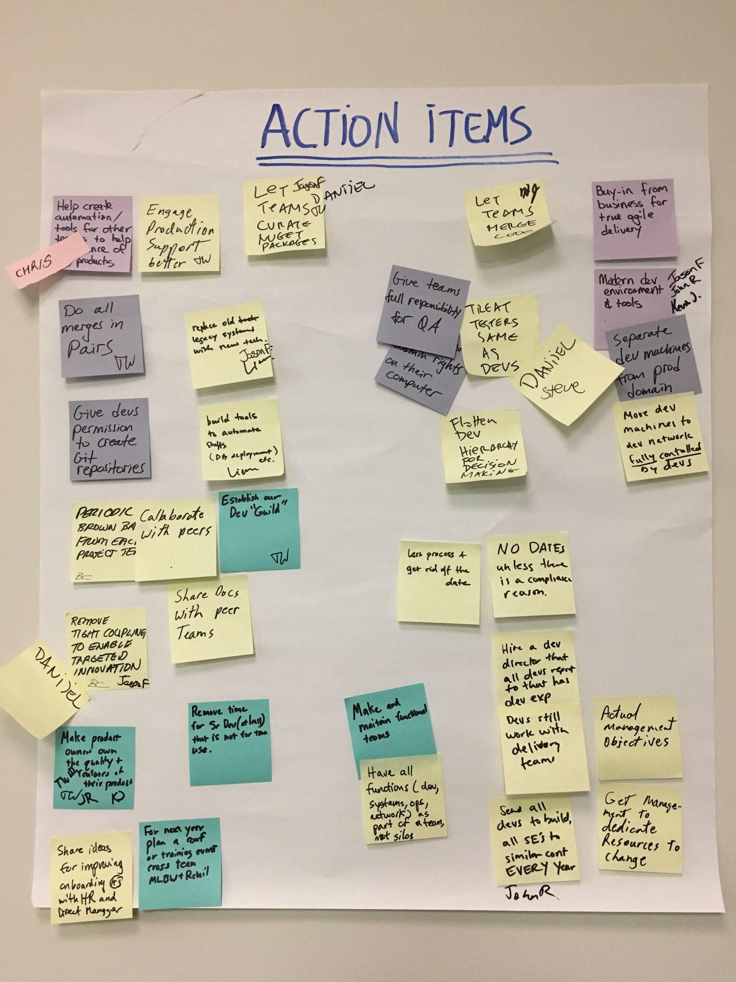
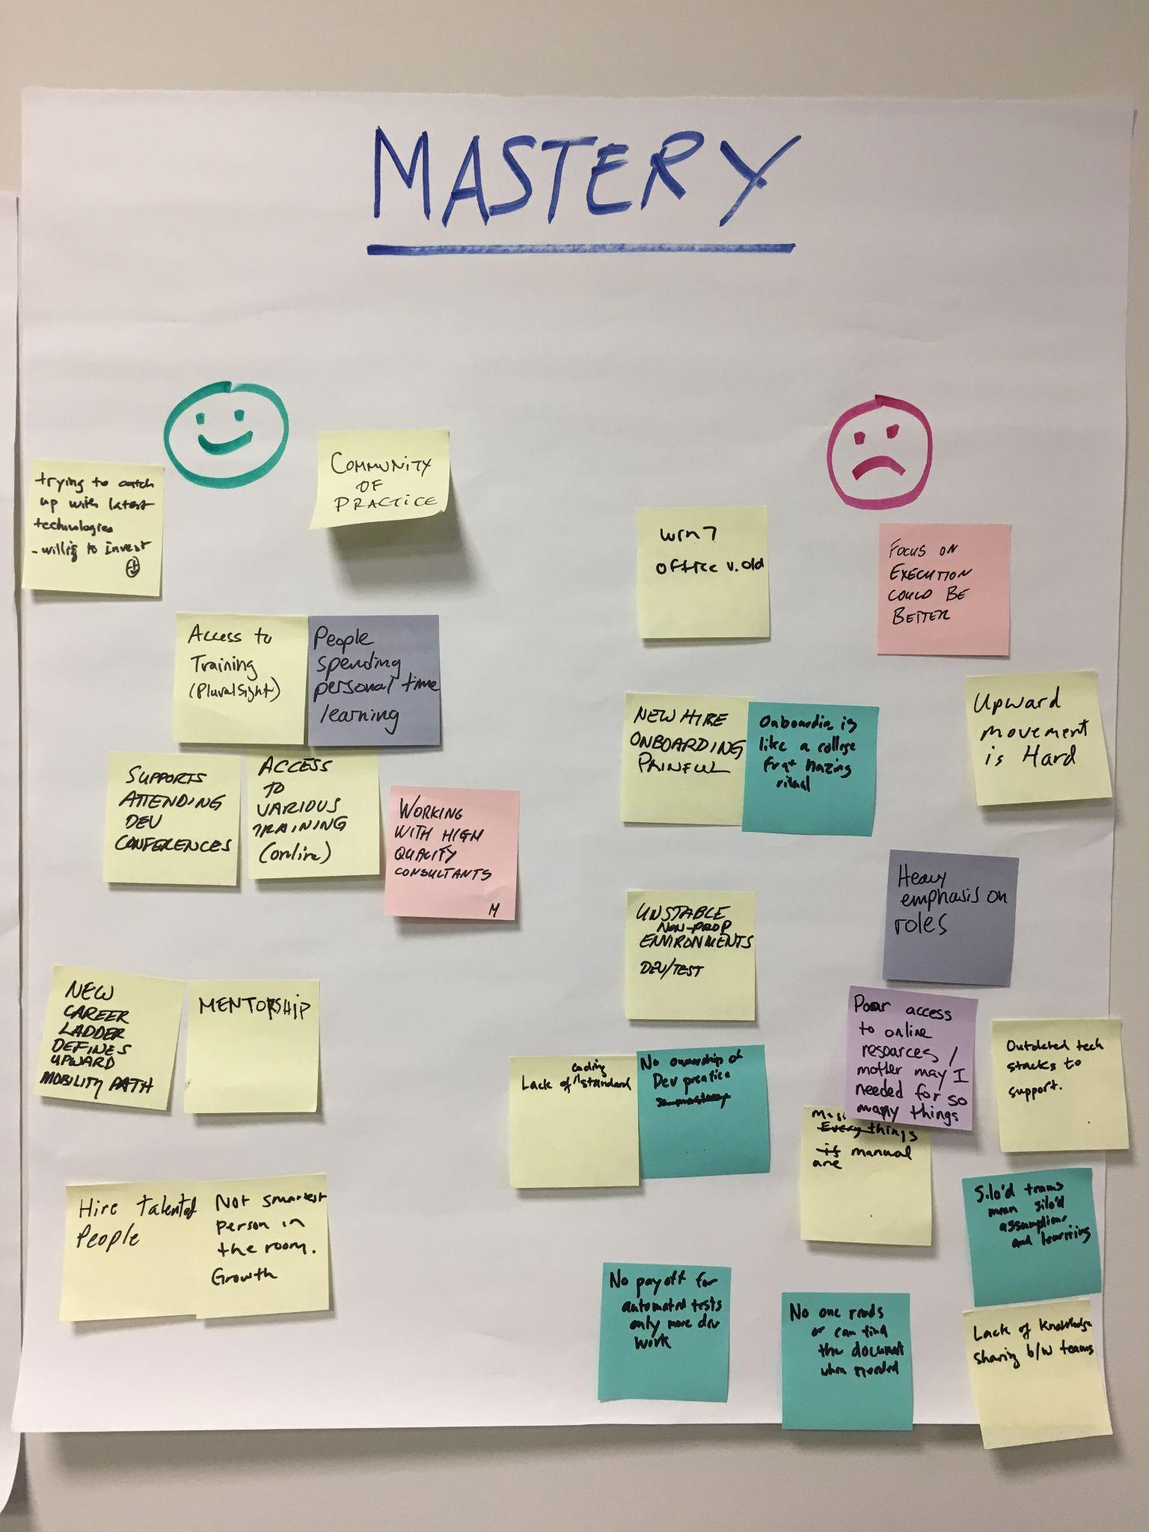
Ask the Developers

