Slide 1


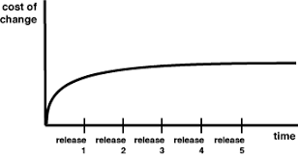
Technical Coaching Vision
How
(Coaching Methods)
What
(Practices)
Why
(Outcomes)
Learning by doing
Write code together (90%)
Workshops
Coding dojos
Continuous Integration /Continuous Delivery
Pair/Mob programming
Test-driven Development
Refactoring
Simple/Emergent Design
Zero bugs
Ship at will
Changes are easy

Slide 2
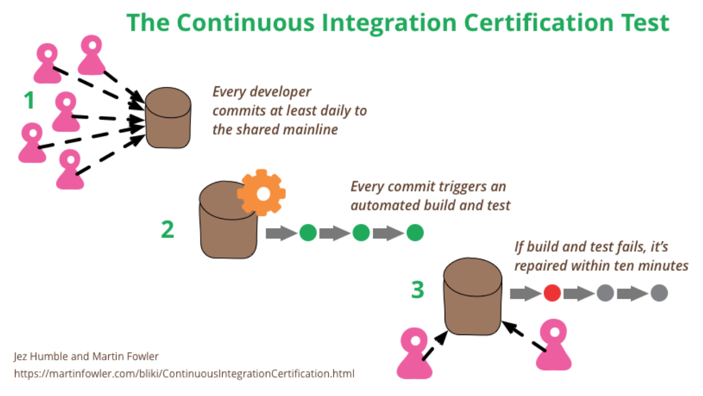
Continuous Integration
It’s not about tools! It is the practices/behaviors surrounding the tools.

Slide 3
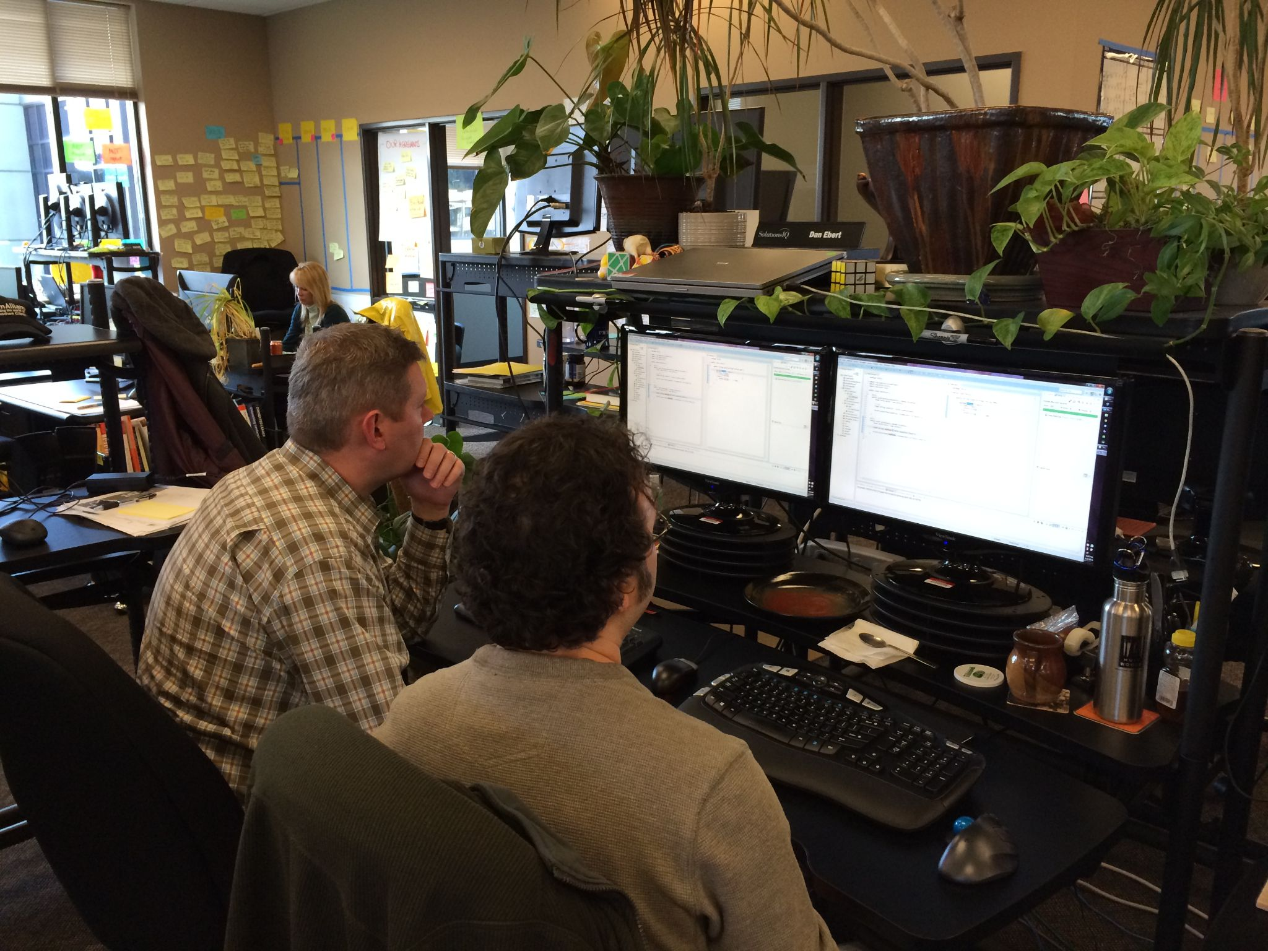
Collaborative Development - pair programming
Pair Programming: two people sitting at one computer working on the same task
Driver/Navigator: swap who is at the keyboard frequently
Studies show a 43% reduction in development time and 60% reduction in defects
Follows the XP model of “dial it up to 10” - if code reviews are good, then let’s do them all the time
Deming: inspecting for quality just generates rework, you must build quality in
Knowledge sharing increases, silos are reduced

Slide 4
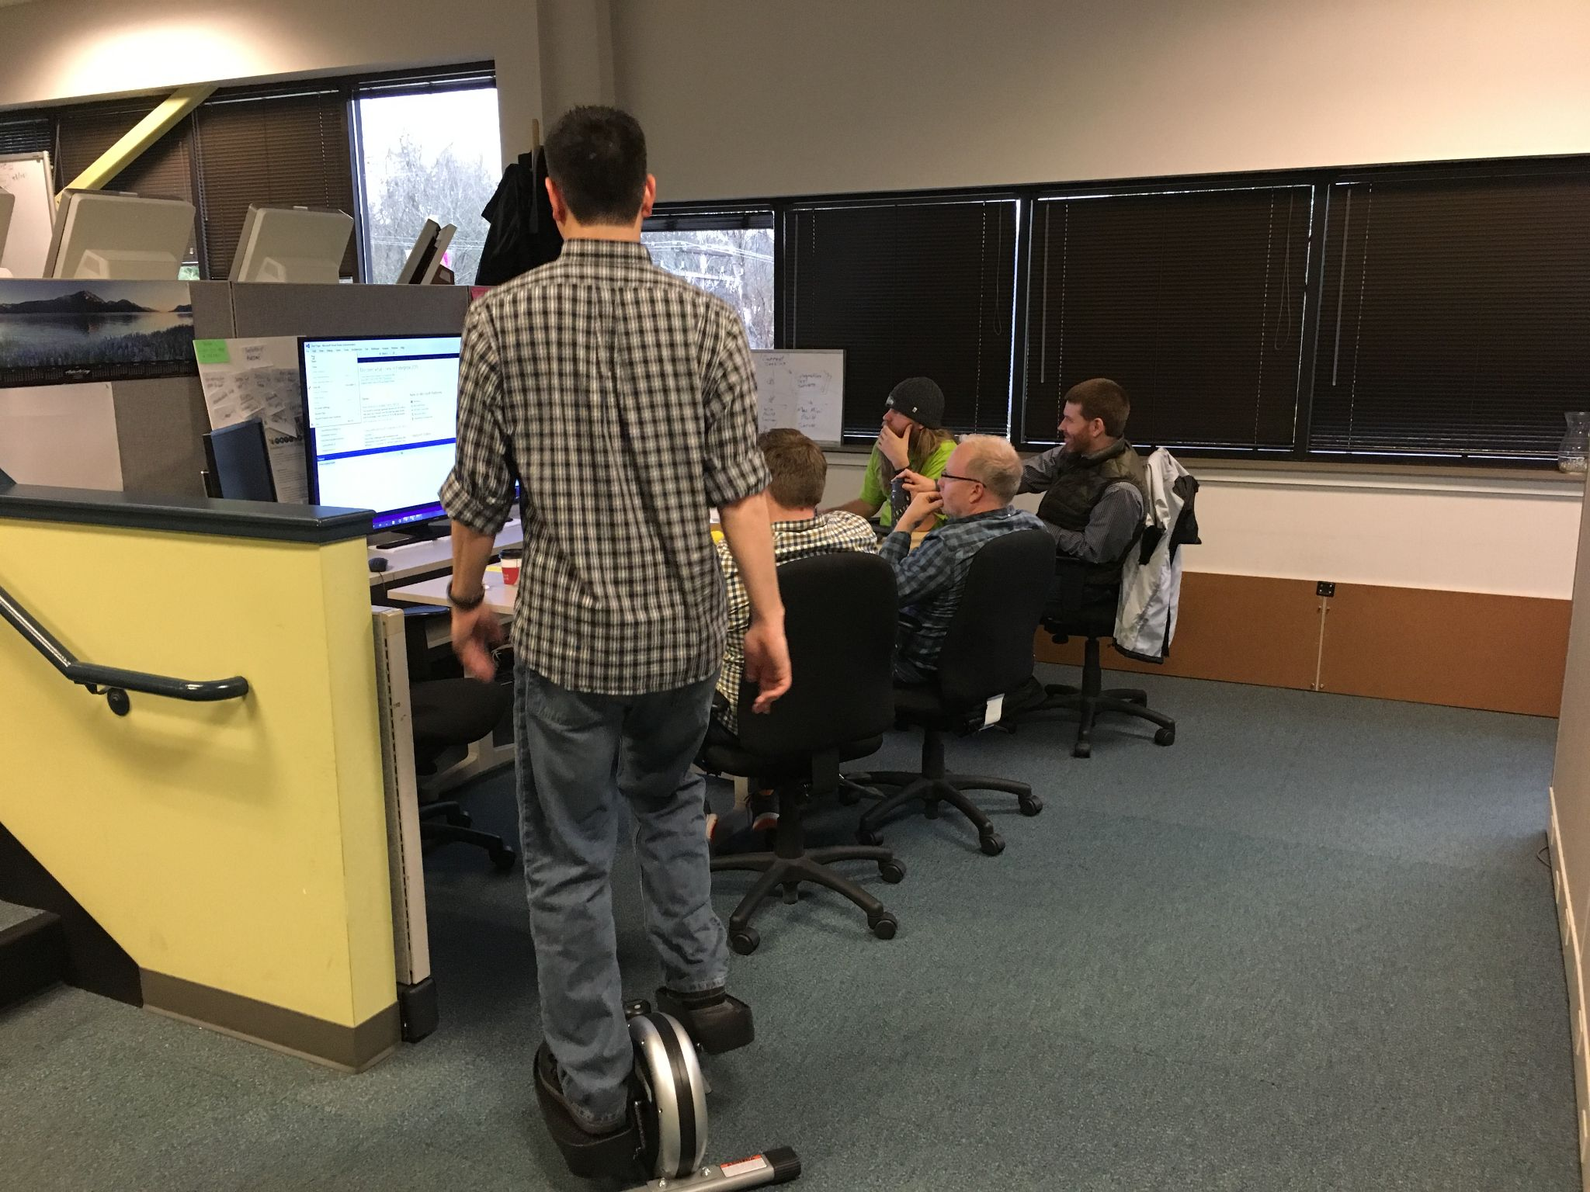
Collaborative Development - mob programming
"All the brilliant minds working together on the same thing, at the same time, in the same space, and at the same computer" Woody Zuill
Shortest possible cycle time for a team (WIP = 1)
Most predictable velocity
Highest level of knowledge sharing
No handoffs, no waiting
Notes:
cycle time = WIP / average completion rate

Slide 5
Testing Strategies
Strategy | Result
No testing/all manual testing | Users find bugs in production
Test after (“debug later programming”) | Developer finds bugs in code written last week
Continuous testing | Developer knows code written 1 minute ago is correct

Slide 6

Test-driven Development
Cycle
Write a test describing a small piece of behavior (will fail, as behavior doesn’t exist yet)
Write just enough code to make that failing test pass
Repeat by expanding the test or writing a new test
Benefits
Prevents defects
Ensures the developer always knows the code does what he/she thinks it does
Eliminates time spent debugging
Ensures a testable design, and a design that only does what is required
Provides a safety net for refactoring, and future changes/additions to the software

Slide 7

Refactoring
“A disciplined technique for restructuring an existing body of code, altering its internal structure without changing its external behavior” Martin Fowler
Is:
the antidote to code and design entropy
should be going on continuously
Is not:
rewriting code
completing unfinished work
fixing missed requirements or defects
improving observable aspects of the software
Examples:
renaming methods or variables for clarity
removing code duplication
restructuring disparate elements to unify a design
anything to improve readability/ease of maintenance

Slide 8
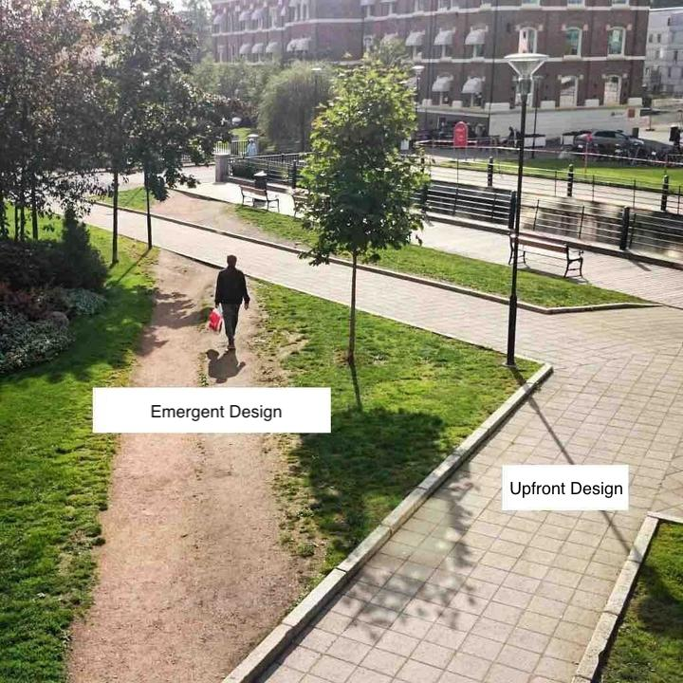
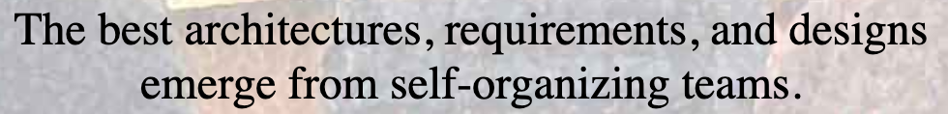
Simple Design/Emergent Design
Different from:
designs being dictated from above
designing based on assumptions about the future
creating frameworks or infrastructure ahead of features
Four Rules of Simple Design:
Tests Pass
Expresses Intent
No Duplication
Fewest Elements
“Features Before Infrastructure” Bob Martin

Slide 9
Technical Coaching Vision
How
(Coaching Methods)
What
(Practices)
Why
(Outcomes)
Learning by doing
Write code together (90%)
Workshops
Coding dojos
Continuous Integration /Continuous Delivery
Pair/Mob programming
Test-driven Development
Refactoring
Simple/Emergent Design
Zero bugs
Ship at will
Changes are easy

Slide 10
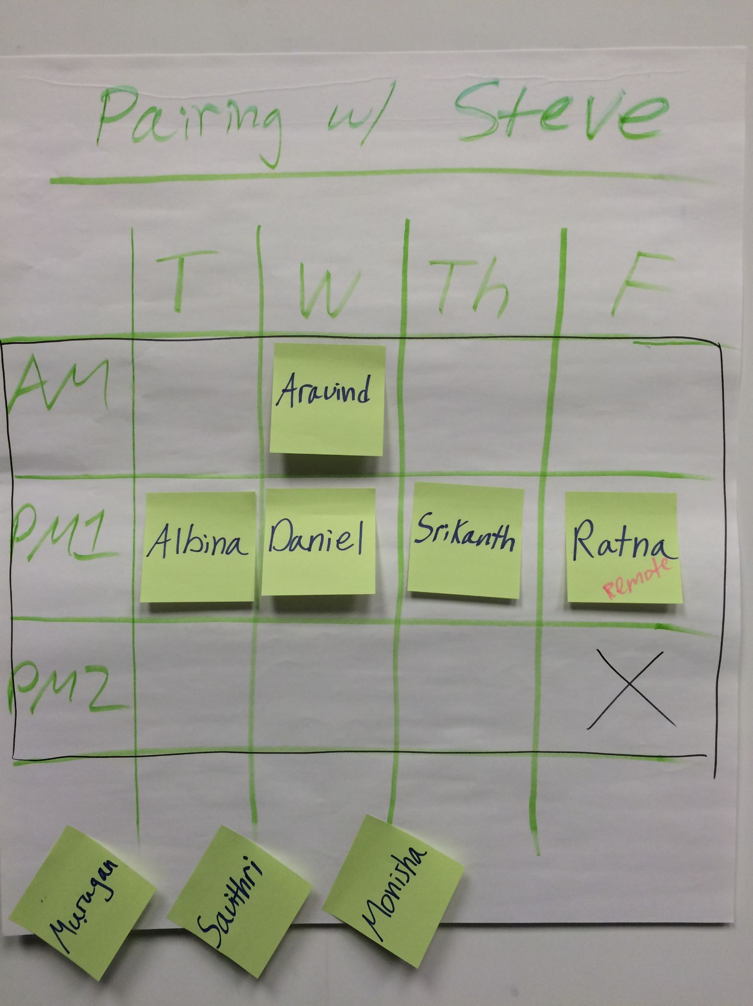
How: Pairing Sessions

Slide 11
How: Embedded coaching model
A Day in the Life of an embedded technical coach
08:00 Preparation for the day’s sessions
09:30 Mob programming with Team 1
11:30 Lunch
13:00 Learning hour with both teams
14:00 Break
14:15 Mob programming with Team 2
16:15 Debrief, reflect
17:00 Go home

