Slide 1
Team Topologies
A Book Summary

Slide 2
Preface
Purpose: Help those who care to make the delivery and running of software systems more effective.
Three parts:
Conway’s Law, Teams as a means of delivery
Team patterns (4) and interactions modes (3)
Organizational design, to create a sensing organization
Influences:
Systems thinking
Tuckman model
Five Dysfunctions of a Team

Slide 3
Organizations
Building and running highly complex, interconnected software systems is a team activity
Organizations need stable teams and effective team patterns and interactions
Rely on decoupled, long-lived teams
Actual communication lines are different from the org chart
Move from Project to Product
Team topologies evolve with technological and organizational maturity
During discovery more collaboration is needed, less later

Slide 4
Conway’s Law
“Organizations which design systems are constrained to produce designs which are copies of the communication structures of these organizations”
Reverse Conway Maneuver: organize team structures to match the architecture you want.
Cognitive Load: can be reduced by thinking about team size, responsibilities, and collaboration boundaries with other teams
An organization that is arranged in functional silos is unlikely to ever produce software systems that are well-architected for end-to-end flow.

Slide 5
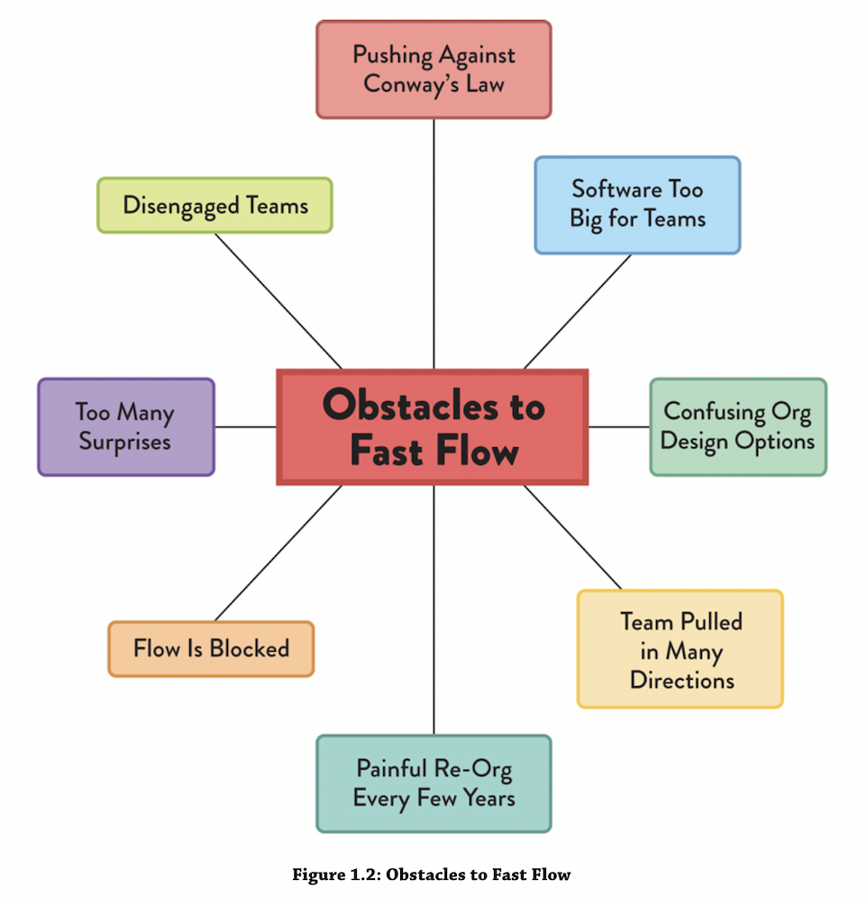
Obstacles to Flow
The result of organizations viewing software development the same as manufacturing, to be completed by separate individuals.

Slide 6
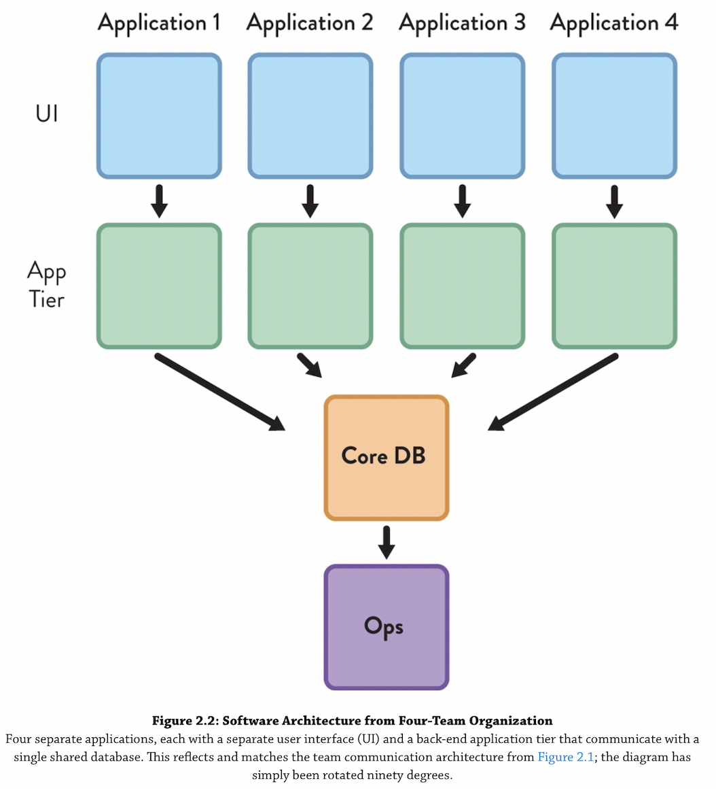
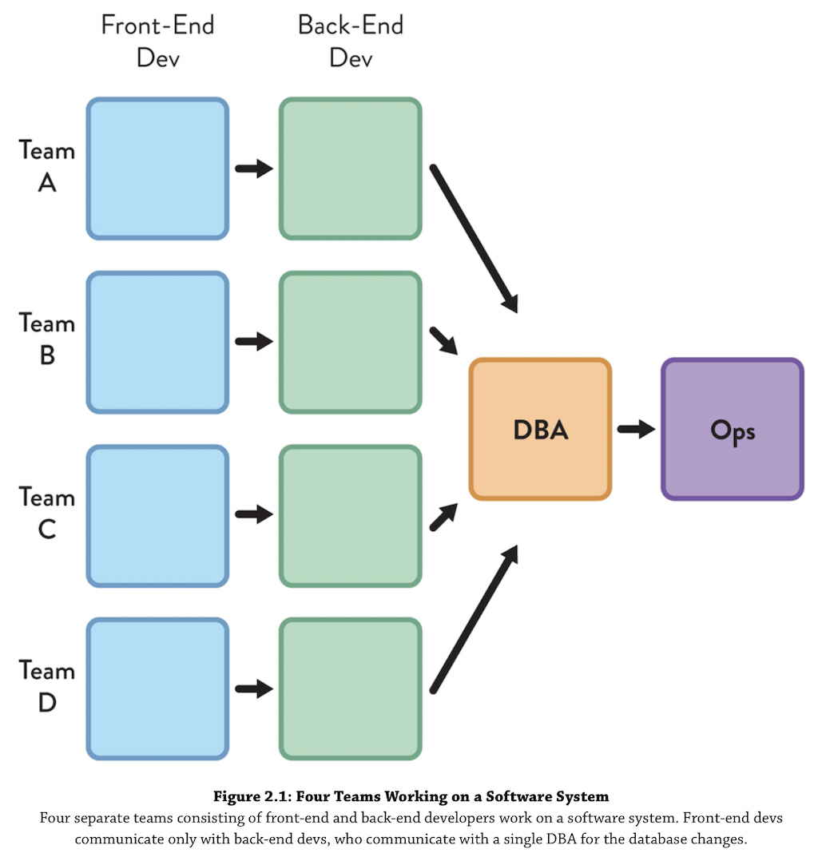
Conway’s Law - Example 1
Team Design
Resulting Architecture

Slide 7
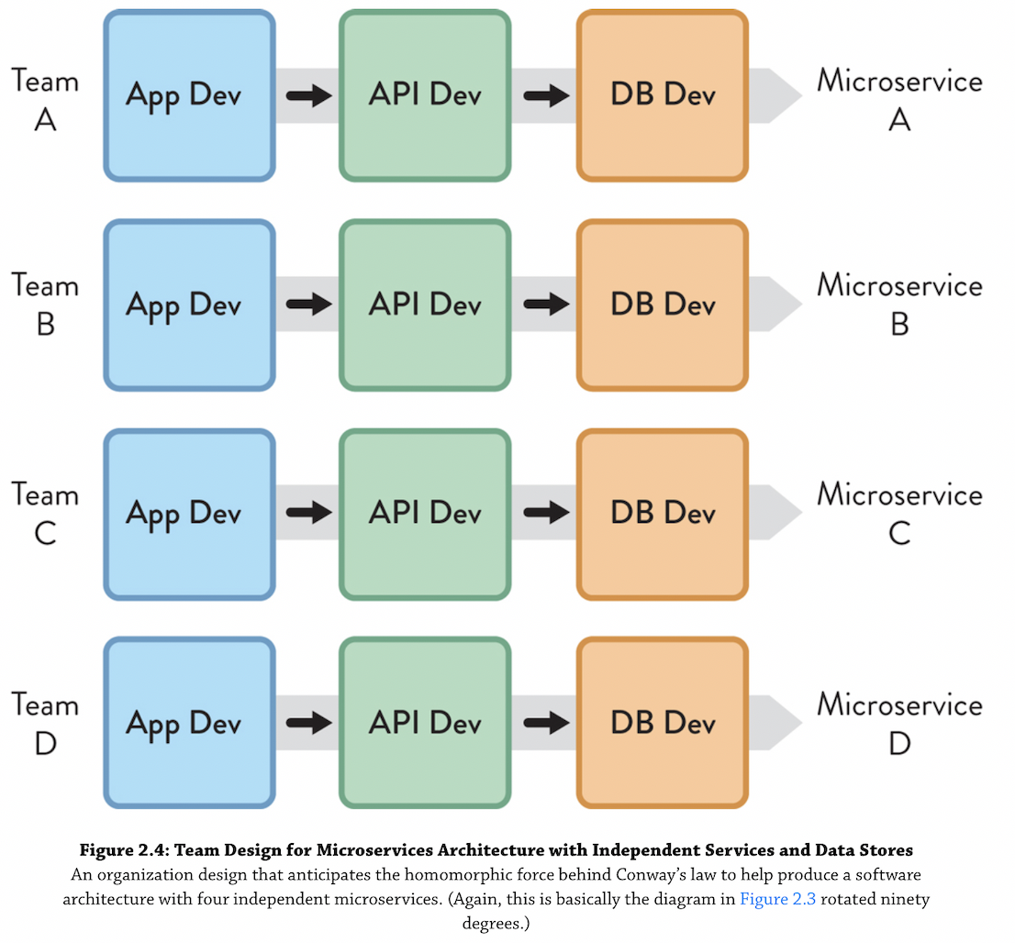
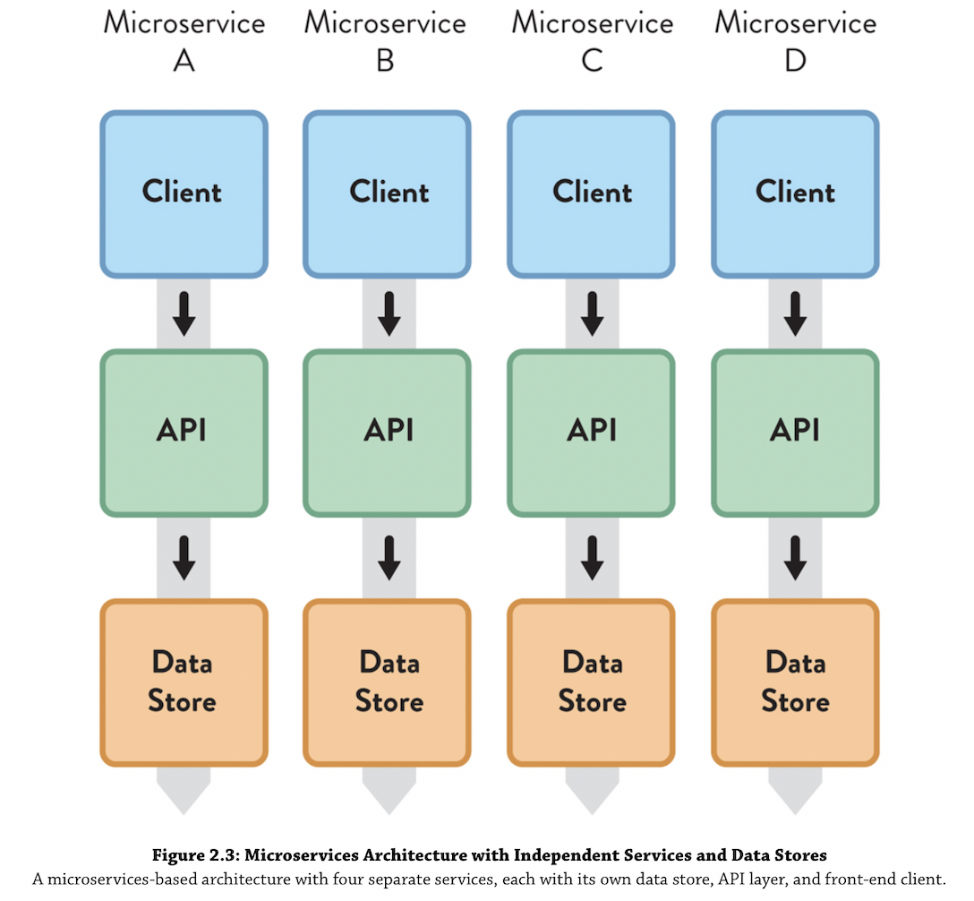
Conway’s Law - Example 2
Team Design
Resulting Architecture

Slide 8
Implications of Conway’s Law
Team assignments are the first draft of the architecture
Anyone who makes decisions about the shape and placement of engineering teams is strongly influencing the software architecture
Do the people making these decisions (sometimes HR) have the right knowledge?
Organization design and software design are two sides of the same coin

Slide 9
Team design should follow good architectural practices
Loose coupling - teams are not dependent on other teams
High cohesion - teams have clearly bounded, strongly related, responsibilities
Appropriate number of communication paths
High-bandwidth within the team
Low-bandwidth between most teams

Slide 10
Team-first Thinking
Teams working as a cohesive unit perform far better than individuals
The team is the fundamental means of delivery
Smaller team size fosters trust
Keep the team stable and flow work to the team
Every part of the software system is owned by exactly one team

Slide 11
Cognitive Load
Restrict team responsibilities to match team cognitive capacity
Limit the size of the subsystem or area on which the team works
Limit the number and type of domains per team
Favor small, decoupled services

Slide 12
Other Considerations
Design Team APIs
Cover what code the team owns, where their wiki is, team norms, how they communicate with other teams.
Facilitate team interactions, through guilds, CoPs
Design physical and virtual environments for all modes of work:
focused individual work
collaborative intra-team work
collaborative inter-team work

Slide 13
Team Topologies - Organize teams according to business domain areas
Organizations that expose software development teams to the software running in the live environment tend to address user-visible and operational problems much more rapidly compared to their siloed competitors
Cross-functional teams: all the skills necessary to design, develop, test, deploy, and operate the system

Slide 14
Avoid having a separate “DevOps Team”
Anti-pattern: tooling expertise ends up in a silo, that everyone is dependent on
Delivery teams should own development and operations automation
Could have a “DevOps Evangelists” team (see Platform team)

Slide 15
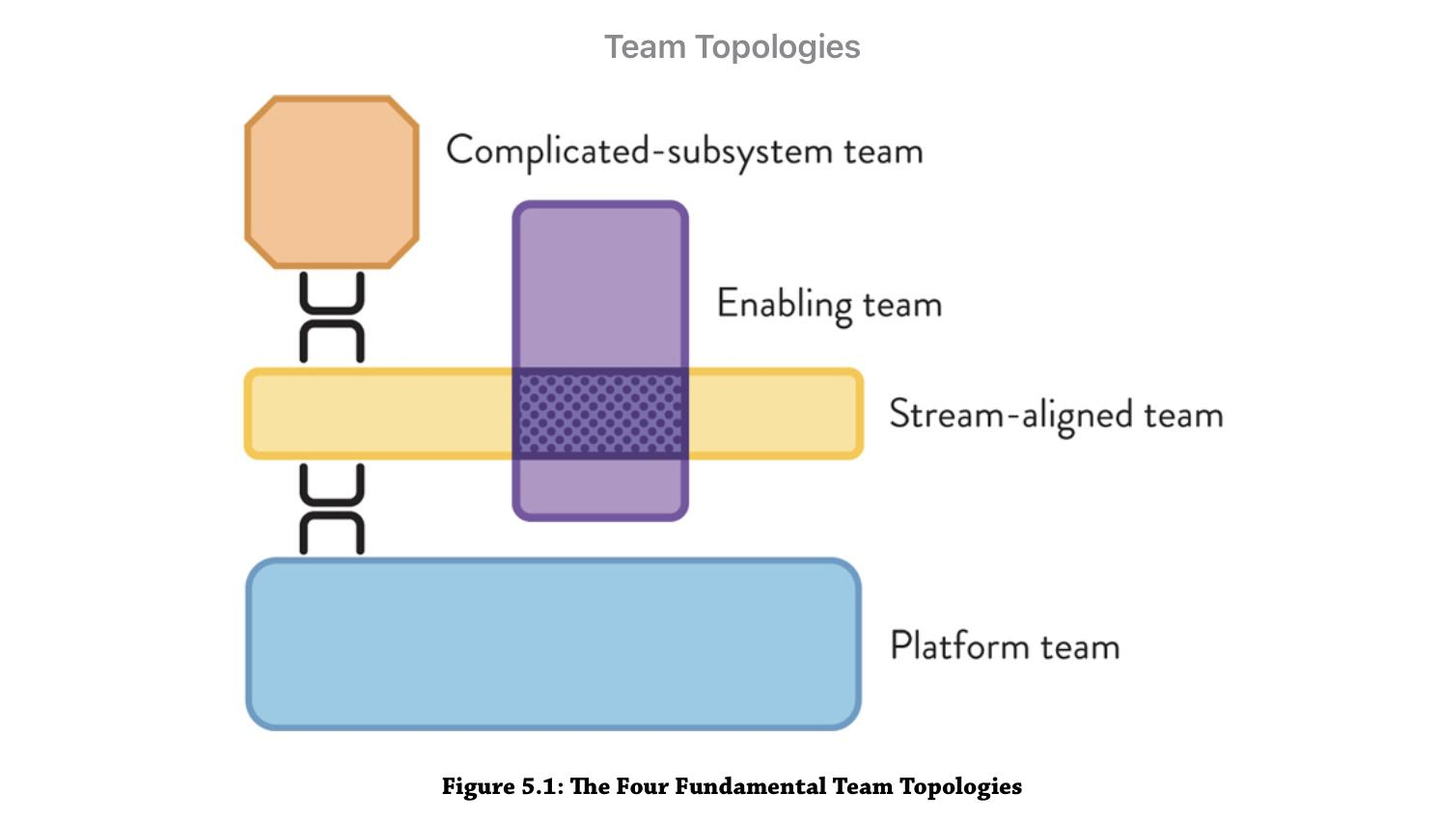
The 4 Team Topologies

Slide 16
Stream-aligned Teams
Aligned to a single, valuable stream of work
Empowered to deliver value, without requiring hand-offs to other teams
Quickly incorporate feedback from customers
Monitor their software in production
Might be a mix of generalists and a few specialists
Must have time and space to address code quality
changing the code remains safe and easy
Most teams are stream-aligned

Slide 17
Enabling Teams
Composed of specialists in a given domain
Cross-cut stream-aligned teams
Have bandwidth to research
Consultants - provide guidance, not execution
Goal: increase autonomy of stream-aligned teams
Educate, share good practices
Help stream-aligned teams acquire missing capabilities
Dependency on them is not permanent

Slide 18
Complicated Subsystem Teams
Group of specialists, responsible for building and maintaining a part of the system that depends heavily on specialist knowledge
Examples: video processing codec, mathematical models, facial recognition engine
Created to reduce team cognitive load, not be a perceived opportunity to share the component
Occasionally needed but only for exceptional cases

Slide 19
Platform Teams
Enable stream-aligned teams to deliver with autonomy
Steam-aligned team maintains full ownership of building, running, and fixing their application in production
Provide internal self-service tools, services, knowledge, and support
Treat the services they offer as products
Understands needs of stream-aligned teams

Slide 20
Examples of services provided by Platform teams
Provisioning a new server instance
Tools for access management and security enforcement
Build and release tools
Configuration management system
Logging and monitoring services
APIs for creating test environments
Facilities for querying resource usage
Machine or container provisioning
Network configuration
Note: these are all services for developers, not an integral layer of the application

Slide 21
Conversion Strategies
Convert most teams to steam-aligned teams
Convert infrastructure teams to platform teams
needs to be self-service
treating the platform as a product requires software development techniques that may be unfamiliar

