Slide 1
Code Coverage
The good, the bad, and the ugly.

Slide 2
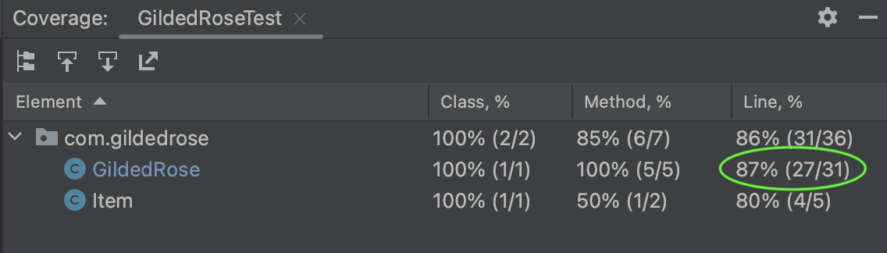
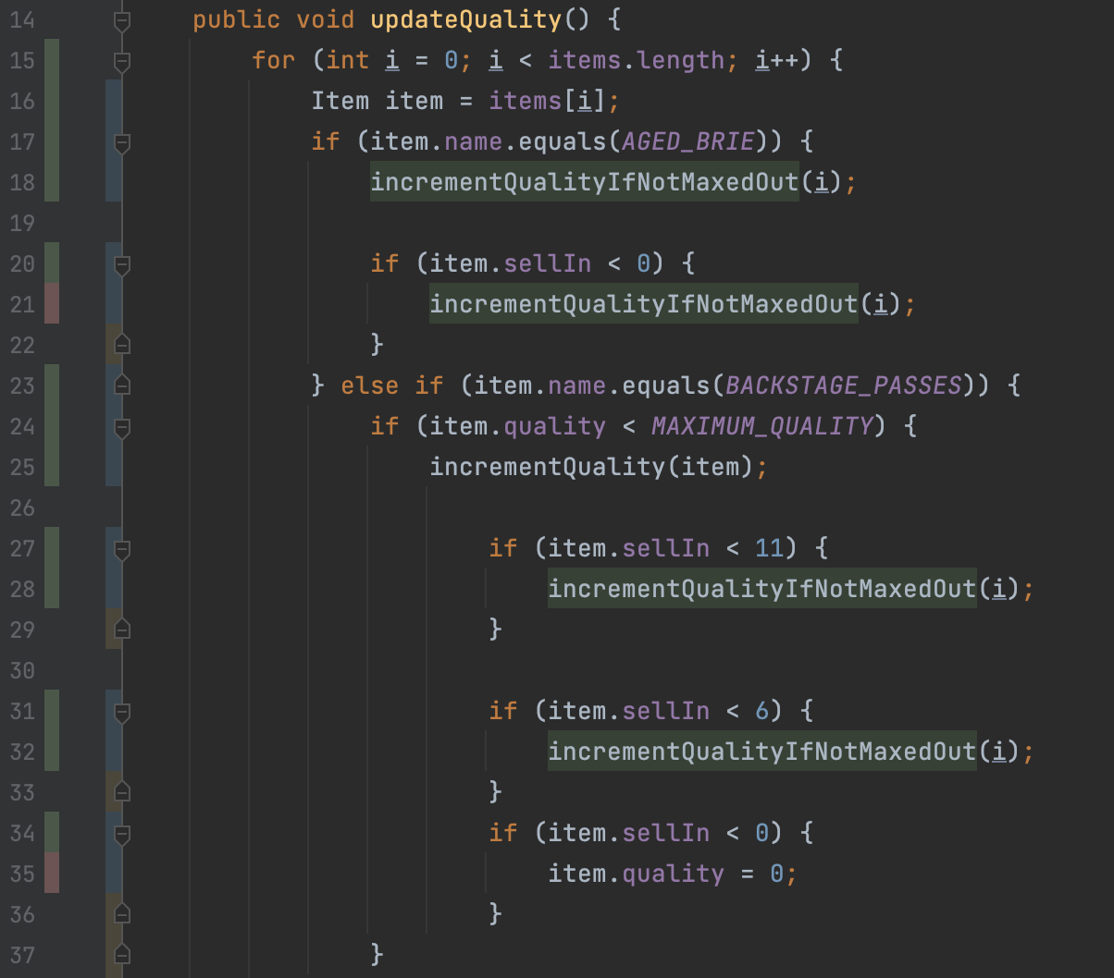
What is code coverage?
Notes:
Great for a self-organizing team to use on their own. Not so great when management is measuring it.

Slide 3

Measurement Dysfunction is Inevitable
“When people believe that their performance will be judged based on a measurement, they change their behavior to get a better score on that measurement.”
“But people’s time is limited. By doing more for the measurement, they must do less for something else. Rather than doing work that achieves the best result, they do work that achieves the best score.”
Notes:
When leaders set code coverage targets, teams will work to meet them in the quickest way possible. The resulting tests will be low quality.

Slide 4

What is a Unit Test?
Michael Feathers, Working Effectively with Legacy Code:
“A test that runs in less than 1/10th of a second and is small enough to help you localize problems when it fails”
A test is not a unit test if:
It talks to a database
It communicates across a network
It touches the file system
You have to do special things to your environment (such as editing configuration files) to run it
You have to deploy a build to an environment

Slide 5
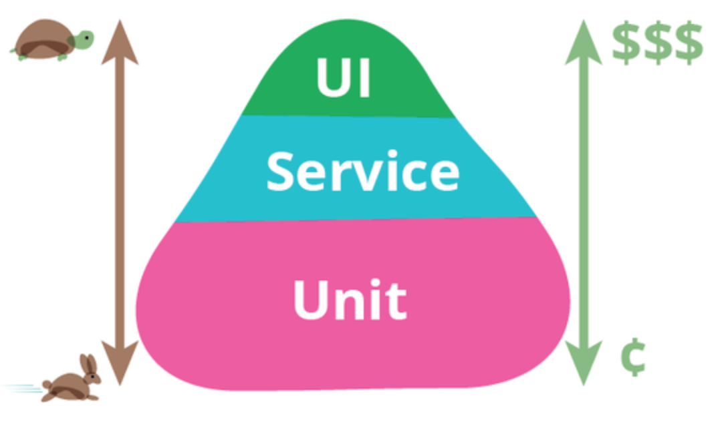
Overview
Time to execute
Cost to write/maintain
Each test takes minutes
Each test takes seconds
Each test takes milliseconds
https://martinfowler.com/bliki/TestPyramid.html

Slide 6
Leap Year Example
@Test
public void year1995IsNotLeapYear() {
int year = 1995;
boolean isLeapYear = leapYearCalculator.isLeapYear(year);
assertThat(isLeapYear, is(false));
}
public boolean isLeapYear(int year)
{
if (year % 400 == 0) {
return true;
}
if (year % 4 == 0 && year % 100 != 0) {
return true;
}
return false;
}
Test
Code Under Test

Slide 7
Evaluating Test Quality
Problem | How to detect | Result | Caused By | The Fix
No assertions | In the test, remove the call to the code under test | Test still passes | Focusing on code coverage Writing tests after | Test-driven Development
Ineffective assertions | Inject a defect into the code under test. Change if (a == b) to if (a != b) | Test still passes | Focusing on code coverage Writing tests after | Test-driven Development
Test coupled to the implementation | Refactor the code under test | Test fails | Testing implementation details Use of mocking frameworks | Test behavior, not implementation Avoid mocking
Code coverage does not tell you anything about test quality (and pursuing it generally reduces quality)

Slide 8
Test After vs Test First
Low quality tests
Code
Code
Code
Code
Code
Manual Testing
Debug/Fix
Debug/Fix
Debug/Fix
Done!
Add Tests
Test
Add code
More tests
Add code
More tests
Add code
Done!

Slide 9

What Can Managers Do?
Encourage the team to use code coverage internally, to find the gaps themselves. Make sure they have the needed tools.
Provide any needed coaching on test-driven development and pair and mob programming.
Nurture good habits, such as adding tests as a part of all work (new development or touching old code).
Let the team know you expect high quality, and that this type of testing is part of their way of working.

