Slide 2
Waterfall
Each phase is months
Analysis
Design
Coding
Test
Deploy

Slide 3
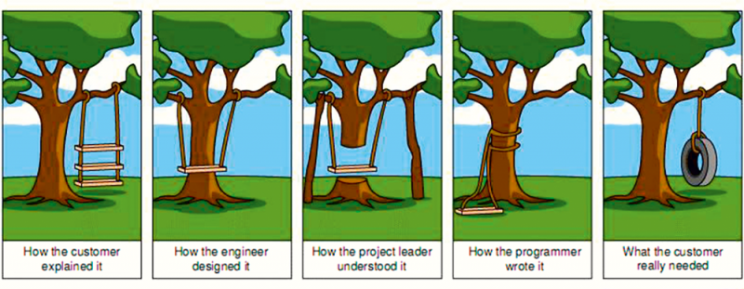

Slide 4
Scrum’s Intent
Two week cycles
Analysis
Deploy
Design
Test
Coding

Slide 5
Water-Scrum-Fall
Water
Two week sprint
Analysis
Scrum
Design
Coding
Fall
Test
Still a linear flow with handoffs
Deploy

Slide 6
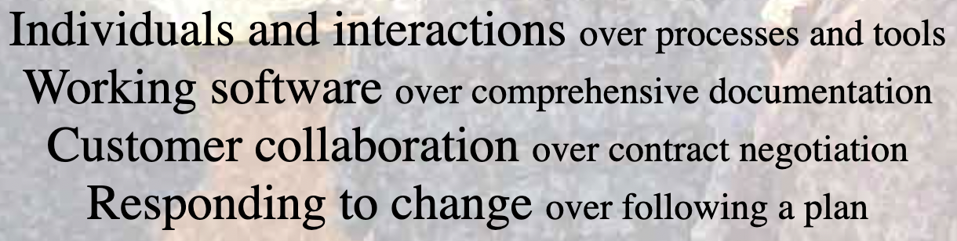

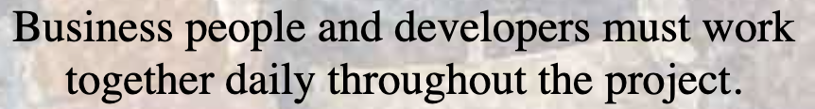
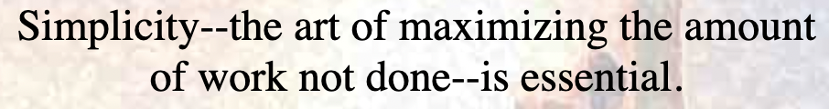
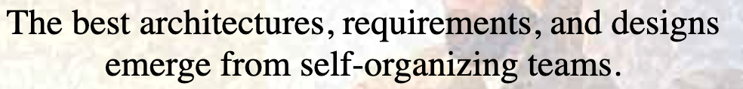
Agile Values & Principles to Consider

Slide 7
Thoughts on Reducing Prework
Can we have less documentation and more conversations?
Can the team take on some of the responsibility for design?
Can we have less handoffs and more collaborative work?
Can we experiment with working outside of our traditional silos of expertise?

