Slide 1
Thoughts on Shortening Feedback Loops
Increase Speed of Learning

Slide 2
Waterfall
Each phase is months
Analysis
Design
Coding
No feedback until here:
Characterized by:
Phase gates
Handoffs
Work done by specialists
Delayed feedback
Test
Deploy

Slide 3

Scrum’s Intent
Two week cycles
Analysis
Deploy
Design
Test
Coding
Characteristics
No handoffs
Following a Test-driven Development approach, design, coding, and testing are all happening simultaneously, by 2 people pairing
Builds are validated automatically
Deployment is automated
Feedback every 2 weeks

Slide 4
Typical Process
Define Business Need
Analysis
Rough Feature
Ready Feature
Story Break- down
PM
Rough Stories
Customer
Arch
UX
PO
Design
Automation
Prod
UAT Valida- tion
Sprint
Class diagrams, Pseudo code
Story Refine- ment
Ready Stories
Leads
Systems Team
QA
Dev
QA
Dev
Total Time: 3 months

Slide 5
Agile Approach
Define Business Need
PM
PO
Sprint
PM
QA
Dev
Prod
Customer
Arch
Automation
Leads
UX
Total Time: 3 days

Slide 6
Removing Waste to Learn Fast
In Lean Manufacturing, Excess Inventory is considered waste.
What is the equivalent waste in lean software development?
Unvalidated Decisions
First chance to validate a decision.
Customer Request
Delivered
Lead Time
A lead time of several months is slow learning, high risk
A lead time of 1 week speeds up learning, reduces risk

Slide 7
What is a cross-functional team? (Needed for speed)
Definition from the Scrum Guide:
“Scrum Teams are cross-functional, meaning the members have all the skills necessary to create value each Sprint.”
Users don’t care about frontend vs backend - they want a usable feature
Team should be able to complete features/stories independently of any other team
This also requires a shift in how user stories are written (vertically sliced)

Slide 8
Conway’s Law
Conway’s Law:
“Organizations which design systems are constrained to produce designs which are copies of the communication structures of these organizations”
In other words:
A product’s architecture tends to mirror the structure of the organization in which it is developed.
Just as loosely coupled, highly cohesive designs are more effective, loosely coupled, highly cohesive teams are more effective.

Slide 9
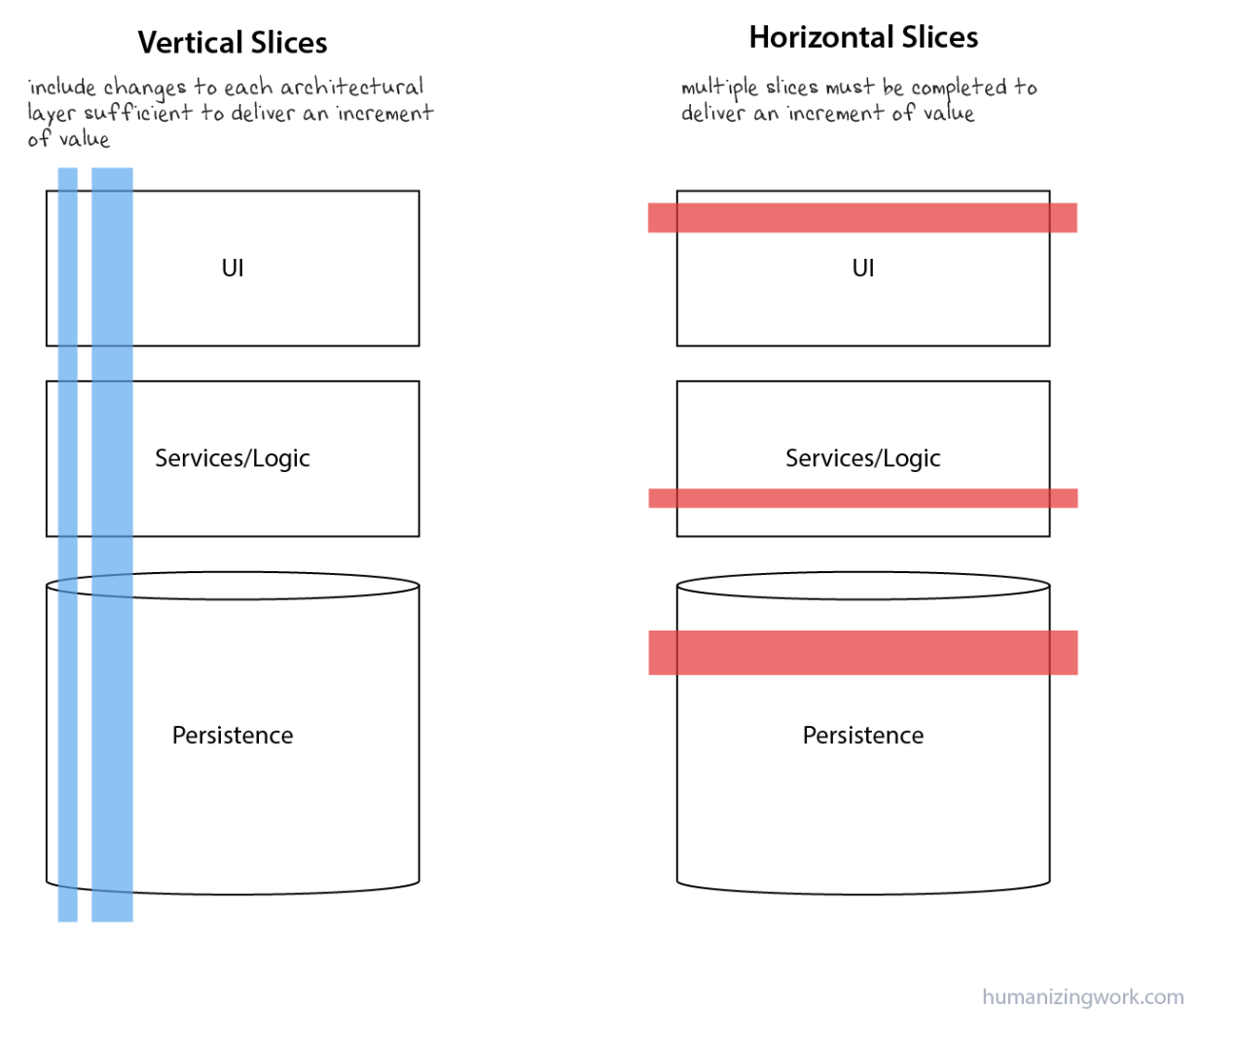
Vertically Sliced Stories - have value to the user
Story: Create UI to display shopping cart.
Story: Display # items in shopping cart. (will involve work in all layers)
Story: Create API to retrieve shopping cart.
Story: Create persistence for shopping cart.

Slide 10
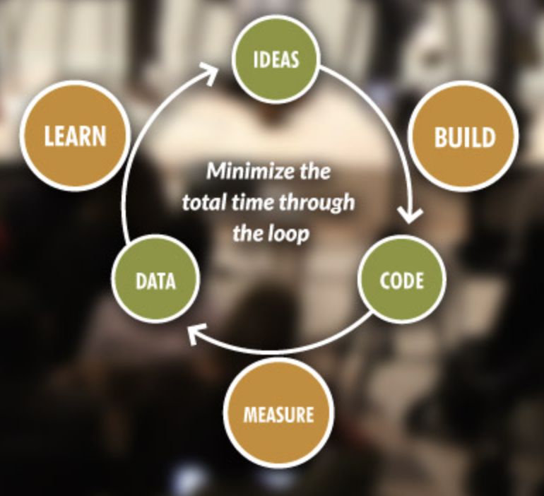

Build-Measure-Learn: an approach to maximize speed of learning
“The Lean Startup approach can work in any size company, even a very large enterprise.”
Turn ideas into products, measure how customers respond, and then learn whether to pivot or persevere.

Slide 11
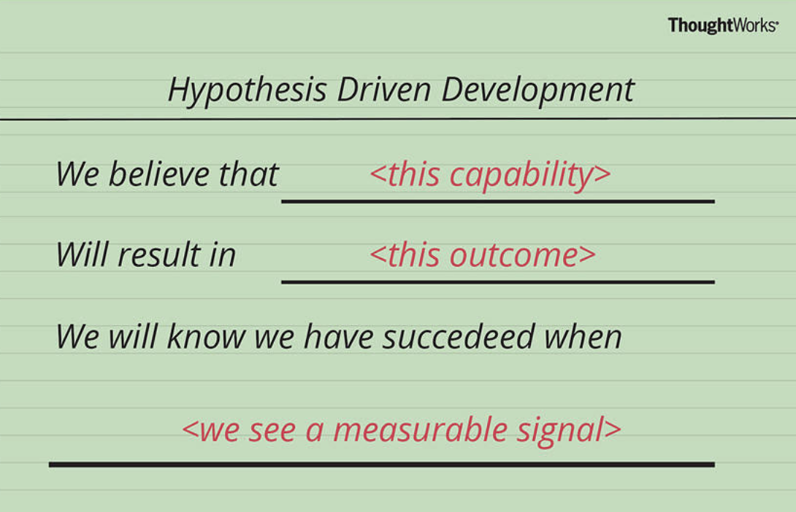
HDD fits in well with the Build-Measure-Learn cycle

Slide 12
Example
We Believe That increasing the size of hotel images on the booking page
Will Result In improved customer engagement and conversion
We Will Know We Have Succeeded When we see a 5% increase in customers who review hotel images who then proceed to book in 48 hours.
Goal: Conduct an experiment that can be validated quickly.

