Slide 1
Unit Testing Without Mocks

Slide 2
Agenda
What is a unit test?
What is mocking?
Disadvantages of mocking
How much to mock?
No mocks
Resources

Slide 3
Unit Test
Michael Feathers, Working Effectively with Legacy Code:
“A test that runs in less than 1/10th of a second and is small enough to help you localize problems when it fails”
A test is not a unit test if:
It talks to a database
It communicates across a network
It touches the file system
You have to do special things to your environment (such as editing configuration files) to run it

Slide 4
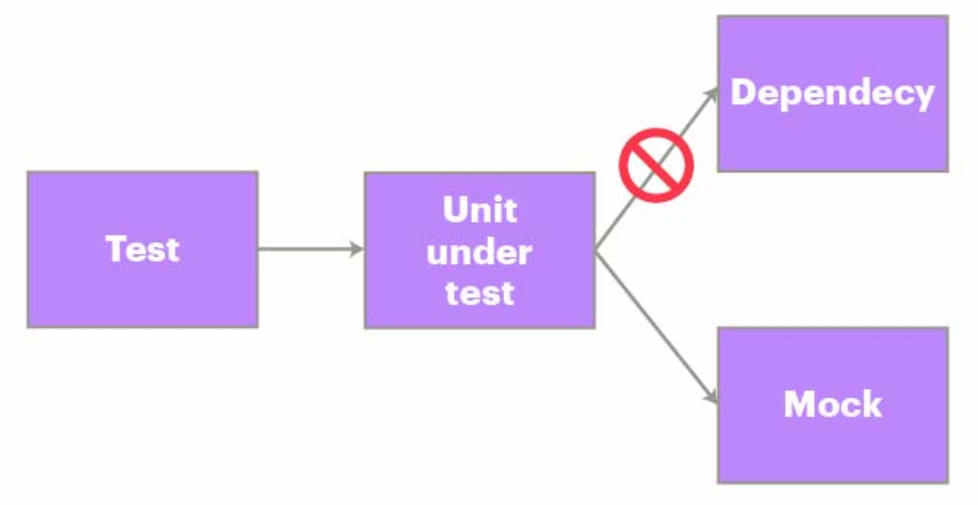
Mocking
Mocking is a way to replace a dependency in a unit under test with a stand-in for that dependency. The stand-in allows the unit under test to be tested without invoking the real dependency.

Slide 5
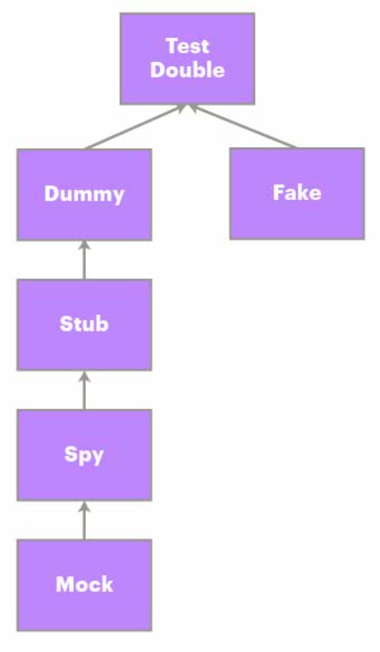
A Note on Terminology

Slide 6
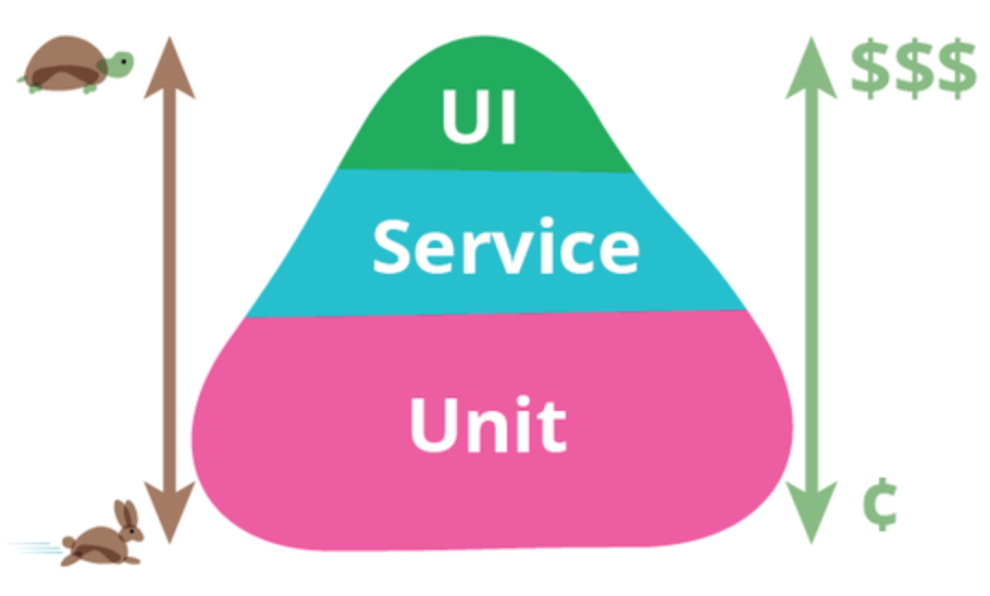
Effect of mocking
Mock

Slide 7
Disadvantages to Mocking
Violates the DRY principle
“Every piece of knowledge must have a single, unambiguous, authoritative representation within a system” (Pragmatic Programmer, p. 27)
Knowledge of how to interact with the dependency

Slide 8
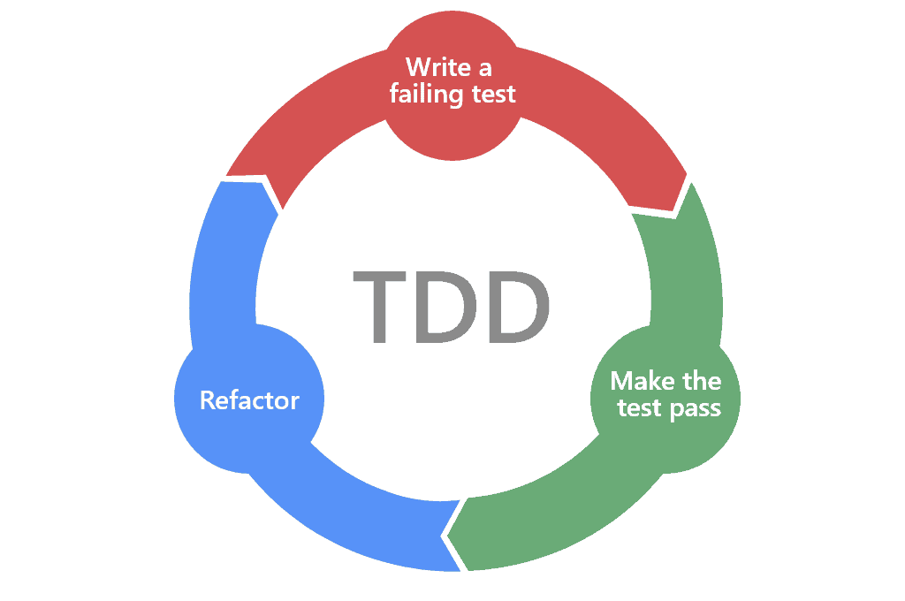
Disadvantages to Mocking
2. Inhibits Refactoring
Refactoring: “a disciplined technique for restructuring an existing body of code, altering its internal structure without changing its external behavior” (Martin Fowler)
Tests still pass
Unit tests should test behavior, not implementation details.

Slide 9

The Conflict
Refactoring: freely modify implementation details
Unit tests with mocks: tests depend on implementation details

Slide 10
Disadvantages to Mocking
3. Reduces Design Simplicity
Simple Design: “One that is easy to change” (Corey Haines)
“The need for mocking is a sign of a design with too many dependencies” (Arlo Belshee)

Slide 11
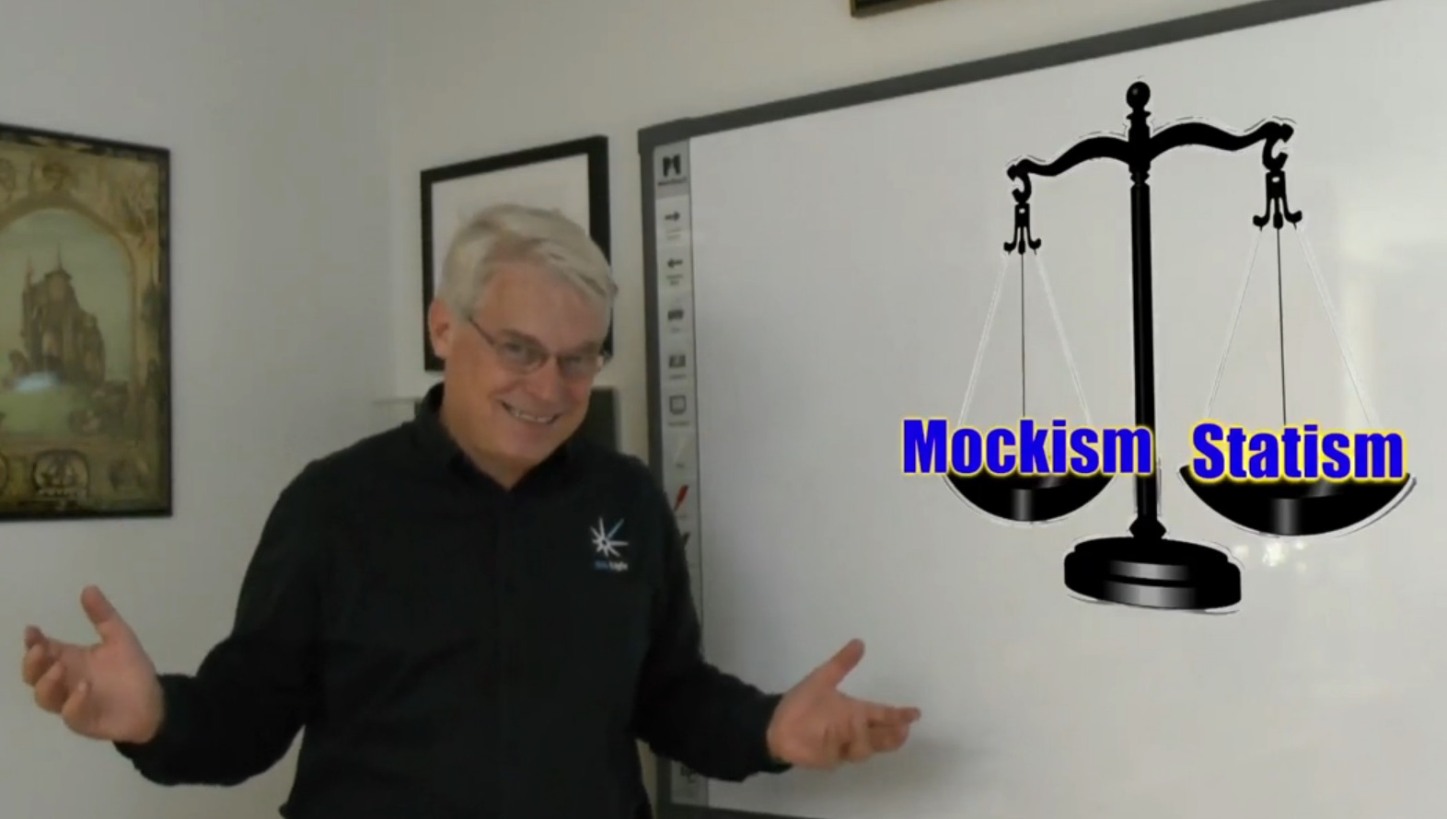
How much to mock?
Statist/Classicist (Detroit) vs Mockist (London)
Compromise
Only mock across architectural boundaries
Avoid mocking frameworks (write your own test doubles)
Use the simplest level of abstraction possible

Slide 12
Testing Without Mocks
Arlo Belshee: The No Mocks Book
James Shore: Testing Without Mocks: A Pattern Language
Nullable Infrastructure: “Program each infrastructure class with a factory method, such as “createNull(),” that disables communication with the external system. Instances should behave normally in every other respect.”

Slide 13
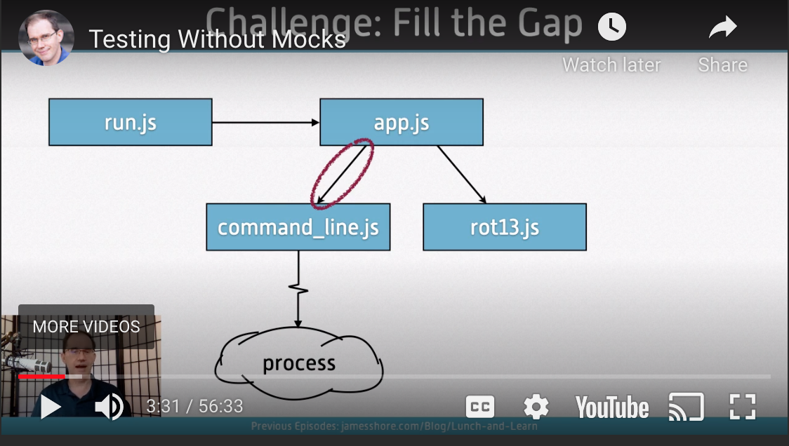
Nullable Infrastructure

Slide 14
Movie Database Example - Dependency Rule
Traditional Layers
Hexagonal Architecture
Port
MovieService
MovieService
<<interface>>
ForPersistingMovies
MovieDao
MovieDao
Adapter

Slide 15
Movie Database Example - Nullables
Unit Test
Unit Test
MovieService
MovieService
MovieDao
Mock
MovieDao
MovieDao
no op

Slide 16
References
Working Effectively with Legacy Code
https://www.amazon.com/Working-Effectively-Legacy-Michael-Feathers/dp/0131177052
To Mock or Not
https://www.accenture.com/us-en/blogs/software-engineering-blog/to-mock-or-not-to-mock-is-that-even-a-question
Four Rules of Simple Design
https://leanpub.com/4rulesofsimpledesign
Technical Excellence with Arlo Belshee
https://www.youtube.com/watch?v=njg33YM0E0M
The No Mocks Book
https://arlobelshee.com/the-no-mocks-book/
Testing Without Mocks: A Pattern Language
https://www.jamesshore.com/v2/blog/2018/testing-without-mocks
The Little Mocker
http://blog.cleancoder.com/uncle-bob/2014/05/14/TheLittleMocker.html

