Slide 1
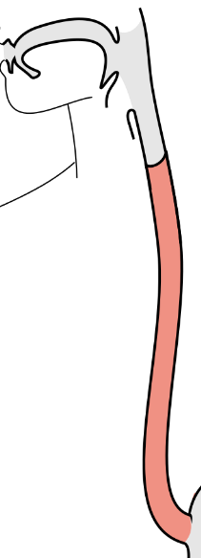
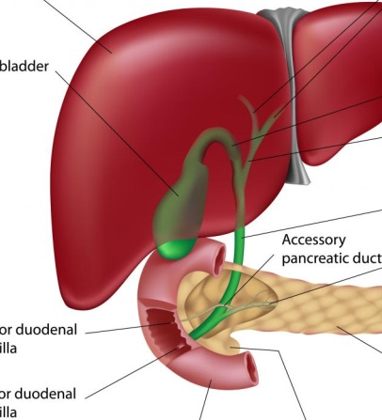
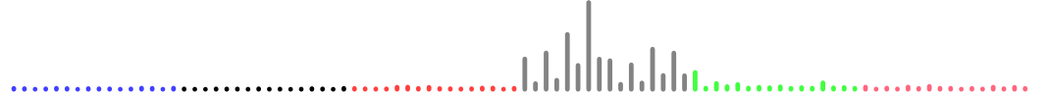
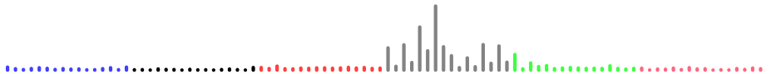

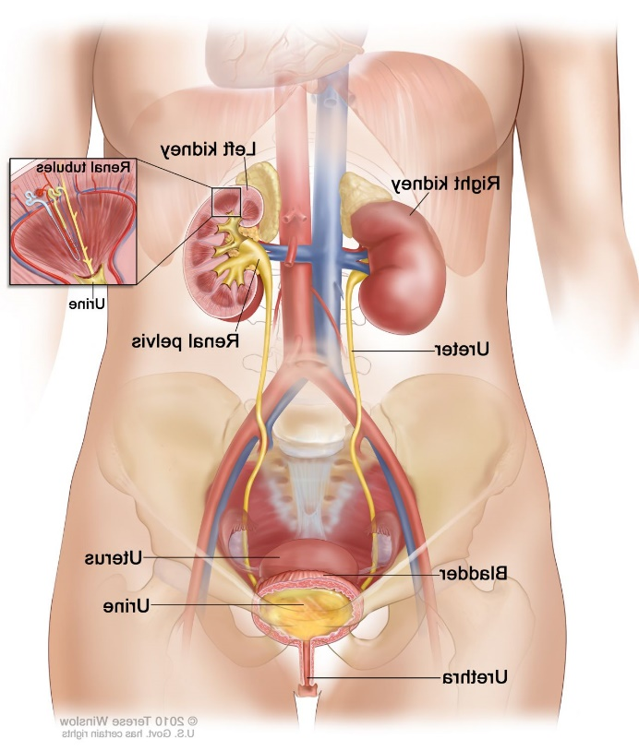


Example AA-dominated mutational spectra from 6 cancer types will strong evidence for AA mutagenesis; strong evidence for causal roles in liver and urothelial cancers
Esophagus (squamous cell)
Liver
Bile duct
Kidney
Upper tract urothelial
Bladder

Slide 2
References
Poon et al., 2013 and subsequent data (liver - hepatocellular carcinoma [HCC])
Zou et al., 2015, Jusakul et al., 2017 (bile duct carcinoma)
Scelo et al., 2014, Jelakovic et al., 2014 (kidney/renal cell carcinoma)
Poon et al., 2013, Hoang et al., 2013, many others (upper tract urothelial carcinoma)
Poon et al., 2015, others (bladder urothelial carcinoma)
Esophagus:
Yan et al, 2019, Nat Commun, doi: 10.1038/s41467-019-09255-1
Cui et al., 2020, Cell Research, doi: 10.1038/s41422-020-0333-6

