Slide 1
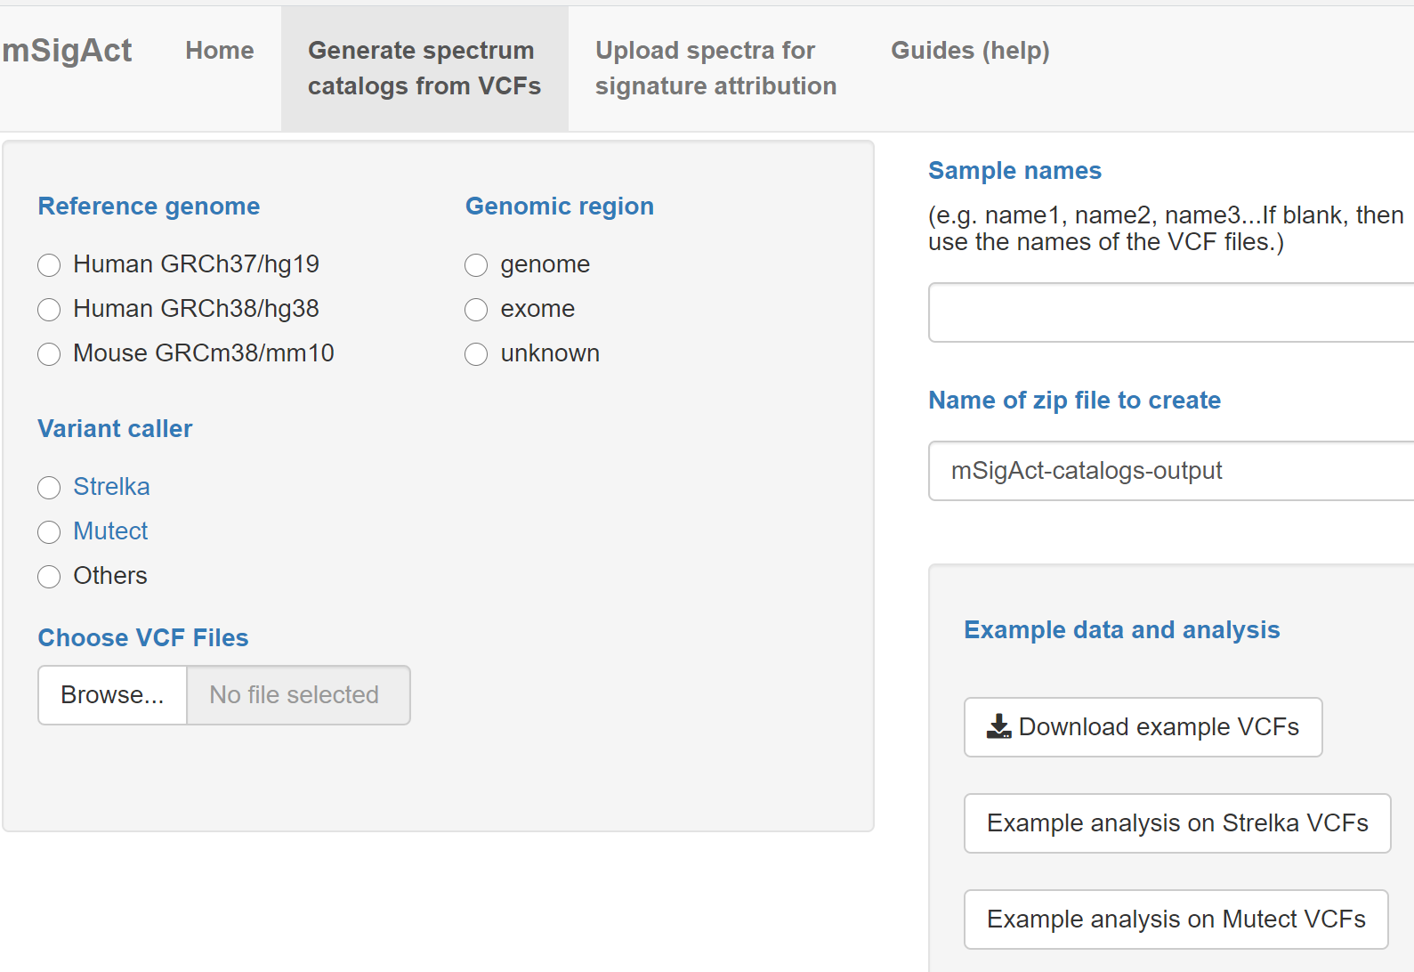

Slide 2
Example input VCFS that you can download and then upload
Pre-loaded example input VCFs

Slide 3
Select the reference genome. mSigAct needs that to get the sequence context for mutations, to know where the transcripts are, and to know the abundances of different di, tri, and pentanucleotides

Slide 4
Is this genome or exome data (or unknown)? mSigAct needs this information to know the abundances of different di, tri, and pentanucleotides. If “unknown”, mSigAct will not be able to show “density” spectra – spectra where mutations are shown as mutations per megabase.

Slide 5
What kind of variant caller generated the VCFs? Different variant callers have slightly different formats and information. For instance, Mutect puts single base substation mutations and indels in the same VCF, while Strelka puts them in separate VCFs. Mutect keeps track of DBS (doublet base substitutions) that are on the same reads; Strelka does not.

Slide 6
Upload 1 or more VCFs. If you upload multiple VCFs, they should all be from the same variant caller, and, if from a caller like Strelka, the should all be either indel VCFs or all single-base-substitution VCFs.

Slide 7
By default mSigAct will use the VCF file names as sample names, but you can override the names here.

Slide 8
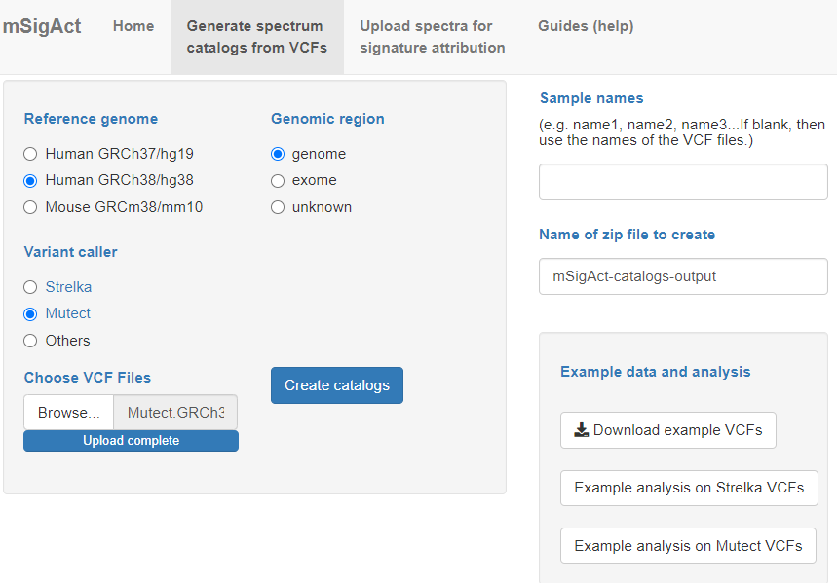

Slide 9
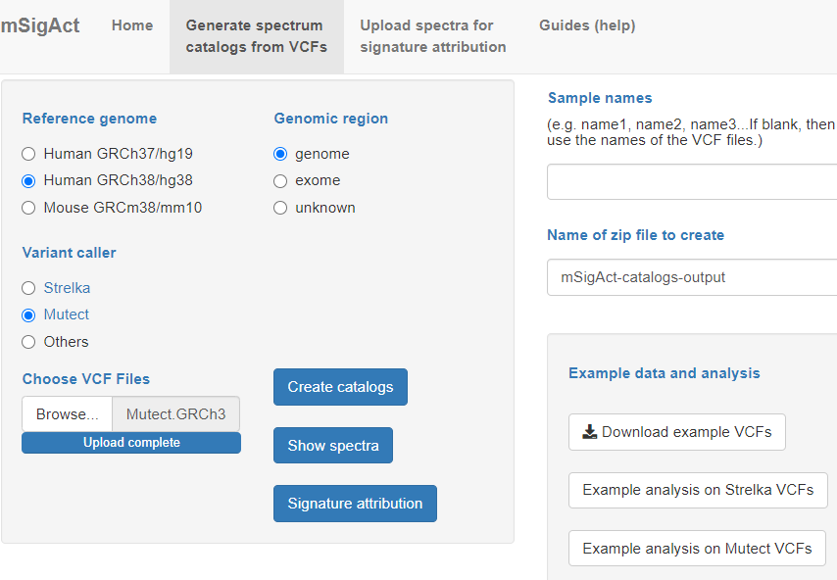

Slide 10
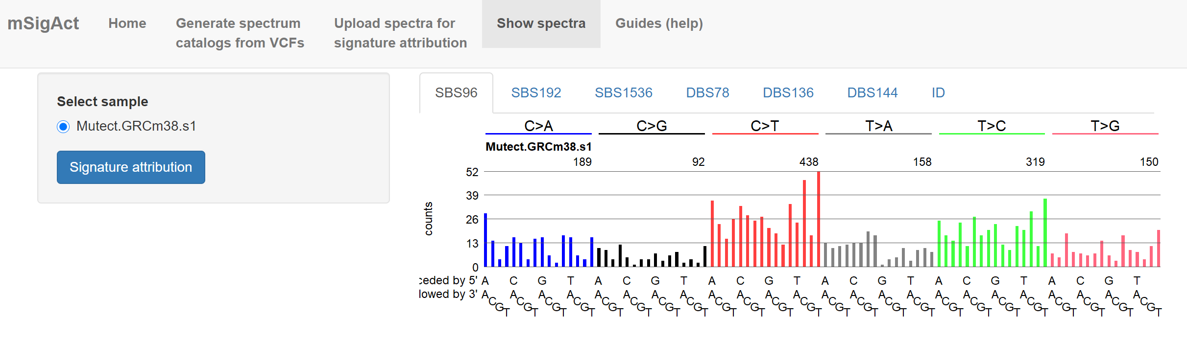
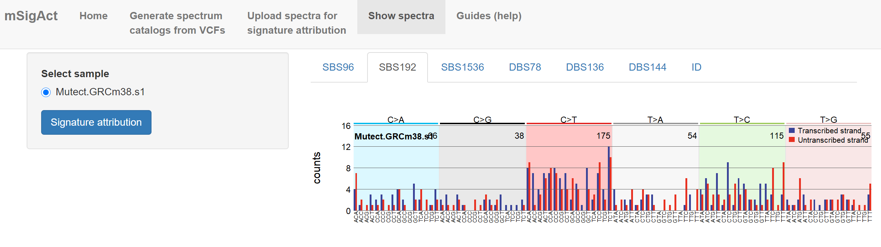

Slide 11
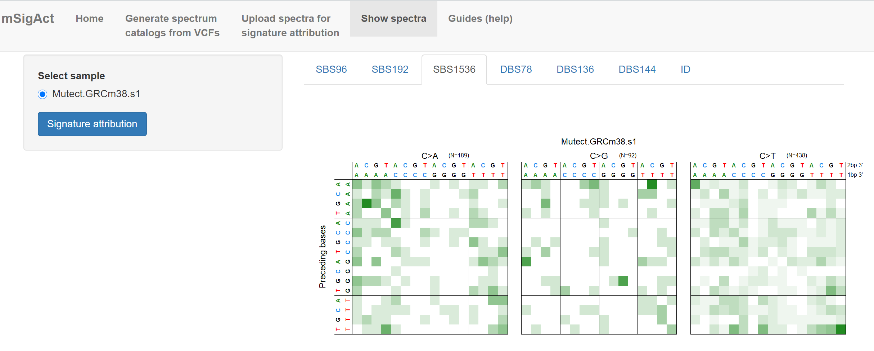
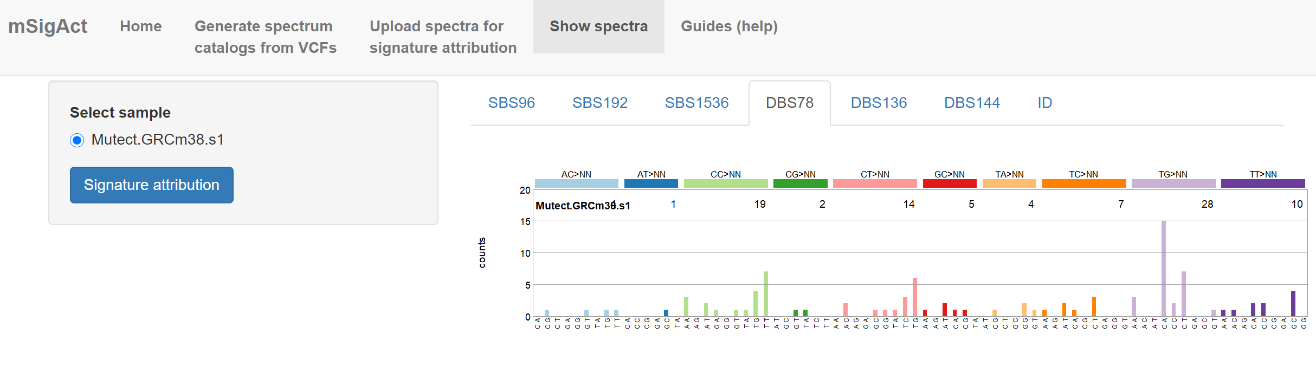

Slide 12
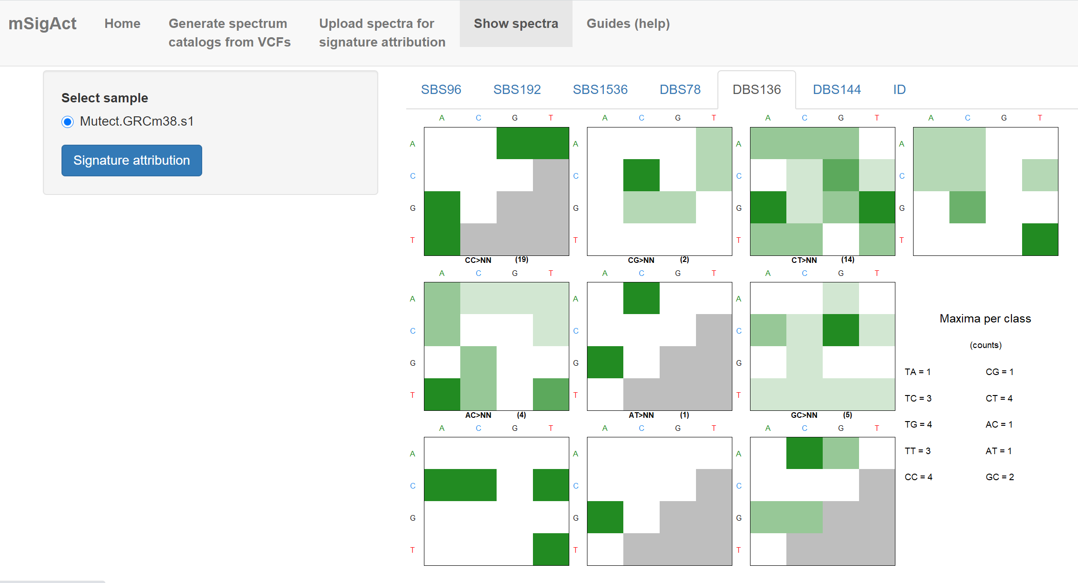

Slide 13
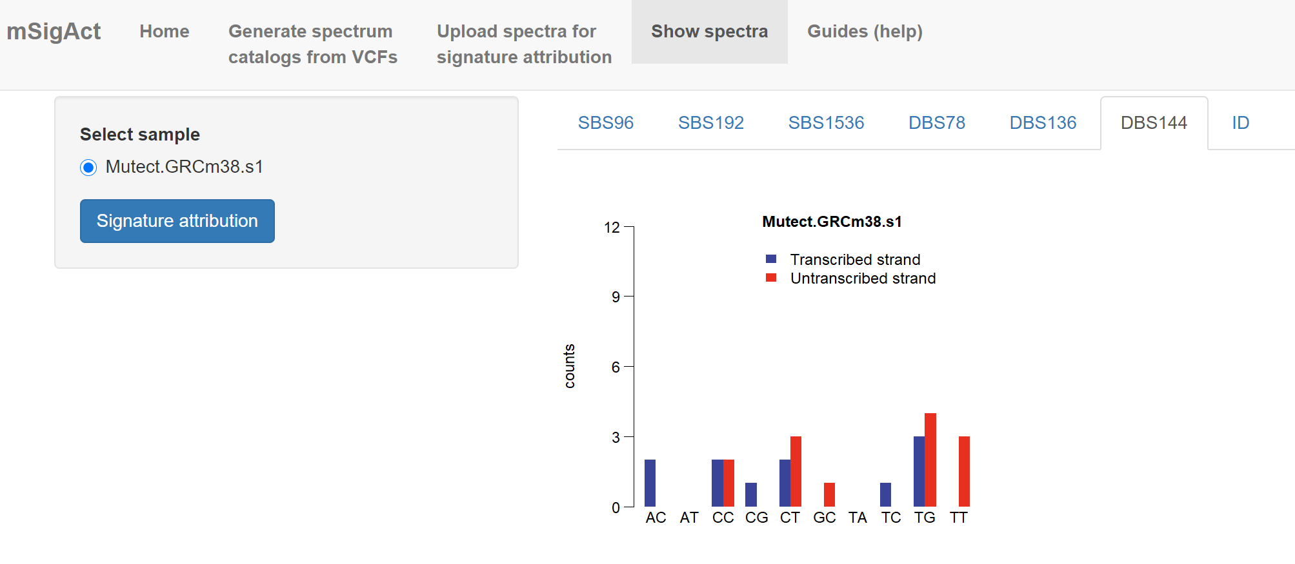
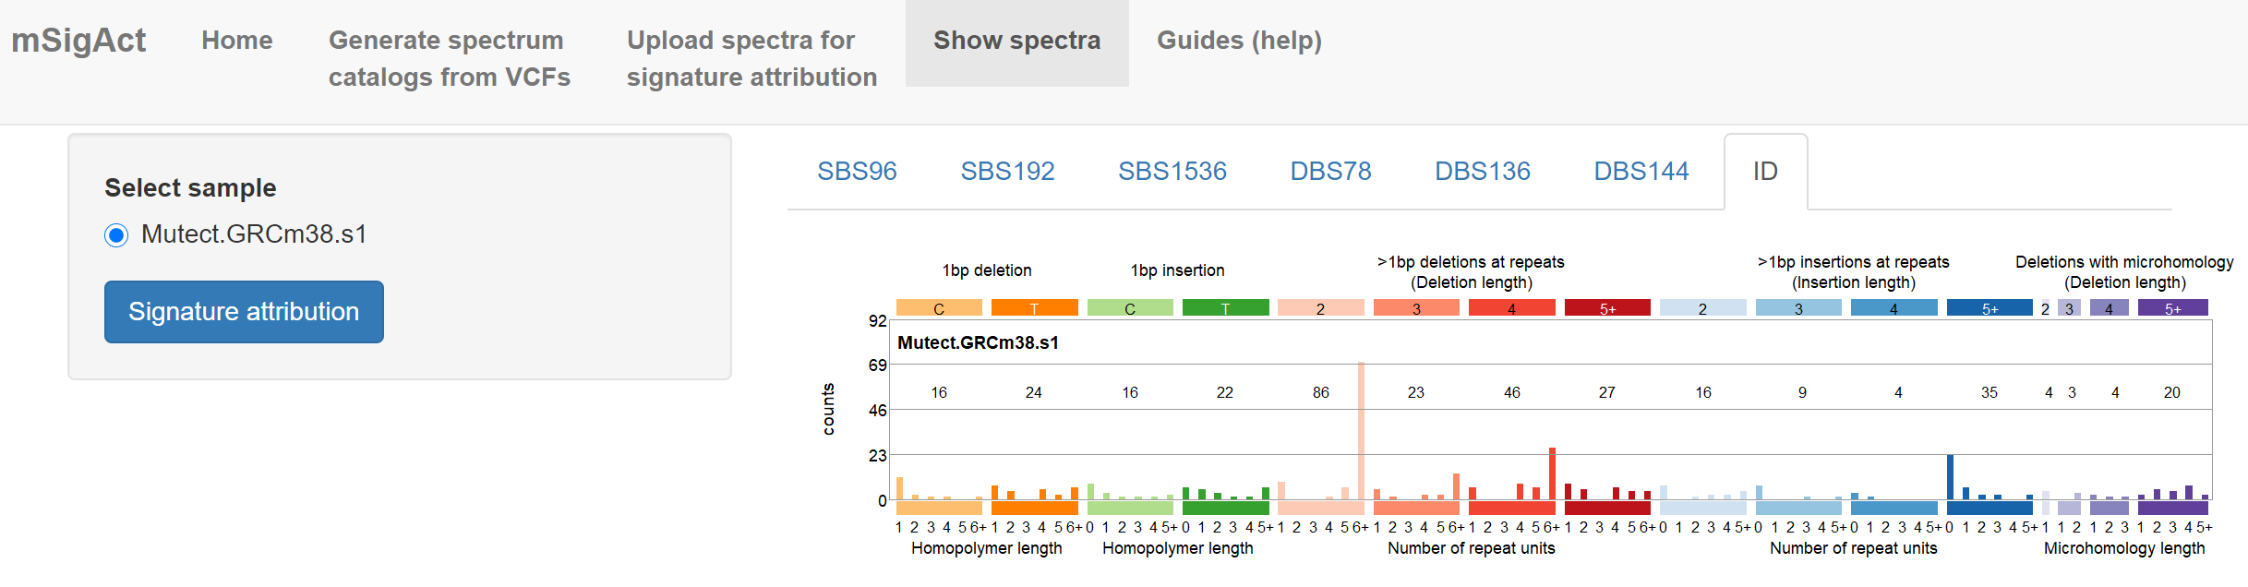

Slide 14
See the guide for signature attribution

