Slide 1
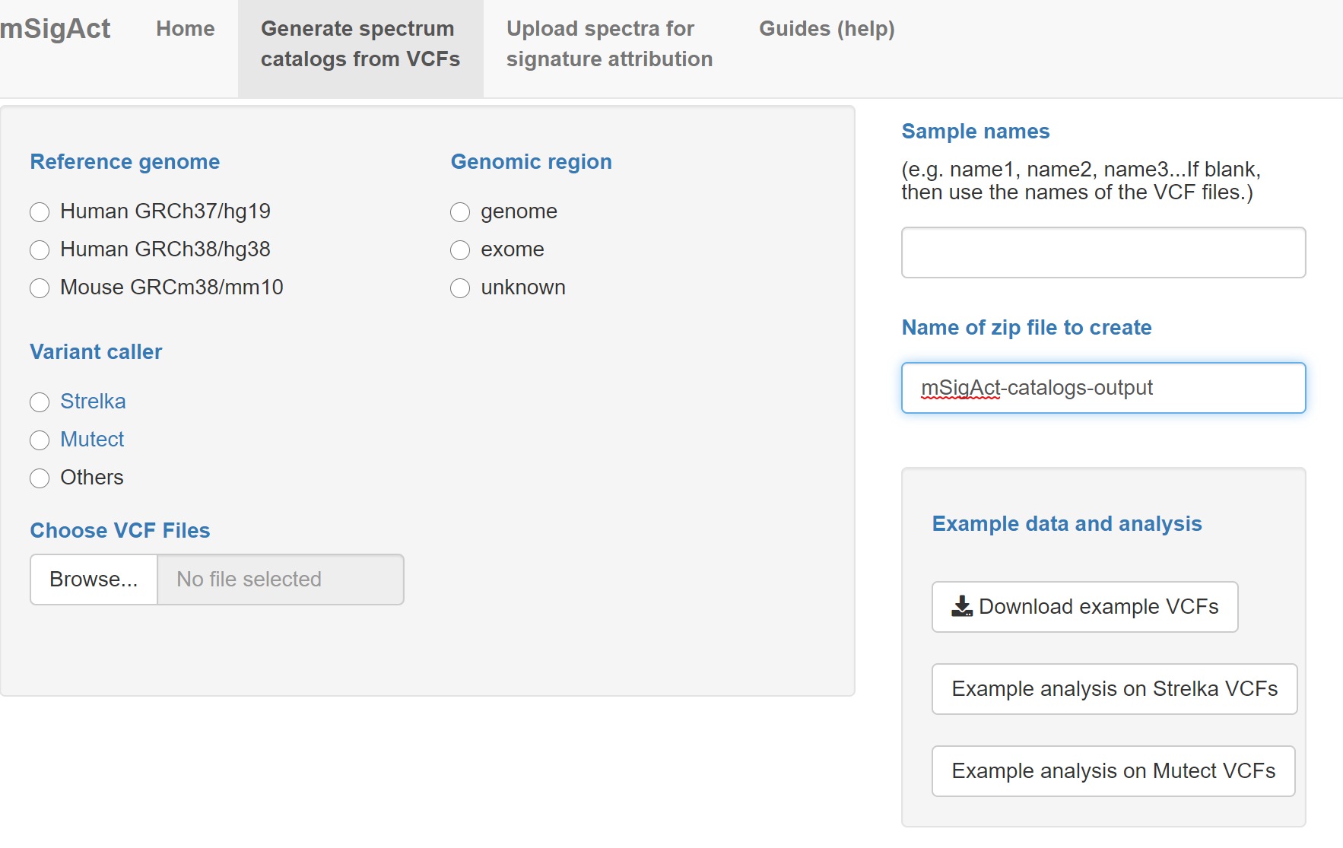
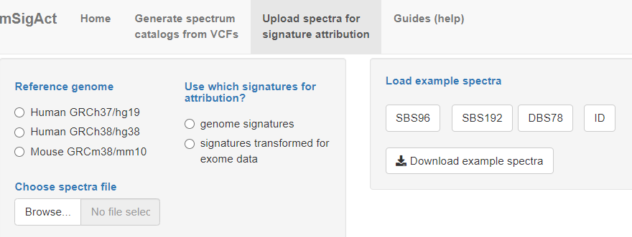
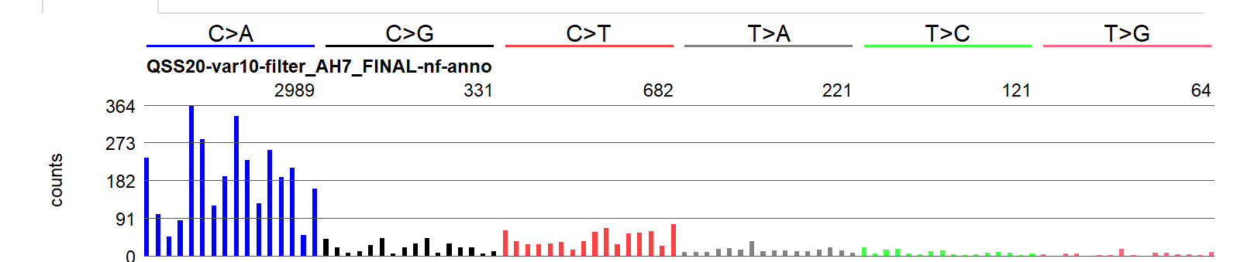
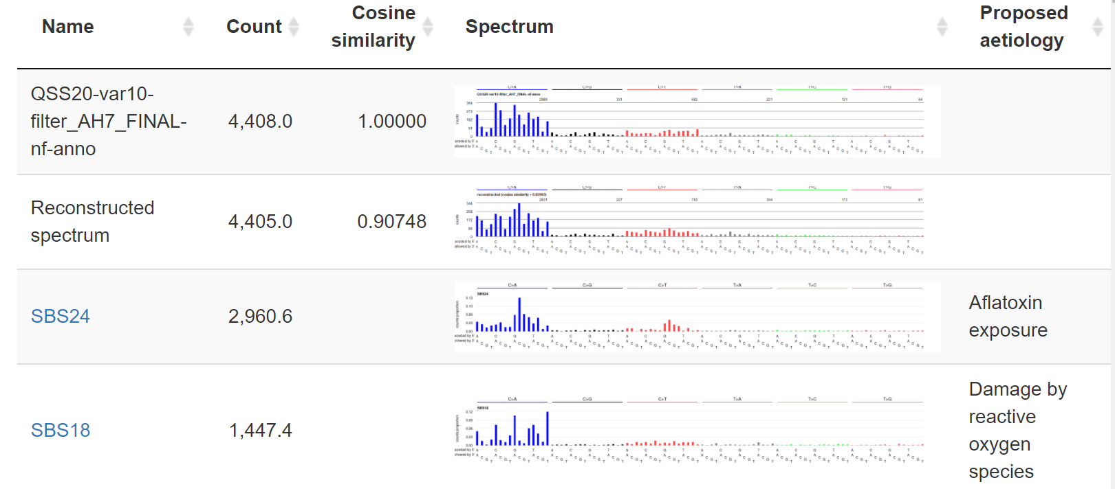
mSigAct: mutational Signature Activity https://msigact.ai
Generate mutational spectrum catalogs from uploaded VCFs (variant call files)
Compute mutational signature attributions for uploaded mutational spectra or for mutation spectra derived from VCFs
Example data
Download mutational spectra as .csv files; download or view plots of spectra
View and download attributions and plots of constituent signatures and of reconstructed spectrum

Slide 2
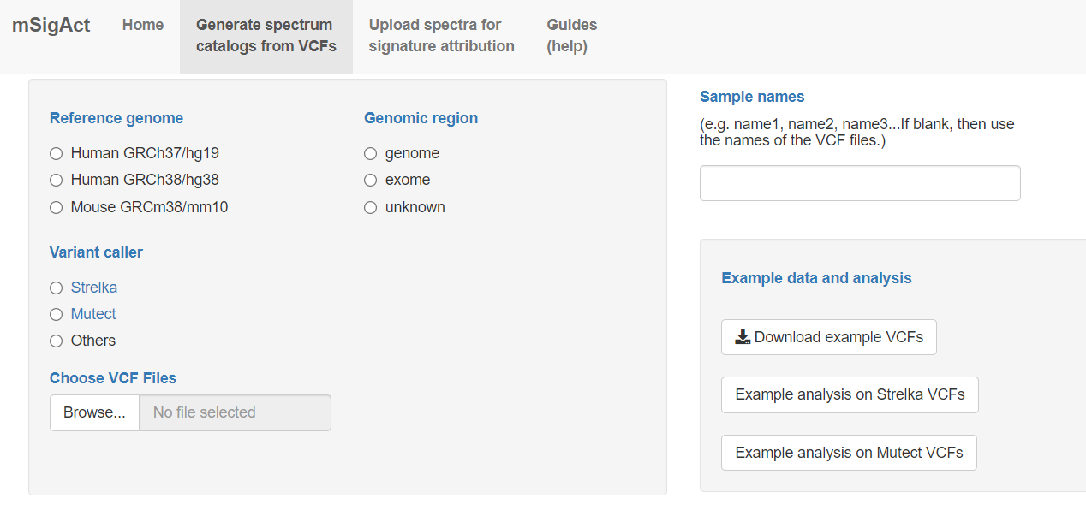
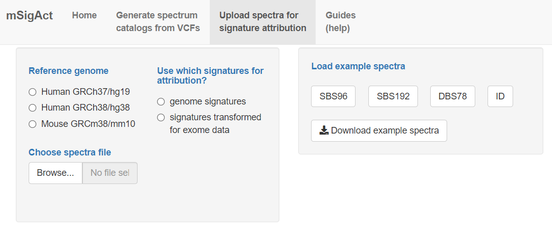
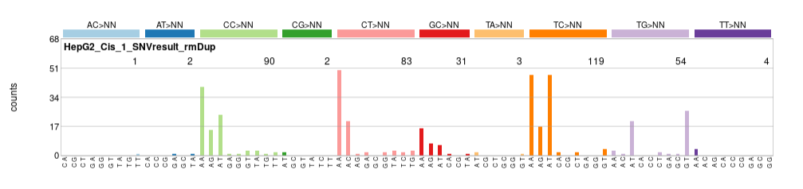
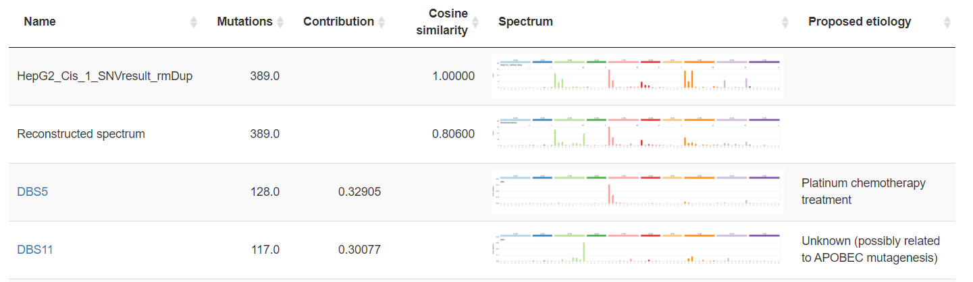
mSigAct: mutational Signature Activity
Generate mutational spectra catalogs (SBS, DBS and ID) from uploaded VCFs (variant call files)
Estimate mutational signature activities (SBS, DBS and ID) for uploaded mutational spectra or for mutation spectra derived from VCFs
Example data
Download mutational spectra as .csv files; download or view plots of spectra
View and download attributions and plots of constituent signatures and of reconstructed spectrum

