Slide 1
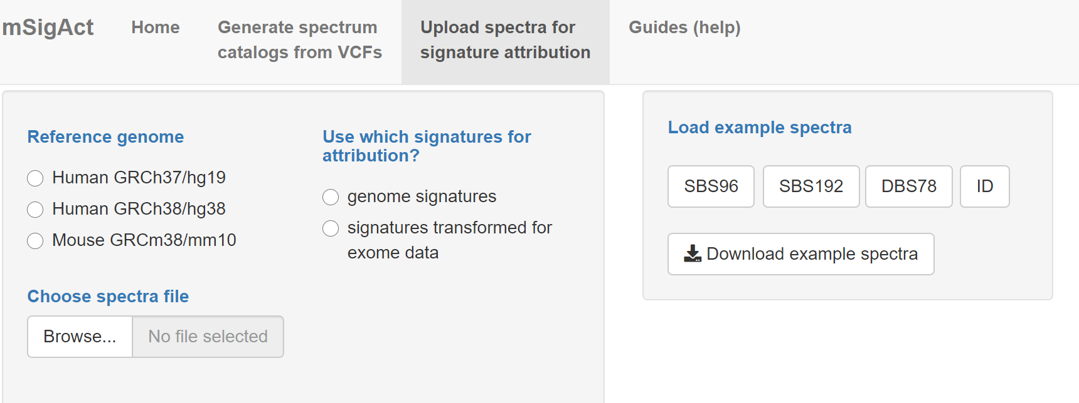

Slide 2
Pre-loaded example input spectra catalogs; SBS96, SBS192, DBS78, and ID are different kinds of mutations; each has its own catalog
Example input spectra catalogs that you can download and then upload and analyse

Slide 3
This is important. The standard mutational signatures in COSMIC are based on the counts of mutations across the human (GRCh37/hg19) genome. The frequencies of di, tri, and pentanucleotides are noticeably different between the whole genome and the exome (the exonic parts of genes). When mSigAct analyses attributions for an exome spectra, it converts the COSMIC signatures to the exome signatures by accounting for the differences these frequencies.

Slide 4
Select the reference genome. mSigAct needs that to know the abundances of different di, tri, and pentanucleotide. These frequencies vary slightly between human genome reference sequences and between human and mouse

Slide 5
Upload a .csv file containing one or more spectrum catalogs. See the examples for formatting.

Slide 6
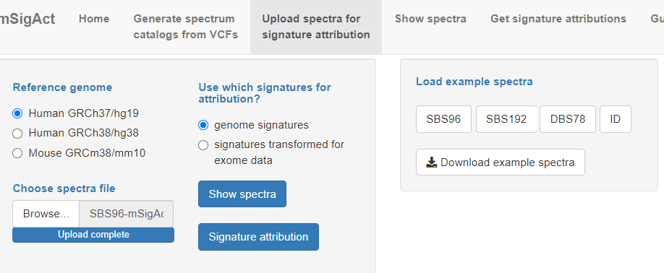
“Show spectra” lets you view spectra before running attribution analysis; “Signature attribution” lets you select on of the spectra and analyses the signature attributions

Slide 7
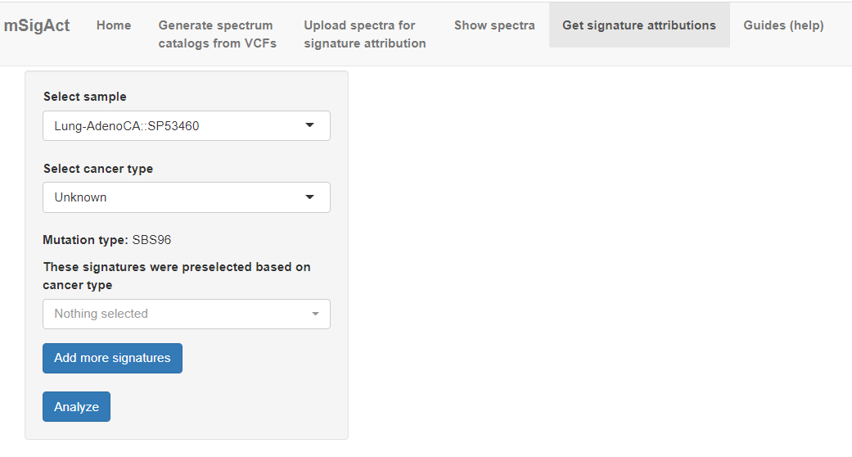
You have to select a cancer type, in this case “Lung-AdenoCA” (lung adenocarcinoma)

Slide 8
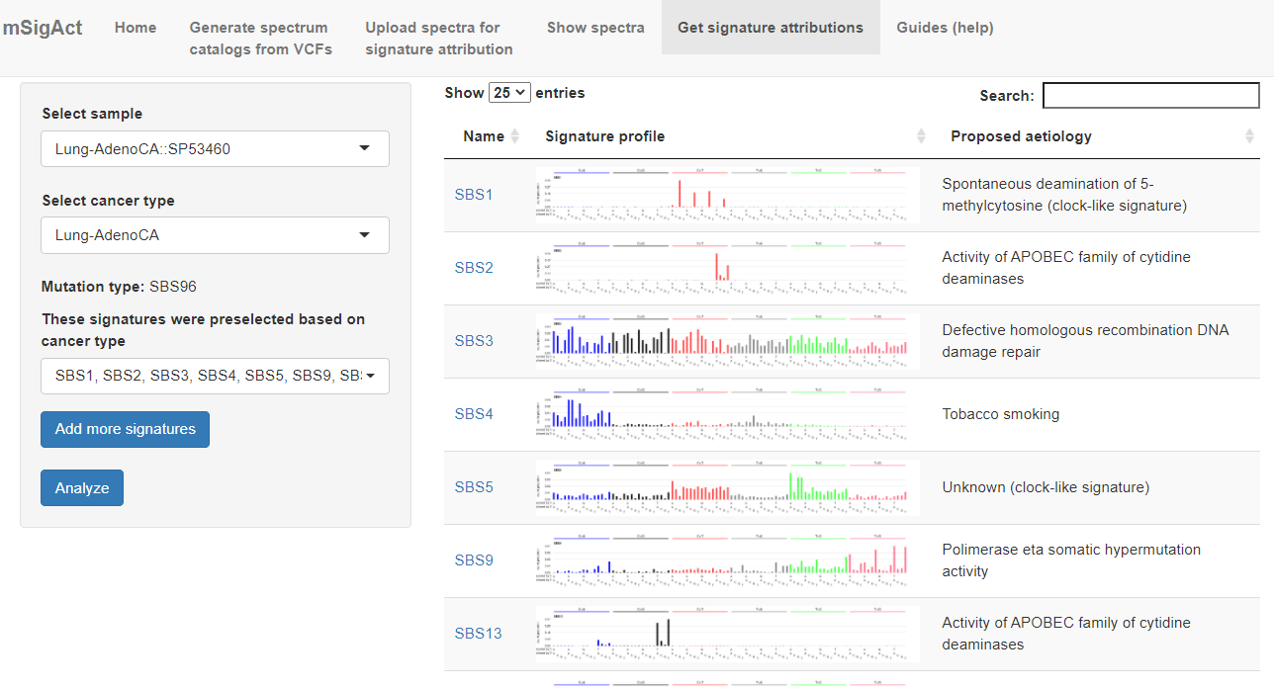
After you select the cancer type, mSigAct will suggest the mutational signatures previously observed in that cancer type. You can remove some signatures by editing the list or click on “Add more signatures” to add signatures to the analysis.

Slide 9
The mutational signature profiles under consideration and some brief information about them appear on the right.

Slide 10
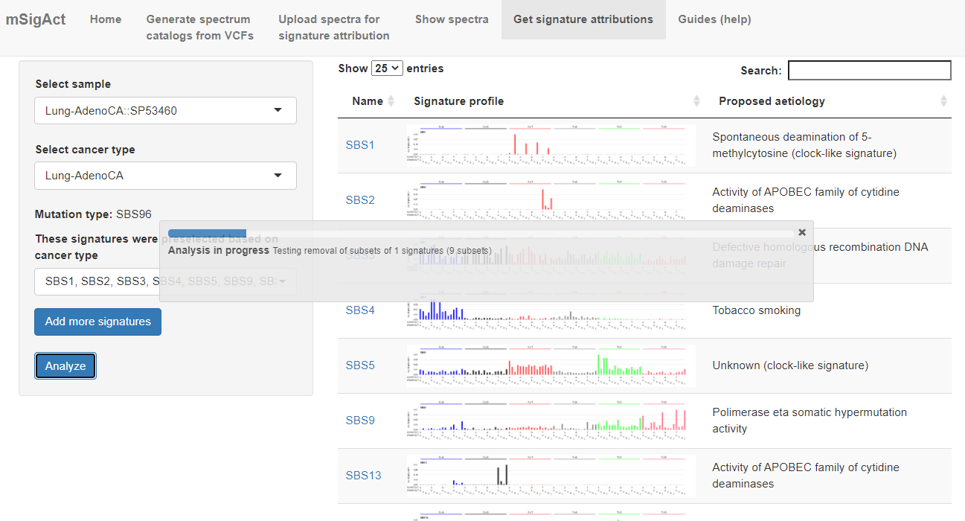
Click to start the analysis. Could take several minutes.

Slide 11
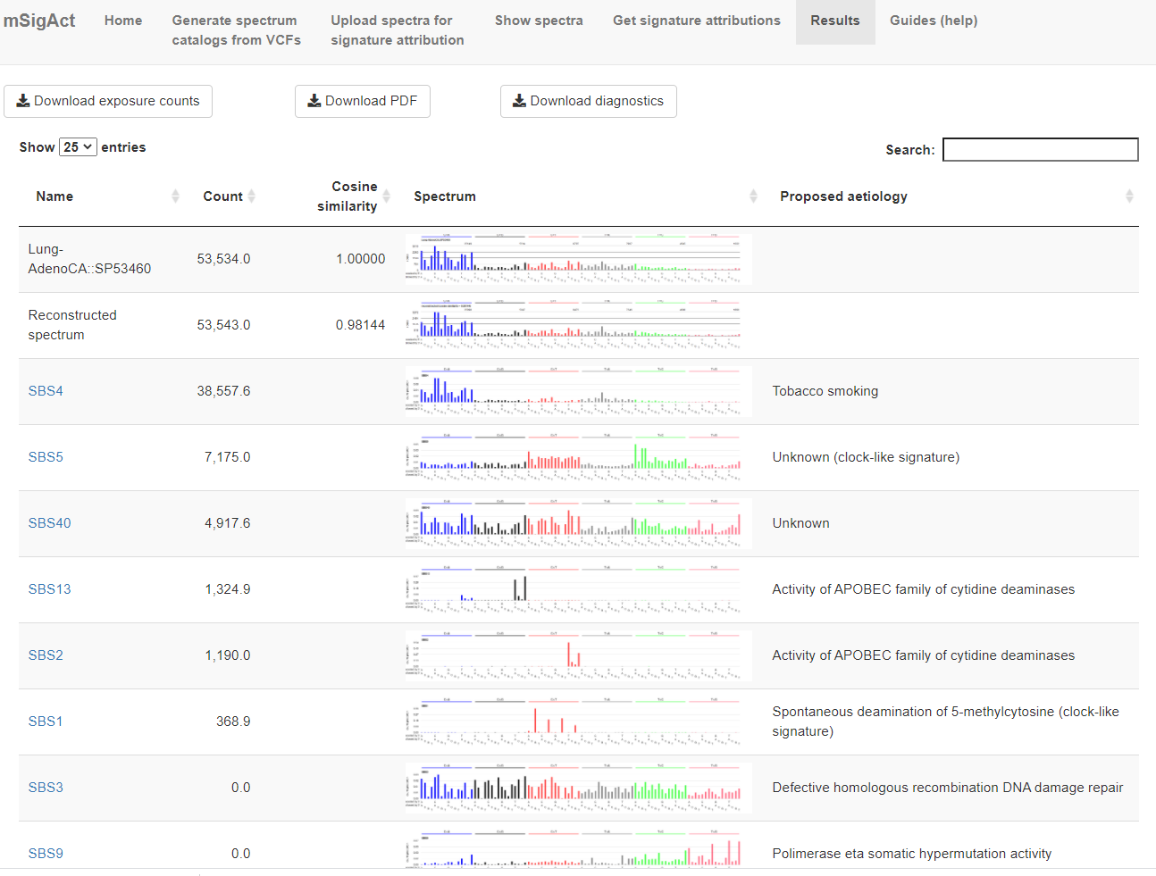
Cosine similarity between original and reconstructed spectrum
Original spectrum (above) compared to reconstructed spectrum (below)
Signatures not used in the reconstruction are also shown

Slide 12
ID attribution example

Slide 13
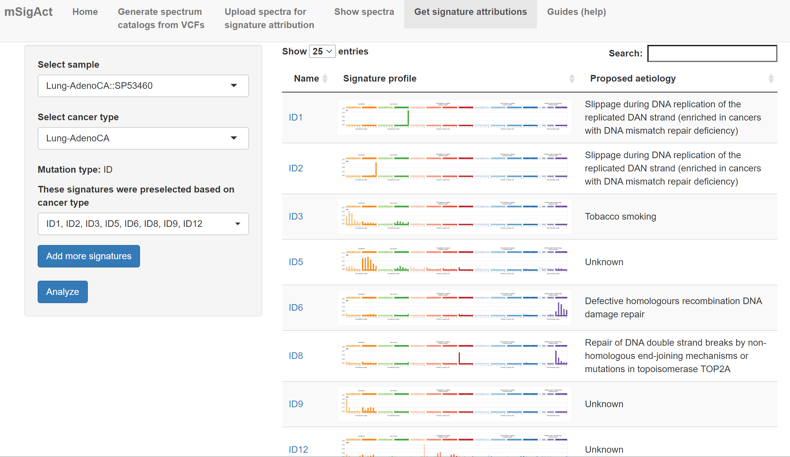

Slide 14
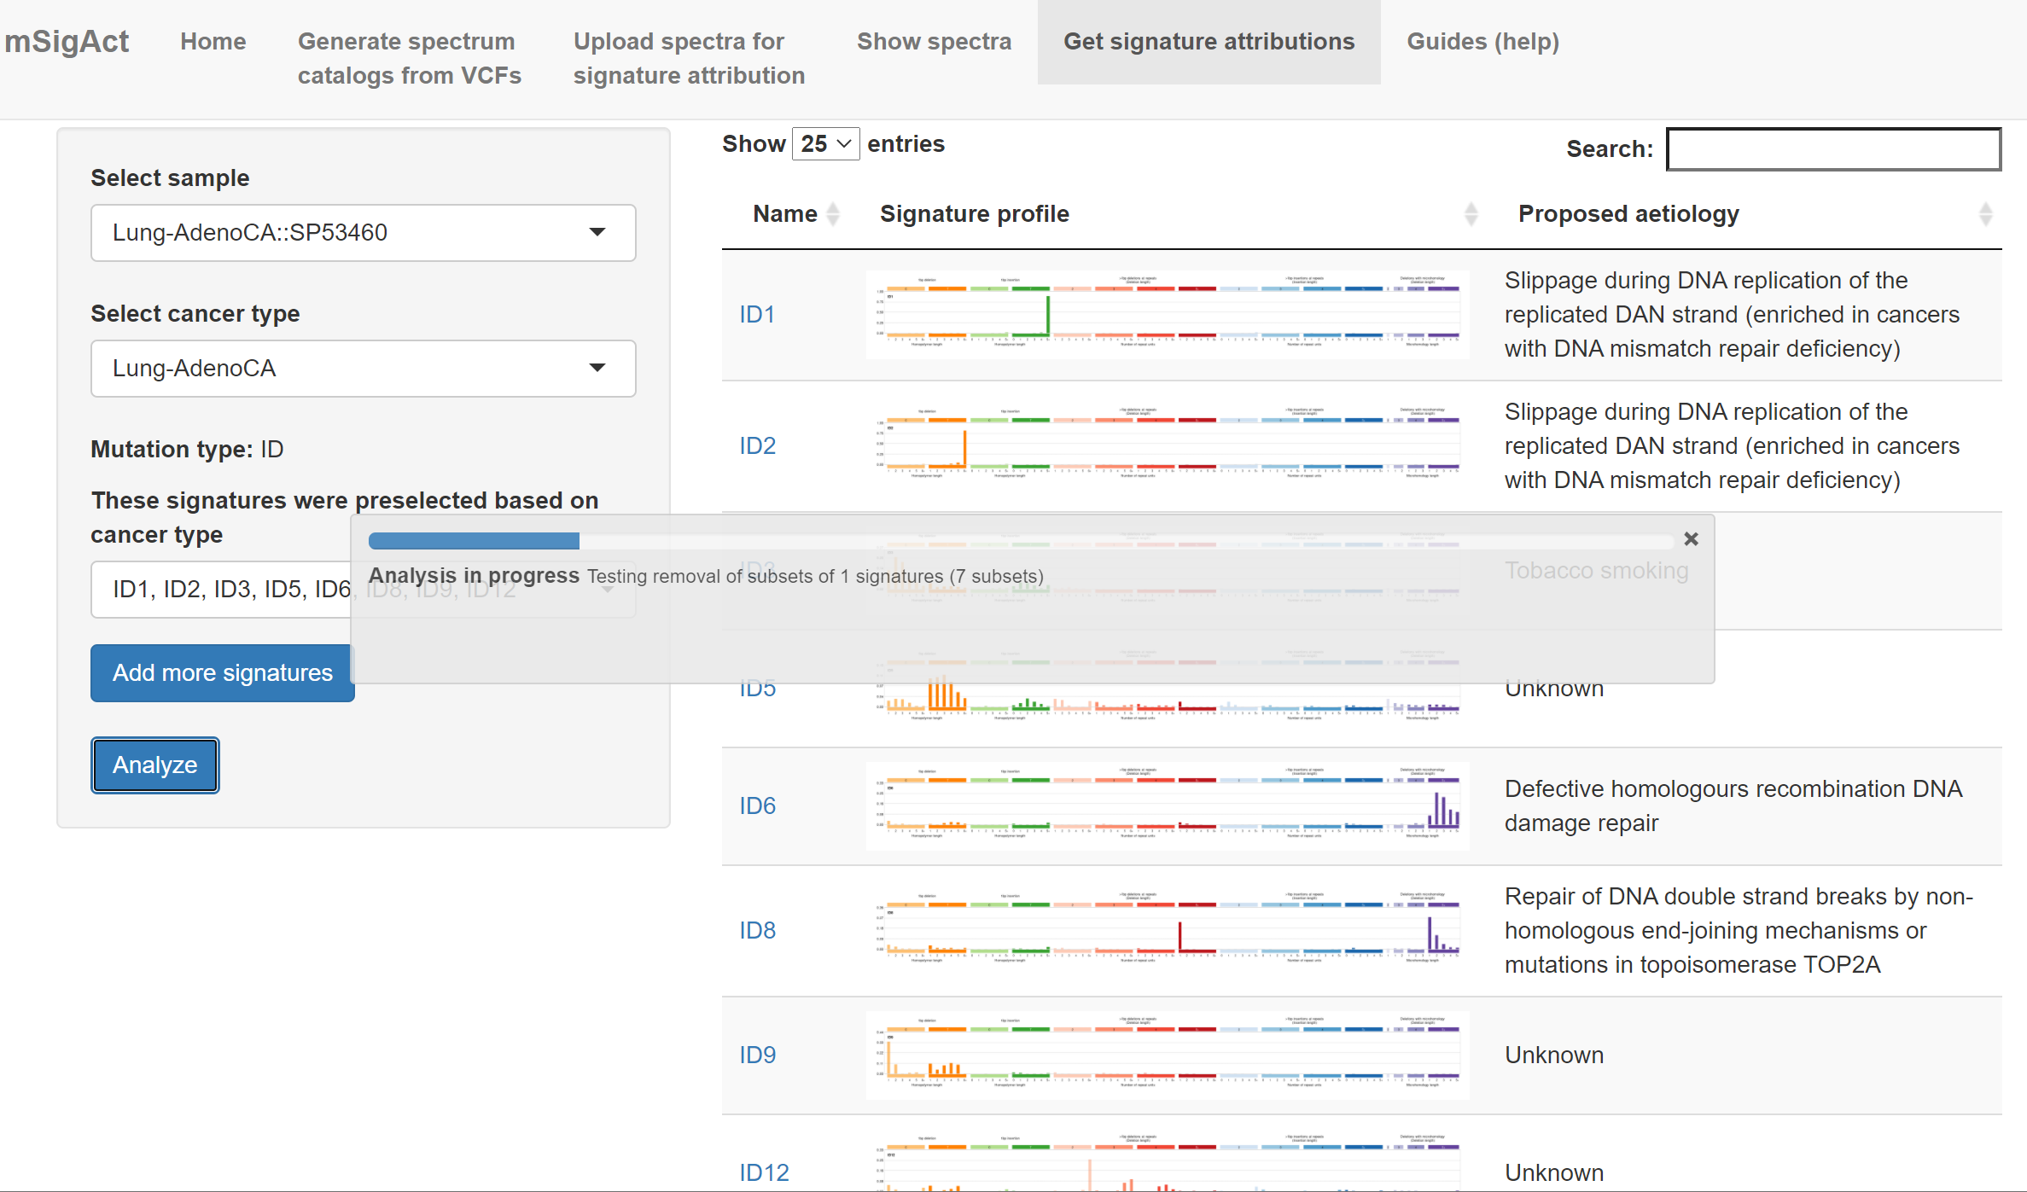

Slide 15
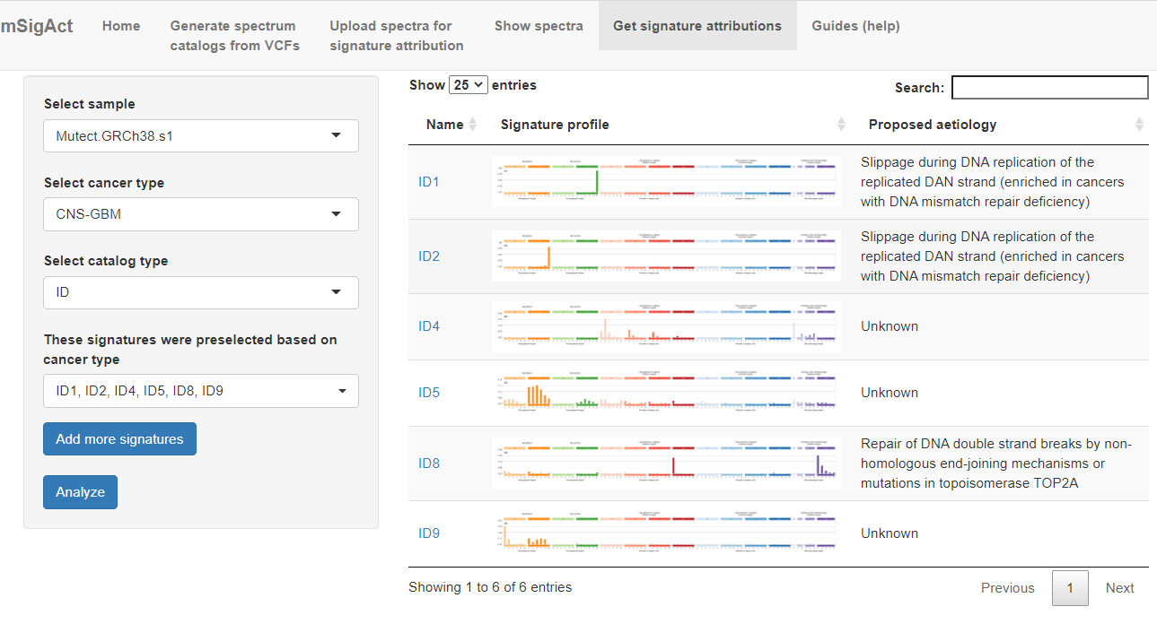

Slide 16
Next are analysis possibilities if you got here from analyzing a VCF

Slide 17
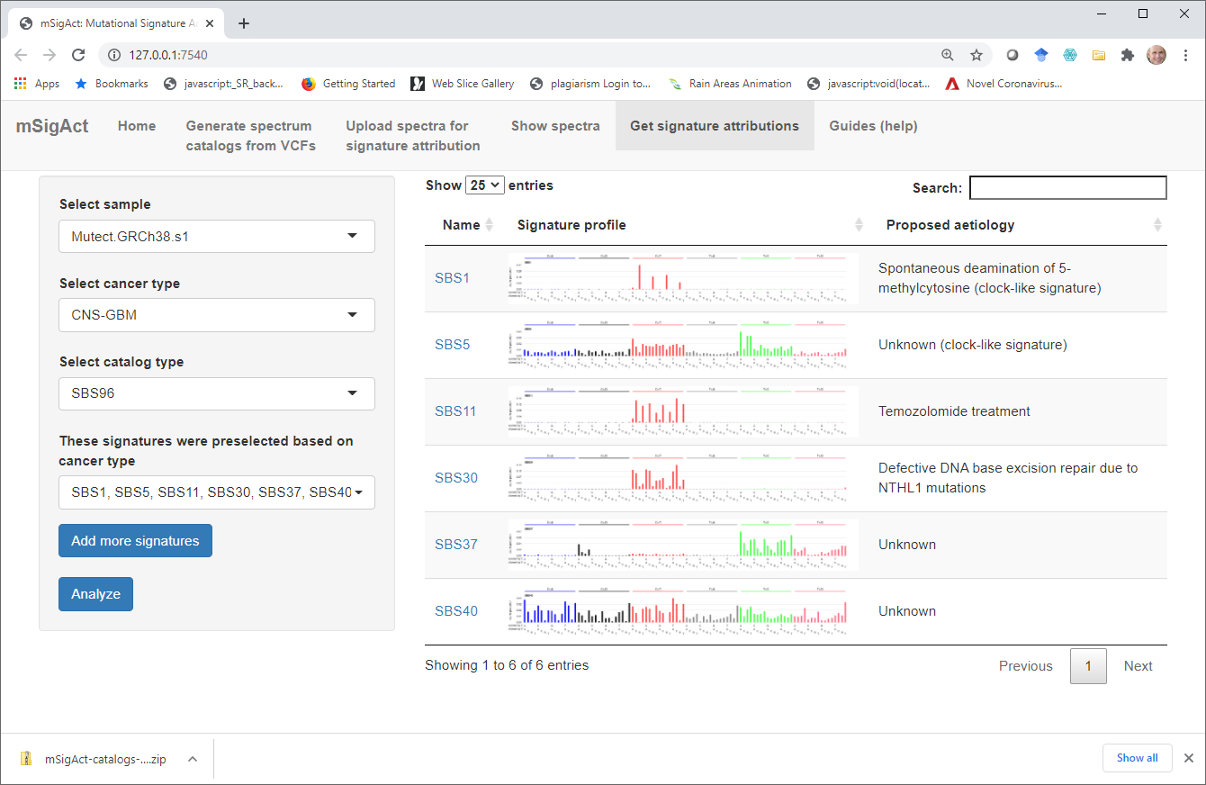

Slide 18
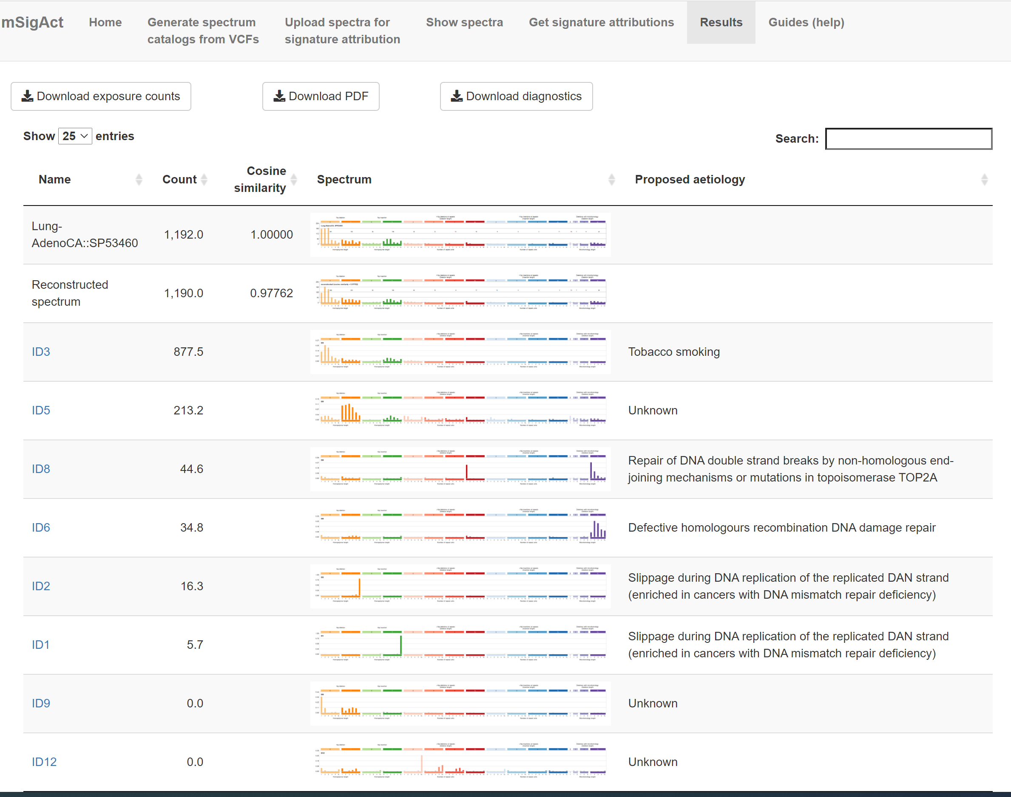

Slide 19
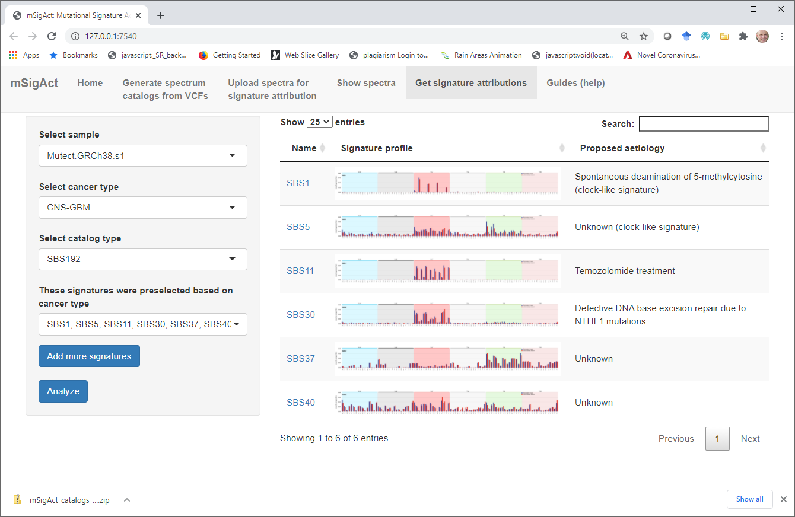

Slide 20
