Slide 1
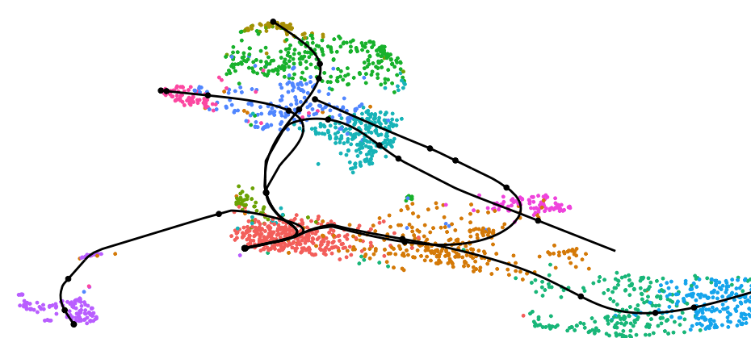
Overview of
single-cell experiments and bioinformatics
August 7, 2026
Steve Rozen
severozen [at] pm.me
sr110 [at] duke.edu
Course material for this afternoon for download at:
https://github.com/steverozen/handouts2026

Slide 2
Two key dimensions across different types of single-cell omics:
1. What do the different technologies actually measure?
2. What scientific questions can we ask once we have the data?

Slide 3
The technologies and what they measure
- Disaggregated / non-spatial
- Spatial

Slide 4
Disaggregated
Cells are dissociated out of the tissue or organoid
Position info is lost
High throughput
Every cell is measured the same way

Slide 5
Disaggregated
Transcriptome: single cell RNA-seq. The most common modality.
Chromatin accessibility: single cell ATAC-seq
Surface protein: CITE-seq, antibody-derived tags read out as extra from each cell along side it sRNA
Immune receptor repertoire: single-cell TCR-seq and BCR-seq
Perturb-seq: carry out a separate experiment in each cell and read out the transcriptomic changes

Slide 6
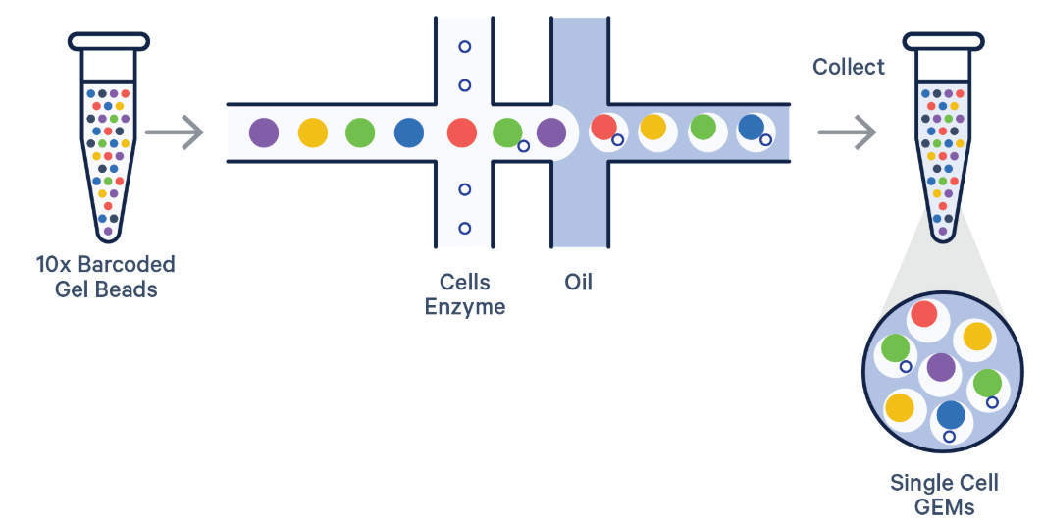
10X technology
GEM = "Gel beads in emulsion"
https://cdn.10xgenomics.com/image/upload/f_auto,q_auto,w_900,dpr_2.0/v1709753672/blog/GEM-X%20Launch%20blog/vertical_flipped_GEM96_H1975_high_4_S0001.gif
https://www.10xgenomics.com/blog/the-next-generation-of-single-cell-rna-seq-an-introduction-to-gem-x-technology

Slide 7
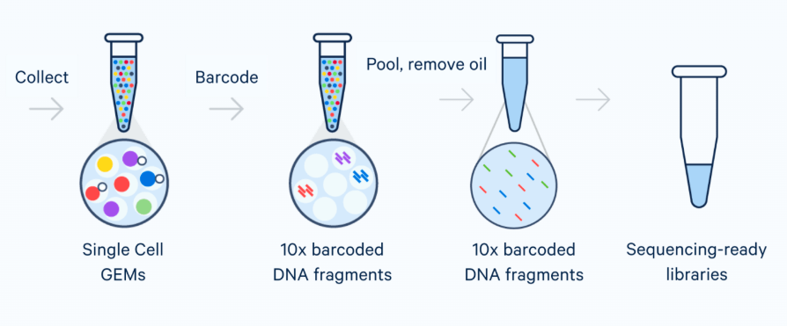
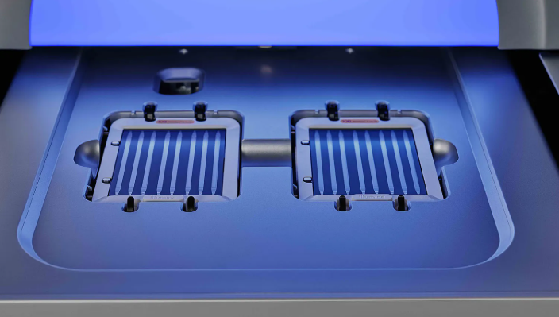
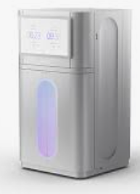
Short-read sequencer

Slide 8
Single cells versus single nuclei
Whole cells:
more RNA per cell
more cytoplasmic and mitochondrial reads
dissociation stress shows up in the data
Nuclei:
works on frozen and hard-to-dissociate tissue such as brain
RNA in nuclei than in whole cells
enriched for unspliced transcripts

Slide 9
Perturb-Seq
Everything else we discuss is observational. You take a snapshot and infer what is driving it.
Perturb-seq puts a pooled CRISPR screen and scRNA-seq in the same experiment: each cell carries a guide RNA, and the guide is read out alongside the transcriptome
The readout is not survival or one reporter, it is the whole transcriptional consequence of knocking out that gene, per cell
Replogle et al. took this genome-scale: every expressed gene knocked down, across 2.5 million cells
Related idea, heritable barcodes instead of guides, and you recover lineage rather than perturbation

Slide 10
Analyzing perturb-seq data
You assign the cell label
You don’t have to cluster anything.
That turns 'what is regulating this?' from an inference into a measurement
Problems: guide assignment is noisy, multiplets carry two guides, and knockdown is partial and variable between cells

Slide 11
Spatial
Molecular measurement is tied back to tissue architecture, at the cost of either gene coverage or resolution
2 Major subtypes https://pachterlab.github.io/LP_2021/index.html (Jan 2026)
Imaging-based
Molecules are detected in place in the tissue
MERFISH / Vizgen MERSCOPE, Nanostring CosMx, 10x Xenium, Akoya CODEX for protein.
Sequencing-based
transcripts are captured from tissue onto a barcoded surface
then remove tissue, build library, and sequence
Visium, Visium HD, Slide-seq.

Slide 12
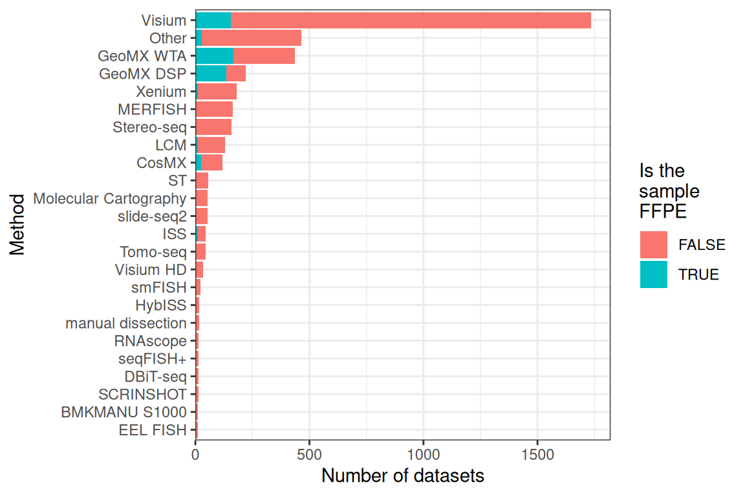
https://pachterlab.github.io/LP_2021/current-analysis.html

Slide 13
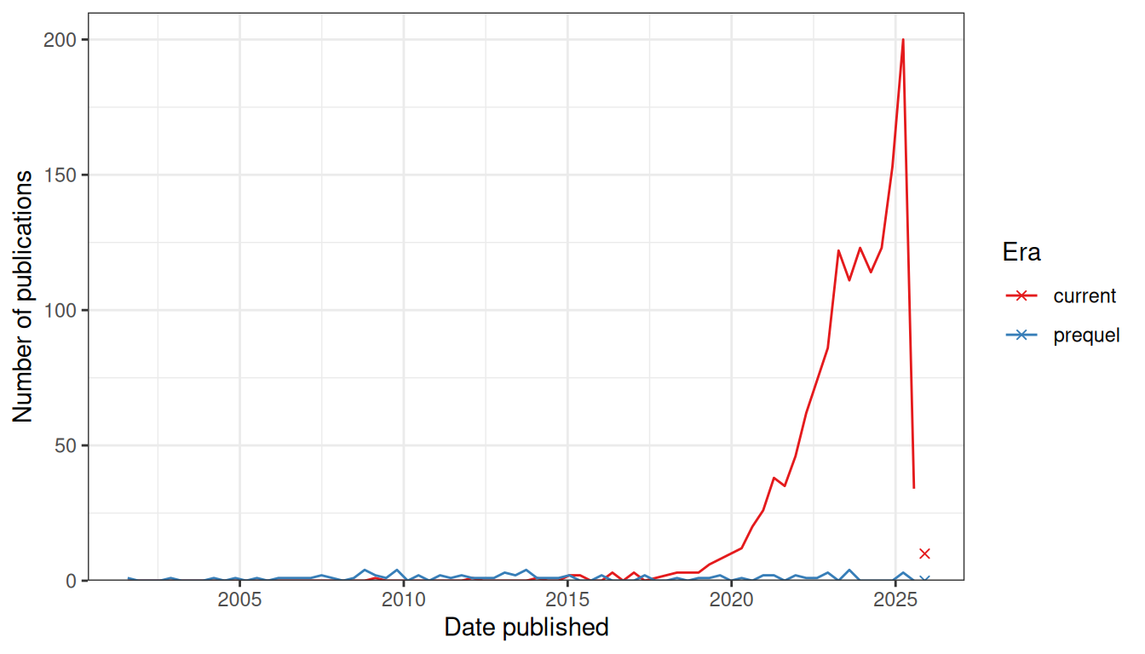
https://pachterlab.github.io/LP_2021/current-analysis.html

Slide 14
Imaging-based versus sequencing-based single-cell spatial omics
Genes measured
Resolution
Cell boundaries
Sensitivity
Sample format
Field of view
Data you get
Main headache
Examples
Imaging-based
Targeted panel, 100s to 5000
Sub-cellular, single molecule
Segmentation required
High per gene
FFPE or fresh frozen
Small, imaging time bound
Molecule coordinates
Bad segmentation
MERSCOPE, CosMx, Xenium
Sequencing-based
Whole transcriptome
Spot, bead or bin
Deconvolution required
Lower, capture-limited
Mostly fresh frozen, FFPE now
Whole section
Counts per spot, plus image
Spots are cell mixtures
Visium, Visium HD, Slide-seq

Slide 15
What scientific questions can we ask
once we have the data?

Slide 16
What cell types are here?
A key question; probably the first one you want to answer
Approach:
1. Dimension reduction on intial measurement space (e.g transcript abundance)
2. Graph-based clustering in the reduce-dimension space
3. Use marker genes (genes that are characteristic of specific cell types to identify what cell type(s) each cluster represents

Slide 17
Which known cell type is each cluster?
The annotation question, and it is a different problem from finding the clusters
By hand: score canonical markers per cluster and name it
Automatically: classify against a reference atlas, or transfer labels from an annotated dataset
Automated labels are confident even when they are wrong. Always check the markers you would have used by hand.

Slide 18
Are the samples even comparable?
Usually has to be settled before clustering and annotation can be trusted
Batch correction and integration: make cells of the same type from different samples, donors or chemistries land together
Query-to-reference mapping: place new cells into an existing atlas rather than re-clustering from scratch
The failure modes run both ways. Under-correct and every cluster is one sample, over-correct and you have erased the biological difference you came to find.

Slide 19
How does one cell type differ between conditions, or over time?
The commonest question anyone actually asks of the data
Subset to the cell type, then test condition against condition
Testing cell by cell treats cells as independent replicates. They are not: cells from one donor are correlated, and p-values come out absurdly small.
Pseudobulk instead: sum counts per cell type per sample, then use bulk RNA-seq machinery with samples as the unit of replication

Slide 20
Are there more or fewer of a cell type?
Differential abundance, or compositional analysis
Harder than it looks: proportions must sum to one, so one population expanding makes every other one appear to shrink
Also depends entirely on how you drew the cluster boundaries
Milo sidesteps the clustering by testing abundance in overlapping neighbourhoods of the k-nearest-neighbour graph instead

Slide 21
How do cells order along a continuous process?
For differentiation, activation, or any gradual change, discrete clusters are the wrong model
Trajectory inference orders cells along a path, and pseudotime says how far along a cell sits
Pseudotime is a distance, not a clock. Units are arbitrary and direction comes from biology, not from the algorithm.
RNA velocity uses the unspliced-to-spliced ratio to point at where a cell is heading, and is more fragile than its pictures suggest

Slide 22
What is driving the difference?
Gene set and pathway enrichment: is the gene list you found enriched for something already named
Gene regulatory network inference: which transcription factors have their targets moving together, for example SCENIC
In tumour work, inferred copy number from expression separates malignant cells from the normal cells beside them

Slide 23
Which cells are talking to which?
Ligand-receptor analysis: a ligand expressed in one cell type and its receptor in another
This is a prediction from co-expression. Nothing about contact, secretion, or an actual signalling event has been observed.
Two cell types can express a matched pair and sit at opposite ends of the tissue
Which is exactly why spatial data makes this question much stronger

Slide 24
Where are the cells in the image?
Imaging-based spatial gives molecule coordinates, not cells. You have to draw the boundaries.
Segmentation from a nuclear stain, expanded outward, or learned from cell membranes
Every downstream count depends on it, and mis-assigned transcripts look exactly like doublets or like hybrid cell types that do not exist
Spot-based data has the mirror-image problem: no segmentation to do, but each spot is a mixture, so you deconvolve it into cell-type proportions instead

Slide 25
How is the tissue organised?
The question you can only ask once position is retained
Spatial domains: recurring neighbourhoods of cell types, tumour core versus margin, germinal centre versus mantle
Spatially variable genes: expression structured by location rather than by cell type
Neighbourhood analysis: which cell types are found next to which, more often than chance

Slide 26
Combine different measurements from the same sample
Paired: RNA and protein, or RNA and ATAC, measured in the same cell. Alignment is given, the work is in weighting the modalities.
Unpaired: the same tissue assayed two ways in different cells. You have to infer which cell corresponds to which.
Mosaic: a set of datasets that overlap partially in modality, which is what atlas building really looks like
Also the bridge between the two spatial branches, and between spatial and dissociated reference data

Slide 27
Recap
Disaggregated and spatial technologies
Disaggregated much cheaper / more widely used / less data intensive / downstream analysis more widely understood
Spatial, more expensive, requires more data handling computing power / more specialized / increasingly more Python packages (versus R packages).
There are now many “single cell atlases” of different tissues. These serve as a point of reference for new experiments

Slide 28
Questions? Comments?

Slide 29
References: analysis and best practice
Luecken and Theis 2019, Current best practices in single-cell RNA-seq analysis: a tutorial, Molecular Systems Biology 15(6):e8746. https://doi.org/10.15252/msb.20188746
Heumos et al. 2023, Best practices for single-cell analysis across modalities, Nature Reviews Genetics 24(8):550-572. https://doi.org/10.1038/s41576-023-00586-w
Zappia and Theis 2021, Over 1000 tools reveal trends in the single-cell RNA-seq analysis landscape, Genome Biology 22:301. https://doi.org/10.1186/s13059-021-02519-4

Slide 30
References: technologies
Moses and Pachter 2022, Museum of spatial transcriptomics, Nature Methods 19(5):534-546. https://doi.org/10.1038/s41592-022-01409-2
Palla et al. 2022, Spatial components of molecular tissue biology, Nature Biotechnology 40(3):308-318. https://doi.org/10.1038/s41587-021-01182-1
Dixit et al. 2016, Perturb-Seq: Dissecting Molecular Circuits with Scalable Single-Cell RNA Profiling of Pooled Genetic Screens, Cell 167(7):1853-1866.e17. https://doi.org/10.1016/j.cell.2016.11.038
Replogle et al. 2022, Mapping information-rich genotype-phenotype landscapes with genome-scale Perturb-seq, Cell 185(14):2559-2575.e28. https://doi.org/10.1016/j.cell.2022.05.013

