Slide 1
Trajectory inference: Slingshot and Monocle 3

Slide 2
Trajectory analysis goal
Consider cells in differentiation process in a single-cell RNA-seq experiment
We do not have a real time-course, just cells capture a different stage
Trajectory inference estimates a path of gradual change and orders cells that path
The term “pseudotime” is misleading
There is no estimate of time. We just have arbitrary units indicating where along the path a cell sits

Slide 3
Two packages
Slingshot fits smooth curves through a cluster-level tree, and gives one pseudotime per lineage
Monocle 3 fits a principal graph to the UMAP embedding, and gives one pseudotime per cell, measured from a root you pick

Slide 4
Slingshot
Input: a reduced-dimension embedding plus and cluster labels
Stage 1, getLineages(): minimum spanning tree on the cluster centroids, which gives the branching structure
Stage 2, getCurves(): fit simultaneous principal curves, one per lineage
The curves are shrunk toward each other near branch points, so lineages share a trunk and then separate

Slide 5
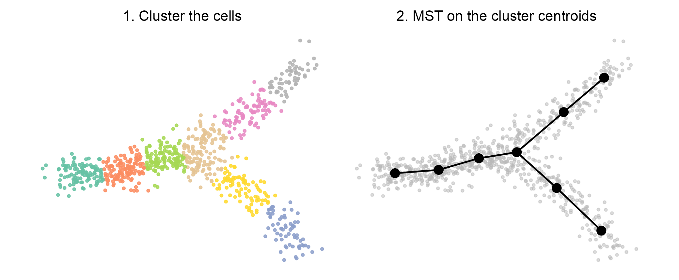
Slingshot stage 1: the cluster-level tree
Schematic, drawn to show the algorithm. Not package output.

Slide 6
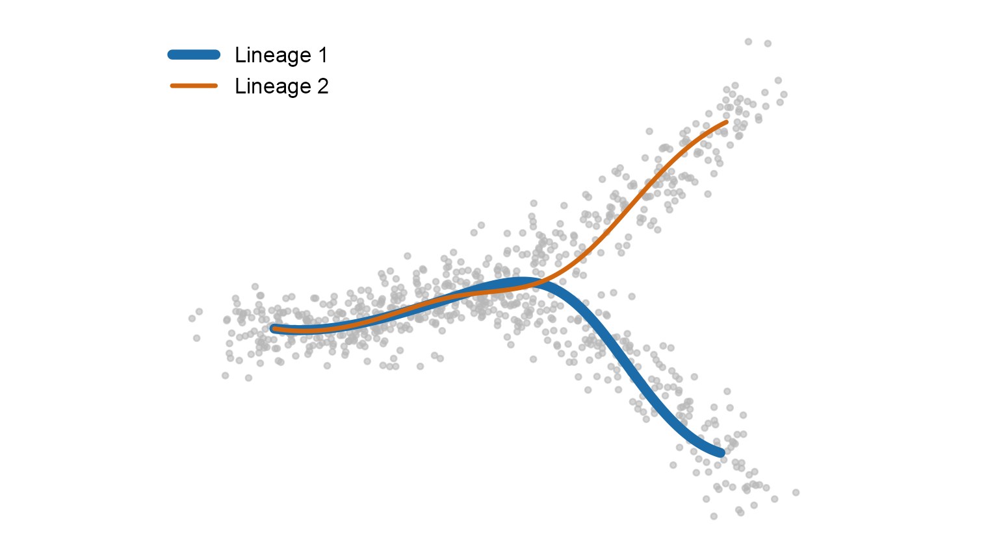
Slingshot stage 2: one smooth curve per lineage
The two curves nearly coincide along the trunk, then separate. Schematic, drawn to show the algorithm. Not package output.

Slide 7
Monocle 3
Input: a cell_data_set, built through Monocle's own preprocessing
cluster_cells() assigns both clusters and partitions
learn_graph() fits a principal graph by reversed graph embedding, within each partition
order_cells() sets the root, and pseudotime is the distance along the graph from that root

Slide 8
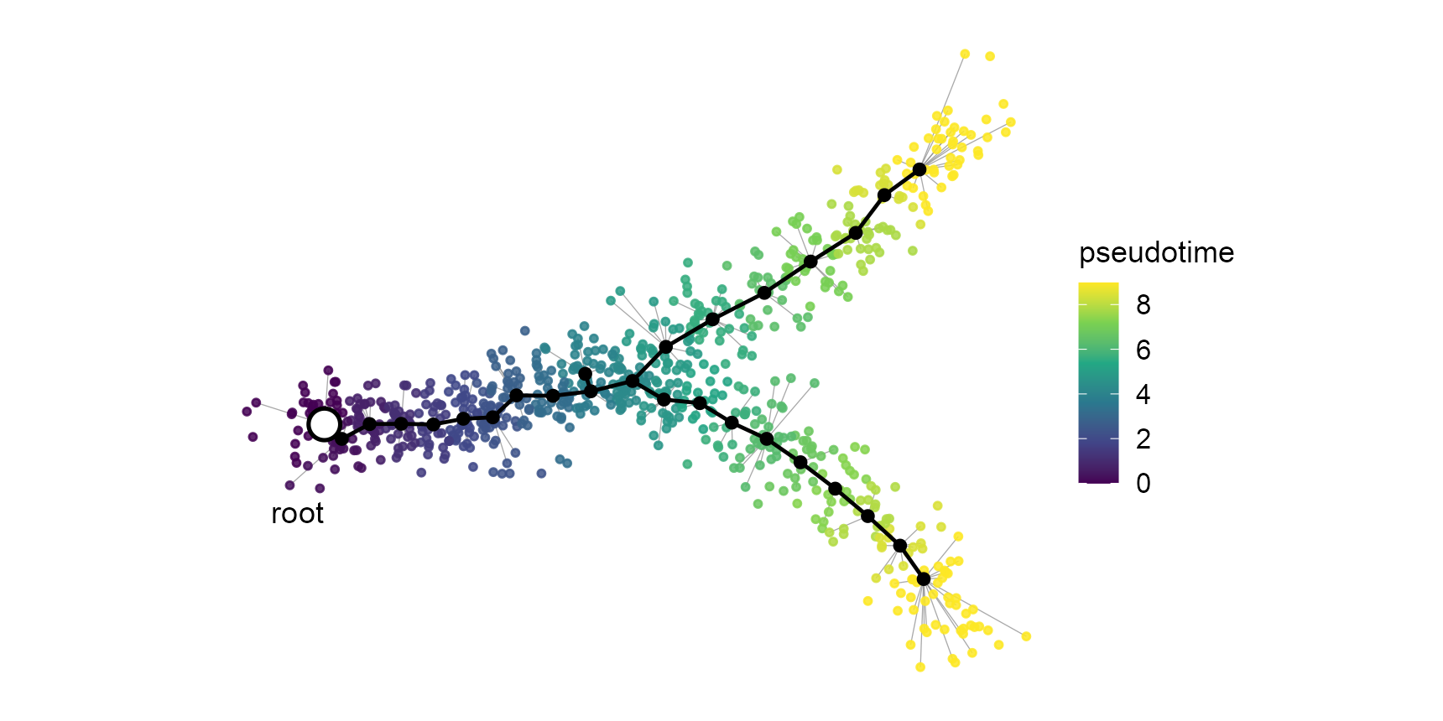
Monocle 3: the principal graph, fitted to the embedding
Grey spokes show each cell assigned to its nearest vertex. Pseudotime is distance from the root along the black edges. Schematic, drawn to show the algorithm. Not package output.

Slide 9
Careful: the black dots mean different things
Slingshot's dots are cluster centroids. Eight clusters, eight dots. You can label each one with a cell type.
Monocle 3's dots are principal points: landmarks the algorithm invents to build a skeleton through the cells
They are not cells and not clusters, and no single one means anything biologically. Only the shape of the whole graph does.
How many is set by ncenter in learn_graph_control, usually far more than you have clusters
They are what you name in order_cells(root_pr_nodes = ...), hence labels like Y_1 and Y_17

Slide 10
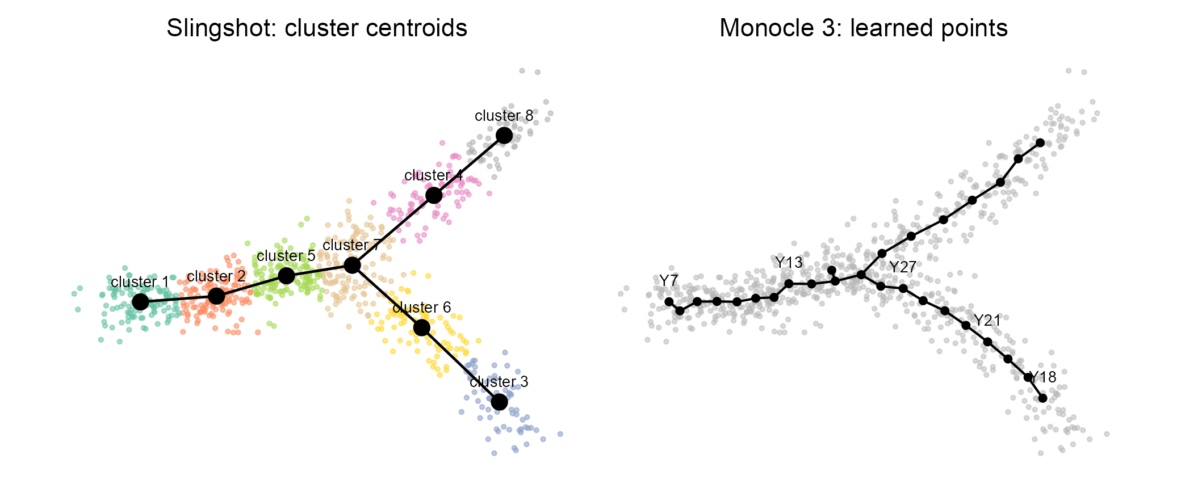
The same picture, two different meanings
Left: one dot per cell type. Right: 28 landmarks, chosen by ncenter, individually meaningless. Schematic, drawn to show the algorithm. Not package output.

Slide 11
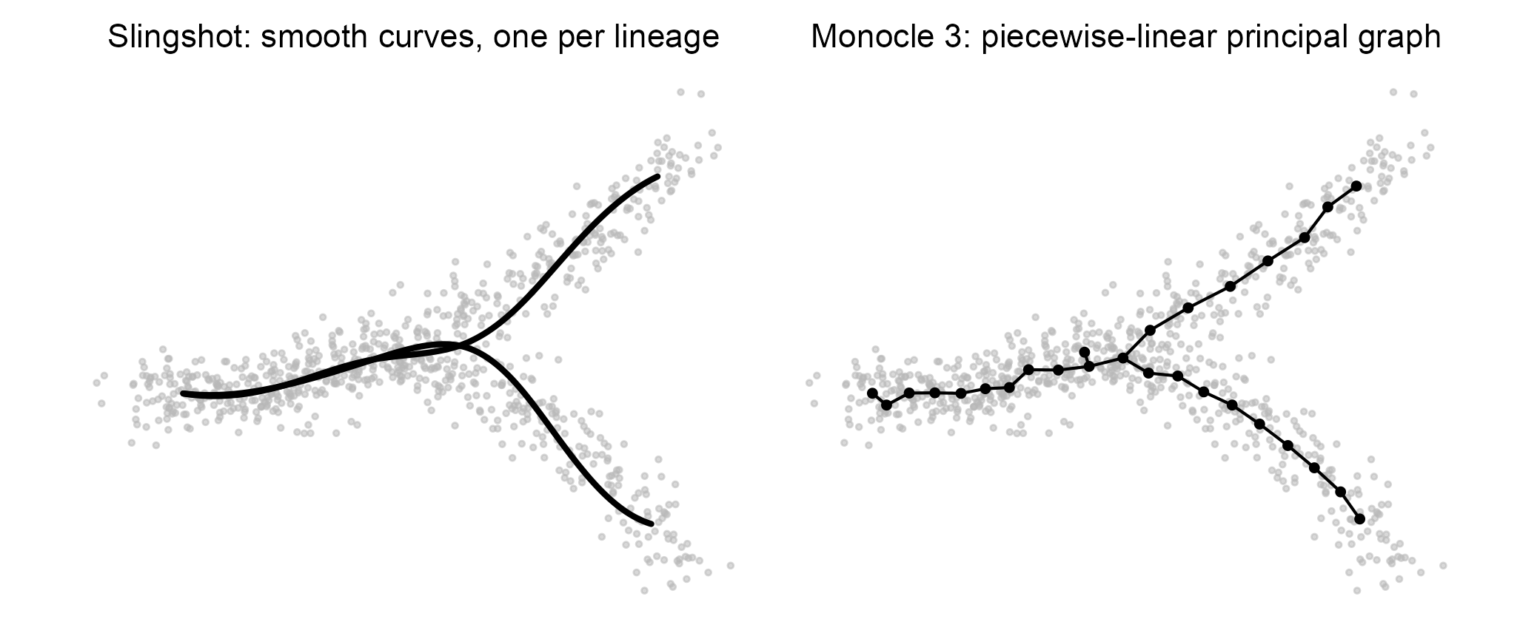
The same data, the two models
Schematic, drawn to show the algorithm. Not package output.

Slide 12
Side by side:
Topology
Fitted in
Pseudotime
Measured from
Branches
Disconnected parts
Cycles
DE on pseudotime
Ecosystem
Slingshot
MST on clusters, then curves
Any reduced space, e.g. 10 PCs
Matrix: cells x lineages
A start cluster you supply
Explicit, named lineages
No, it connects everything
No, tree only
Not included, use tradeSeq
One Bioconductor package
Monocle 3
Principal graph (SimplePPT)
The UMAP embedding, usually 2D
One vector per cell
Root nodes you supply
Structure in the graph
Yes, via partitions
Yes, loops can be closed
Built in: graph_test()
Framework, own object type

Slide 13
Difference 1: curves versus a graph
Slingshot gives a few smooth 1-D paths. That is the developmental picture most people already have in mind.
Monocle 3 gives a piecewise-linear skeleton that can branch repeatedly, close loops, and be disconnected
More flexible topology, but less smooth and harder to summarise

Slide 14
Difference 2: which space the fit happens in
This is the one with the biggest practical consequences
Slingshot can fit in, say, 10 PCs and only project to 2D for the figure
Monocle 3 fits the graph in the UMAP embedding itself
UMAP does not preserve global distances, so the trajectory inherits whatever distortion UMAP introduced
Change the UMAP seed or n_neighbors and the trajectory can change shape

Slide 15
Difference 3: per-lineage versus single pseudotime
Slingshot: a cell before the branch point gets a pseudotime in every downstream lineage, plus a weight for each
That is exactly what tradeSeq consumes to ask whether a gene behaves differently in lineage 1 than in lineage 2
Monocle 3: one number per cell, so branch-specific questions mean subsetting and re-running

Slide 16
Difference 4: composable versus all-in-one
Slingshot needs only an embedding and cluster labels, so it drops into a Seurat or scran workflow you already trust
Monocle 3 wants you inside its cell_data_set world: its normalization, its clustering, its batch alignment
Convenient if you start there, awkward if you are converting from Seurat

Slide 17
Gotchas
Slingshot will connect anything you give it. Feed it T cells and monocytes together and it will draw a lineage between them.
So subset to related cells first, and set start.clus explicitly
Monocle 3 infers trajectories within a partition. Cells in other partitions get infinite pseudotime, which is the usual cause of a half-grey UMAP.
Neither tool finds the root for you. Direction comes from biology.

Slide 18
Which to use:
Start with Slingshot: the two stages are easy to reason about, and it composes with the Seurat workflow we used earlier
Reach for Monocle 3 when the topology is genuinely complex, or when you want the built-in DE and gene modules
In the dynverse benchmark Slingshot was among the top performers for linear and branching topologies
Note that the benchmark tested Monocle 2 (DDRTree), not Monocle 3, so that result does not transfer directly

Slide 19
Hands-on tutorials:
Slingshot, NBIS workshop-scRNAseq, Seurat-based, bone marrow data, Slingshot plus tradeSeq:
https://nbisweden.github.io/workshop-scRNAseq/labs/seurat/seurat_07_trajectory.html
Monocle 3, Galaxy Training Network, about 3 hours in R:
https://training.galaxyproject.org/training-material/topics/single-cell/tutorials/scrna-case_monocle3-rstudio/tutorial.html

Slide 20
References:
Street et al. 2018, Slingshot: cell lineage and pseudotime inference for single-cell transcriptomics, BMC Genomics. https://doi.org/10.1186/s12864-018-4772-0
Cao et al. 2019, The single-cell transcriptional landscape of mammalian organogenesis, Nature. https://doi.org/10.1038/s41586-019-0969-x
Saelens et al. 2019, A comparison of single-cell trajectory inference methods, Nature Biotechnology. https://doi.org/10.1038/s41587-019-0071-9
Van den Berge et al. 2020, Trajectory-based differential expression analysis for single-cell sequencing data, Nature Communications. https://doi.org/10.1038/s41467-020-14766-3

