Slide 1
Signature Presence Test How to detect the AA signature in a mix of background signatures
2019 09 08

Slide 2
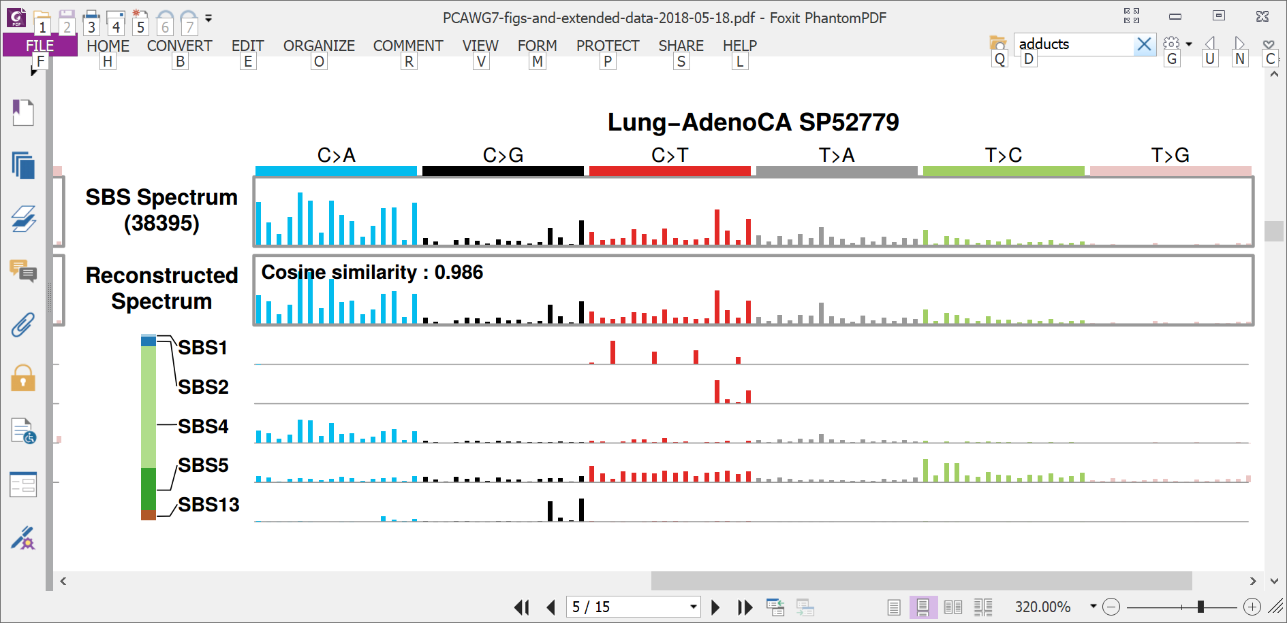
Mutational spectra usually consist of superimposed mutations from multiple processes
Spectrum:
39,000 mutations

Slide 3
Mutational spectra usually consist of superimposed mutations from multiple processes
Spectrum:
39,000 mutations
Counts of mutations due to 5 signatures

Slide 4
Mutational spectra usually consist of superimposed mutations from multiple processes
Spectrum:
39,000 mutations
Counts of mutations due to 5 signatures

Slide 5
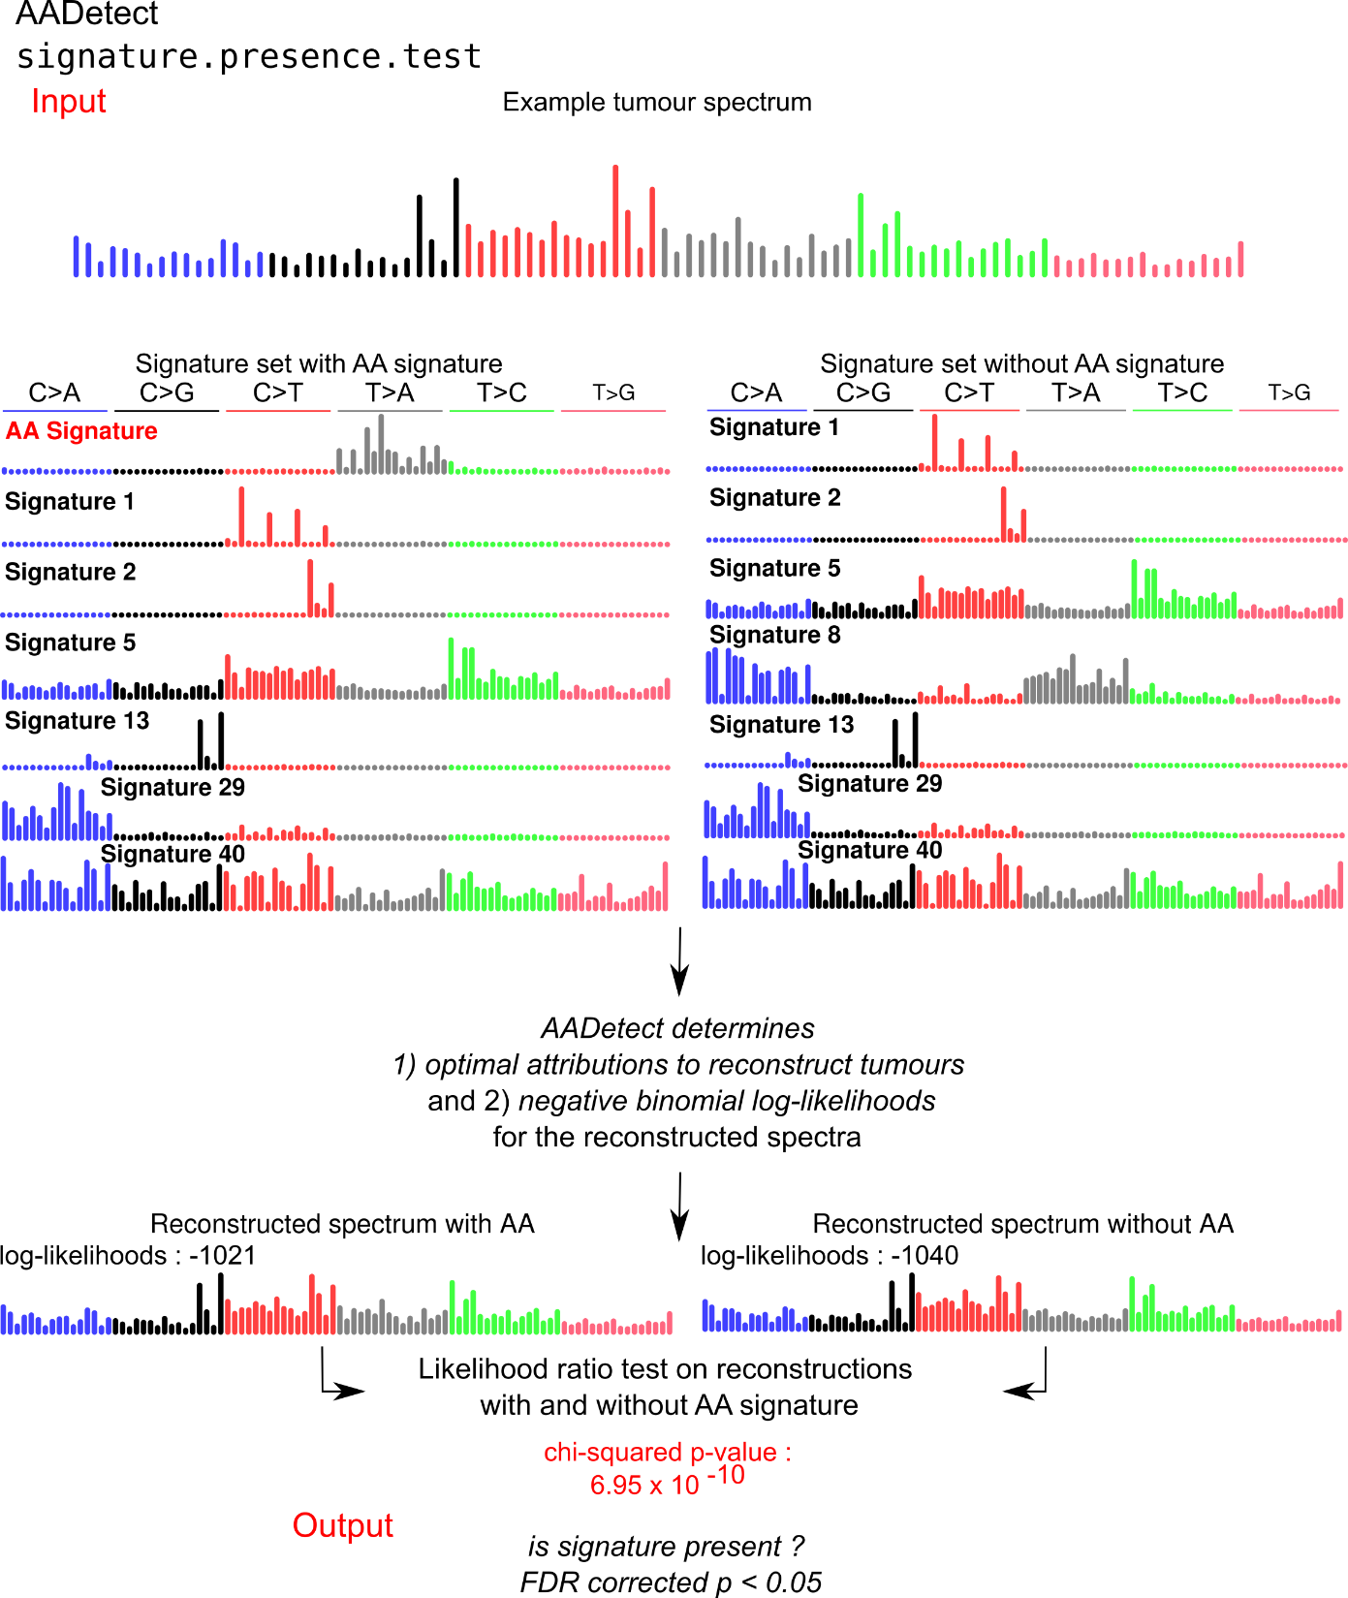
Signature presence test
?
Is the AA signature present?
Was this tumour exposed to AA?
Did AA contribute to the development of this cancer?

Slide 6
Signature presence test

Slide 7
Signature presence test

Slide 8
Signature presence test

Slide 9
Signature presence test
Likelihood ratio test, p < 10⁻⁹

