Slide 1
Method of generating new SBS synthetic data for mSigHdp paper

Slide 2
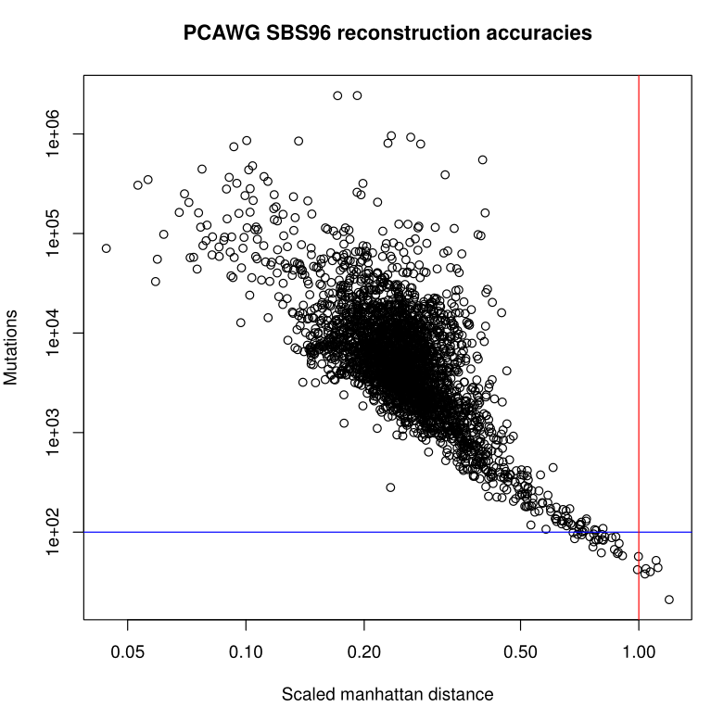
How many synthetic tumors to generate?
The exposure information from the PCAWG “platinum” genomes, Alexandrov et al. (2020) was treated as real exposure
Scaled Manhattan distance (SMD) was used to filter out those poorly reconstructed tumors (SMD > 1)
Tumor mutations cut-off 100 was used to exclude low reconstruction accuracy tumors

Slide 3
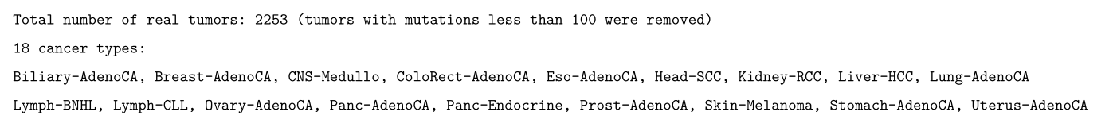
How many synthetic tumors to generate?
The original total number of tumors for the 18 cancer types in PCAWG exposure is 2253

Slide 4
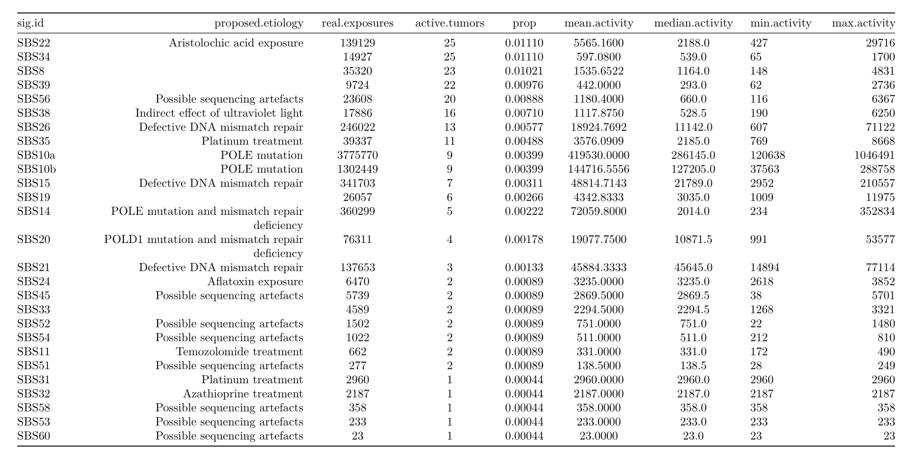
How many synthetic tumors to generate?
Tumors which have the artefact signatures were excluded
(total 30 tumors out of 2253 were removed; prop = 0.01331558; left with 2223 tumors )

Slide 5
How many synthetic tumors to generate?
Rare signatures (active tumors < 10) were excluded
(another 39 tumors out of 2223 were removed ; prop = 0.01754386; left with 2184 tumors)
Signatures removed

Slide 6
Overview of new SBS96 synthetic data
For each cancer type, only generate 60 synthetic tumors
The number of MSI-H tumors were scaled accordingly;
scale factor = 60 / total num of real tumor in each cancer type
There are no POLE-mutated tumors in the synthetic data

Slide 7
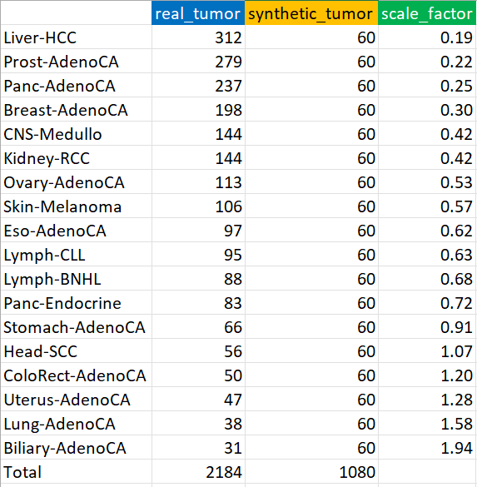
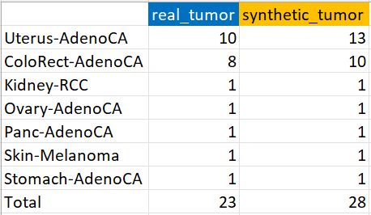
Overview of new SBS96 synthetic data
1080 synthetic tumors from 18 cancer types
28 synthetic MSI-H tumors from 7 cancer types
There are no POLE-mutated tumors in the synthetic data

Slide 8
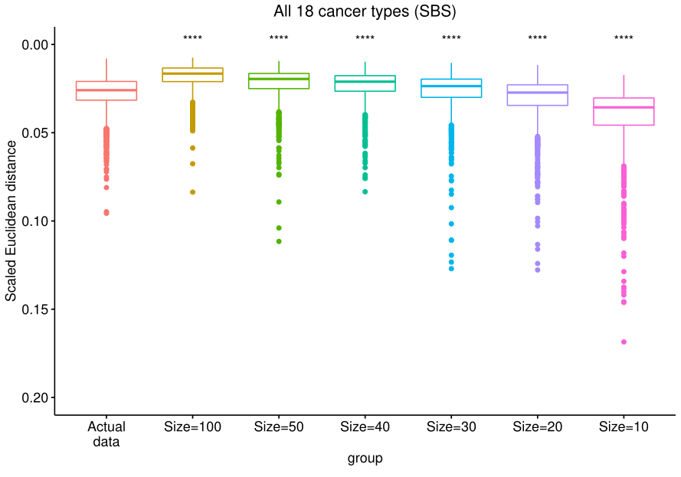
Size = 30 was used to add noise to the synthetic data

Slide 9
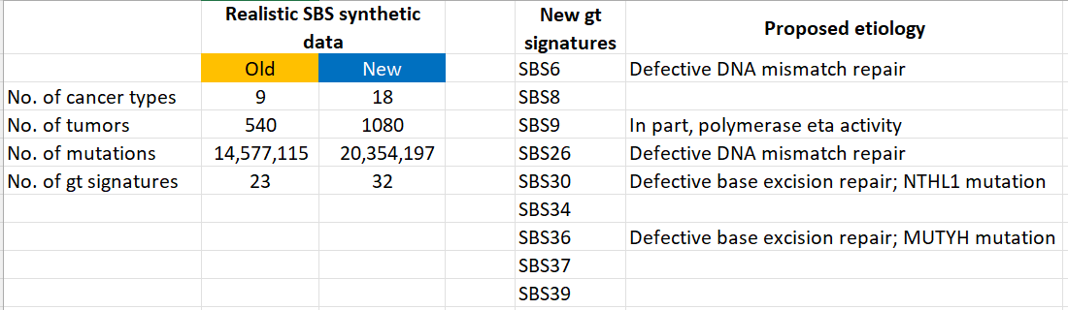
Comparison between old and new SBS synthetic data

