Slide 1
Method of generating new indel synthetic data for mSigHdp paper

Slide 2
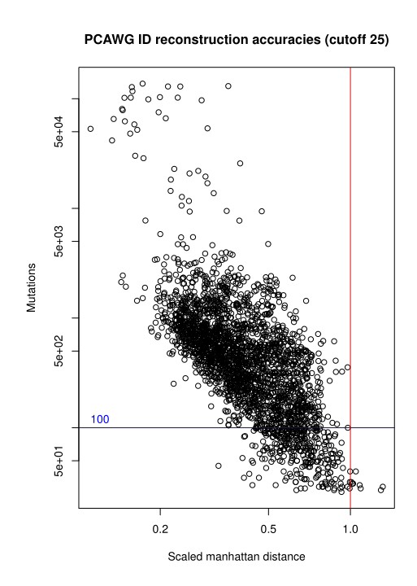
How many synthetic tumors to generate?
The exposure information from the PCAWG “platinum” genomes, Alexandrov et al. (2020) was treated as real exposure
Scaled Manhattan distance (SMD) was used to filter out those poorly reconstructed tumors (SMD > 1)
Tumor mutations cut-off 100 was used to exclude low reconstruction accuracy tumors

Slide 3
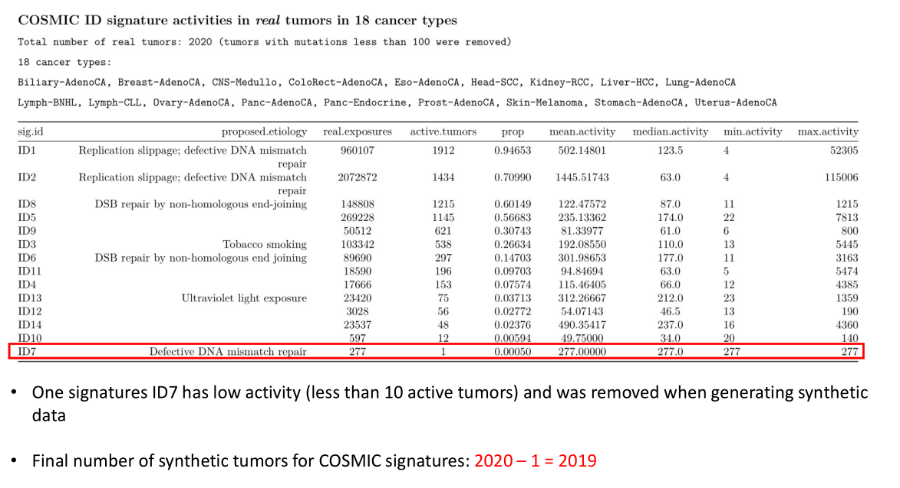
How many synthetic tumors to generate?

Slide 4
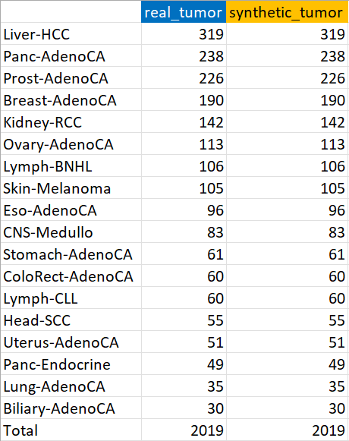
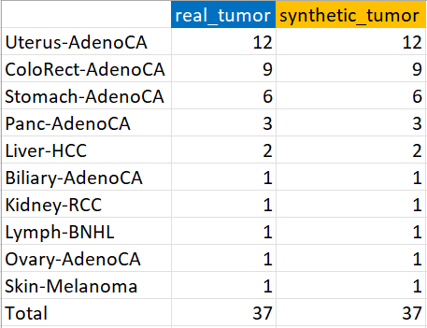
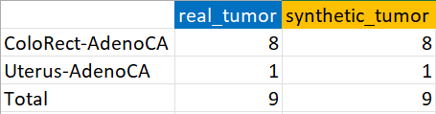
Overview of new indel synthetic data by cancer type
2019 synthetic tumors from 18 cancer types
37 synthetic MSI-H tumors from 10 cancer types
9 synthetic POLE-mutated tumors from 2 cancer types

Slide 5
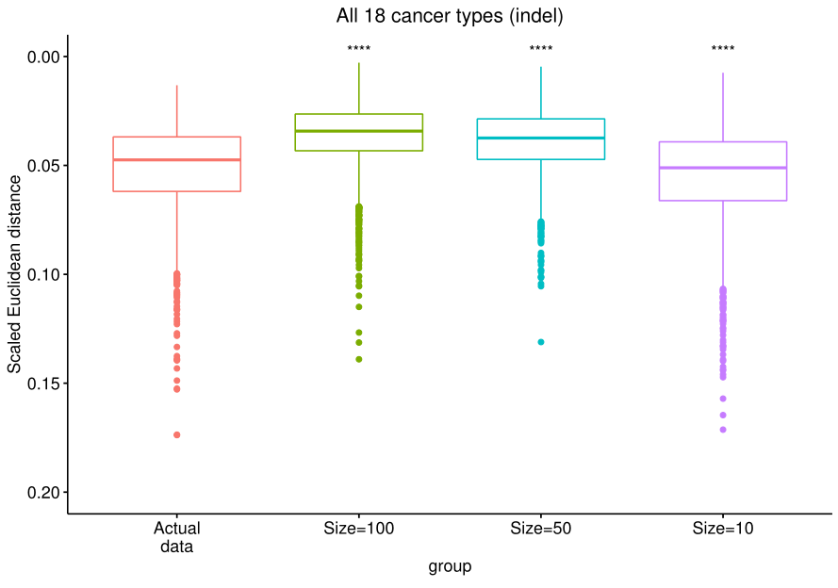
Size = 10 was used to add noise to the synthetic data

Slide 6
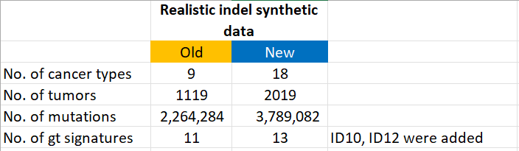
Comparison between old and new indel synthetic data

