Slide 1
grid: viewports, grobs, and gtables

Slide 2
Mental model
Concept | Role
device | the physical page (file/window)
viewport | a coordinate region on the page
grob | a drawable thing (rect, text, points, gtable)
gtable | a grob that arranges other grobs by pushing viewports

Slide 3
The chain: gtable defines a layout, pushes viewports, draws grobs into them, onto the device.

Slide 4
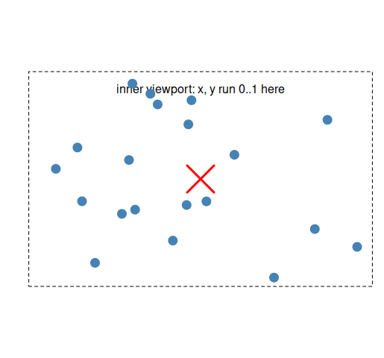
Code and its output
library(grid) grid.newpage() # a viewport is a coordinate region; name it so we can re-enter it pushViewport(viewport(x = 0.5, y = 0.5, width = 0.6, height = 0.6, name = "inner"))
# width and height are in npc (normalized parent units)
# This is generated from quarto with fig-width/height 8/5 so our
# rectangle is has the same aspect ratio grid.rect(gp = gpar(lty = "dashed")) # outlines THIS viewport grid.text("inner viewport: x, y run 0..1 here", y = 0.92) grid.points(runif(20), runif(20), pch = 19,
# placed in viewport coords gp = gpar(col = "steelblue")) upViewport() # back to the root viewport # re-enter the named viewport later and add a big red X
# in the middle downViewport("inner") grid.points(0.5, 0.5, pch = 4, gp = gpar(col = "red", cex = 3, lwd = 3)) upViewport()

