Slide 1
A gentle bioinformatics on-ramp:
R, python, bash, IDEs, AI coding agents
August 3, 2026
Steve Rozen
steverozen [at] pm.me
sr110 [at] duke.edu

Slide 2
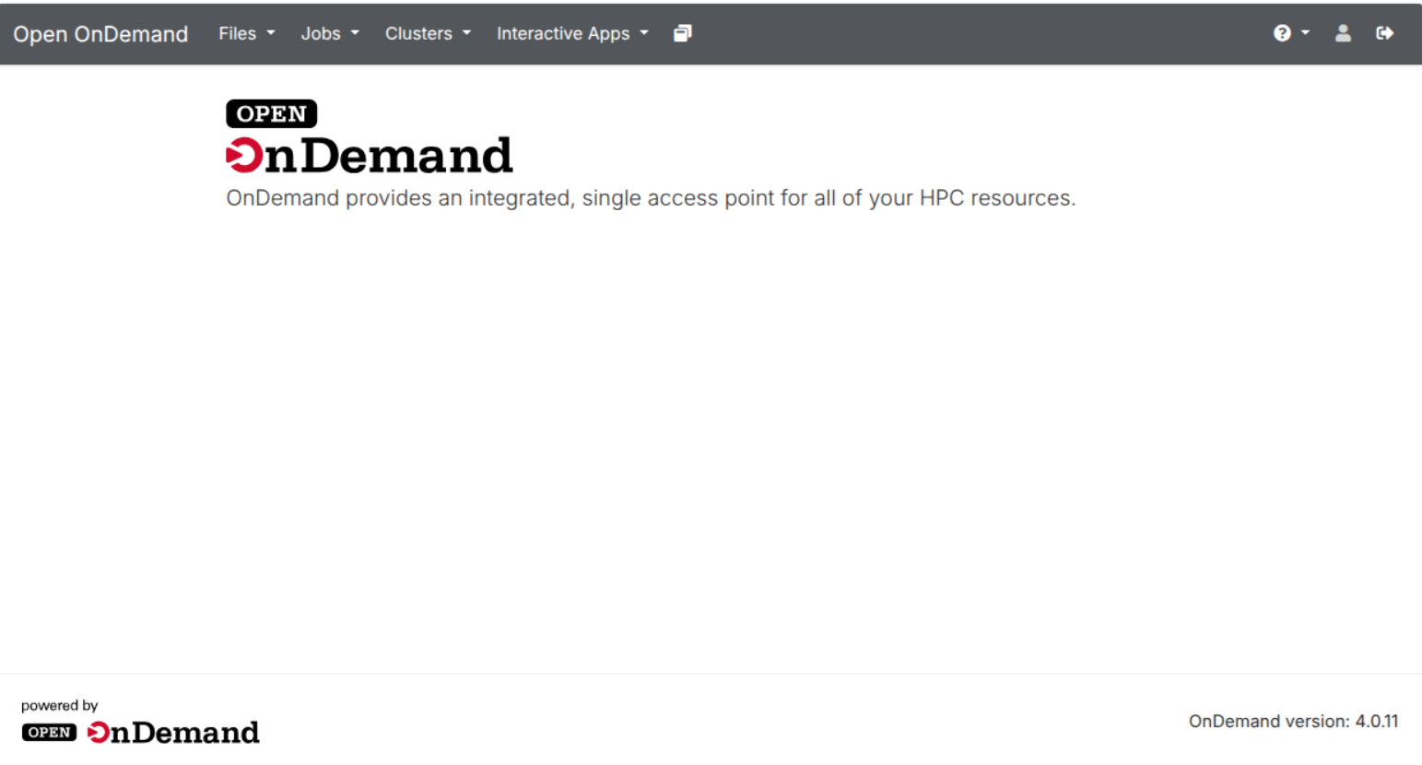
Using RStudio from OnDemand or from your laptop

Slide 3
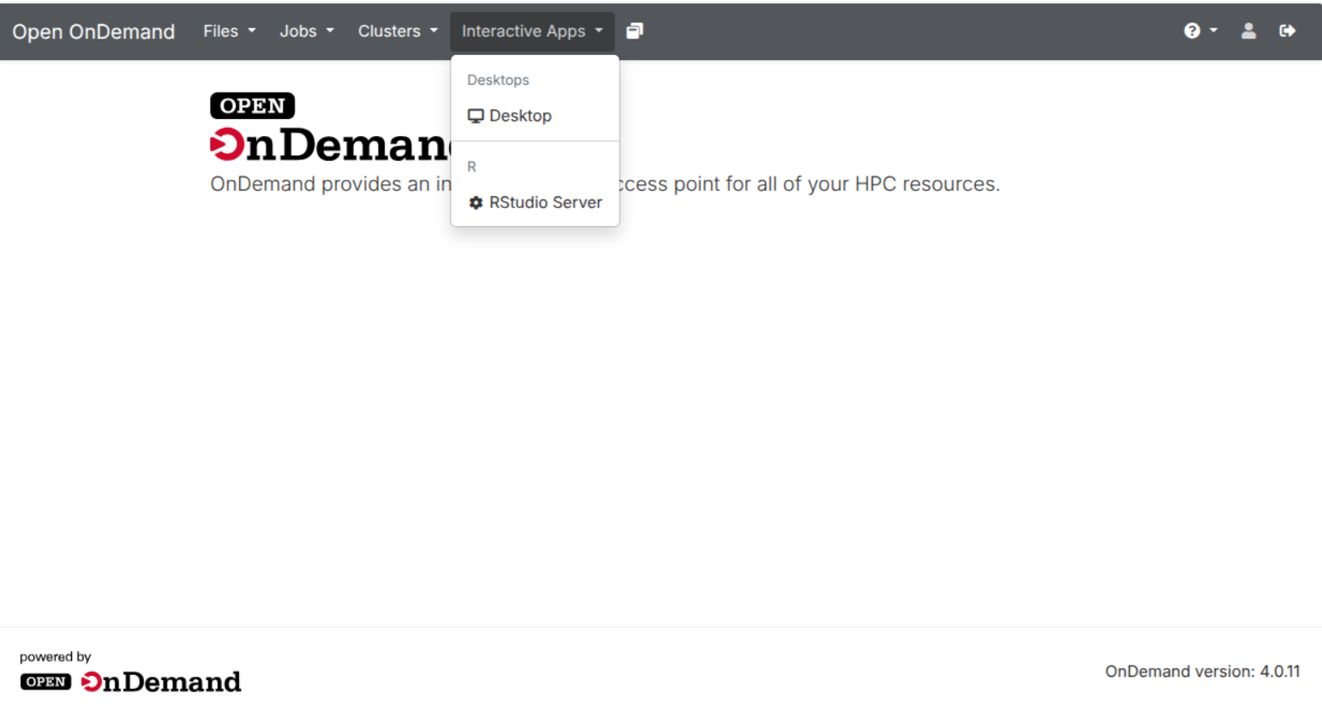

Slide 4
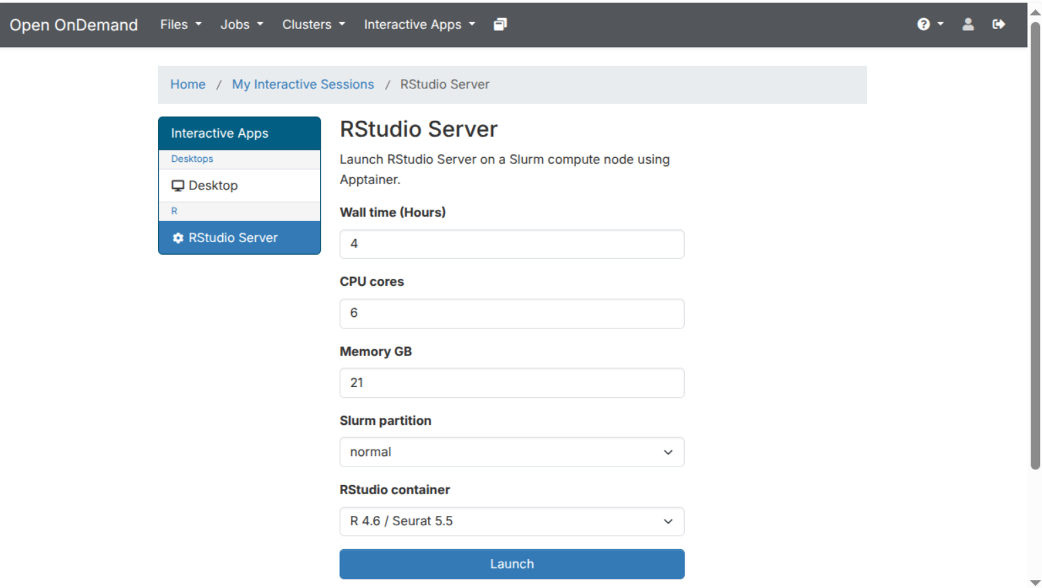

Slide 5
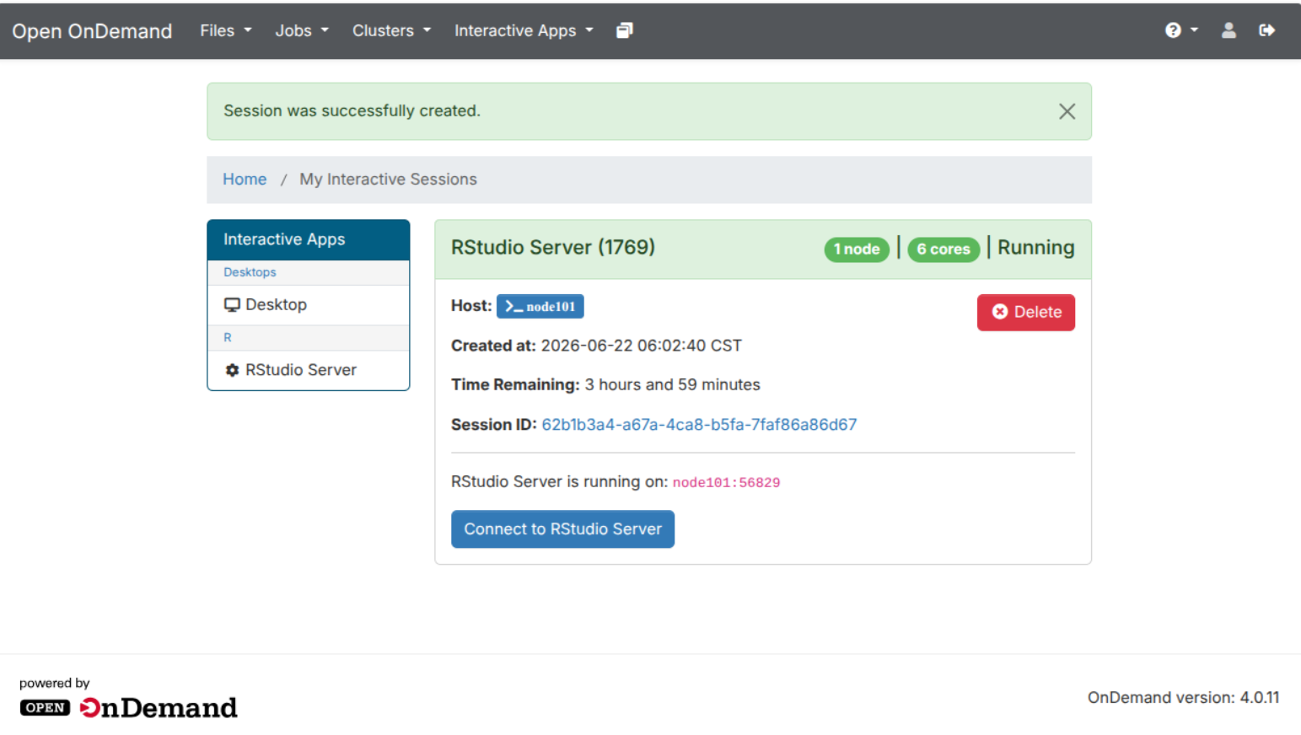

Slide 6
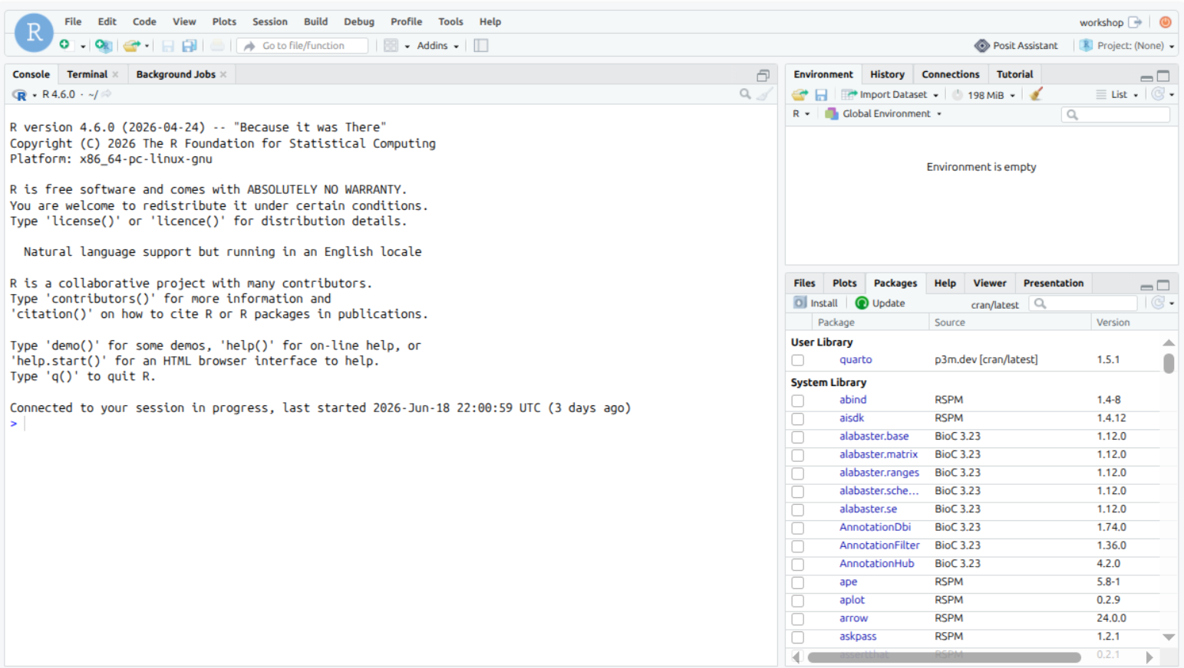
This is the “console”, running an R programming language interpreter in a “read-eval-print loop”
Show examples

Slide 7
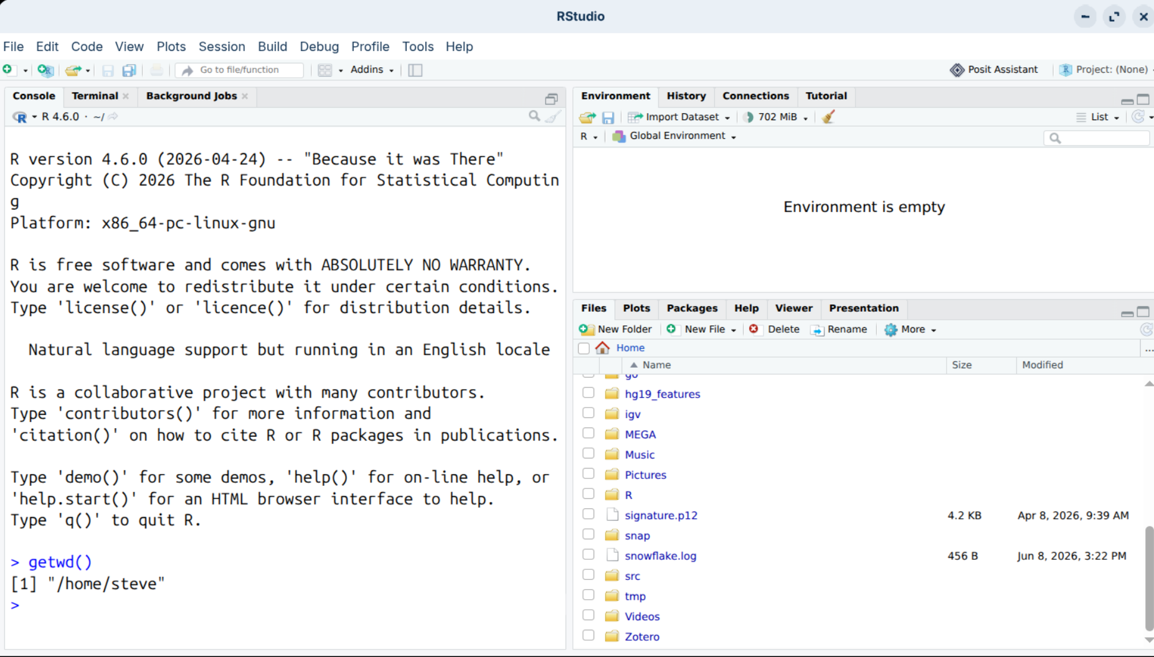
What folder am I in?
getwd – get working directory
R function

Slide 8
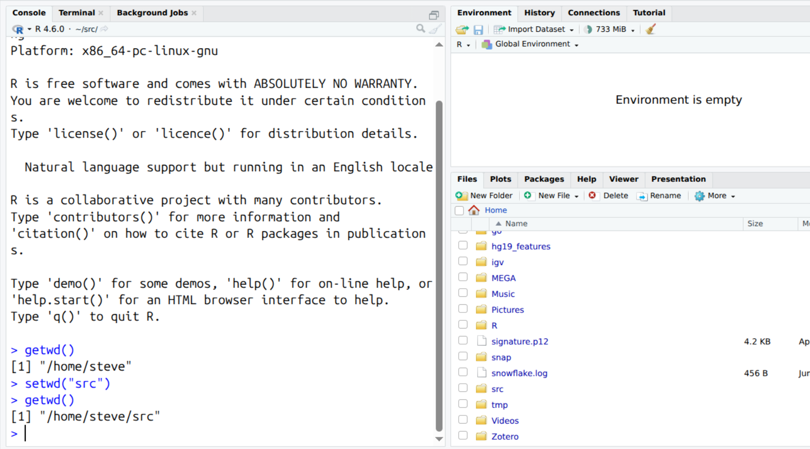
But no change here
setwd(“src”) =
Set working directory src
Then getwd – get working directory

Slide 9
But no change here
setwd(“src”) =
Set working directory src
Then getwd – get working directory

Slide 10
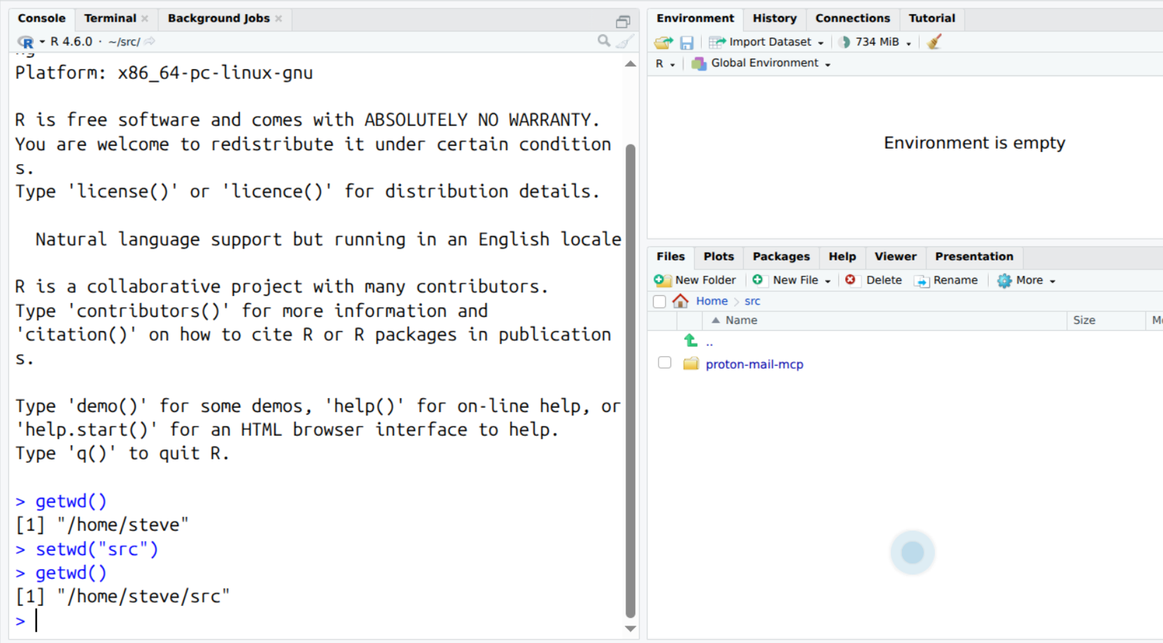
Show how to create new folder / navigate in the files tab, and then make that the working directory in the R console

Slide 11
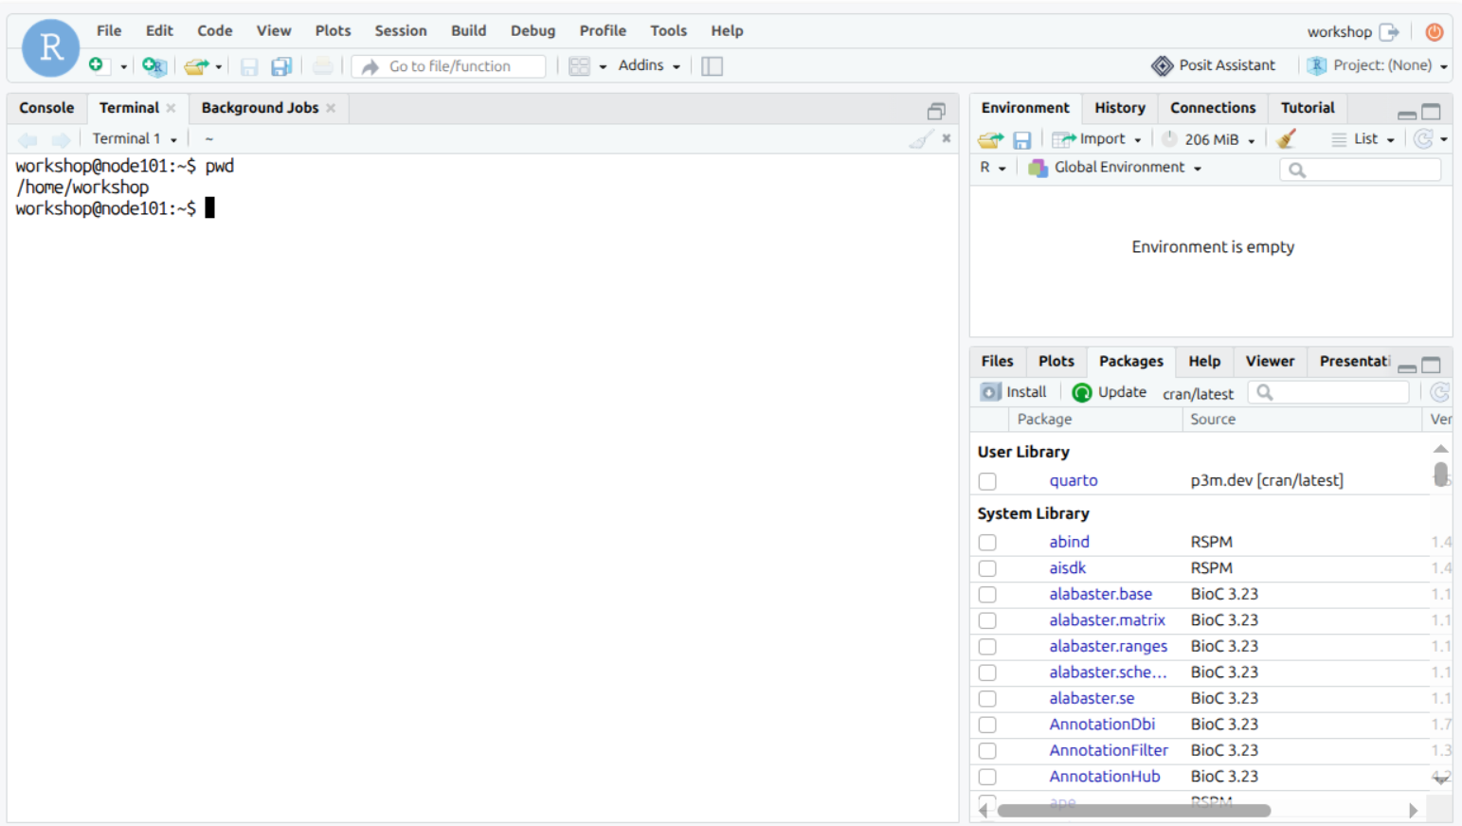
What folder am I in (pwd – print working directory) bash function
Terminal is running bash; continue with orientation

Slide 12
Outline for the rest:
Setting up and running an AI coding assistant / examples
More on bash
Environment variables
PATH
Scripts
Executable bits
AI coding agents use bash a lot

Slide 13
Outline for the rest:
R
Variables and assignment and basic data types
“Built in” functions:
Reading data
Writing data
Working with data (data.frame, Tibble)
Basic statistics
User defined functions
Packages and how to find and use packages
CRAN
Bioconductor
Github / etc repos
Seurat / Bioconductor packages
Git/Github
Why

Slide 14
Reference slides: R compared to Python
Reference slides:
R compared to Python

Slide 15


1 · Single Values & Vectors
The building blocks: one value, or many values that are all the same type.
Single value (a “scalar”)
Vector — many values, one type
x <- 3.14
c(10, 20, 30)
x = 3.14
np.array([10, 20, 30])
No separate scalar type in R — it’s a vector of length 1.
R’s core structure. Every element must be the same type.
Named vector (an R favourite)
Factor — a vector for categories
c(a = 10, b = 20)
factor(c("low","high"))
{"a": 10, "b": 20} a dict
pd.Categorical(["low"])
Each value has a label; grab it by name. Python uses a dict.
A vector for fixed categories — e.g. treatment vs control.
Basic types R: numeric · integer · character · logical Python: float · int · str · bool
1 / 6

Slide 16
2 · Lists, Dictionaries & Arrays
Mixing types, labelling items, and working with grids of numbers.
List — a mixed bag
Matrix / Array — a grid of numbers
list(1, "two", TRUE)
matrix(1:6, nrow=2)
[1, "two", True]
np.array([[1,2,3],[4,5,6]])
A list can mix types — and even hold other lists inside.
Same type, in rows × columns.
NumPy broadcasting
Named list / Dictionary
When arrays have different shapes, NumPy stretches the smaller one to fit — without copying any data.
list(name="Ada") → x$name
{"name":"Ada"} → x["name"]
1
2
3
+
10
10
10
=
11
12
13
Label each item. An R named list ≈ a Python dict.
np.array([1,2,3]) + 10 → the 10 is added to every element. R calls this “recycling.”
2 / 6

Slide 17
3 · Tables: data.frame, tibble & DataFrame
Rows and columns — the format you’ll use most for real data.
Every object below stores data as rows × columns, like this:
sample | gene | expr
S1 | TP53 | 5.2
S2 | EGFR | 8.1
S3 | MYC | 6.7
In R
In Python
data.frame data.frame(gene=…)
pandas.DataFrame pd.DataFrame(…)
Base R’s classic table; columns may differ in type.
The everyday Python table — matches all three at left.
tibble tibble(gene=…)
polars.DataFrame pl.DataFrame(…)
Tidyverse table — cleaner, stricter, keeps text as text.
Fast, modern — Python’s answer to R’s data.table.
data.table data.table(gene=…)
Rule of thumb: data.frame / tibble ≈ pandas, data.table ≈ polars
Built for speed on big data: DT[i, j, by].
3 / 6

Slide 18


4 · Selecting Columns & Rows
The two most common moves — pick the columns you want, keep the rows you want.
Select columns
dplyr
df %>% select(gene, expr)
pandas
df[["gene", "expr"]]
Keep only the columns you name.
polars df.select("gene", "expr")
Select rows
dplyr
df %>% filter(expr > 6)
pandas
df[df["expr"] > 6]
Keep only the rows that meet a condition.
polars df.filter(pl.col("expr") > 6)
4 / 6

Slide 19


5 · Adding & Updating Rows
Append a new observation, or change a value in an existing row.
Add a row
dplyr
df %>% add_row(sample="S4", gene="KRAS", expr=7.3)
pandas
df.loc[len(df)] = ["S4", "KRAS", 7.3]
Append a new observation (sample S4) to the bottom.
polars pl.concat([df, df_new])
Update a value in a row
dplyr
df %>% mutate(expr = if_else(sample=="S2", 9.0, expr))
pandas
df.loc[df["sample"] == "S2", "expr"] = 9.0
Change a cell where a condition holds (set S2’s expr to 9.0).
polars df.with_columns(pl.when(pl.col("sample")=="S2").then(9.0).otherwise(pl.col("expr")).alias("expr"))
5 / 6

Slide 20
Backup · The Older Base R Way
Same operations without the tidyverse — worth recognizing in older code.
BACKUP
Select columns
df[, c("gene", "expr")]
Add drop=FALSE to guarantee it stays a data.frame.
Select rows
df[df$expr > 6, ]
Mind the trailing comma — it means “all columns.”
Add a row
rbind(df, data.frame(sample="S4", gene="KRAS", expr=7.3))
Column names and types must line up.
Update a value
df$expr[df$sample == "S2"] <- 9.0
Edits the data frame in place.
6 / 6

