Slide 1

A gentle bioinformatics on-ramp:
R, python, bash, IDEs, AI coding agents
August 3, 2026
Steve Rozen
steverozen [at] pm.me
sr110 [at] duke.edu
https://tinyurl.com/47vvh447

Slide 2
Workshop objectives
Provide hands-on orientation on computational infrastructure needed for bioinformatics today:
RStudio and R
Bash (the Linux command shell)
Directories and files and file location
Python
Using an HPC (high performance computing) cluster
Moving large files around
Using agentic coding agents effectively

Slide 3
R and RStudio
Starting RStudio in “OnDemand”

Slide 4
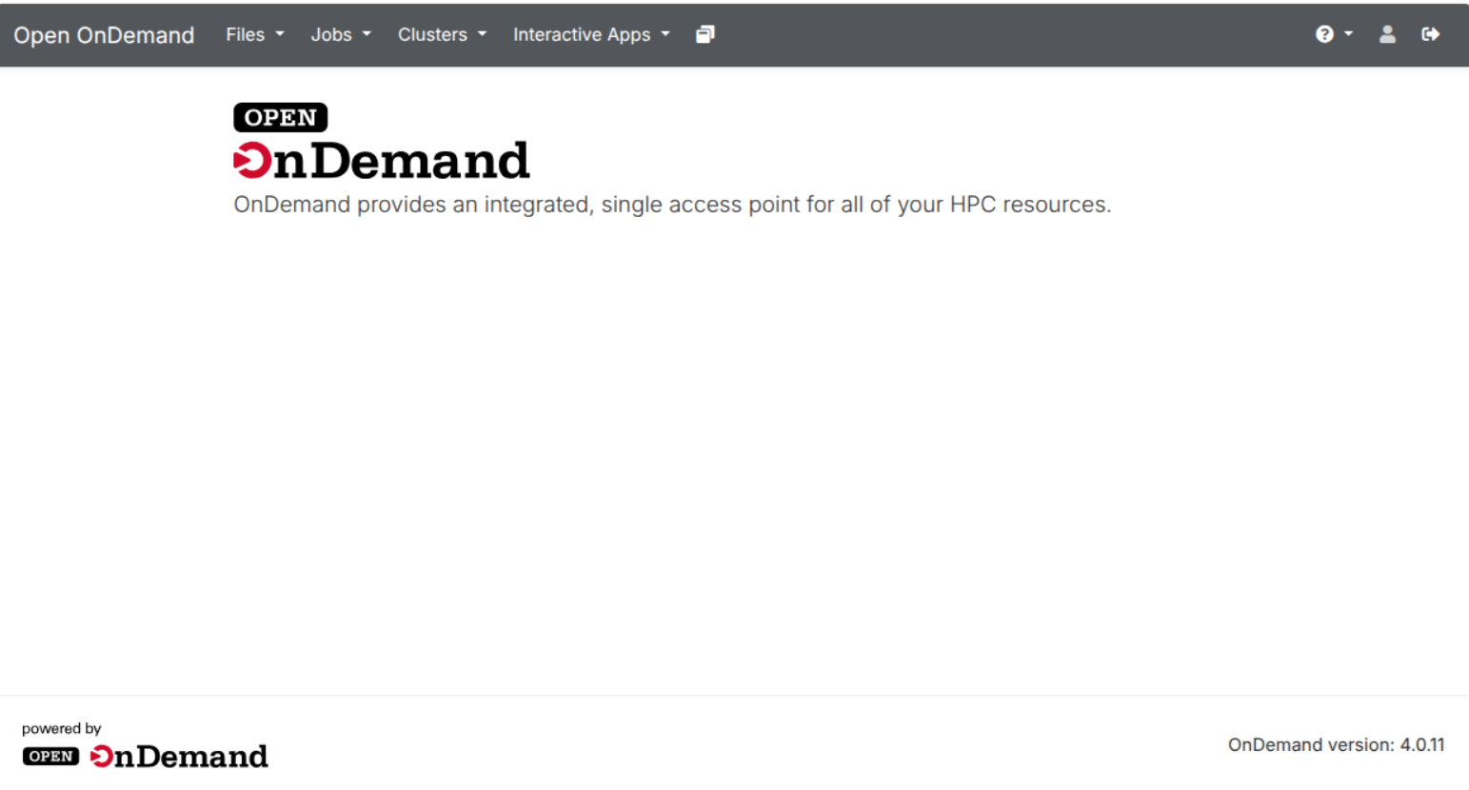
Using RStudio from OnDemand or from your laptop

Slide 5
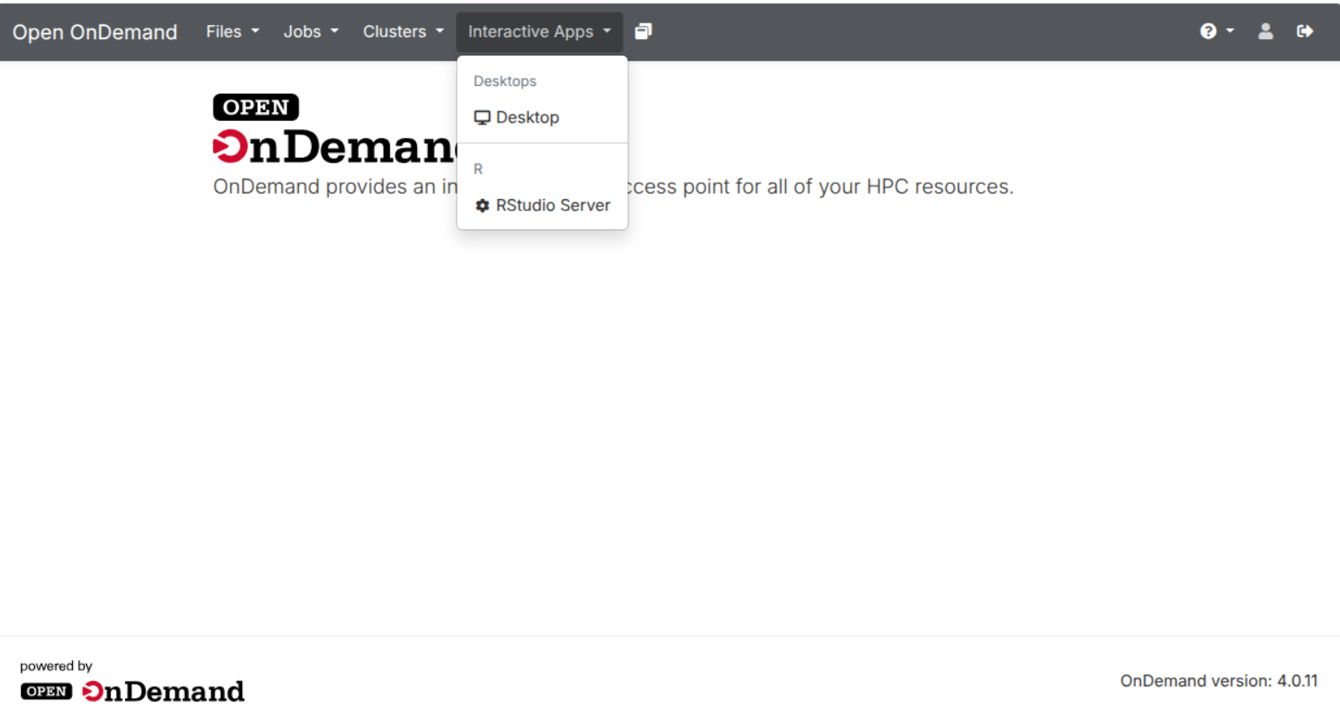

Slide 6
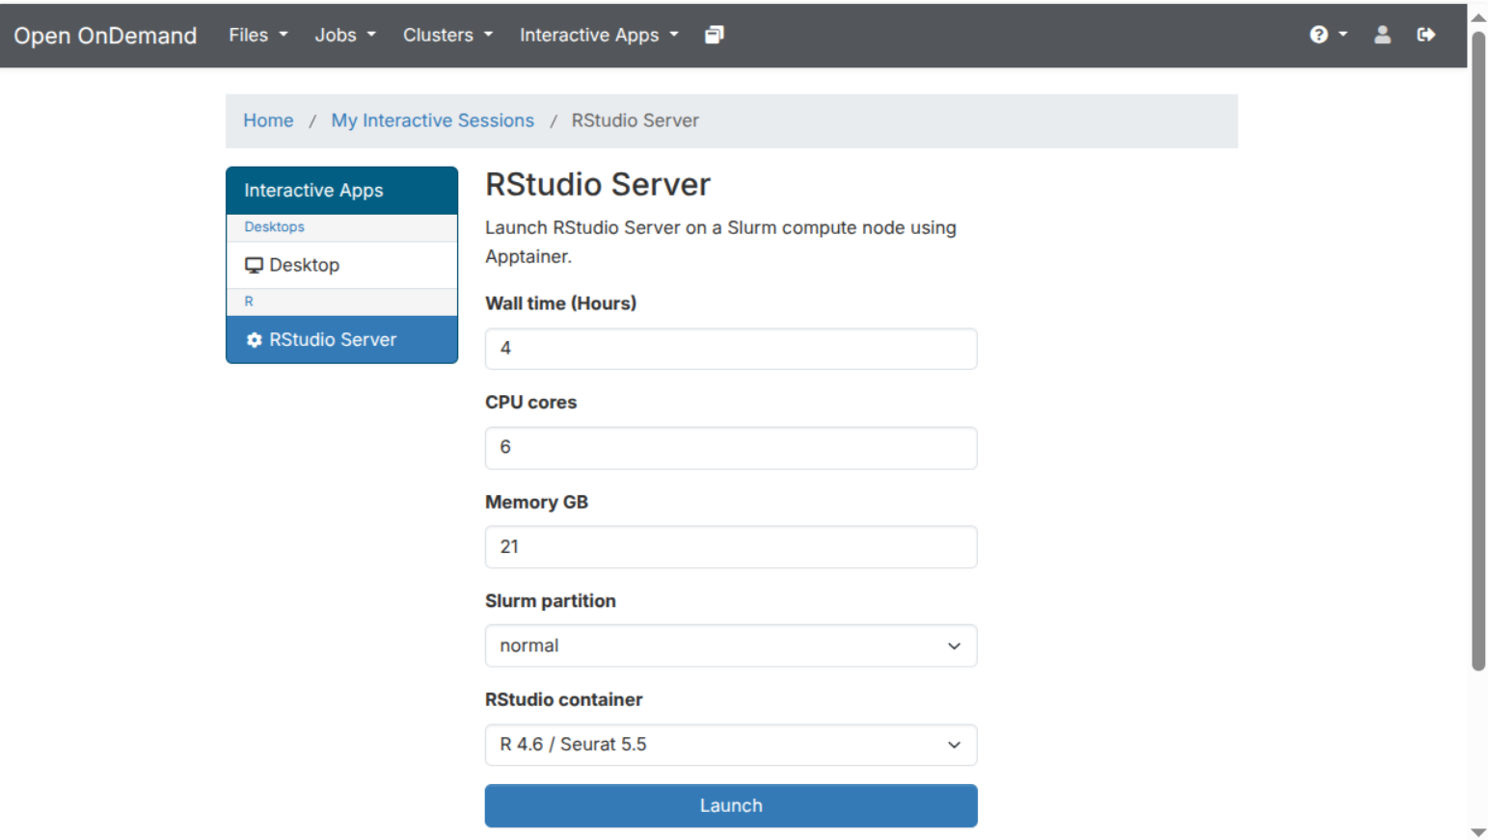

Slide 7
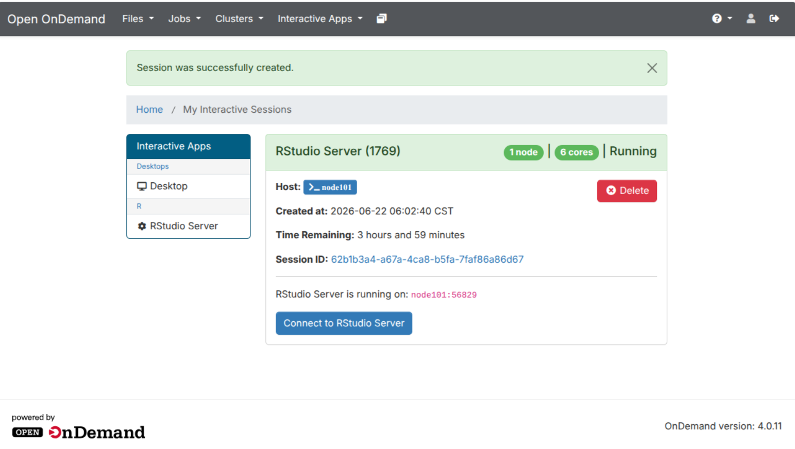

Slide 8
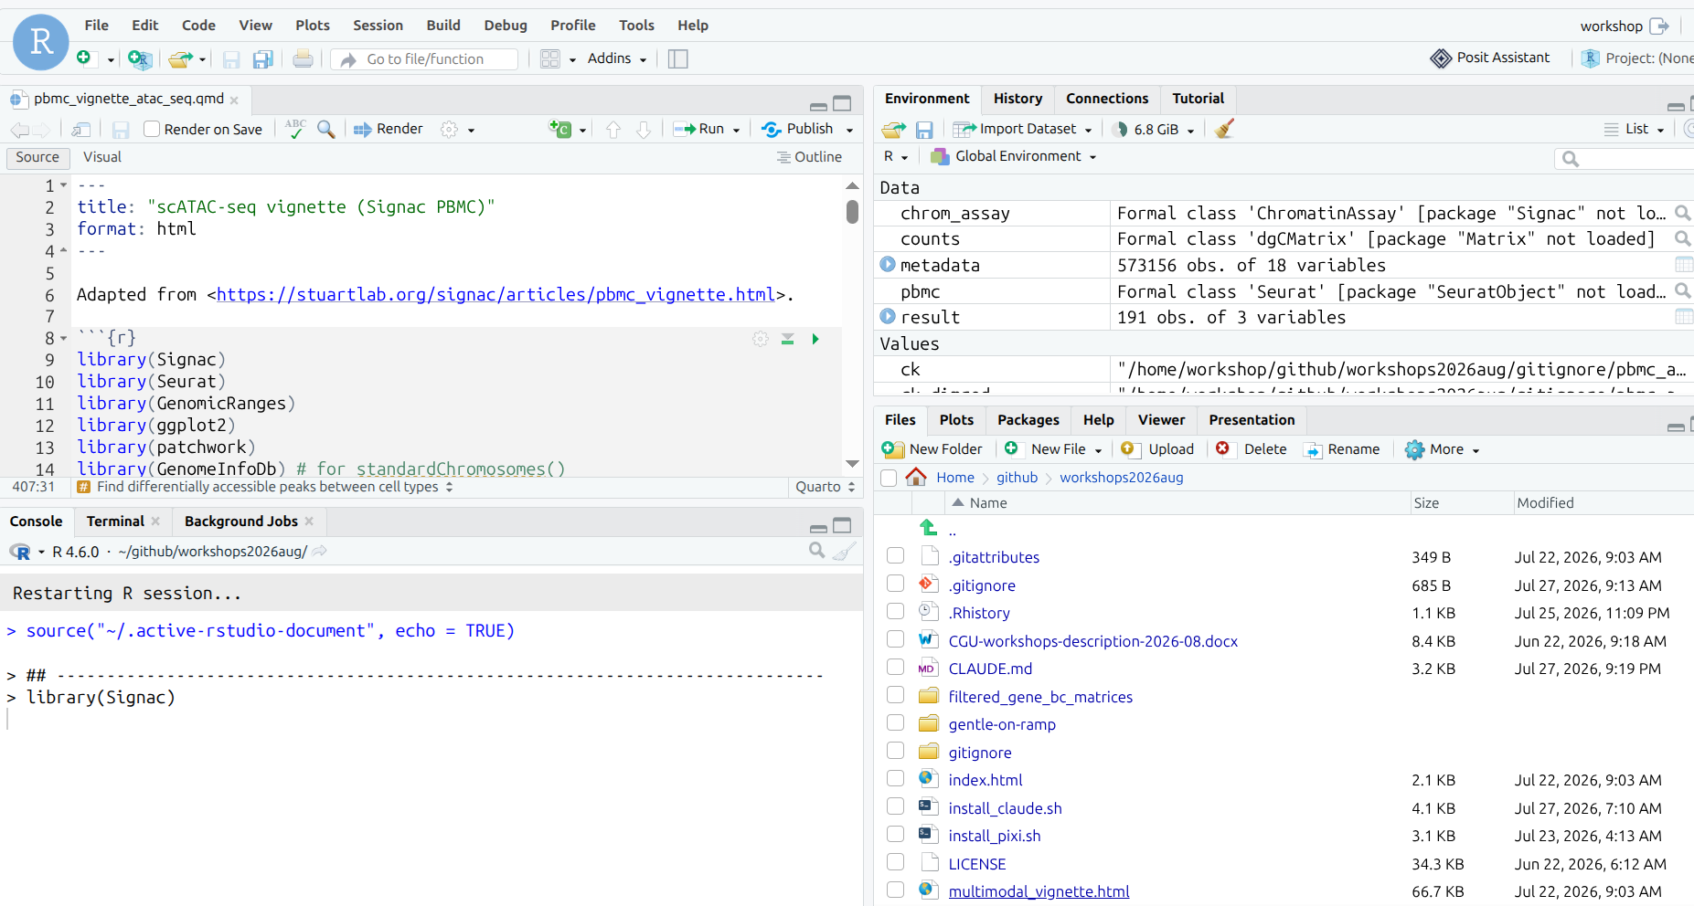

Slide 9
How OnDemand starts an RStudio session on the HPC cluster
YOUR LAPTOP
HPC CLUSTER
request session
Browser tab 1
cgbs.cgu.edu.tw
Interactive Apps → RStudio Server:
choose hours, cores, memory, Launch
1
Login or designated node
Open OnDemand web server.
Turns your form into a SLURM
job and proxies traffic later.
SLURM scheduler
Queues the job, waits for a
node with free cores and RAM,
then dispatches it.
2
4
You click
“Connect to
RStudio Server”
session ready + URL
start container on a node
3
Compute node (e.g. node07)
Browser tab 2
The RStudio Server interface:
console, editor, plots, files.
Looks like desktop RStudio, but
every keystroke runs on the node.
Container (Apptainer / Singularity)
rserver process + R + your packages, running as you,
with your home directory and project files mounted.
Listens on a private port on this node only.
proxied via
the login node
5
Nothing is installed on your laptop. The browser is just a window onto R running on a cluster node.

Slide 10
The cluster: a login node, many compute nodes, and SLURM in between
HPC CLUSTER
Compute nodes
Login node
Where you land when you log in.
Edit scripts, move files, submit jobs, run tiny tests.
Shared by everyone logged in, so do not run a real analysis here.
SLURM scheduler
Holds the queue of waiting jobs.
Each job says how many cores, how much memory, and how long it needs.
SLURM finds a node with room, starts the job there, enforces those limits, and frees the node when it ends.
node01
4 cores, 16 GB, busy
Your laptop
ssh, or the OnDemand web page
node02
4 cores, 16 GB, busy
node03
4 cores, 16 GB, free
node04
4 cores, 16 GB, free
you submit a job
SLURM places it on a free node

Slide 11
Everyday SLURM commands
sbatch job.sh submit a batch script to the queue
squeue -u $USER list your pending and running jobs
scancel 12345 kill a job, by its job ID
srun --pty bash grab an interactive shell on a compute node
sinfo which partitions and nodes exist, and which are idle
sacct -j 12345 after the fact: did it finish, what did it use
A job is a request, not a command: cores, memory, and wall-clock time.
Ask for more than you need and you wait longer in the queue. Ask for less and SLURM kills the job when it runs over. Your RStudio jobs here get 4 cores and 16 GB.

Slide 12
This is the “console”, running an R programming language interpreter in a “read-eval-print loop”
Steve show examples, participants try it

Slide 13
This is the context of a file
Steve show examples, participants try it

Slide 14
This is a file browser
Steve show examples, including
opening files etc; participants try it

Slide 15
Show some R statements in the read-eval-print loop:
Assignment
Numeric
Character
Logical
Vectors are 1st class
Libraries/packages
How to find packages (CRAN, BioCondutor, github etc)
Working the console (completion, arrow up)
Go to cheat sheet
https://rstudio.github.io/cheatsheets/base-r.pdf

Slide 16
Create an R file and source it
Write a function that adds 2 numbers; show error adding two strings
Next: tutorial on navigating between consol, terminal, and file browser

Slide 17
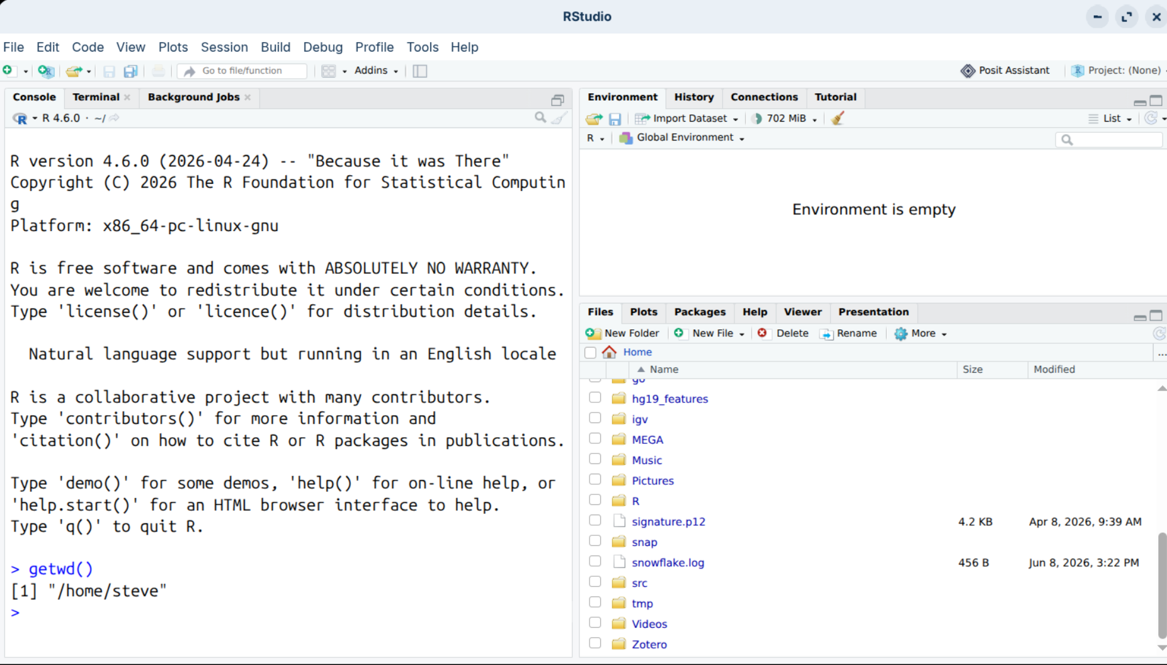
What folder am I in?
getwd – get working directory
R function

Slide 18
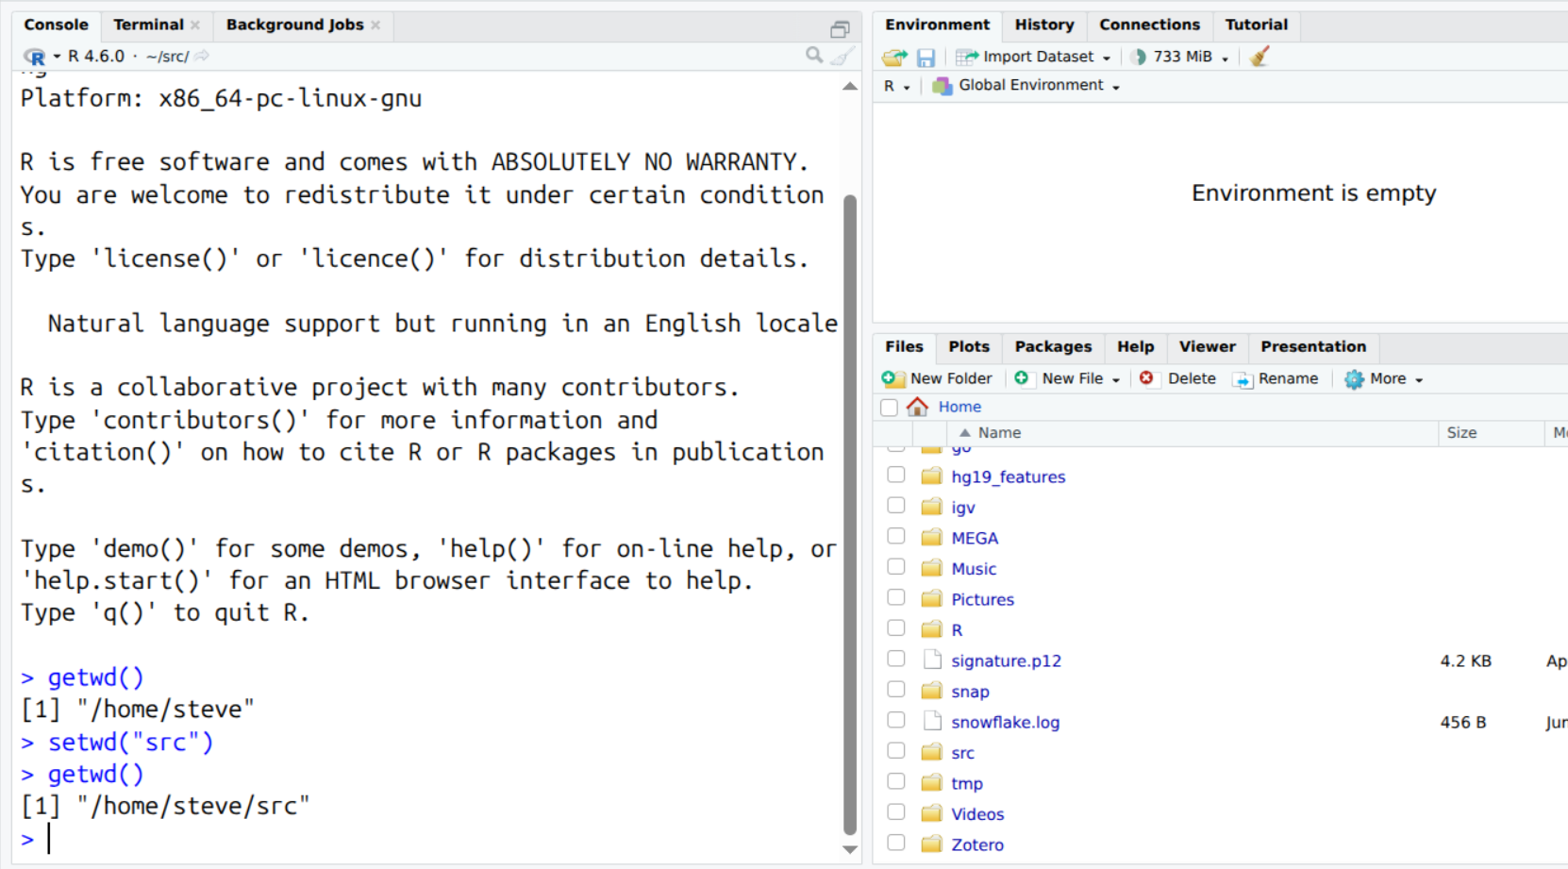
But no change here
setwd(“src”) =
Set working directory src
Then getwd – get working directory

Slide 19
But no change here
setwd(“src”) =
Set working directory src
Then getwd – get working directory

Slide 20
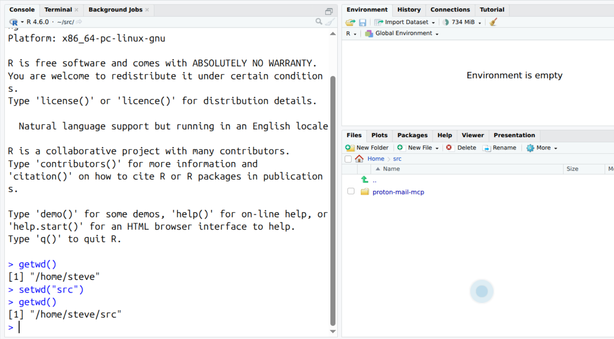
Show how to create new folder / navigate in the files tab, and then make that the working directory in the R console

Slide 21
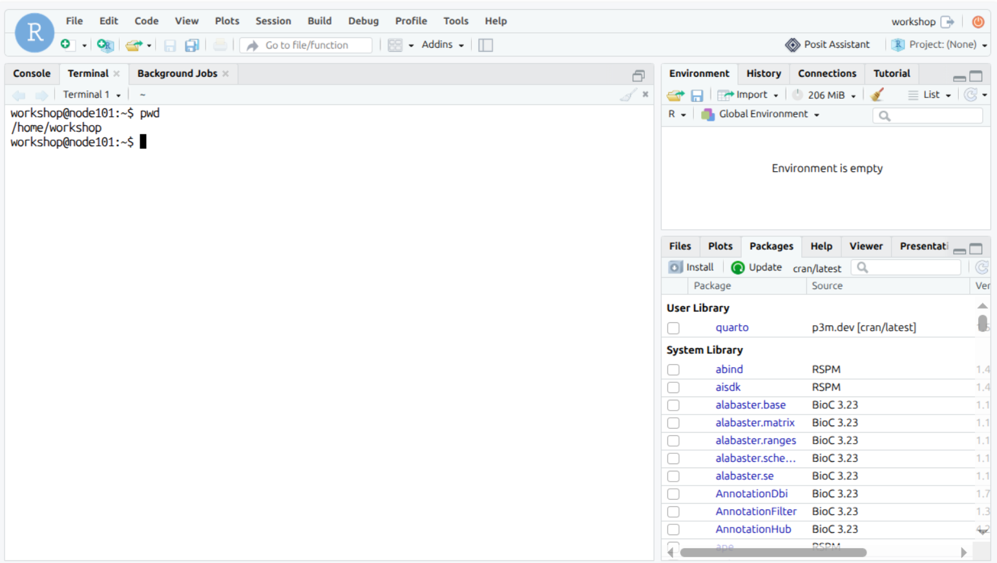
What folder am I in (pwd – print working directory) bash function
continue with orientation

Slide 22
Create a file (e.g. write.csv(mtcars)) and find it
setwd(“~workshop/workshop_data”), move file browser there
Go back to “~”
data.table, data.frame, tibble, selecting rows, columns
View
Tidyr select rows, select columns

Slide 23
Bash examples
Directories, ls, cd, pwd
Commands
Cheat sheet at https://github.com/RehanSaeed/Bash-Cheat-Sheet
Environment variables
PATH
Scripts
Executable bits
AI coding agents use bash a lot and can help with oddities of common unix commands and bash syntax
→ Demo

Slide 24
Python
Different vocabulary and grammar, similar underlying concepts
/usr/bin/python3.12
def add(a, b):
print(a + b)

Slide 25
Agentic coding
Bash command “what python interpreters are available to me”
Bash command “Summarize CPU load, RAM usage, and number of users on each node in the cluster”
R and pyton example: write the R mtcars table to disk as a tsv file, then write and test 1 python script read the data from disk and create a png showing mpg vs hp; test and run the script
curl -fsSL https://opencode.ai/install | bash
opencode
Use “Nemotron 3 Ultra Free Opencode Zen” (pretty limited free tier)

Slide 26
Reference Slide: LLM-agnostic open source coding agents: terminal first
Aider terminal AI pair programming, any model via LiteLLM
https://github.com/Aider-AI/aider
Goose extensible agent that installs, runs, edits, and tests with any LLM
https://github.com/block/goose
Crush Go terminal UI agent from Charm, multi-provider
https://github.com/charmbracelet/crush
opencode terminal coding agent from SST, provider agnostic
https://github.com/sst/opencode
Plandex aimed at large projects and long multi-file tasks
https://github.com/plandex-ai/plandex
Codex CLI OpenAI's, but accepts any OpenAI-compatible provider in config
https://github.com/openai/codex
All six are open source and swap the model behind the same agent loop.

Slide 27
Reference slide:
LLM-agnostic open source coding agents: editors and autonomous
Editor extensions
Cline autonomous coding agent as SDK, IDE extension, or CLI
https://github.com/cline/cline
Roo Code a Cline fork, adds multiple agent modes
https://github.com/RooCodeInc/Roo-Code
Kilo Code a further fork, merges Cline and Roo features
https://github.com/Kilo-Org/kilocode
Continue open source coding agent with pluggable model backends
https://github.com/continuedev/continue
Autonomous and research
OpenHands full sandboxed dev agent platform, formerly OpenDevin
https://github.com/All-Hands-AI/OpenHands
SWE-agent takes a GitHub issue and tries to fix it, NeurIPS 2024
https://github.com/SWE-agent/SWE-agent

Slide 28
Other common IDE (interactive development environments)

Slide 29
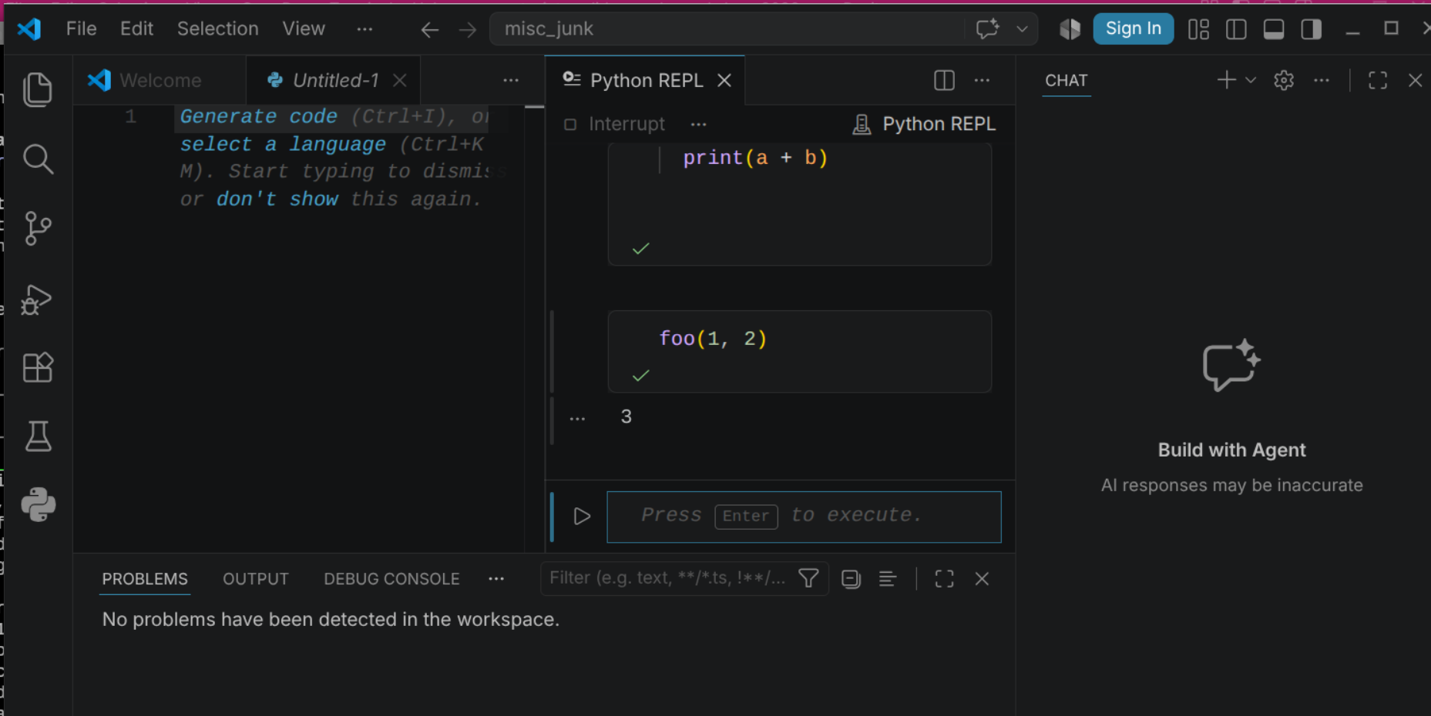
VS Code super extensible, very popular, open source so often cloned and modified by other vendors

Slide 30
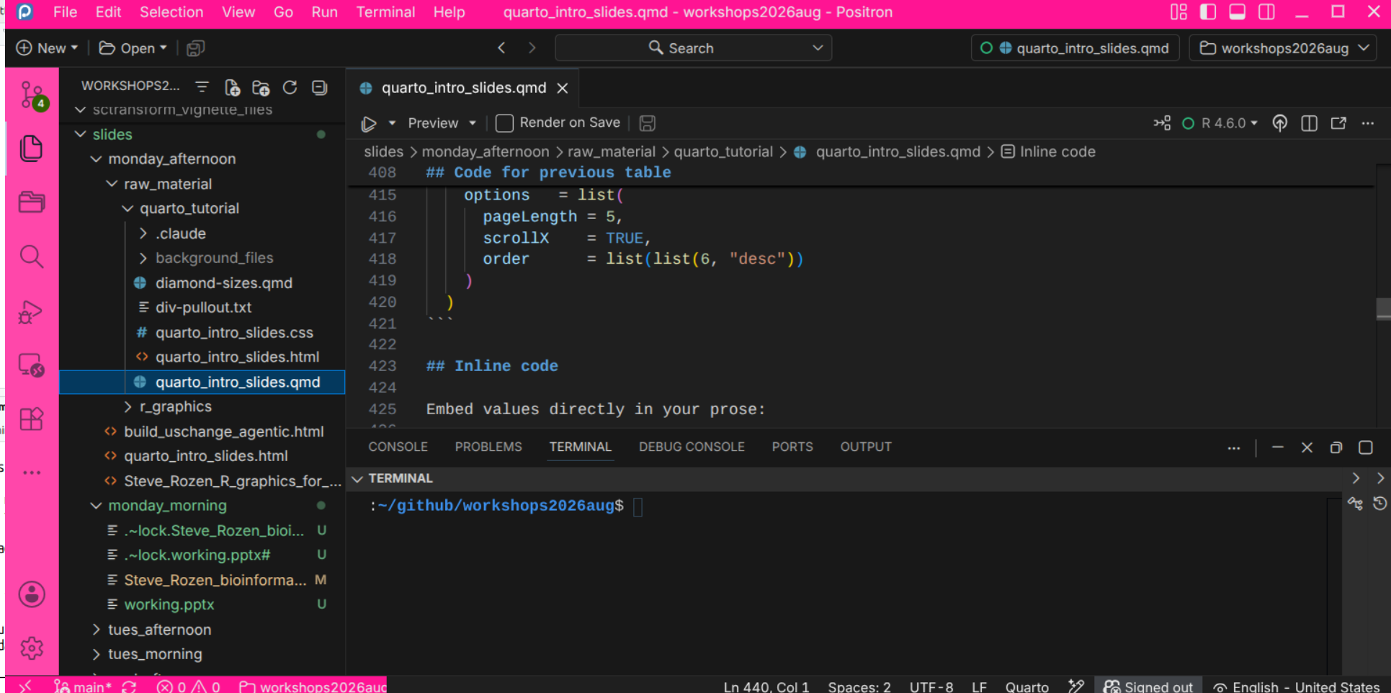
Postiron, a VS code derivative from the makers of RStudio; better native support for R than VS Code, better Python support than RStudio

Slide 31
Git: your local clone and the remote
YOUR COMPUTER, the local clone
Working directory
The files you actually edit.
git status shows what has changed.
Staging area
Also called the index.
What you have marked to go into the next commit.
Local repository
The .git directory.
Full commit history, on your machine, works offline.
Remote, e.g. GitHub
The shared copy.
Where collaborators, and your other machines, get the code.
git add
stage
git commit
record
git push
publish
git pull bring new commits from the remote into your clone
git clone once, at the start: copy the whole repository
Commits are local until you push. Pull before you start work, so your clone is current because other people are pushing commits to the Remote

Slide 32
End

Slide 33
Reference slides:
R compared to Python

Slide 34


1 · Single Values & Vectors
The building blocks: one value, or many values that are all the same type.
Single value (a “scalar”)
Vector — many values, one type
x <- 3.14
c(10, 20, 30)
x = 3.14
np.array([10, 20, 30])
No separate scalar type in R — it’s a vector of length 1.
R’s core structure. Every element must be the same type.
Named vector (an R favorite)
Factor — a vector for categories
c(a = 10, b = 20)
factor(c("low","high"))
{"a": 10, "b": 20} a dict
pd.Categorical(["low"])
Each value has a label; grab it by name. Python uses a dict.
A vector for fixed categories — e.g. treatment vs control.
Basic types R: numeric · integer · character · logical Python: float · int · str · bool
1 / 6

Slide 35
2 · Lists, Dictionaries & Arrays
Mixing types, labelling items, and working with grids of numbers.
List — a mixed bag
Matrix / Array — a grid of numbers
list(1, "two", TRUE)
matrix(1:6, nrow=2)
[1, "two", True]
np.array([[1,2,3],[4,5,6]])
A list can mix types — and even hold other lists inside.
Same type, in rows × columns.
NumPy broadcasting
Named list / Dictionary
When arrays have different shapes, NumPy stretches the smaller one to fit — without copying any data.
list(name="Ada") → x$name
{"name":"Ada"} → x["name"]
1
2
3
+
10
10
10
=
11
12
13
Label each item. An R named list ≈ a Python dict.
np.array([1,2,3]) + 10 → the 10 is added to every element. R calls this “recycling.”
2 / 6

Slide 36
3 · Tables: data.frame, tibble & DataFrame
Rows and columns — the format you’ll use most for real data.
Every object below stores data as rows × columns, like this:
sample | gene | expr
S1 | TP53 | 5.2
S2 | EGFR | 8.1
S3 | MYC | 6.7
In R
In Python
data.frame data.frame(gene=…)
pandas.DataFrame pd.DataFrame(…)
Base R’s classic table; columns may differ in type.
The everyday Python table — matches all three at left.
tibble tibble(gene=…)
polars.DataFrame pl.DataFrame(…)
Tidyverse table — cleaner, stricter, keeps text as text.
Fast, modern — Python’s answer to R’s data.table.
data.table data.table(gene=…)
Rule of thumb: data.frame / tibble ≈ pandas, data.table ≈ polars
Built for speed on big data: DT[i, j, by].
3 / 6

Slide 37


4 · Selecting Columns & Rows
The two most common moves — pick the columns you want, keep the rows you want.
Select columns
dplyr
df %>% select(gene, expr)
pandas
df[["gene", "expr"]]
Keep only the columns you name.
polars df.select("gene", "expr")
Select rows
dplyr
df %>% filter(expr > 6)
pandas
df[df["expr"] > 6]
Keep only the rows that meet a condition.
polars df.filter(pl.col("expr") > 6)
4 / 6

Slide 38


5 · Adding & Updating Rows
Append a new observation, or change a value in an existing row.
Add a row
dplyr
df %>% add_row(sample="S4", gene="KRAS", expr=7.3)
pandas
df.loc[len(df)] = ["S4", "KRAS", 7.3]
Append a new observation (sample S4) to the bottom.
polars pl.concat([df, df_new])
Update a value in a row
dplyr
df %>% mutate(expr = if_else(sample=="S2", 9.0, expr))
pandas
df.loc[df["sample"] == "S2", "expr"] = 9.0
Change a cell where a condition holds (set S2’s expr to 9.0).
polars df.with_columns(pl.when(pl.col("sample")=="S2").then(9.0).otherwise(pl.col("expr")).alias("expr"))
5 / 6

Slide 39
Backup Slides: The Older Base R Way
Same operations without the tidyverse — worth recognizing in older code.
BACKUP
Select columns
df[, c("gene", "expr")]
Add drop=FALSE to guarantee it stays a data.frame.
Select rows
df[df$expr > 6, ]
Mind the trailing comma — it means “all columns.”
Add a row
rbind(df, data.frame(sample="S4", gene="KRAS", expr=7.3))
Column names and types must line up.
Update a value
df$expr[df$sample == "S2"] <- 9.0
Edits the data frame in place.
6 / 6

