Slide 1
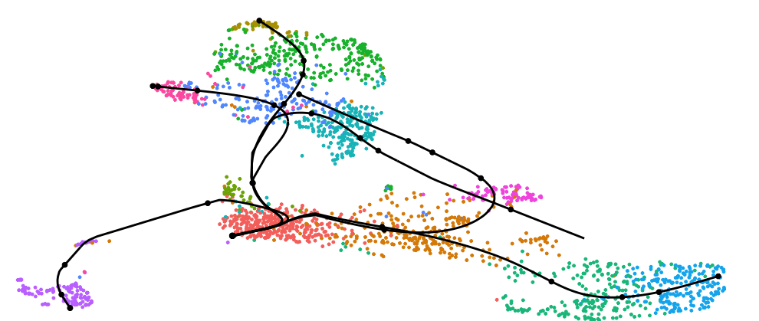
Overview of single-cell bioinformatics
August 4, 2026
Steve Rozen
severozen [at] pm.me
sr110 [at] duke.edu

Slide 2
Two key questions across different types of single-cell omic:
1. What does the technology actually measure?
2. What do we ask once we have the datat?

Slide 3
Two key questions across different types of single-cell omic:
1. What does the technology actually measure?
1.1 Disaggregated
1.2 Spatial
2. What do we ask once we have the data?

Slide 4
Technologies

Slide 5
Non-spatial: cells are dissociated out of the tissue
Position is destroyed, throughput is high, and every cell is measured the same way
Transcriptome: scRNA-seq. The default, and most of what follows assumes it.
Chromatin accessibility: scATAC-seq
Surface protein: CITE-seq, antibody-derived tags read out as extra features alongside RNA
Immune receptor repertoire: single-cell TCR-seq and BCR-seq
Joint multi-omic assays measure two of these in the same cell

Slide 6
Cells or nuclei?
A choice you make at the bench that you then have to live with in the analysis
Whole cells: more RNA per cell, more cytoplasmic and mitochondrial reads, and dissociation stress shows up as a gene programme
Nuclei: works on frozen and hard-to-dissociate tissue such as brain, less RNA per nucleus, enriched for unspliced transcripts
Do not integrate the two casually. The difference is larger than most batch effects.

Slide 7
Perturbation screens: don't just observe, intervene
Everything else on this list is observational. You take a snapshot and infer what is driving it.
Perturb-seq puts a pooled CRISPR screen and scRNA-seq in the same experiment: each cell carries a guide RNA, and the guide is read out alongside the transcriptome
So the readout is not survival or one reporter, it is the whole transcriptional consequence of knocking out that gene, per cell
Replogle et al. took this genome-scale: every expressed gene knocked down, across 2.5 million cells
Related idea, heritable barcodes instead of guides, and you recover lineage rather than perturbation

Slide 8
Why Perturb-seq changes the analysis:
The cell label is now assigned by you, not inferred. You know which gene was hit before you cluster anything.
That turns 'what is regulating this?' from an inference into a measurement, and gives the gene-network methods something to be tested against
New problems come with it: guide assignment is noisy, multiplets carry two guides, and knockdown is partial and variable between cells
Not covered in this workshop's tutorials. Worth knowing it exists if you run screens.

Slide 9
Spatial: position is kept
Molecular measurement is tied back to tissue architecture, at the cost of either gene coverage or resolution
The field splits cleanly in two (Moses and Pachter 2022):
Imaging-based: molecules are counted in place, one fluorescent round at a time. MERFISH / Vizgen MERSCOPE, Nanostring CosMx, 10x Xenium, and Akoya CODEX for protein.
Sequencing-based: transcripts are captured onto a barcoded surface, then sequenced off the tissue. Visium, Visium HD, Slide-seq.

Slide 10
Imaging-based versus sequencing-based:
Genes measured
Resolution
Cell boundaries
Sensitivity
Sample format
Field of view
Data you get
Main headache
Examples
Imaging-based
Targeted panel, 100s to 5000
Sub-cellular, single molecule
Segmentation required
High per gene
FFPE or fresh frozen
Small, imaging time bound
Molecule coordinates
Bad segmentation
MERSCOPE, CosMx, Xenium
Sequencing-based
Whole transcriptome
Spot, bead or bin
Deconvolution required
Lower, capture-limited
Mostly fresh frozen, FFPE now
Whole section
Counts per spot, plus image
Spots are cell mixtures
Visium, Visium HD, Slide-seq

Slide 11
Our workshop:
Tuesday: dissociated scRNA-seq end to end, then CITE-seq and scATAC-seq
Wednesday morning: differential expression, reference mapping and trajectory inference, all on dissociated data
Wednesday afternoon: spatial, both branches. Visium and Visium HD on the sequencing side, MERSCOPE, CosMx and CODEX on the imaging side.
See wed_morning_tutorials.md and wed_afternoon_tutorials.md for the tutorial list behind each of these

Slide 12
Questions

Slide 13
What cell types are here?
The discovery question: you do not yet know what is in the sample
Dimension reduction, then graph-based clustering, then marker genes per cluster
The resolution parameter is a choice, not a result. Two clusters or five is often defensible either way.
Clusters are hypotheses about cell types, not cell types

Slide 14
Which known cell type is each cluster?
The annotation question, and it is a different problem from finding the clusters
By hand: score canonical markers per cluster and name it
Automatically: classify against a reference atlas, or transfer labels from an annotated dataset
Automated labels are confident even when they are wrong. Always check the markers you would have used by hand.

Slide 15
Are the samples even comparable?
Usually has to be settled before clustering and annotation can be trusted
Batch correction and integration: make cells of the same type from different samples, donors or chemistries land together
Query-to-reference mapping: place new cells into an existing atlas rather than re-clustering from scratch
The failure modes run both ways. Under-correct and every cluster is one sample, over-correct and you have erased the biological difference you came to find.

Slide 16
How does one cell type differ between conditions, or over time?
The commonest question anyone actually asks of the data
Subset to the cell type, then test condition against condition
Testing cell by cell treats cells as independent replicates. They are not: cells from one donor are correlated, and p-values come out absurdly small.
Pseudobulk instead: sum counts per cell type per sample, then use bulk RNA-seq machinery with samples as the unit of replication

Slide 17
Are there more or fewer of a cell type?
Differential abundance, or compositional analysis
Harder than it looks: proportions must sum to one, so one population expanding makes every other one appear to shrink
Also depends entirely on how you drew the cluster boundaries
Milo sidesteps the clustering by testing abundance in overlapping neighbourhoods of the k-nearest-neighbour graph instead

Slide 18
How do cells order along a continuous process?
For differentiation, activation, or any gradual change, discrete clusters are the wrong model
Trajectory inference orders cells along a path, and pseudotime says how far along a cell sits
Pseudotime is a distance, not a clock. Units are arbitrary and direction comes from biology, not from the algorithm.
RNA velocity uses the unspliced-to-spliced ratio to point at where a cell is heading, and is more fragile than its pictures suggest
Wednesday morning is entirely about this

Slide 19
What is driving the difference?
Gene set and pathway enrichment: is the gene list you found enriched for something already named
Gene regulatory network inference: which transcription factors have their targets moving together, for example SCENIC
In tumour work, inferred copy number from expression separates malignant cells from the normal cells beside them

Slide 20
Which cells are talking to which?
Ligand-receptor analysis: a ligand expressed in one cell type and its receptor in another
This is a prediction from co-expression. Nothing about contact, secretion, or an actual signalling event has been observed.
Two cell types can express a matched pair and sit at opposite ends of the tissue
Which is exactly why spatial data makes this question much stronger

Slide 21
Where are the cells in the image?
Imaging-based spatial gives molecule coordinates, not cells. You have to draw the boundaries.
Segmentation from a nuclear stain, expanded outward, or learned from cell membranes
Every downstream count depends on it, and mis-assigned transcripts look exactly like doublets or like hybrid cell types that do not exist
Spot-based data has the mirror-image problem: no segmentation to do, but each spot is a mixture, so you deconvolve it into cell-type proportions instead

Slide 22
How is the tissue organised?
The question you can only ask once position is retained
Spatial domains: recurring neighbourhoods of cell types, tumour core versus margin, germinal centre versus mantle
Spatially variable genes: expression structured by location rather than by cell type
Neighbourhood analysis: which cell types are found next to which, more often than chance

Slide 23
Can I combine different measurements from the same sample?
Paired: RNA and protein, or RNA and ATAC, measured in the same cell. Alignment is given, the work is in weighting the modalities.
Unpaired: the same tissue assayed two ways in different cells. You have to infer which cell corresponds to which.
Mosaic: a set of datasets that overlap partially in modality, which is what atlas building really looks like
Also the bridge between the two spatial branches, and between spatial and dissociated reference data

Slide 24
The honest caveats:
Most of these outputs are inference, not measurement
Cluster resolution is a choice you made, and the number of cell types moves with it
Cell-cell interaction is a prediction from co-expression
Pseudotime is a distance, not a clock
Segmentation error propagates into every count downstream
None of this is a reason not to do it. It is a reason to say what you did.

Slide 25
References: analysis and best practice
Luecken and Theis 2019, Current best practices in single-cell RNA-seq analysis: a tutorial, Molecular Systems Biology 15(6):e8746. https://doi.org/10.15252/msb.20188746
Heumos et al. 2023, Best practices for single-cell analysis across modalities, Nature Reviews Genetics 24(8):550-572. https://doi.org/10.1038/s41576-023-00586-w
Zappia and Theis 2021, Over 1000 tools reveal trends in the single-cell RNA-seq analysis landscape, Genome Biology 22:301. https://doi.org/10.1186/s13059-021-02519-4

Slide 26
References: technologies
Moses and Pachter 2022, Museum of spatial transcriptomics, Nature Methods 19(5):534-546. https://doi.org/10.1038/s41592-022-01409-2
Palla et al. 2022, Spatial components of molecular tissue biology, Nature Biotechnology 40(3):308-318. https://doi.org/10.1038/s41587-021-01182-1
Dixit et al. 2016, Perturb-Seq: Dissecting Molecular Circuits with Scalable Single-Cell RNA Profiling of Pooled Genetic Screens, Cell 167(7):1853-1866.e17. https://doi.org/10.1016/j.cell.2016.11.038
Replogle et al. 2022, Mapping information-rich genotype-phenotype landscapes with genome-scale Perturb-seq, Cell 185(14):2559-2575.e28. https://doi.org/10.1016/j.cell.2022.05.013

