Slide 1
ClimateWins
Machine Learning Possible Uses
By Steven So

Slide 2
Project Objective
In this project, you’ll use machine learning to help predict the consequences of climate change while working as a data analyst at a European nonprofit organization.
Project Hypothesis
Using historical data, we can attempt to predict days that will have bad weather and measure our algorithm’s level of accuracy.
Plotting the max and min temperature over time, we can attempt to predict if either are rising or dropping in the future.
By observing the temperature mean over time, we may be able to identify changes to that consistency and the direction of those changes.

Slide 3
About the Data
Where does the data come from?
The source of the data, comes from the European Climate Assessment & Dataset Project (ECA&D).
The objective of the project is to combine collation of daily series of observations at meteorological stations, quality control, analysis of extremes and dissemination of both the daily data and the analysis result.
The ECA dataset used for this project consists of daily station series obtained from climatological divisions of national Meteorological and Hydrological Services and station series maintained throughout Europe and the Mediterranean.

Slide 4
Possible Biases & Data Accuracy
The series collected from participating countries do not contain data for the most recent years.
Gaps in data/missing data are infilled with observations from nearby stations (Provided they are within 12.5km distance and height differences are less than 25km).
Different countries estimate daily average temperatures using different methods and formulas. Additionally the time intervals for observing min and max temperature differ between countries.
Note: Full disclosure of information can be found on the ECA&D’s FAQ page located here: https://www.ecad.eu/FAQ/index.php

Slide 5
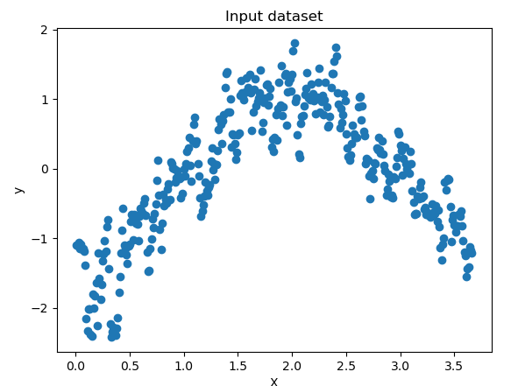
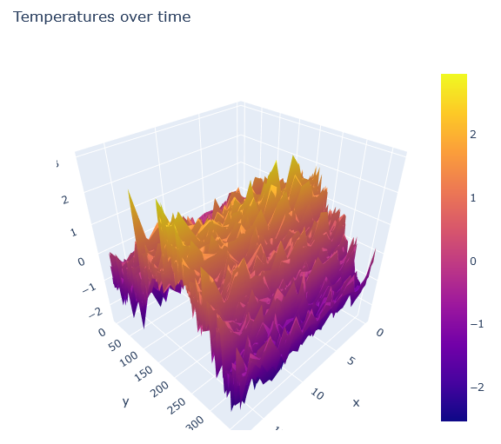
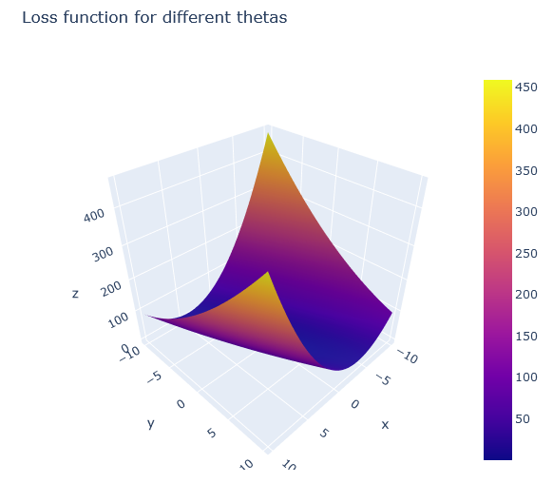
Optimization Techniques
To get a better understanding of the dataset, we created an index for each day of the year and used that information to calculate the temperatures over time and the lost function for different thetas.

Slide 6
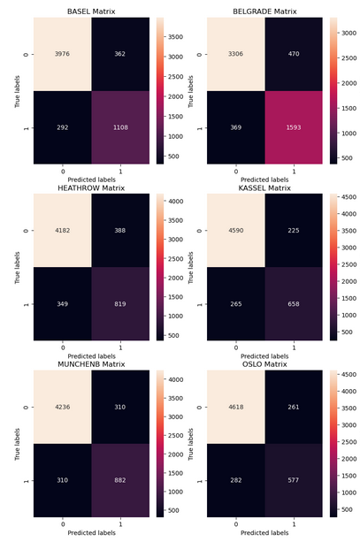
Supervised Learning
K-Nearest Neighbor:
Technique measuring relative distance of results to create groupings.
Confusion Matrix:
Displayed results from algorithm to quickly gather if it is making mistakes or is accurate in its conclusions.
Decision Tree:
Utilized branches of “questions” and “answers” to arrive at a conclusion.

Slide 7
Moving Forward
Of the methods used, the Decision Tree Algorithm looks to be the most promising and applicable to ClimateWin’s end goals.
The results from the Confusion Matrix are promising, showing a high rate of accuracy from our Machine Learning Model.
Some possible future analysis may include determining which months have the most ideal weather days, and which months would have the worse.

Slide 8
Questions?

Slide 9
Thank You!
This presentation, its data, and project materials can be found at the following GitHub page

