Slide 1

Programming Language Advances in Racket
CSC 201 Section 3, Team 4
Nitin Nath
Jeffrey Byrnes
Steven Mackey
Alex Nosenko

Slide 2
History of Racket
The Rocket Manifesto[1]:
Traces its roots back to the PLT Group, founded by Matthias Felleisen in 1990s
PLT began producing educational material, and teaching high school students fundamentals of programming
Originally offered material using the language “Scheme”
PLT quickly identified several challenges
It’s impossible to teach the syntax of scheme, and then focus on the theory of programming within a short amount of time
Professional-grade editors such as vi and emacs distract from the actual mission of teaching

Slide 3

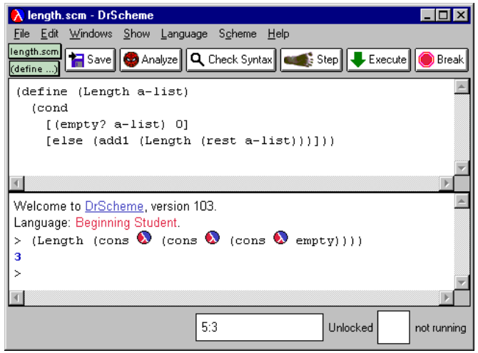
History of Racket
A programmable programming language[2]:
PLT began developing their simplified dialect of Scheme in 1995: PLT Scheme
Simultaneously began developing an education focused IDE: DrScheme
The development on DrScheme (which was written in PLT Scheme) influenced the design of PLT Scheme.
PLT Scheme’s logo [4]
Screenshot of DrScheme (Findler)[3]

Slide 4
History of Racket
The Rocket Manifesto[1]:
PLT Scheme evolved over the course of 15 years. Was no longer focused only on education
Designers recognized the need to be able to represent meta-languages as first class citizens in PLT Scheme
“"As Hudak puts it, “domain-specific languages are the ultimate abstractions.”“”
“By 2010, our dialect of Scheme had evolved so much that we renamed it to Racket to let the world know that we had something different.”
PLT Scheme was Rebranded to Racket, DrScheme was rebranded to DrRacket

Slide 5
Main Characteristics and main Strengths of Racket
“Racket” https://racket-lang.org/ (accessed Nov. 24, 2020)
Racket is a stable programming language that has matured over time - It is cross-platform - Windows - Linux - MacOS
Racket contains - Package system
Racket Package Manager where you can install/update/remove a package and use the libraries provided
raco pkg (raco pkg install, raco pkg update, raco pkg remove)
GUI Framework - Foreign Interface such as Ctype
The ffi/unsafe library enables use of C-based APIs within Racket programs without having to write any new C code.

Slide 6
Main Characteristics and main Strengths of Racket
Racket has a rich language with an extensive set of libraries and tools. Not a “minimalist” language. - Web Applications - Database - Math & Statistics - Network Libraries - Parsing Libraries
Racket is Extensible & Robust - Powerful Macros (Little and Big Macros) - Programmer can make domain-specific Languages or constructs with these macros - Provides a Contract Guide * High-Order Contracts * The Typed Contract Guide

Slide 7
Main Characteristics and main Strengths of Racket
Racket Documentation
Teaching Section
How to design programs
How to design languages
Tutorials
Examples of simple Racket programming
Tools
i.e. Simple barcode reader /writer, QR-Code Writer and Reader, Spreadsheet read/Writer etc.
Several other Libraries
Network, Parsing, GUI, Data Structures, Chess, Databases etc.

Slide 8
Main Characteristics and main Strengths of Racket
Racket supports Major Editors
VIM Integration
EMACS Integration
Inspired by other Integrated Development Environments (IDE)
It comes with its own IDE, Dr. Racket.
Racket Community
Github
Continued Racket development via Github
Issues, Bugs etc.
Mailing Community
Twitter

Slide 9
The Racket Language
Racket is multi-paradigm, but is best known for its functional programming capabilities
Contains all standard features of a programming language
Familiar built-in datatypes
User-defined datatypes
Iteration (for loops, sequences)
I/O
Etc.

Slide 10

The Racket Language
In Racket, an atomic unit is an “expression” which can be either a value or a function call
Additionally, we can define variables as function calls

Slide 11
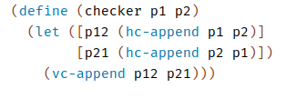

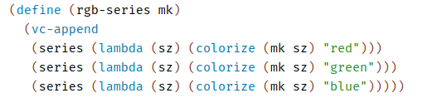

The Racket Language
We can also use Local Binding for ease of programmability
Racket is lexically scoped (lexical closure)

Slide 12
The Racket Language
Racket also supports
Lists
Objects
Modules
Etc
For more info, see the racket language manual [8]

Slide 13
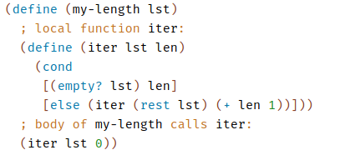
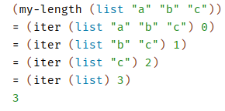
Main Features / Strengths of Racket
Tail-call evaluation
In racket, evaluation is done by recursively applying function to the tail of the input

Slide 14
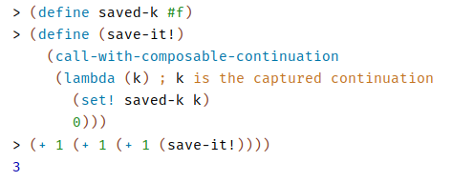
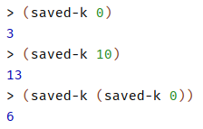
Main Features / Strengths of Racket
Continuations (call-with-composable-continuation)
Allows us to capture the partial evaluation of a function
Similar to lambda expressions, except they can be dynamically defined
Lends to dynamic evaluation capabilities of racket

Slide 15

Main Features / Strengths of Racket
Macros (define-syntax-rule)
Binds a macro that matches a single pattern
A form of pattern matching

Slide 16
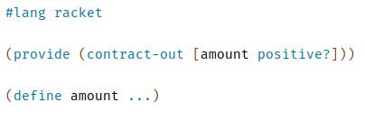
Main Features / Strengths of Racket
Contracts (provide)
Makes “promises” about values that will be exported

Slide 17
Racket Applications
Main applications:
Language Development
Education
Web Development
Racket Tools

Slide 18
Racket Applications
As previously mentioned, Racket is based on Scheme
Powerful functional programming features
As seen in project one, functional programming provides an effective environment for language development
Not surprisingly, one of the main use cases of Racket is language development

Slide 19
Racket Applications: Hackett
Hackett is a language similar to haskell written in Racket
Hackett is a statically typed, pure, lazy, functional programming language in the Racket language ecosystem
Project repo (which includes a demo) [5]

Slide 20
Racket Applications: Fractalide
Fractalide [6] is another open-source programming language written in Racket
An interesting approach to designing a programming language which utilizes graphs as the basic language concepts
Project makes use of the functional features of racket (e.g. tail-call optimization, etc)

Slide 21
Racket Applications: DrRacket
Some of the other features of racket we have discussed (GUI, OS support, etc) make it a feasible candidate for other applications
In fact, Racket’s IDE (DrRacket [7]) was written in Racket
DrRacket includes all typical features of an IDE
Debugging
Source highlighting
Library Support
Etc.

Slide 22
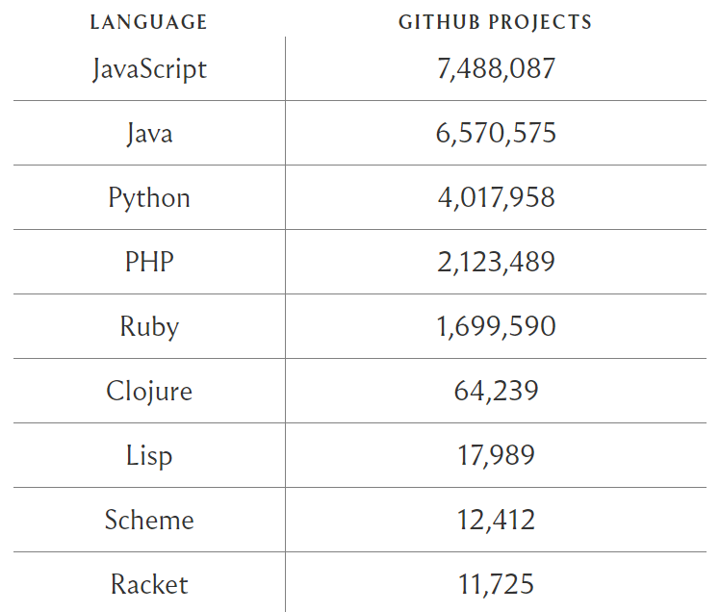
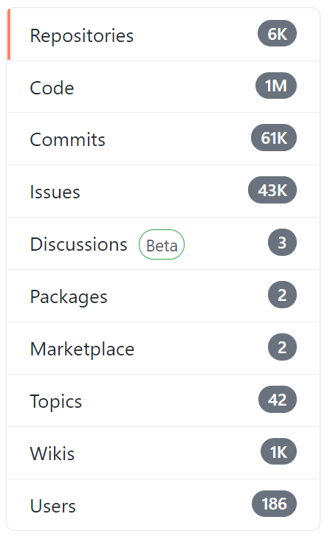
Projects on GitHub

Slide 23
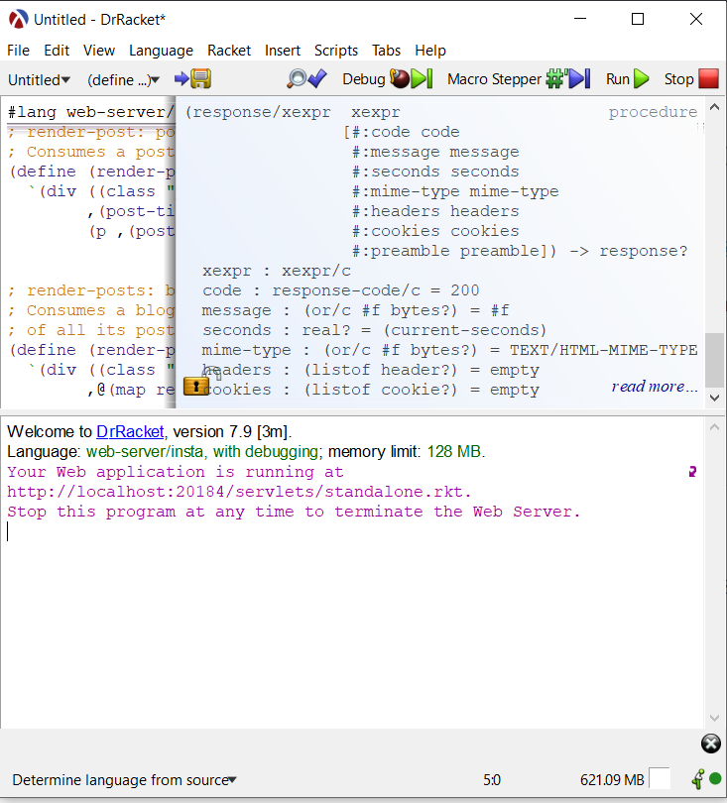
Racket in Action
Demo projects:
Recursion
Web application

Slide 24
Conclusion
Open source and cross-platform support
Concise and full-featured
Libraries and Documentation
Interactive IDE
Use of Macros
New language prototyping

Slide 25
References
[1] Felleisen, Matthias, et al. "The racket manifesto." 1st Summit on Advances in Programming Languages (SNAPL 2015). Schloss Dagstuhl-Leibniz-Zentrum fuer Informatik, 2015.
[2] Felleisen, Matthias, et al. "A programmable programming language." Communications of the ACM 61.3 (2018): 62-71.
[3] Findler, Robert Bruce, et al. "DrScheme: A programming environment for Scheme." Journal of functional programming 12.2 (2002): 159.
[4] PLT. “PLT Scheme.” PLT Scheme, PLT, 1 Apr. 2010, plt-scheme.org
[5] King, Alexis, Hacket Programming Language, GitHub repository, https://lexi-lambda.github.io/hackett/
[6] Mackenzie, Setwart, Fractalide, GitHub repository, https://github.com/fractalide/fractalide
[7] Findler, Robby, DrRacket, GitHub repository, https://github.com/racket/drracket
[8] Flatt, Matthew, “The Racket Guide”, https://docs.racket-lang.org/guide/index.html

