Slide 1

Programming Language Advances in Racket
CSC 201 Section 3, Team 4
Nitin Nath
Jeffrey Byrnes
Steven Mackey
Alex Nosenko

Slide 2
Main Characteristics and main Strengths of Racket
source: https://racket-lang.org/
Racket is a stable programming language that has matured over time - It is cross-platform - Windows - Linux - MacOS
Racket contains - Package system where you can install a package and use the libraries provided - GUI Framework - Foreign Interface such as Ctype

Slide 3
Main Characteristics and main Strengths of Racket
Racket includes rich set of Libraries - Web Applications - Database - Math & Statistics - Network Libraries - Parsing Libraries
Racket is Extensible & Robust - Powerful Macros - Programmer can make domain-specific Languages or constructs with these macros - Provides a Contract Guide * High-Order Contracts * The Typed Contract Guide

Slide 4
Main Characteristics and main Strengths of Racket
Racket supports Major Editors - Inspired by other Integrated Development Environments (IDE) - VIM - EMACS

Slide 5
Applications of Racket
As previously mentioned, Racket is based on Scheme
Powerful functional programming features
As seen in project one, functional programming provides an effective environment for language development
Not surprisingly, one of the main use cases of Racket is language developement

Slide 6
Racket Applications: Hackett
Hackett is a language similar to haskell written in Racket
Hackett is a statically typed, pure, lazy, functional programming language in the Racket language ecosystem [https://lexi-lambda.github.io/hackett/]
Project repo (which includes a demo) https://github.com/lexi-lambda/hackett

Slide 7
Racket Applications: Fractalide
Fractalide is another open-source programming language written in Racket
An interesting approach to designing a programming language which utilizes graphs as the basic language concepts
https://github.com/fractalide/fractalide

Slide 8
Racket Applications: Other Applications
The other features of racket we have discussed make it a feasible candidate for other applications
In fact, Racket’s IDE (DrRacket) was written in Racket https://github.com/racket/drracket
DrRacket includes all typical features of an IDE
Debugging
Source highlighting
Library Support
Etc.

Slide 11
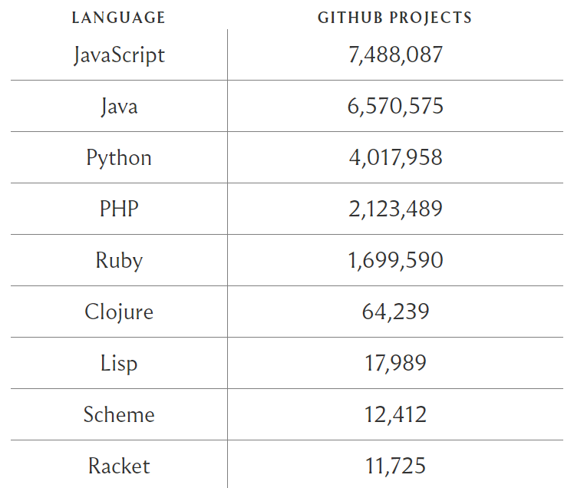
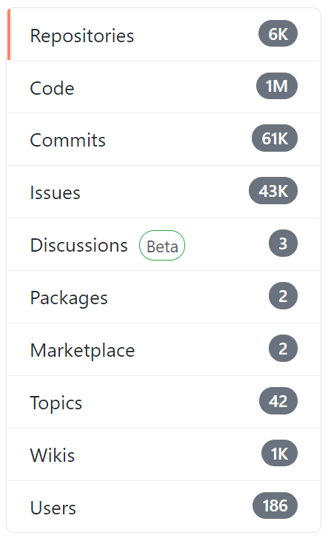
Projects and Use

Slide 12
Pros about the Pro’s
Open source
Concise and full-featured
Libraries and Documentation
Interactive IDE
Use of Macros
Semantically and Syntactically flexible (Create new languages)

