Slide 1
Project 2
CSC 201 Section 3, Team 4
Alex Nosenko - OBJ
Jeffrey Byrnes - NUM
Nitin Nath - IDS
Steven Mackey - SEC

Slide 2
IDS
IDS11-J https://wiki.sei.cmu.edu/confluence/display/java/IDS11-J.+Perform+any+string+modifications+before+validation
WHAT: Perform string modifications before validation. WHY: Do not correct a string after validation as it will cause the first check to not detect an HTML tag. In this case such as <scr!ipt> therefore the tag <script> went undetected the first time. HOW: After the first validation if the script tag is modified to be correct then now the tag <script> is valid in HTML which essentially went undetected during validation.

Slide 3
IDS
import java.text.Normalizer; import java.text.Normalizer.Form; import java.util.regex.Matcher; import java.util.regex.Pattern; public class TagFilter { public static String filterString(String str) { String s = Normalizer.normalize(str, Form.NFKC); // Validate input Pattern pattern = Pattern.compile("<script>"); Matcher matcher = pattern.matcher(s); if (matcher.find()) { throw new IllegalArgumentException("Invalid input"); } // Deletes noncharacter code points s = s.replaceAll("[\\p{Cn}]", ""); return s; } public static void main(String[] args) { // "\uFDEF" is a noncharacter code point String maliciousInput = "<scr" + "\uFDEF" + "ipt>"; String sb = filterString(maliciousInput); // sb = "<script>" } }
import java.text.Normalizer; import java.text.Normalizer.Form; import java.util.regex.Matcher; import java.util.regex.Pattern; public class TagFilter { public static String filterString(String str) { String s = Normalizer.normalize(str, Form.NFKC); // Replaces all noncharacter code points with Unicode U+FFFD s = s.replaceAll("[\\p{Cn}]", "\uFFFD"); // Validate input Pattern pattern = Pattern.compile("<script>"); Matcher matcher = pattern.matcher(s); if (matcher.find()) { throw new IllegalArgumentException("Invalid input"); } return s; } public static void main(String[] args) { // "\uFDEF" is a non-character code point String maliciousInput = "<scr" + "\uFDEF" + "ipt>"; String s = filterString(maliciousInput); // s = <scr?ipt> }

Slide 4
IDS
IDS13-J (Deprecated moved to STR04-J) https://wiki.sei.cmu.edu/confluence/display/java/STR04-J.+Use+compatible+character+encodings+when+communicating+string+data+between+JVMs WHAT: Use compatible character encodings when communicating string data between JVMs. (Java Virtual Machines) WHY: Incompatible encoding of strings can result in corrupted data when communicating between JVMs. This is data integrity violation. HOW: Be sure to encode the data the same way and not make any assumptions (be explicit) in how the data is encoded when sending data between JVMs.

Slide 5
IDS
FileInputStream fis = null; try { fis = new FileInputStream("SomeFile"); DataInputStream dis = new DataInputStream(fis); byte[] data = new byte[1024]; dis.readFully(data); //String result = new String(data); //assumes default character set String result = new String(data, "UTF-16LE"); } catch (IOException x) { // Handle error } finally { if (fis != null) { try { fis.close(); } catch (IOException x) { // Forward to handler } } }

Slide 6
IDS
IDS14-J https://wiki.sei.cmu.edu/confluence/display/java/IDS14-J.+Do+not+trust+the+contents+of+hidden+form+fields WHAT: Both the hidden and visible forms need to be sanitized or checked. WHY: In this case if the hidden form field is not checked for strings that are sensitive to HTML then user can be directed to an unexpected website or witness an unexpected result. HOW: Check the Hidden form field as well as the Visible Form field for sensitive or manipulative strings that can cause issues in HTML.

Slide 7
IDS
public class SampleServlet extends HttpServlet {
public void doGet(HttpServletRequest request, HttpServletResponse response)
throws IOException, ServletException {
response.setContentType("text/html");
PrintWriter out = response.getWriter();
out.println("<html>");
String visible = request.getParameter("visible");
String hidden = request.getParameter("hidden");
if (visible != null || hidden != null) {
out.println("Visible Parameter:");
out.println( sanitize(visible));
out.println("<br>Hidden Parameter:");
out.println( sanitize(hidden)); // Hidden variable sanitized
} else {
out.println("<p>");
out.print("<form action=\"");
out.print("SampleServlet\" ");
out.println("method=POST>");
out.println("Parameter:");
out.println("<input type=text size=20 name=visible>");
out.println("<br>");
out.println("<input type=hidden name=hidden value=\'a benign value\'>");
out.println("<input type=submit>");
out.println("</form>");
}
}
public void doPost(HttpServletRequest request, HttpServletResponse response)
throws IOException, ServletException {
doGet(request, response);
}
// Filter the specified message string for characters
// that are sensitive in HTML.
public static String sanitize(String message) {
// ...
}
}

Slide 8
IDS
IDS54-J
https://wiki.sei.cmu.edu/confluence/display/java/IDS54-J.+Prevent+LDAP+injection
BACKGROUND: The Lightweight Directory Access Protocol (LDAP) allows an application to remotely perform operations. Operations such as searching and modifying records.
WHAT: Prevent LDAP injection. WHY: It is important to not allow LDAP injection since doing so will grant user access privileges that the user should not have access to. HOW: Perform validation on the username and password entered by user against the whitelist. (A list of valid characters)

Slide 9
IDS
// String userSN = "S*"; // Invalid
// String userPassword = "*"; // Invalid
public class LDAPInjection {
private void searchRecord(String userSN, String userPassword) throws NamingException {
Hashtable<String, String> env = new Hashtable<String, String>();
env.put(Context.INITIAL_CONTEXT_FACTORY, "com.sun.jndi.ldap.LdapCtxFactory");
try {
DirContext dctx = new InitialDirContext(env);
SearchControls sc = new SearchControls();
String[] attributeFilter = {"cn", "mail"};
sc.setReturningAttributes(attributeFilter);
sc.setSearchScope(SearchControls.SUBTREE_SCOPE);
String base = "dc=example,dc=com";
// The following resolves to (&(sn=S*)(userPassword=*))
String filter = "(&(sn=" + userSN + ")(userPassword=" + userPassword + "))";
NamingEnumeration<?> results = dctx.search(base, filter, sc);
while (results.hasMore()) {
SearchResult sr = (SearchResult) results.next();
Attributes attrs = (Attributes) sr.getAttributes();
Attribute attr = (Attribute) attrs.get("cn");
System.out.println(attr);
attr = (Attribute) attrs.get("mail");
System.out.println(attr);
}
dctx.close();
} catch (NamingException e) {
// Forward to handler
}
}
}
sc.setSearchScope(SearchControls.SUBTREE_SCOPE);
String base = "dc=example,dc=com";
if (!userSN.matches("[\\w\\s]*") || !userPassword.matches("[\\w]*")) {
throw new IllegalArgumentException("Invalid input");
}
String filter = "(&(sn = " + userSN + ")(userPassword=" + userPassword + "))";

Slide 10
IDS
IDS55-J https://wiki.sei.cmu.edu/confluence/display/java/IDS55-J.+Understand+how+escape+characters+are+interpreted+when+strings+are+loaded WHAT: Understand how escape characters are interpreted when strings are loaded. WHY: Incorrect use of escape characters in string inputs can result in misinterpretation and potential corruption of data HOW: When there is a '\' followed by t or r or n or b then you need to escape the sequence with an additional \ (backslash) otherwise the java compiler will see it as a special character i.e newline or tab or backspace etc.

Slide 11
IDS
public class Splitter { // Interpreted as backspace // Fails to split on word boundaries private final String WORDS = "\b"; public String[] splitWords(String input) { Pattern pattern = Pattern.compile(WORDS); String[] input_array = pattern.split(input); return input_array; } }
public class Splitter { // Interpreted as two chars, '\' and 'b' // Correctly splits on word boundaries private final String WORDS = "\\b"; public String[] split(String input){ Pattern pattern = Pattern.compile(WORDS); String[] input_array = pattern.split(input); return input_array; } }

Slide 12
NUM
NUM08-J https://wiki.sei.cmu.edu/confluence/display/java/NUM08-J.+Check+floating-point+inputs+for+exceptional+values
WHAT: Check floating-point inputs for exceptional (infinity, -infinity, NaN) values WHY: Failure to detect and handle exceptional values can cause unexpected and inconsistent program execution HOW: After accepting double or float values from user input, write handlers for the cases of exceptional values

Slide 13
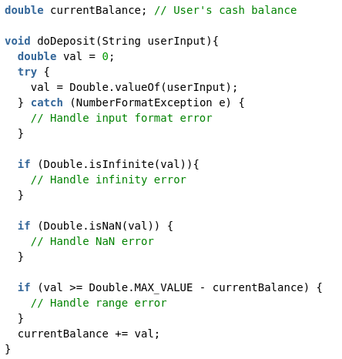
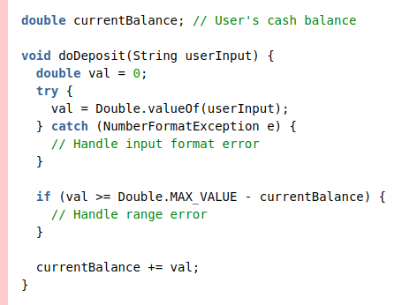
NUM

Slide 14
NUM
NUM09-J https://wiki.sei.cmu.edu/confluence/display/java/NUM09-J.+Do+not+use+floating-point+variables+as+loop+counters
WHAT: Don’t use floating point variables as loop counters (loop counter – formally defined in rule, intuitively, it is a variable controlling the execution of a loop) WHY: Due to lack of precision, floats are sometimes given a binary value that closely approximates the intended value. A result of this is that exact comparisons may not always be accurate, and, if used as a loop counter, could result in unintended behavior HOW: Express the loop controlling logic in integers, or some other non-approximated data type (e.g. char) as appropriate for problems

Slide 15
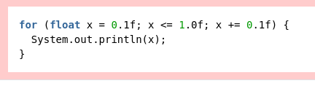



NUM

Slide 16
NUM
NUM53-J https://wiki.sei.cmu.edu/confluence/display/java/NUM53-J.+Use+the+strictfp+modifier+for+floating-point+calculation+consistency+across+platforms
WHAT: Use the strictfp modifier for floating-point calculation consistency across platforms WHY: Java allows platforms with extended floating point support to make use of such, so some platforms have access to a superset of floating point representations compared to what is available via Java’s primitive types. Thus, the same code will behave differently on different platforms (due to floating point architecture) HOW: Prefix a class, method or interface with the strictfp modifier

Slide 17
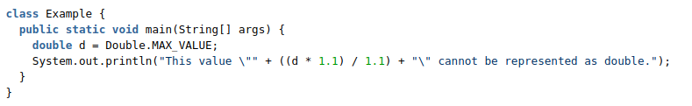
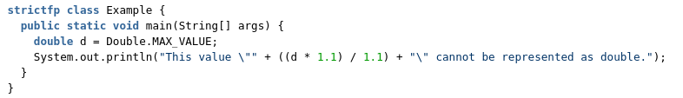
NUM

Slide 18
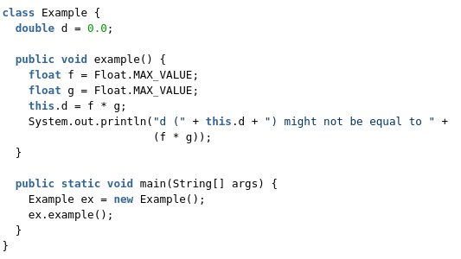
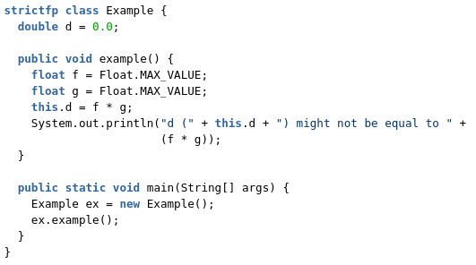
NUM

Slide 19
SEC06-J
“Do not rely on the default automatic signature verification provided by URLClassLoader and java.util.jar” WHAT: URLClassLoader and java.util.jar load classes from external sources. Integrity checks are performed on the JAR, but authenticity is not verified (IE, the PKI chain is not followed). WHY: A malicious third party (Man in the middle) could inject code that passes integrity checks, but is not the code you thought you were running. HOW: One of the following:
- Check the JARs manually at runtime with jarsigner -verify signed-updates-jar-file.jar
- Programatically follow the PKI certficate chain until you hit a trusted cert (Or reject the code if no cert found).

Slide 20
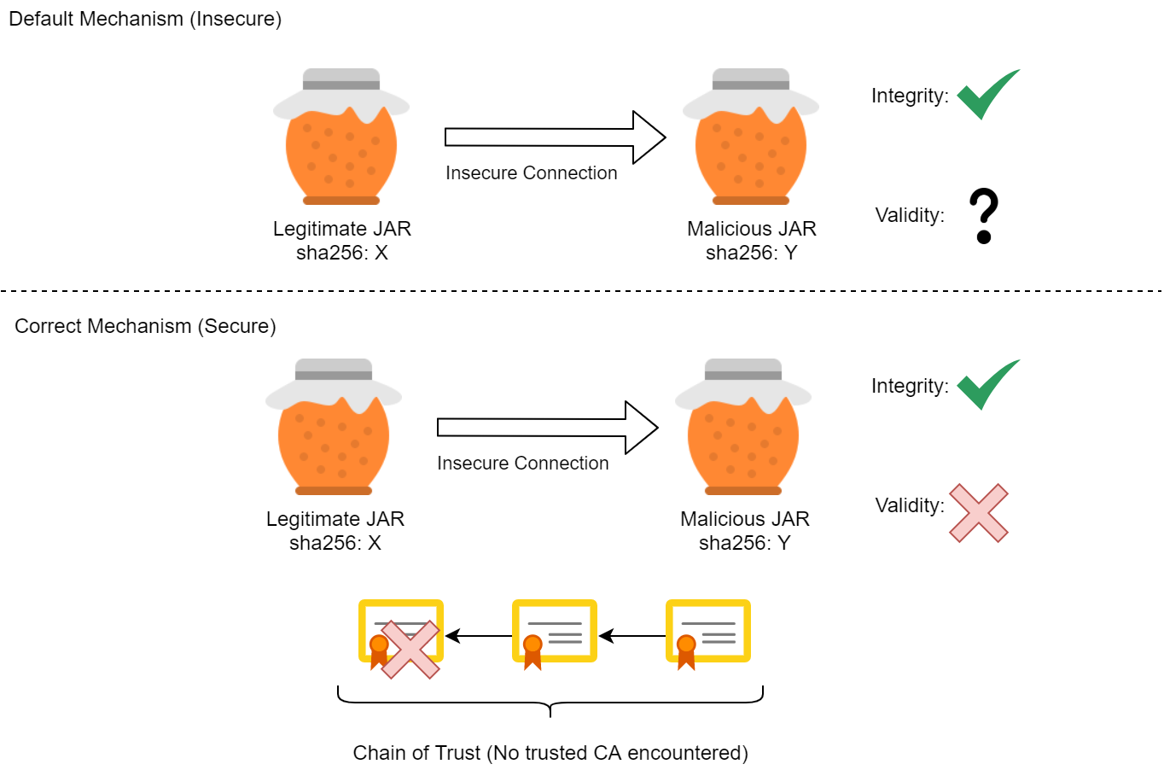
SEC06-J

Slide 21
SEC07-J
“Call the superclass's getPermissions() method when writing a custom class loader”
BACKGROUND: Java allows classes to be loaded into the JVM at runtime. Java provides default class loaders which developers may need to extend for their use case. The “getpermissions” method in a class loader returns the permissions context that the loaded class then runs in.
WHAT: If a developer extends a default class loader, and overrides the “getpermissions()” method, the developer may fail to call the superclass’s “getpermissions()”, effectively sidestepping system level policy. WHY: The permissions returned by the custom class loader may be more permissive than the system level policy, thereby giving the loaded class greater permissions than intended. HOW: Call the superclass’s “getpermissions()” and then append to that list any required permissions.

Slide 22
SEC07-J
Noncompliant
Compliant
protected PermissionCollection getPermissions(CodeSource cs) {
// Note how we are building an entirely new PermissionCollection
// Effectively sidestepping the system's policy
PermissionCollection pc = new Permissions();
// Allow exit from the VM anytime
pc.add(new RuntimePermission("exitVM"));
return pc;
}
protected PermissionCollection getPermissions(CodeSource cs) {
// We get the super class's permissions.
// We are building off of the system's policy
PermissionCollection pc = super.getPermissions(cs);
// Allow exit from the VM anytime
pc.add(new RuntimePermission("exitVM"));
return pc;
}

Slide 23
SEC56-J
“Do not serialize direct handles to system resources”
BACKGROUND: Java allows objects to be serialized into a bytestream which can be loaded dynamically.
WHAT: Serialized system resources may be maliciously modified out of band (IE man in the middle, or modified on disk). Unless the bytestream is sealed and signed. WHY: Example: A serialized file would be recreated with the serialized path. That path may be modified to point to a malicious file. HOW: One of the following:
- Do not implement serializable (Basically don’t allow your object to be serialized at all).
- Mark resource handles as transient (transient classes will be serialized using default values).

Slide 24
SEC56-J
Noncompliant
Compliant
final class Ser implements Serializable {
File f;
public Ser() throws FileNotFoundException {
// This can be modified when serialized
f = new File("c:\\filepath\\filename"); }
}
final class Ser implements Serializable {
// When serialized, File f will equal "new File();"
transient File f;
public Ser() throws FileNotFoundException {
f = new File("c:\\filepath\\filename");
}
}
Or
final class Ser implements Serializable {
// When serialized, File f will equal "new File();"
transient File f;
public Ser() throws FileNotFoundException {
f = new File("c:\\filepath\\filename");
}
}

Slide 25
SEC57-J
“Do not let untrusted code misuse privileges of callback methods” WHAT: Always running callbacks with a fixed set of permissions would allow malicious callbacks to be run with those permissions. WHY: Hypothetically, if we assigned elevated privileges to a callback invoker, then malicious callbacks will run with those elevated permissions. HOW: Do not invoke callbacks with elevated permissions. Require the callbacks themselves to acquire the necessary permissions.

Slide 26
SEC57-J
Noncompliant
Compliant
public void perform() {
// Note how we are invoking the callback in a privileged context
AccessController.doPrivileged(new PrivilegedAction<Void>() {
public Void run() {
potentially_malicious_callback.callMethod();
}
});
}
public void perform() {
// Not invoked with any privileged context
// Principle of least privilege being applied
// If callback needs privileges it will acquire them itself
potentially_malicious_callback.callMethod();
}

Slide 27
OBJ07-J
OBJ07-J https://wiki.sei.cmu.edu/confluence/display/java/OBJ07-J.+Sensitive+classes+must+not+let+themselves+be+copied
WHAT: Classes containing private, confidential, or sensitive data should not be allowed to be copied. Simply not defining copy mechanisms, is insufficient to prevent copying. WHY: Java's object cloning mechanism allows an attacker to manufacture new instances of a class by copying the memory images of existing objects rather than by executing the class's constructor. This is not the way the objects are normally created. An attacker can misuse the clone feature to manufacture multiple instances of a class and violate the invariants of critical data. HOW: The easiest way to prevent malicious subclasses is to declare class containing sensitive information as final. Since all the classes inherit clone() from superclass Object the method clone() should be implemented in a way that it throws exception CloneNotSupportedException

Slide 28
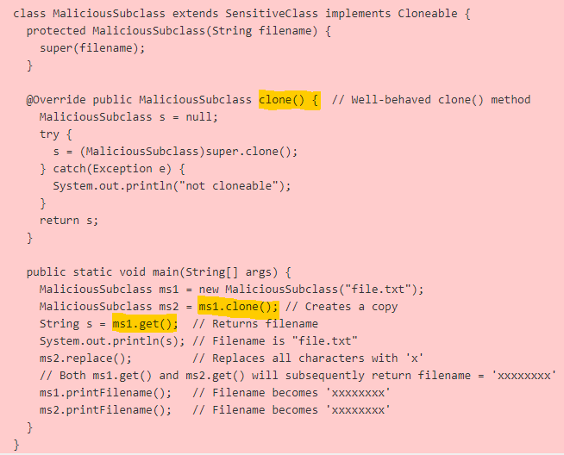

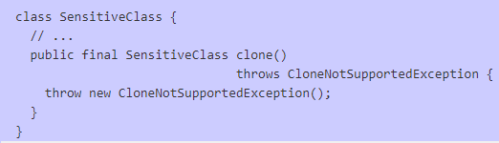
OBJ07-J
Noncompliant
Compliant

Slide 29
OBJ08-J
OBJ08-J https://wiki.sei.cmu.edu/confluence/display/java/OBJ08-J.+ Do+not+expose+private+members+of+an+outer + class+from+within+a+nested+class
WHAT: Nested class must not expose the private members of the outer class to external classes or packages. WHY: A nested class is any class whose declaration occurs within the body of another class or interface. The use of a nested class is error prone unless the semantics are well understood. A common notion is that only the nested class may access the contents of the outer class. Not only does the nested class have access to the private fields of the outer class, but the same fields can be accessed by any other class within the package when the nested class is declared public or if it contains public methods or constructors. HOW: Use the private access specifier to hide the inner class and all contained methods and constructors.

Slide 30
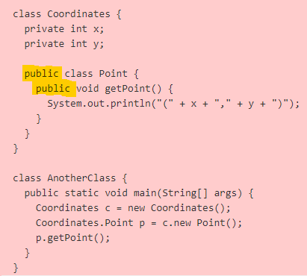
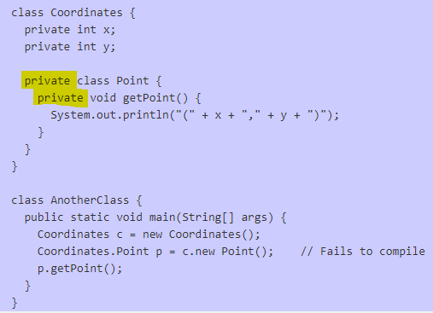
OBJ08-J
Noncompliant
Compliant

Slide 31
OBJ56-J
OBJ56-J https://wiki.sei.cmu.edu/confluence/display/java/OBJ56-J.+Provide+ sensitive+mutable+classes+with+ unmodifiable + wrappers
WHAT: Read-only access to mutable classes can be granted to untrusted code using unmodifiable wrappers WHY: Immutability of fields prevents inadvertent modification as well as malicious tampering so that defensive copying while accepting input or returning values is unnecessary. However, some sensitive classes cannot be immutable. A malicious invoker may call the setter method in attempt to modify the objects. HOW: To prevent misuse of the mutator methods they must be overridden in a way that throws exception on invocation (UnsupportedOperationException()). This will prevent modification of the private internal state of the class.

Slide 32
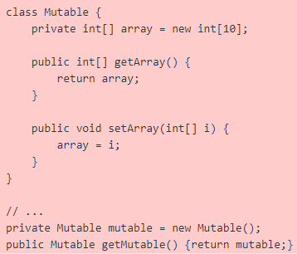
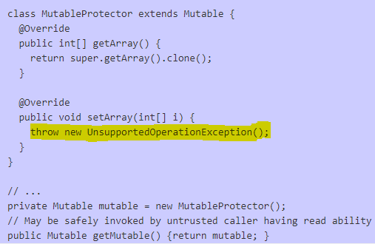
OBJ56-J
Noncompliant
Compliant

Slide 33
OBJ57-J
OBJ57-J https://wiki.sei.cmu.edu/confluence/display/java/OBJ57-J.+ Do+not+rely+on+methods+that+can+ be+overridden+ by+untrusted+code
WHAT: Sensitive information organized in key-value format must be saved in a data structure that supports .equals() reference-equality method. Methods such as Object.equals(), Object.hashCode(), and Thread.run() must be a part of immutable class. WHY: Untrusted code can misuse APIs provided by trusted code to override methods such as Object.equals(), Object.hashCode(), and Thread.run(). These methods are valuable targets because they are commonly used behind the scenes and may interact with components in a way that is not easily discernible. HOW: To create compliant solution the datastructure IdentityHashMap must be utilized instead of HashMap to store sensitive key value pairs since it uses reference equality in place of object-equality. An effective use of final keyword protects class methods from being overridden and misused.

Slide 34

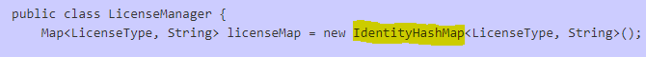


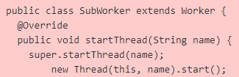
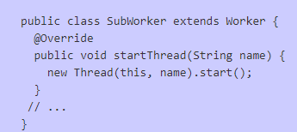
OBJ57-J
Noncompliant
Compliant

Slide 35
Conclusion
Code implementation is one of the main drivers for computer security.
Unintentionally writing non secure code is more common that we thought.
There are resources like SEI where we can learn secure coding best practices.

