Slide 1

Programming Language Advances in Racket
CSC 201 Section 3, Team 4
Nitin Nath
Jeffrey Byrnes
Steven Mackey
Alex Nosenko

Slide 2
History of Racket
The Rocket Manifesto[1]:
Traces its roots back to the PLT Group, founded by Matthias Felleisen in 1990s
PLT began producing educational material, and teaching high school students fundamentals of programming
Originally offered material using the language “Scheme”
PLT quickly identified several challenges
It’s impossible to teach the syntax of scheme, and then focus on the theory of programming within a short amount of time
Professional-grade editors such as vi and emacs distract from the actual mission of teaching

Slide 3

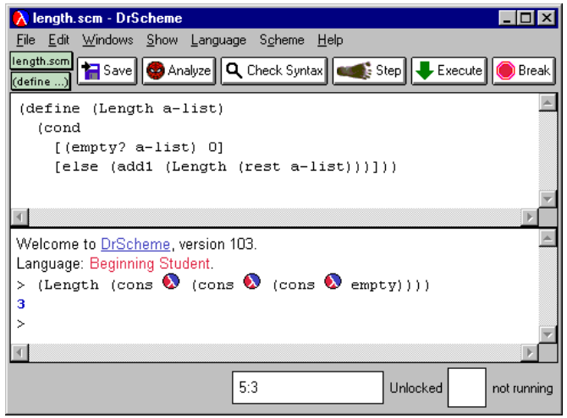
History of Racket
A programmable programming language[2]:
PLT began developing their simplified dialect of Scheme in 1995: PLT Scheme
Simultaneously began developing an education focused IDE: DrScheme
The development on DrScheme (which was written in PLT Scheme) influenced the design of PLT Scheme.
PLT Scheme’s logo [4]
Screenshot of DrScheme (Findler)[3]

Slide 4
History of Racket
The Rocket Manifesto[1]:
PLT Scheme evolved over the course of 15 years. Was no longer focused only on education
Designers recognized the need to be able to represent meta-languages as first class citizens in PLT Scheme
“"As Hudak puts it, “domain-specific languages are the ultimate abstractions.”“”
“By 2010, our dialect of Scheme had evolved so much that we renamed it to Racket to let the world know that we had something different.”
PLT Scheme was Rebranded to Racket, DrScheme was rebranded to DrRacket

Slide 5
Main Characteristics and main Strengths of Racket
“Racket” https://racket-lang.org/ (accessed Nov. 24, 2020)
Racket is a stable programming language that has matured over time - It is cross-platform (Windows, Linux, MacOS)
Racket contains - Package system - Racket Package Manager where you can install/update/remove a package (raco pkg install, raco pkg update, raco pkg remove)
Foreign Interface such as Ctype
The ffi/unsafe library enables use of C-based APIs within Racket programs without having to write any new C code.
Racket offers functional language capabilities such as tail-call optimization and lexical closures.
Racket has a rich language with an extensive set of libraries and tools. Not a “minimalist” language.
Racket is Extensible & Robust - Powerful Macros (Little and Big Macros) - Programmer can make domain-specific Languages or constructs with these macros
Racket Documentation
Teaching Section, Tutorials, Tools, Racket supports Major Editors like VIM, EMACS
It comes with its own IDE, Dr. Racket.
Open Source licensed under Apache 2.0 and MIT

Slide 6
The Racket Language
Racket is multi-paradigm, but is best known for its functional programming capabilities
Contains all standard features of a programming language
Familiar built-in datatypes
User-defined datatypes
Iteration (for loops, sequences)
I/O
Etc.

Slide 7

The Racket Language
In Racket, an atomic unit is an “expression” which can be either a value or a function call
Additionally, we can define variables as function calls

Slide 8
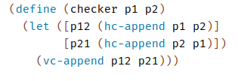

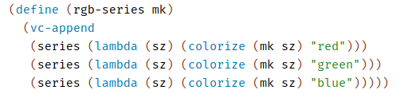

The Racket Language
We can also use Local Binding for ease of programmability
Racket is lexically scoped (lexical closure)

Slide 9
The Racket Language
Racket also supports
Lists
Objects
Modules
Etc
For more info, see the racket language manual [8]

Slide 10
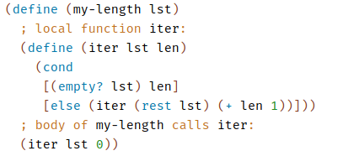
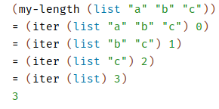
Main Features / Strengths of Racket
Tail-call evaluation
In racket, evaluation is done by recursively applying function to the tail of the input

Slide 11
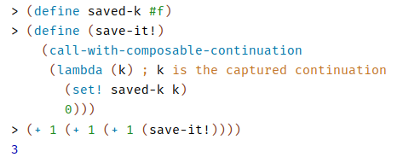
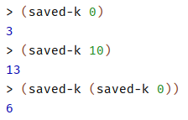
Main Features / Strengths of Racket
Continuations (call-with-composable-continuation)
Allows us to capture the partial evaluation of a function
Similar to lambda expressions, except they can be dynamically defined
Lends to dynamic evaluation capabilities of racket

Slide 12

Main Features / Strengths of Racket
Macros (define-syntax-rule)
Binds a macro that matches a single pattern
A form of pattern matching

Slide 13
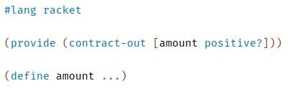
Main Features / Strengths of Racket
Contracts (provide)
Makes “promises” about values that will be exported

Slide 14
Racket Applications
Main applications:
Language Development
Education
Web Development
Racket Tools

Slide 15
Racket Applications
As previously mentioned, Racket is based on Scheme
Powerful functional programming features
As seen in project one, functional programming provides an effective environment for language development
Not surprisingly, one of the main use cases of Racket is language development

Slide 16
Racket Applications: Hackett
Hackett is a language similar to haskell written in Racket
Hackett is a statically typed, pure, lazy, functional programming language in the Racket language ecosystem
Project repo (which includes a demo) [5]

Slide 17
Racket Applications: Fractalide
Fractalide [6] is another open-source programming language written in Racket
An interesting approach to designing a programming language which utilizes graphs as the basic language concepts
Project makes use of the functional features of racket (e.g. tail-call optimization, etc)

Slide 18
Racket Applications: DrRacket
Some of the other features of racket we have discussed (GUI, OS support, etc) make it a feasible candidate for other applications
In fact, Racket’s IDE (DrRacket [7]) was written in Racket
DrRacket includes all typical features of an IDE
Debugging
Source highlighting
Library Support
Etc.

Slide 19
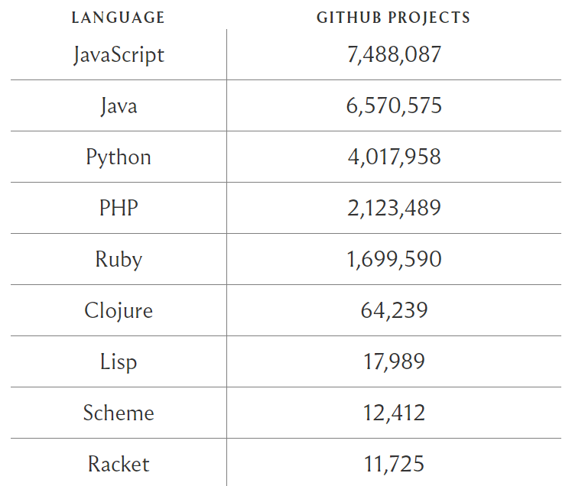
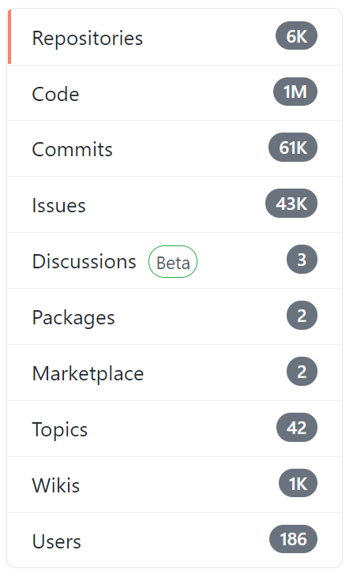
Projects on GitHub

Slide 20
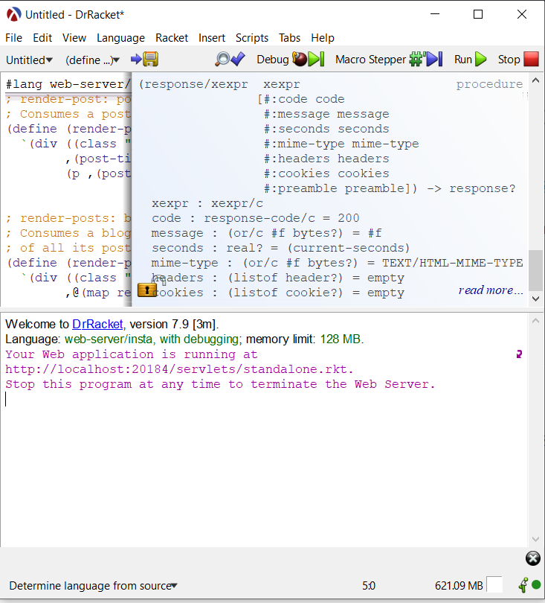
Racket in Action
Demo projects:
Recursion
Web application

Slide 21
Conclusion
Open source and cross-platform support
Concise and full-featured
Libraries and Documentation
Interactive IDE
Use of Macros
New language prototyping

Slide 22
References
[1] Felleisen, Matthias, et al. "The racket manifesto." 1st Summit on Advances in Programming Languages (SNAPL 2015). Schloss Dagstuhl-Leibniz-Zentrum fuer Informatik, 2015.
[2] Felleisen, Matthias, et al. "A programmable programming language." Communications of the ACM 61.3 (2018): 62-71.
[3] Findler, Robert Bruce, et al. "DrScheme: A programming environment for Scheme." Journal of functional programming 12.2 (2002): 159.
[4] PLT. “PLT Scheme.” PLT Scheme, PLT, 1 Apr. 2010, plt-scheme.org
[5] King, Alexis, Hacket Programming Language, GitHub repository, https://lexi-lambda.github.io/hackett/
[6] Mackenzie, Setwart, Fractalide, GitHub repository, https://github.com/fractalide/fractalide
[7] Findler, Robby, DrRacket, GitHub repository, https://github.com/racket/drracket
[8] Flatt, Matthew, “The Racket Guide”, https://docs.racket-lang.org/guide/index.html

