Slide 1

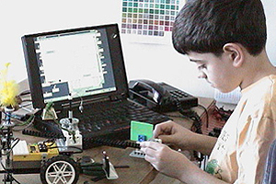
Build-It-Yourself seeks partners who can help bring our unique online learning environment direct to kids and their parents at home.
John Galinato
617-875-1960
john@build-it-yourself.com
www.build-it-yourself.com
Empowering the next generation of builders
Notes:
Build-It-Yourself has developed a popular, highly valued, art and engineering, after-school program, driven by technology-in-education research at MIT.
We target 12 million boys and girls 8 – 13 in the after-school, USA market.
In the next few slides, we will outline our plan to grow from 500 customers to 100,000+ customers generating annual revenue of $50M+.

Slide 2


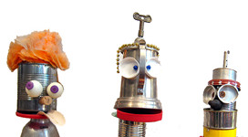
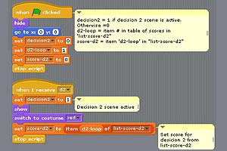
The Mission
Inspire and guide kids 8 – 13 to use technology creatively and collaboratively.
Prove that online instruction can be better than traditional instruction.
Offer a high return on investment.
Empowering the next generation of builders
Notes:
Our Mission:
1) We aim to prove that online instruction can be more effective than face to face instruction.
2) We aim to reward our team and partners handsomely.

Slide 3
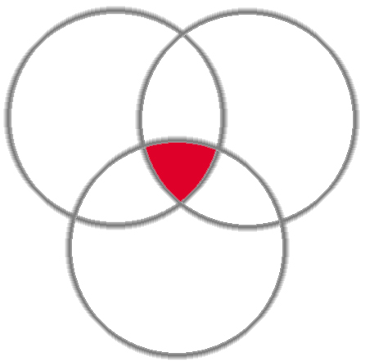
The Product
Parents pay a $40/mo. membership fee:
Four live, 1-hour, Webcast workshops.
Access to project plans, modules.
Invention Universe online virtual community to show off projects.
Content
Specialists
Collaboration
Empowering the next generation of builders
Notes:
Our unique, online laboratory for builders includes:
Multimedia content that aids and guides kids to build playful, engaging projects.
Collaboration tools that enable members to build with our network of art and engineering specialists.
A network of art and engineering students from well-known universities.

Slide 4
Growth Plan
Years 2 - 5
Rollout
$50M+ revenue
150,000+ members
Year 1
Proof of Execution
1,000+ members
2006 - Present
Proof of Concept
$1M+ revenue
5000+ customers
Validate that parents value the Build-It-Yourself vision.
Grow the team and infrastructure to serve 1,000+ members
Partner with after school programs like Sylvan, Kaplan and Bright Horizons, publishers and retail outlets to grow quickly.
Empowering the next generation of builders
Notes:
We believe we are poised to grow quickly.
Every kid on a college track must be fluent in technology.
There are roughly 12 million kids in the USA alone between ages 8 – 13 who will go to college.
150,000 members (or 1.25% of our target market) at $30/mo will generate revenue of $50M+.

Slide 5
Proof of Execution Phase
Raise our valuation
Strategy:
Recruit a core team.
  Business Developer
  Operations Manager
  Programmer
  Artist / Content Developer
  Project Manager
Shrink wrap our content and supporting platforms.
Close corporate distribution partnerships.
Set up pipeline of TA’s.
Sell and serve 1000 members at $30/mo.
Close the next round of funding for a Roll Out Phase.
Empowering the next generation of builders
Notes:
Our business goal in the Proof of Execution phase is to raise our valuation.
Our strategy is to:
Recruit a team that will attract partners,
Evolve content and supporting technology,
Close corporate distribution partnership >$50K
increase our customer base from 500 to 1000+ members.

Slide 6
Proof of Execution Phase - Serve 1,000 members
Revenue $143K
- Online rev $134K
- Onsite rev $ 9K
Expense: $348K
- Fixed cost $326K
- Variable cost $ 22K
Worst case cash flow: ($206K)
Capital Required $225K
Breakeven in Month 14
Notes:
In summary, we need capital of $330K to cover our worst case cash flow.
In month 9, we will be profitable (assuming compensation is below market value).

Slide 7

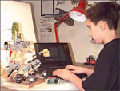
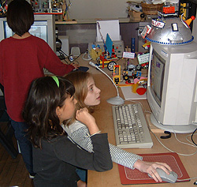
Rollout Phase - Serve 300,000 members
$72M annual revenue
(300,000 members x $20/mo)
Significant investment may be required to:
grow the team
brand the product
evolve the product and infrastructure
develop distribution partnerships
Empowering the next generation of builders
Notes:
After we complete our Proof of Execution Phase, we anticipate needing a significant investment to grow to 300,000 members.

Slide 8
Build-It-Yourself seeks partners who can help bring our unique online learning environment direct to kids and their parents at home.
John Galinato
617-875-1960
john@build-it-yourself.com
www.build-it-yourself.com
Empowering the next generation of builders
Notes:
Our long term business goals are to:
set a new standard for online education.
generate a high return on investment.
We seek partners to help us reach these goals.

Slide 9
Supporting Slides
Gross margin
Market profile
Distribution initiatives
Financials
Supporting PPTs:
Product development
Potential Partners
Territory Manager Initiative
5-year / Rollout Plan
Empowering the next generation of builders

Slide 10
Gross Profit Margin
16 oz cup of coffee
Dunkin Doughnuts price | $ 2.34
Cost of goods
Coffee beans | $ 0.64
cup | $ 0.13
lid | $ 0.03
sugar | $ 0.04
labor | $ 0.33
Total cost of goods | $ 1.17
Gross profit margin | $ 1.17
% Gross profit margin | 50%
iPhone 6
Factory unlocked price | $ 650
Cost of components | $ 220
Labor | $ 5
Total cost of goods | $ 225
Gross profit margin | $ 425
% Gross profit margin | 65%
BIY Onsite Workshop
Revenue per hour | $ 125
Labor (1.5 hrs @$12/hr x 2) | $ 36
Supplies ($1/student x 1 students) | $ 10
Total cost of goods | $ 46
Gross profit margin | $ 79
% Gross profit margin | 63%
BIY Onsite Workshop
Revenue per hour | $ 100.00
Labor (1hr @ $12/hr) | $ 12.00
Supplies (none) | $ -
Webcast platform | $ 0.06
Total cost of goods | $ 12.00
Gross profit margin | $ 88.00
% Gross profit margin | 88%
50% - Cup of coffee
65% - iPhone
63% - BIY Onsite Workshop
88% - BIY Online Workshop

Slide 11
How big is our market?
College bound Kids:
Every kid who goes to college should be technology fluent and therefore is a potential customer.
300K Members:
We need 2% of target US market to build a $72M business.
(300K x $240/yr including supplies and embedded advertising)
30 million kids ages 8 - 13
15 million target market.
Half will go to college. 62% have broadband access at home.
Empowering the next generation of builders
Notes:
Every kid on a college track must be fluent in technology.
There are roughly 12 million kids in the USA alone between ages 8 – 13 who will go to college.
If we can capture 300,000 members or 2.5% of our target market, we will have a $50 million business.

Slide 12
Market Segments
Opportunity:
Summer Camps
7.3 Million Kids
2. After-school Time
Organized by schools
2.5 Million Kids
3. After-school Time
Organized by families
15 Million Kids
Summer Camps
12,000 Camps
7.3M Kids
Summer Camps
Private School
26,569 Schools
3M Kids
Private After-school
450K Kids (15%)
23 Million
Kids
Grades 3 to 8
Public School
71,270 Schools
20M `Kids
Public After-school
2M kids (10%)
5 largest for-profit
organizations
160K Kids
Commercial After-school
Assume 65% of kids can afford a computer and $240/year
15M Kids
@ Home
Sources:
American Camp Association
Institute for Educational Science,
US Dept. of Education
Digest of Education Statistics: 2005
Notes:
MARKET SEGMENTATION
The low hanging fruit are summer camps.
7.3 million kids paying >$10/hr accessible through 12,000 camps.
Followed by after school programs run by volunteer parents, paid teachers.
2.5 million kids paying $10/hr accessible through 97,000 schools.
The holy grail market segment is @Home.
Our challenge is to find efficient ways to seed viral marketing to families.

Slide 13
Proof of Execution Phase - Serve 1,000 members
Viral Marketing Program:
Recruit a social media person to drive a word-of-mouth marketing program.
Corporate Partnerships:
Close a corporate distribution partnership that has the potential to generate 3,000 members in a year.
(300K members @ $240/year in 3-5 years)
Teacher / College Student Run Territories:
College students are recruited to establish a BIY presence in their home towns.
Notes:
Our ultimate goal is to grow our online customer base to 300,000 paying members generating annual revenue of $72M
We envision 3 distribution initiatives

Slide 14









Potential Distribution Partners
Publishers
Online
Entertainment
After-school
Programs
Retailers
Mad Science
Penquin
Sunset
Whole Foods
Build-A-Bear
Monetize web presence.
New content
Series
Expand curriculum.
Generate new revenue.
Monetize web presence.
Capture life-long customers
Notes:
STRATEGIC PARTNERS => EXIT STRATEBY
We will work closely with distribution partners like these to grow our business.
Our exit strategy is to position ourselves as an attractive acquisition.

Slide 15
Proof of Execution Phase - Serve 1,000 members
12-month Execution Phase |  | Assumptions | Target Case
Goals / Benchmarks |  | 1000 | # members month 12
1) Recruit a core team. |  | 50 | Members / TA
- Business Developer |  | 15 | Contractor Hourly Rate
- Operations Manager |  | $ 30 | Membership fee / mo
- Programmer |  | $ 2,500 | Core team annual salary if goals reached
- Artist / Content Developer |  | $ 9,000 | Bonus if meet goals
- Project Manager
2) Shrink wrap our content and supporting platforms. |  | Conclusions
3) Close corporate distribution partnerships. |  | $ 372,000 | Annualized Month 12 Revenue
4) Set up pipeline of TA’s. |  | $ (205,592) | Worst Case Cash Flow (Investment Needed)
5) Sell and serve 1000 - 3000 members at $30/mo. |  | $ 67,780 | Monthly Fixed Cost / Burn Rate
6) Close deal for next round of funding
 | Mo 1 | Mo 2 | Mo 3 | Mo 4 | Mo 5 | Mo 6 | Mo 7 | Mo 8 | Mo 9 | Mo 10 | Mo 11 | Mo 12
Revenue | $ 6,000 | $ 439 | $ 1,732 | $ 7,219 | $ 2,032 | $ 4,387 | $ 14,645 | $ 12,408 | $ 13,440 | $ 25,200 | $ 24,000 | $ 31,000
Expense | $ 26,760 | $ 26,848 | $ 22,907 | $ 23,005 | $ 23,168 | $ 23,440 | $ 23,893 | $ 24,648 | $ 25,457 | $ 26,613 | $ 27,576 | $ 73,780
Monthly Balance | $ (20,760) | $ (26,409) | $ (21,175) | $ (15,785) | $ (21,136) | $ (19,053) | $ (9,248) | $ (12,240) | $ (12,017) | $ (1,413) | $ (3,576) | $ (42,780)
Cash Flow | $ (20,760) | $ (47,169) | $ (68,344) | $ (84,130) | $ (105,265) | $ (124,318) | $ (133,566) | $ (145,806) | $ (157,823) | $ (159,236) | $ (162,812) | $ (205,592)
 |  |  |  |  |  |  |  |  |  |  |  |  |  |  |  | Year 2
Revenue | Mo 1 | Mo 2 | Mo 3 | Mo 4 | Mo 5 | Mo 6 | Mo 7 | Mo 8 | Mo 9 | Mo 10 | Mo 11 | Mo 12 | Total | Revenue |  | Mo 13 | Mo 14
Onsite semester |  |  | 1000 |  |  | 1000 |  |  |  |  |  | 1000 | $ 3,000 | Onsite semester |  | 0 | 0
Onsite summer |  |  |  |  |  |  | 3000 | 3000 |  |  |  |  | $ 6,000 | Onsite summer |  | 0 | 0
Membership |  |  |  |  |  |  |  |  |  |  |  |  |  | Membership |  | 0 | 0
# members |  | 15 | 24 | 41 | 68 | 113 | 188 | 314 | 448 | 640 | 800 | 1000 |  | # members |  | 1200 | 1440
$/member/mo | $ 30 | $ 30 | $ 30 | $ 30 | $ 30 | $ 30 | $ 30 | $ 30 | $ 30 | $ 30 | $ 30 | $ 30 |  | $/member/mo |  | 30 | 30
$ memberships | $ - | $ 439 | $ 732 | $ 1,219 | $ 2,032 | $ 3,387 | $ 5,645 | $ 9,408 | $ 13,440 | $ 19,200 | $ 24,000 | $ 30,000 | $ 109,502 | $ memberships |  | 36000 | 43200
Advanced Builders |  |  |  |  |  |  |  |  |  |  |  |  |  | Advanced Builders |  | 0 | 0
#interns |  |  |  |  |  |  |  |  |  |  |  |  | 16 | #interns |  | 0 | 0
$/adv builder |  |  |  |  |  |  |  |  |  |  |  |  | $ 1,500 | $/adv builder |  | 0 | 0
$ adv builders | 6000 |  |  | 6000 |  |  | 6000 |  |  | 6000 |  |  | $ 24,000 | $ adv builders |  | 0 | 0
$ Onsite | $ - | $ - | $ 1,000 | $ - | $ - | $ 1,000 | $ 3,000 | $ 3,000 | $ - | $ - | $ - | $ 1,000 | $ 9,000 | $ Onsite |  | 0 | 0
$ Online | $ 6,000 | $ 439 | $ 732 | $ 7,219 | $ 2,032 | $ 3,387 | $ 11,645 | $ 9,408 | $ 13,440 | $ 25,200 | $ 24,000 | $ 30,000 | $ 133,502 | $ Online |  | 36000 | 43200
$ Total Revenue | $ 6,000 | $ 439 | $ 1,732 | $ 7,219 | $ 2,032 | $ 4,387 | $ 14,645 | $ 12,408 | $ 13,440 | $ 25,200 | $ 24,000 | $ 31,000 | $ 142,502 | $ Total Revenue |  | $ 36,000 | $ 43,200
Expense | Mo 1 | Mo 2 | Mo 3 | Mo 4 | Mo 5 | Mo 6 | Mo 7 | Mo 8 | Mo 9 | Mo 10 | Mo 11 | Mo 12 | Total | Expense
Acct & Legal | $ 5,000 | $ 5,000 | $ 1,000 | $ 1,000 | $ 1,000 | $ 1,000 | $ 1,000 | $ 1,000 | $ 1,000 | $ 1,000 | $ 1,000 | $ 1,000 | $ 20,000 | Acct & Legal |  | 1000 | 1000
Rent | $ 3,000 | $ 3,000 | $ 3,000 | $ 3,000 | $ 3,000 | $ 3,000 | $ 3,000 | $ 3,000 | $ 3,000 | $ 3,000 | $ 3,000 | $ 3,000 | $ 36,000 | Rent |  | 3000 | 3000
Web Access | $ 650 | $ 650 | $ 650 | $ 650 | $ 650 | $ 650 | $ 650 | $ 650 | $ 650 | $ 650 | $ 650 | $ 650 | $ 7,800 | Web Access |  | 650 | 650
Phone | $ 250 | $ 250 | $ 250 | $ 250 | $ 250 | $ 250 | $ 250 | $ 250 | $ 250 | $ 250 | $ 250 | $ 250 | $ 3,000 | Phone |  | 250 | 250
Heat/Elec | $ 250 | $ 250 | $ 250 | $ 250 | $ 250 | $ 250 | $ 250 | $ 250 | $ 250 | $ 250 | $ 250 | $ 250 | $ 3,000 | Heat/Elec |  | 250 | 250
Supplies | $ 800 | $ 800 | $ 800 | $ 800 | $ 800 | $ 800 | $ 800 | $ 800 | $ 800 | $ 800 | $ 800 | $ 800 | $ 9,600 | Supplies |  | 800 | 800
 |  |  |  |  |  |  |  |  |  |  |  |  | $ - |  |  | 0 | 0
Compensation Fully Loaded |  |  |  |  |  |  |  |  |  |  |  |  | $ - | Compensation Fully Loaded |  | 0 | 0
Business Developer1 | $ 2,500 | $ 2,500 | $ 2,500 | $ 2,500 | $ 2,500 | $ 2,500 | $ 2,500 | $ 2,500 | $ 2,500 | $ 2,500 | $ 2,500 | $ 11,500 | $ 39,000 | Bus Developer |  | 4000 | 4000
Operations Manager | $ 2,500 | $ 2,500 | $ 2,500 | $ 2,500 | $ 2,500 | $ 2,500 | $ 2,500 | $ 2,500 | $ 2,500 | $ 2,500 | $ 2,500 | $ 11,500 | $ 39,000 | Operations Manager |  | 4000 | 4000
Product Manager | $ 2,500 | $ 2,500 | $ 2,500 | $ 2,500 | $ 2,500 | $ 2,500 | $ 2,500 | $ 2,500 | $ 2,500 | $ 2,500 | $ 2,500 | $ 11,500 | $ 39,000 | Product Manager |  | 4000 | 4000
Graphic Designer | $ 2,500 | $ 2,500 | $ 2,500 | $ 2,500 | $ 2,500 | $ 2,500 | $ 2,500 | $ 2,500 | $ 2,500 | $ 2,500 | $ 2,500 | $ 11,500 | $ 39,000 | Graphic Designer |  | 4000 | 4000
Engineer | $ 2,500 | $ 2,500 | $ 2,500 | $ 2,500 | $ 2,500 | $ 2,500 | $ 2,500 | $ 2,500 | $ 2,500 | $ 2,500 | $ 2,500 | $ 11,500 | $ 39,000 | Engineer |  | 4000 | 4000
 |  |  |  |  |  |  |  |  |  |  |  |  |  |  |  | 0 | 0
# TA's (student contractors) | 0 | 0 | 0 | 1 | 1 | 2 | 4 | 6 | 9 | 13 | 16 | 20 | # | # TA's (student contractors) |  | 24 | 29
# hrs / wk / TA | 5 | 5 | 5 | 5 | 5 | 5 | 5 | 5 | 5 | 5 | 5 | 5 | hrs/wk | # hrs / wk / TA |  | 5 | 5
$/TA hr | 15 | 15 | 15 | 15 | 15 | 15 | 15 | 15 | 15 | 15 | 15 | 15 | $/hr | $/TA hr |  | 15 | 15
TA Contractor compensation | $ - | $ 88 | $ 146 | $ 244 | $ 406 | $ 677 | $ 1,129 | $ 1,882 | $ 2,688 | $ 3,840 | $ 4,800 | $ 6,000 | $ 21,900 | TA Contractor compensation |  | $ 7,200 | $ 8,640
 |  |  |  |  |  |  |  |  |  |  |  |  | $ - |  |  | 0 | 0
Meal Meetings | $ 300 | $ 300 | $ 300 | $ 300 | $ 300 | $ 300 | $ 300 | $ 300 | $ 300 | $ 300 | $ 300 | $ 300 | $ 3,600 | Meal Meetings |  | 300 | 300
Postage | $ 40 | $ 40 | $ 40 | $ 40 | $ 40 | $ 40 | $ 40 | $ 40 | $ 40 | $ 40 | $ 40 | $ 40 | $ 480 | Postage |  | 40 | 40
Car Lease | $ 500 | $ 500 | $ 500 | $ 500 | $ 500 | $ 500 | $ 500 | $ 500 | $ 500 | $ 500 | $ 500 | $ 500 | $ 6,000 | Car Lease |  | 500 | 500
T&L (Park+Tolls+Taxi+Plane+Bus+Train) | $ 1,000 | $ 1,000 | $ 1,000 | $ 1,000 | $ 1,000 | $ 1,000 | $ 1,000 | $ 1,000 | $ 1,000 | $ 1,000 | $ 1,000 | $ 1,000 | $ 12,000 | T&L (Parking+Tolls+Taxi+Plane+Bus+Train) |  | 1000 | 1000
 |  |  |  |  |  |  |  |  |  |  |  |  | $ - |  |  | 0 | 0
 |  |  |  |  |  |  |  |  |  |  |  |  | $ - |  |  | 0 | 0
Hdw/Sftw (>$1000 to be amortized) | $ 1,000 | $ 1,000 | $ 1,000 | $ 1,000 | $ 1,000 | $ 1,000 | $ 1,000 | $ 1,000 | $ 1,000 | $ 1,000 | $ 1,000 | $ 1,000 | $ 12,000 | Hdw/Sftw (>$1000 to be amortized) |  | 1000 | 1000
Contributions / scholarships | $ 250 | $ 250 | $ 250 | $ 250 | $ 250 | $ 250 | $ 250 | $ 250 | $ 250 | $ 250 | $ 250 | $ 250 | $ 3,000 | Contributions / scholarships |  | 250 | 250
Misc Bus Exp (ads, conf, bus dev) | $ 1,000 | $ 1,000 | $ 1,000 | $ 1,000 | $ 1,000 | $ 1,000 | $ 1,000 | $ 1,000 | $ 1,000 | $ 1,000 | $ 1,000 | $ 1,000 | $ 12,000 | Misc Bus Exp (ads, conf, bus dev) |  | 1000 | 1000
Bank Fees and Interest | $ 200 | $ 200 | $ 200 | $ 200 | $ 200 | $ 200 | $ 200 | $ 200 | $ 200 | $ 200 | $ 200 | $ 200 | $ 2,400 | Bank Fees and Interest |  | 200 | 200
Total Exp | $ 26,760 | $ 26,848 | $ 22,907 | $ 23,005 | $ 23,168 | $ 23,440 | $ 23,893 | $ 24,648 | $ 25,457 | $ 26,613 | $ 27,576 | $ 73,780 | $ 348,093 | Total Exp |  | $ 37,484 | $ 38,929
Tax Pymts (25% of Rev - Exp) |  |  |  |  |  |  |  |  |  |  |  |  | $ - | Tax Pymts (25% of Rev - Exp) |  | 0 | 0
Total Exp | $ 26,760 | $ 26,848 | $ 22,907 | $ 23,005 | $ 23,168 | $ 23,440 | $ 23,893 | $ 24,648 | $ 25,457 | $ 26,613 | $ 27,576 | $ 73,780 |  | Total Exp |  | $ 37,484 | $ 38,929
Profit / Loss | $ (20,760) | $ (26,409) | $ (21,175) | $ (15,785) | $ (21,136) | $ (19,053) | $ (9,248) | $ (12,240) | $ (12,017) | $ (1,413) | $ (3,576) | $ (42,780) |  | Profit / Loss |  | $ (1,484) | $ 4,271
Cum Profit / Loss | $ (20,760) | $ (47,169) | $ (68,344) | $ (84,130) | $ (105,265) | $ (124,318) | $ (133,566) | $ (145,806) | $ (157,823) | $ (159,236) | $ (162,812) | $ (205,592) |  | Cum Profit / Loss |  | $ (207,076) | $ (202,805)
 | Mo 1 | Mo 2 | Mo 3 | Mo 4 | Mo 5 | Mo 6 | Mo 7 | Mo 8 | Mo 9 | Mo 10 | Mo 11 | Mo 12 | Total
Notes:
This spread sheet outlines our financial plan to grow to 1,000 members.

Slide 16
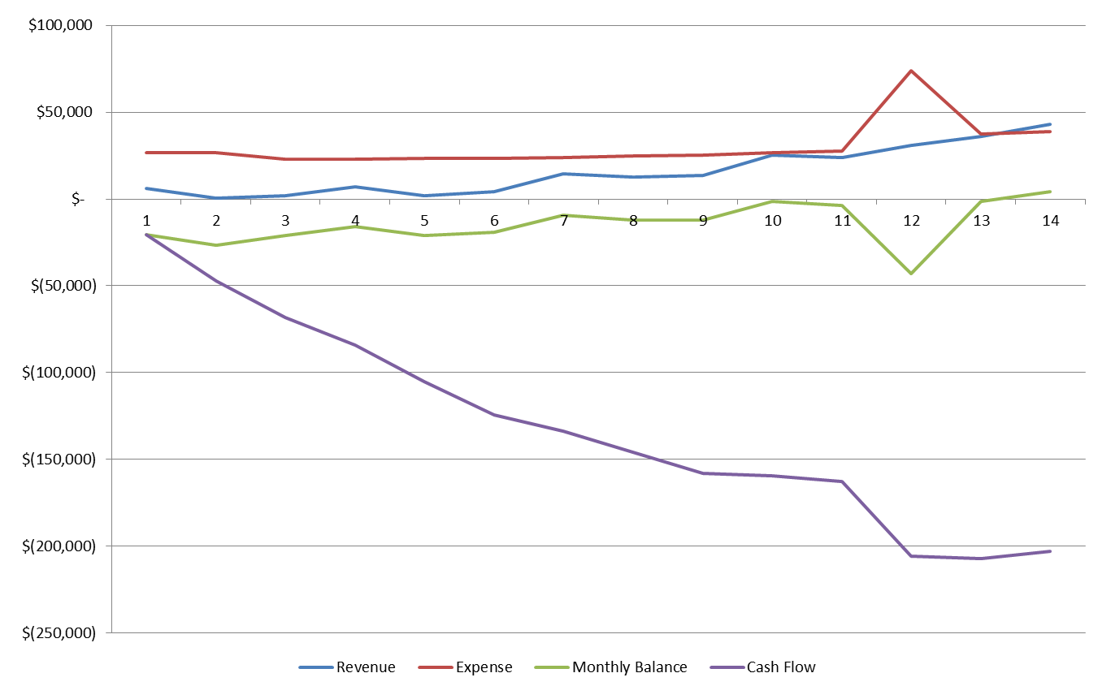
Proof of Execution Phase - Serve 1,000 members
Notes:
This spread sheet outlines our financial plan to grow to 1,000 members.

Slide 17
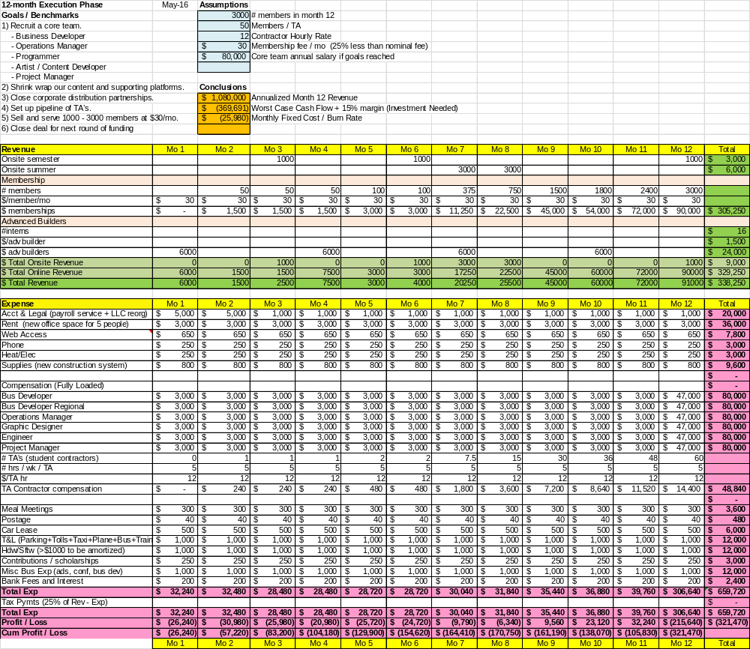
Proof of Execution Phase - Serve 3,000 members
Notes:
This spread sheet outlines our financial plan to grow to 3,000 members.

Slide 18
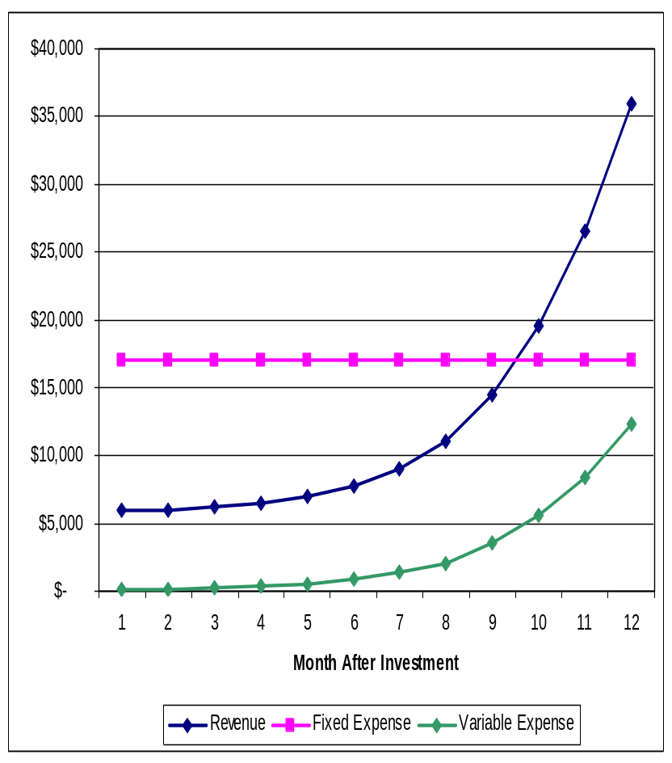
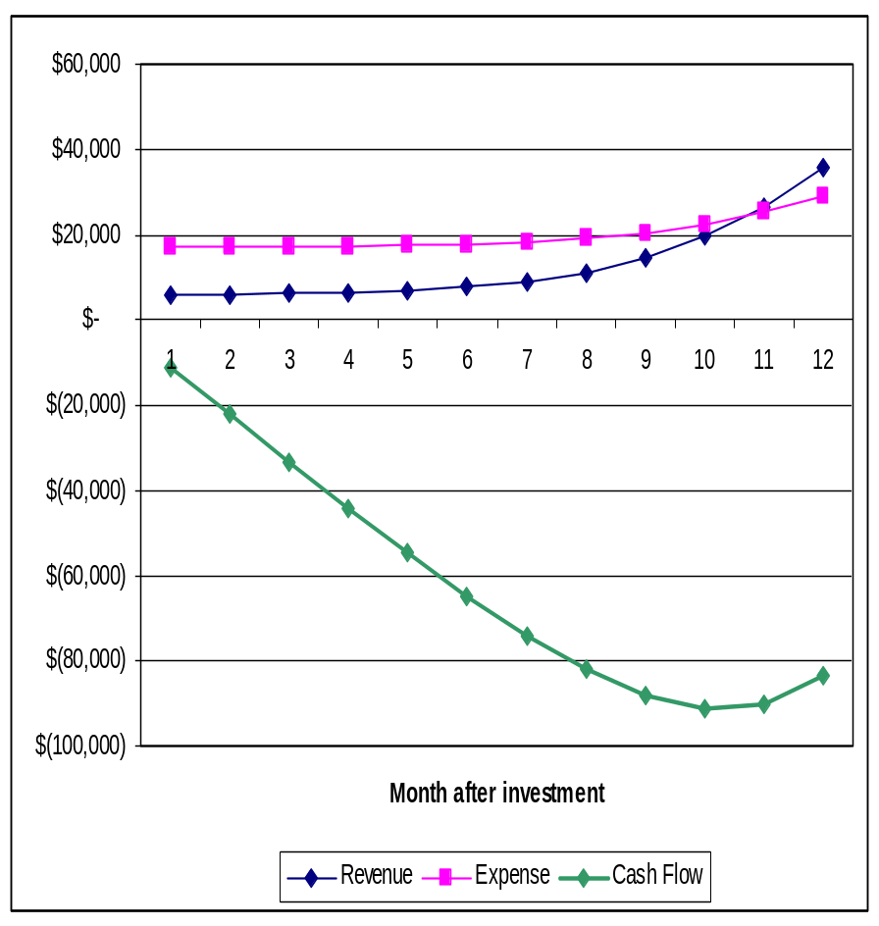
Proof of Execution Phase - Serve 3,000 members
Empowering the next generation of builders
Notes:
Our business model will be highly profitable when it is scaled.
Our worst cast cash flow is $91K in month 10.
.

Slide 19
Milestones / Goals
 | Proof of Concept Phase | Proof of Execution Phase | Roll Out Phase
Strategic | 5,000+ students paid $200+ for BIY workshops. ($10-$20/hr) | Grow from 50 on-line customers to 1,000 online members @ $30/mo. | Grow from 1,000 online members to 300,000 online members. Show profitability.
Product | Content and supporting online platforms developed. Collaboration tools tested. Development team recruited. | Build a core team. Shrink wrap products. Develop regional manager program. | Expand content. Automate member support. Expand team.
Distribution | Strong testimonials and repeat customer relationships built. | Close corporate distribution partnership. Develop regional manager program. Initiate viral marketing program. | Put multiple distribution deals in place.
Notes:
Goals:
1) Serve 3,000 members at $10/month
2) Close a distribution deal greater than $50K
3) Get a letter of intent to invest if we meet Execution Phase goals.
Tasks:
Hire an MBA to run BIY.
Develop a viral marketing campaign to capture 3000 members.
Develop Invention Universe to support 3000 members.
Develop a program to recruit, train and manage Webcasters in university communities.

